Slide 1
Geology in Motion
VIZ Workshop, December 7, 2011
Mary Savina
Notes:
12:00-1:00 PM Lunch Weitz Atrium
1:00-1:10 PM Introduction
1:10-1:40 PM Beyond the Classroom: Intellectual Property and the Visual
(Matt Bailey)
1:40-2:00 PM OCS New Zealand, Geology in Motion (Mary Savina)

Slide 2
Assignment
Working in groups of three, create, film and edit a three to five minute film about an aspect of geothermal geology in New Zealand. Assume your audience is a group of introductory geology students at Carleton.
  Fumaroles
  Geysers
  Mud pools
  Boiling pools
  Sinters
  Living on a volcano
  Geothermal Energy
  Biology and temperature
  Rock alteration

Slide 3
Context and timeline
Assignment for Geology OCS New Zealand – January 2012
  Proposed spring 2011
  Sample footage shot early August 2011
  Editing videos and assignment handouts late August 2011
  Group visits to geothermal areas
  Filming and editing - January 17-18, 2012
  Result (we hope!): 8 short videos

Slide 4
Project learning goals
Deepen observations of geothermal features (beyond “Oh, wow!”)
Combine field observation and reading about geothermal features
Explain geologic concepts to a broad audience
Communicate information visually
(relates to geology department learning goals)

Slide 5
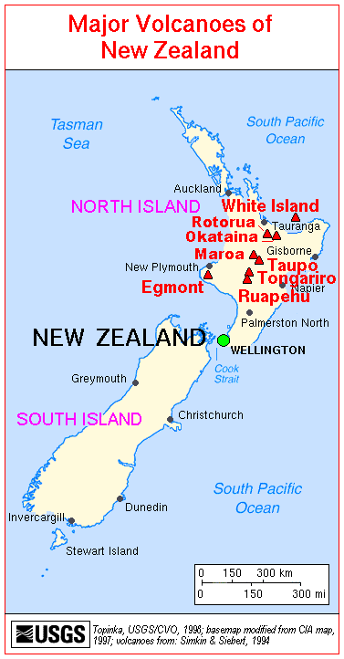
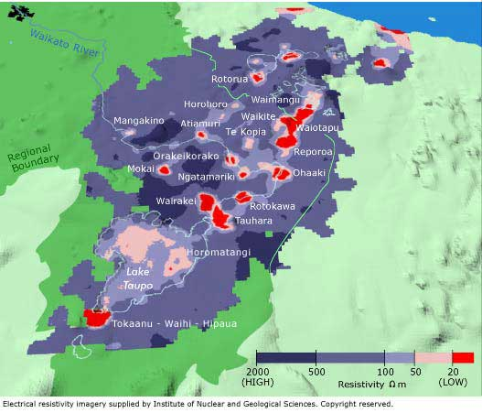
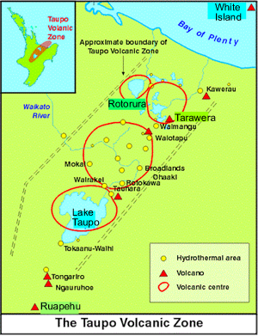
New Zealand active volcanoes
1. http://www.explorevolcanoes.com/Volcano-Profiles.html
2.http://vulcan.wr.usgs.gov/Volcanoes/NewZealand/Maps/map_new_zealand_volcanoes.html
3. http://www.waikatoregion.govt.nz/Environment/Natural-resources/Geothermal-resources/Classifying-geothermal-systems/Geothermal-systems-in-the-Taupo-volcanic-zone/

Slide 6
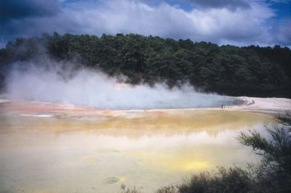
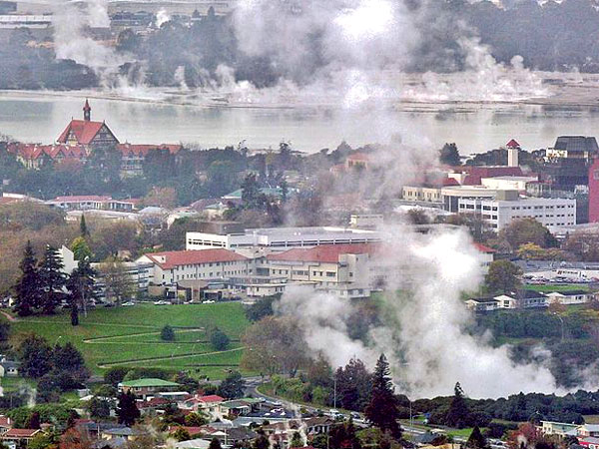
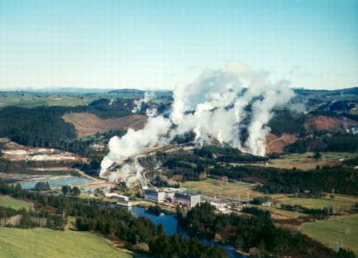
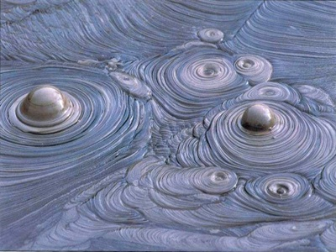
Notice anything about these images?
Images from http://www.geothermal-energy.org/ ; taken by José Manuel Marquez, Contact Energy,; bugbog.com; http://listverse.com/2009/12/18/10-unique-and-amazing-places-on-earth/
Compare

Slide 7
Why visual component is important
Geology deals in the visual (thinking about time, learning in the field, earth as a complex system, spatial thinking)
Why video component is important
  Geothermal features change in time and space

Slide 8
Potential and Real Challenges
Need to set up prior 2-3 days of group observation
Lack of technical background – in shooting, video editing and topic
One computer, seven groups
Remote location
Little use of video by scientists studying geothermal features

Slide 9
What not to do
What not to do with a video camera (links to a QuickTime MP4 video)
Notes:
1:46

Slide 10
Potential and Real Challenges
Need to set up prior 2-3 days of group observation
Lack of technical background – in shooting, video editing and topic
One computer, seven groups
Remote location
Little use of video by scientists studying geothermal features
Notes:
Look at the sample video and see what ethical issues are involved,

Slide 11
Filming fumaroles
Filming fumaroles – Links to a QuickTime MP4 video. 5:20 minutes total length. First 2:50 shows the pieces that were used to make the “final” video, which starts at ~2:55.
Notes:
Start at 2:55 – 5:20 = 2:25 minutes
Volume will need to be raised

Slide 12
Ethical issues and natural hazards
Student positioning and preparation (participant/observer/foreign national)
  Delay making judgments (e.g. safety barriers)
  Consent of anyone photographed
  Care for own safety
  Develop a script ahead of time
  Debrief after filming
Communication of risk of natural hazards is a world-wide issue – NSF solicitation
When hazard becomes disaster (Napier, 1931; Christchurch, 2011) (guidelines for journalists covering natural disasters)
Notes:
Also the ethical issues Matt has discussed about using information

Slide 13
Some specific ethical considerations – anticipated encounters
Filming geothermal features in the equivalent of national parks (Kiwis and foreign tourists)
  Being asked about their projects
  Being asked about hazards (expectation of technical expertise)
  Opportunities for cultural sensitivity and insensitivity
Filming geothermal features in Rotorua (residents); gas samplers
  Need for discretion
  Tactfulness with residents about possible health hazards (the technical expertise thing again)

Slide 14
Conclusions
Will know more in a couple months
Come to a viewing of the films

Slide 15
Questions?

