Slide 1
Framing our Conversation
Learning to Look Ethically
Shana Sippy & Adrienne Falcon

Slide 2
Meta-Questions
What do we mean by seeing and visuality?
What do we mean by ethics?
What do we mean by image? Materially and Metaphorically.

Slide 3
What is Seeing?
In all of our classes, no matter our environment, we are asking our students to see things.
What is the context of their viewing? From what position do we see?

Slide 4
What is Ethics?
To see/act ethically involves a choice in which power is implicit. What do we do with that power?
How can we continue to reevaluate our position and power as we proceed in our viewings and engagements?
Know that understanding the ethical is huge, so as not to be overwhelmed. We need our students to also see ethical as something, which while problematized, is about engaging responsibility.

Slide 5
What are we seeing?
What do we mean by image?
• Text, Film, Ritual, Conflict, Performance, Relationships between people, Demographic Shifts, or Economic Trends.
• Not simply tagged objects of art, but also different environments, perspectives, life

Slide 6
Seeing and Being Seen
Considering the Visual Ethics of Fieldwork
Shana Sippy

Slide 7
Courses Involving
ACE and Visual Ethics
• Modern Hinduism (Case Study-Public Scholarship)
• Encountering Islam: Dialogue and Difference (Case Studies-Public Scholarship)
• Global Religions in Minnesota (Documenting Landscape/ Public Scholarship through website)
• Performing Tradition: Art, Religion & Globalization (Ragamala Dance in residence, but also other artists, work with ArTech)

Slide 8
Case Studies
St. Cloud Cartoon Controversy, December 2009 and ongoing.
Minneapolis/St. Paul Muslim Taxi Drivers
Interfaith Dialogue between HMJDS & MIMS (Jewish and Muslim School) and tension that broke out on facebook with regard to the conflict Gaza.
Interfaith Dialogue between Muslims and Jewish Clergy, Dialogue as a Context of Inquiry
TiZA Charter School (Controversy over charter school’s relationship to Islamic Religion-ACLU suit, etc., school closing).
Vandalism at the Hindu Mandir MN & its Aftermath (2006 and ongoing)
[May 2011 KKK vandalism in Rochester, MN]

Slide 9
Modes of Visuality
Visual Production & Representation (Self/Others)
Visual Reception (Self/Others)

Slide 10
Why See Others/Outside Self?
Seeing others as ethical imperative.
    Why so at Carleton, in particular?
Helping students understand, practically, what is gained by these exercises.
    Professional Life Beyond Carleton (In Medicine, Law, Journalism, Roles of Civic Leadership, Education, etc.)
    Public Scholarship. That work has a life beyond classroom often motivates and inspires work and higher standards.

Slide 11
On Being Seen
How do we present ourselves?
How are we seen by others?
i. Involves the physical—how we look, dress, act, eat.
ii. How we present ourselves—with respect, deference, humility.
iii. How we present our questions, agendas, ideas, projects.

Slide 12
How do we see others?
See Ourselves First
  How seen and expectations and embodiment of it leads to understanding others better, seeing better.
II. Embodiment as Mode of Learning (e.g. kolam, dance, ARTech, observation)
  Understanding social expectations, mores, language, dress codes, bodily practices makes process of seeing others richer, etc
  Tension between honest self-representation, and respectful representation.
  Importance of teaching cultural sensitivity, without essentializing? (i.e. not all Muslims have the same practices & expectations)
III. Stages and Modes of Seeing.

Slide 13
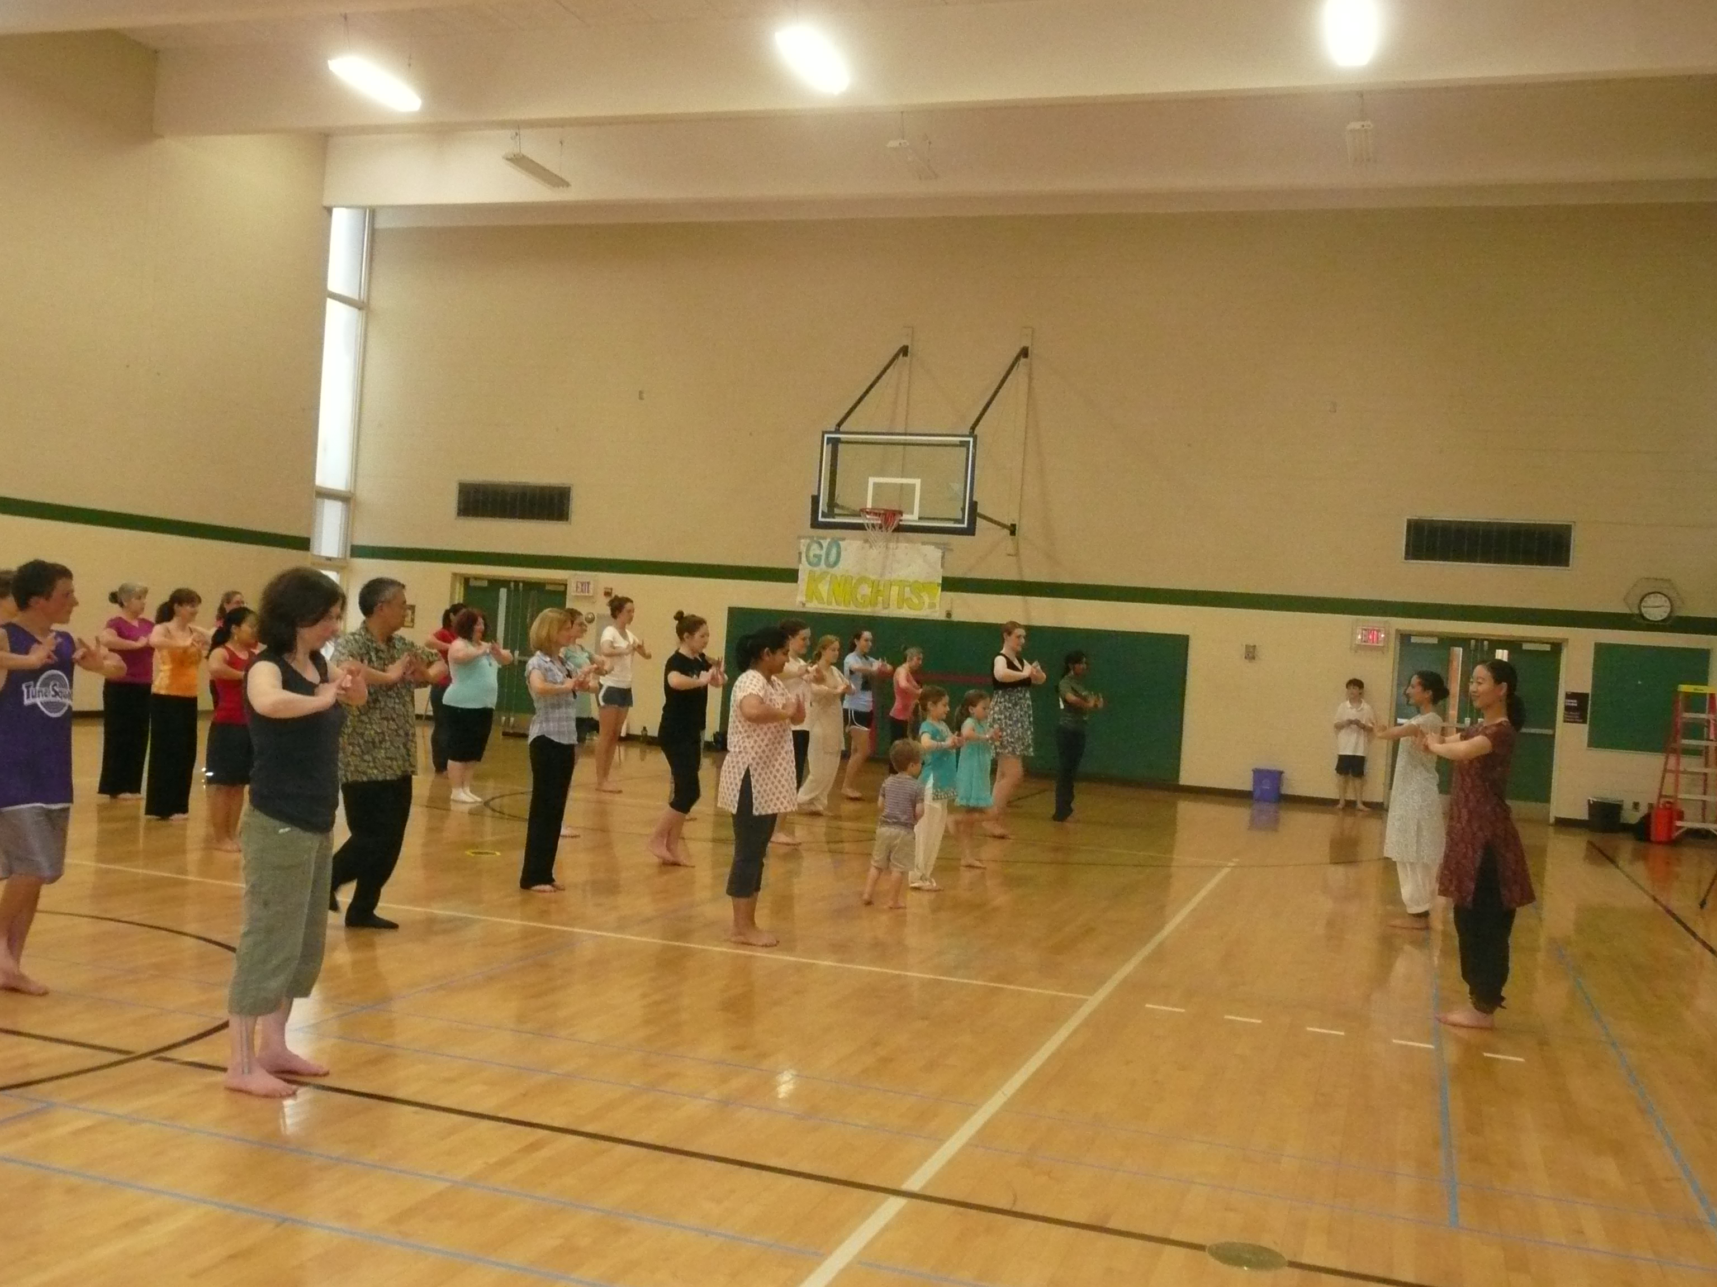

Slide 14
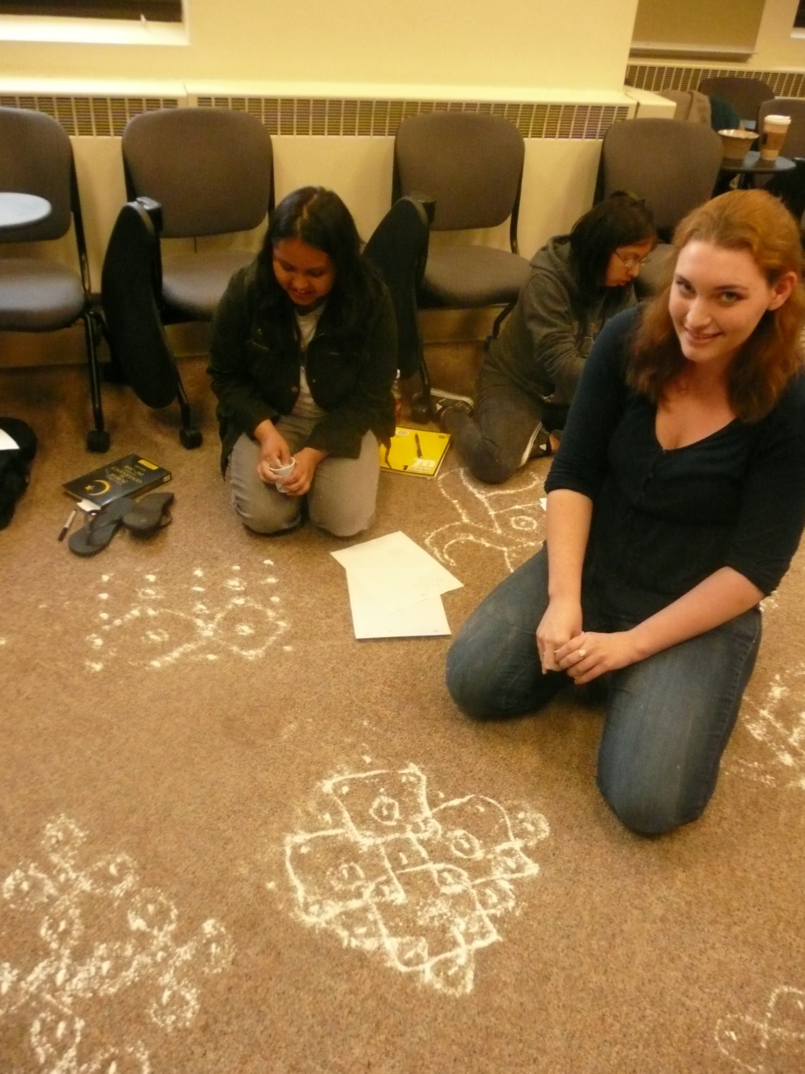

Slide 15
Stages/Modes of Seeing
Descriptive
Evaluative—Ethical, Critical, Academic
  i.e. St. Cloud, what do we do with the images and our assessment of them?
  Other ethical concerns with regard to consent, and critique. (Hindu right, Hate Speech, etc.)
  Why this is more difficult when living, real people are involved. When you have interviewed someone whose words your work will critique or expose. How might we manage this?
  * Open conversation, processing as best practice.
  * Each situation unique.

Slide 16
How do we present/represent others?
Writing (papers for class, articles, etc.)
Exhibition, Performances, etc.
  Challenges of exhibition/performance w/ regard to copyright, etc., especially when work is made more “public.”
  Particular challenges of the internet, which seems a moving target.
Educate others about others.
  Classmates, community members.
  Public Scholarship. https://wp.carleton.edu/globalreligionsmn/

Slide 17
Global Religions in Minnesota
https://wp.carleton.edu/globalreligionsmn/
  Documenting the Landscape
  Oral Histories
  Photo Documentation
  Video
  Research communities, concerns, issues
  Demography
  Support research and produce real scholarship
    Examples: Somali Fairbault, Indo-Caribbean Mandir,, Brazilian Christian Communities, Mega Churches. Different issues in each case and different opportunities.
    Learning about self as significant, in many cases. Sometimes the problems aren’t always external. Understanding and engaging issues close to home can transform their capacity to consider their own campuses, families, communities, etc.
    Case studies as means to transform conflicts in our midst into opportunities for critical inquiry, often complicating purely textual/theoretical. (i.e. Issues of religious freedom, church/state in schools; free speech, secularism, etc.)

Slide 18
Challenges in Representation
St. Cloud Cartoon Issue example. What are our obligations with regard to images we produce in our publications, classrooms, etc.? When image is inflammatory, what are our ethical considerations. (See Image following)
Images of violence in classrooms. What can we require students to see? When is being uncomfortable appropriate and an ethical imperative? Women & Gender Studies Classes examples (Novel Beloved, Films, etc.) What if the point is that we are to be made uncomfortable by what we see? How do we balance that with student experiences of abuse, etc.?
Consent & IRB Questions.
  If there is a written consent form, as required in my courses, a conversation about ethics and objectives is front and center in any interview/documentation, etc. (Written consent raises the bar, above verbal consent, etc. )
  There are downsides, however, to written consent. Makes conversations seem legalistic immediately, barrier in conversation, people are more guarded, often unnecessarily so, etc. Changes the nature of fieldwork.
  Other issues with regard to minor, such as parental consent. Anonymity of interviewees, etc.
  Discrepancy of standards between what is permissible in U.S. and what is expected of scholars working in countries in South Asia and Africa, for example. (This bespeaks other issues of power, etc.)

Slide 19
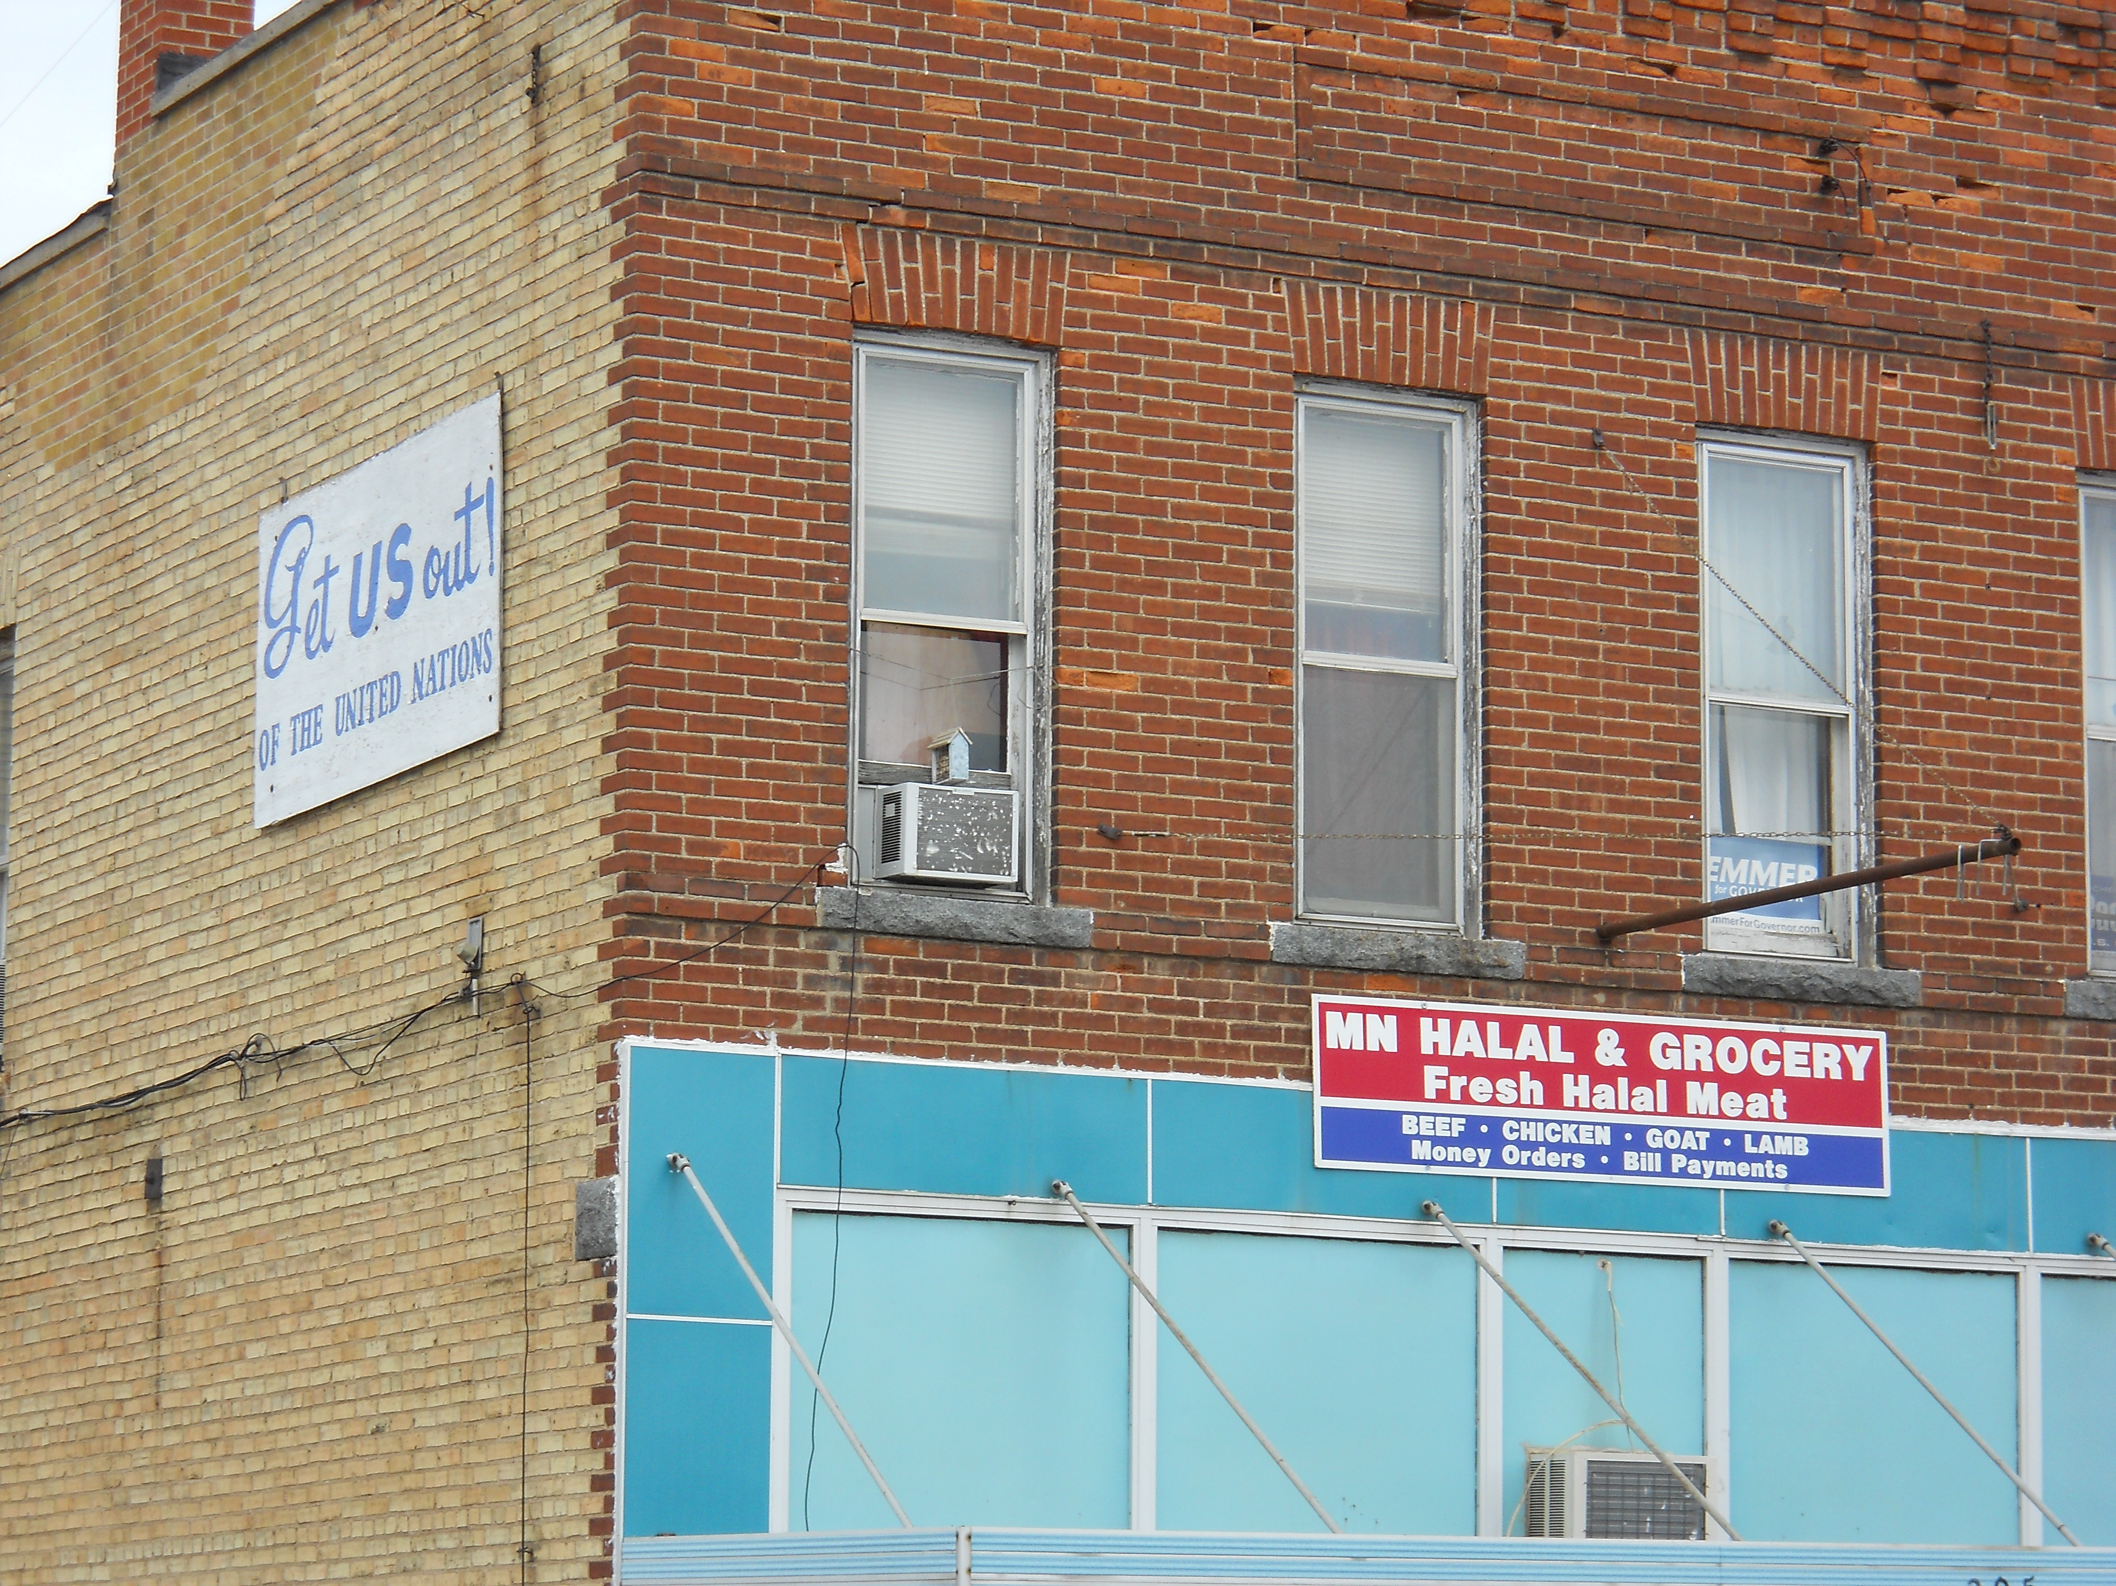

Slide 20
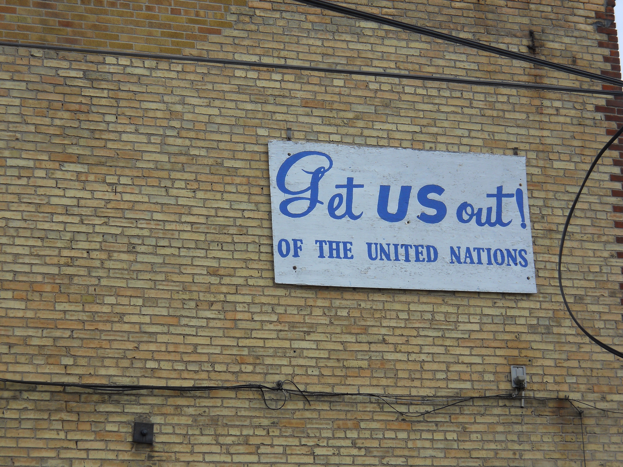

Slide 21
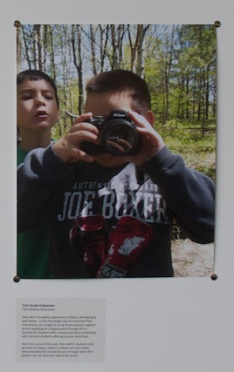
Academic Civic
Engagement
&
“Frames of Engagement
Exhibition”
Adrienne
Falcon

Slide 22
Frames of Engagement Example
Who takes the picture
What is the picture of and how do we understand its context?
Who picks the picture?
Who hangs and what message accompanies the picture?
How do you get access to this image? Visit a website, a gallery? How do people know about it? Are the doors open?

Slide 23
Concrete Questions
What is your goal with this project?
Example:
  Weitz as Bridge.
  What is Civic Engagement?
  How do we show its diverse forms?
  How do we represent visually?

Slide 24
Exhibition Images
http://apps.carleton.edu/campus/civic/photocontest/entries/
https://apps.carleton.edu/campus/viz/exhibitions/archive/frames_of_engagement/

Slide 25
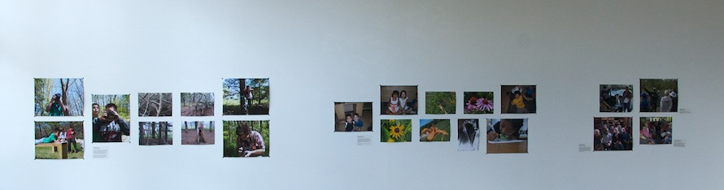

Slide 26
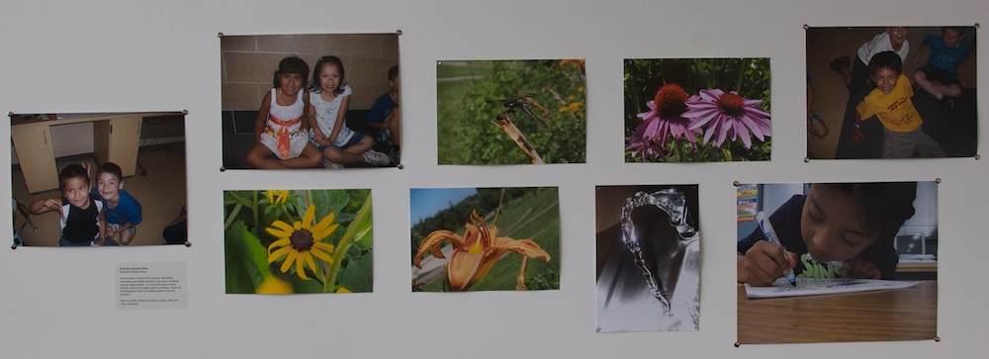

Slide 27
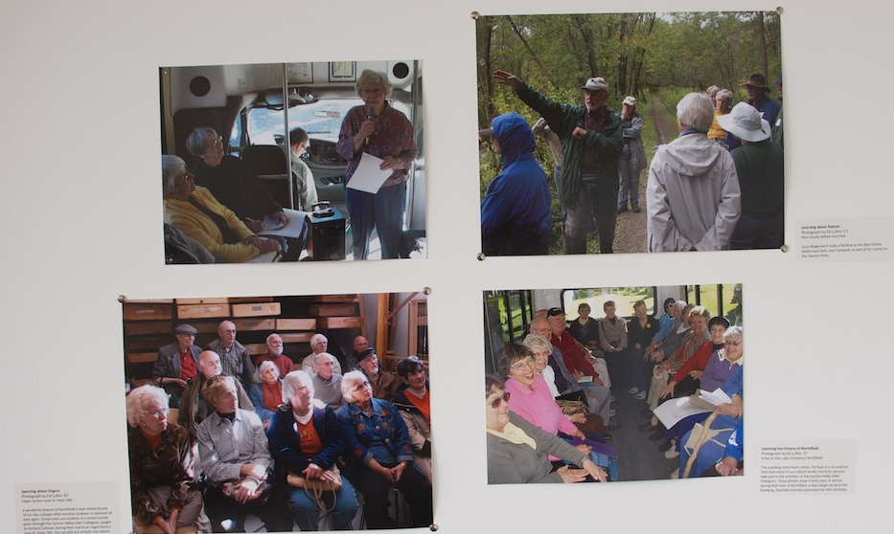

Slide 28
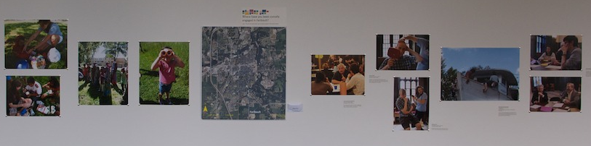

Slide 29
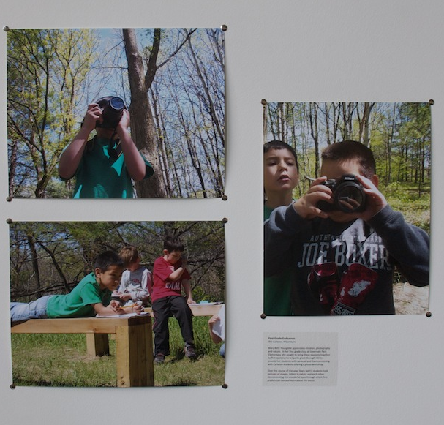

Slide 30
Brainstorming Foundational Questions and/or Best Practices
http://serc.carleton.edu/quirk/CarletonResources/10questions.html
How should we engage in:
• Seeing?
Knowing?
Acting/ Representing/Displaying/Writing?
Consider Susan Sontag’s idea that photography (could we say documentation of any sort?) is not simply seeing but an “evaluation of the world.” Where is the ethical in our seeing and how do we teach our students to be conscious of this goal?

