Slide 1
RUBBER SOUL
The Goodyear Museum of Rubber Objects
Akron, Ohio

Slide 2
Mission
This museum will highlight the importance of rubber in everyday life
Visitors will experience the ubiquity of rubber

Slide 3
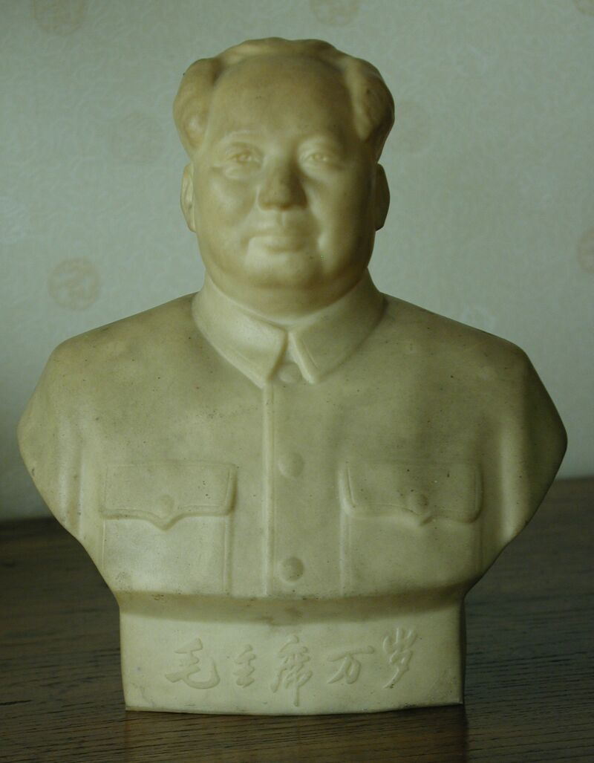
Ball Rotunda Entrance

Slide 4
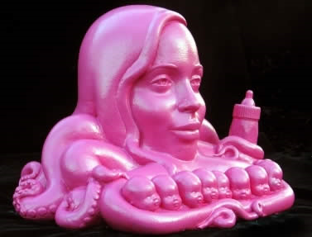
Pop culture

Slide 5

Musical Figures

Slide 6
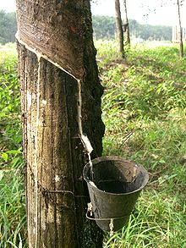
Rubber History and Industrial Production

Slide 7
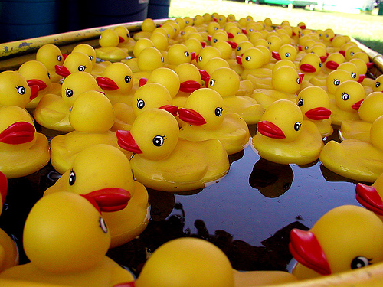
Rubber Flora and Fauna Atrium

Slide 8
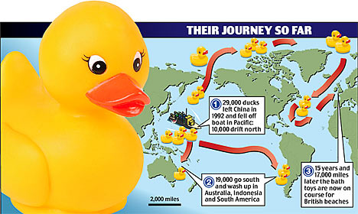
Temporary Exhbits

Slide 9
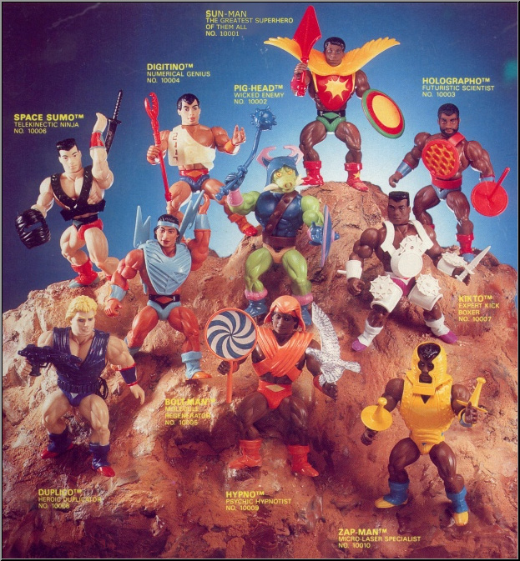
Balls, Toys, and Curios

Slide 10
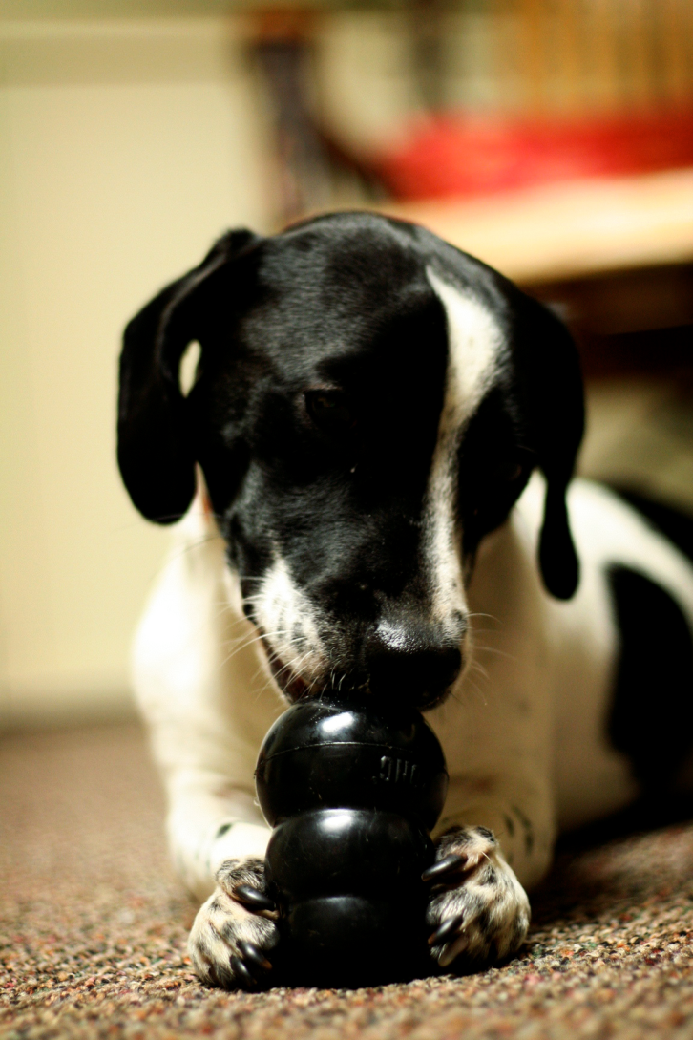
Squeezable Room Interactive

Slide 11

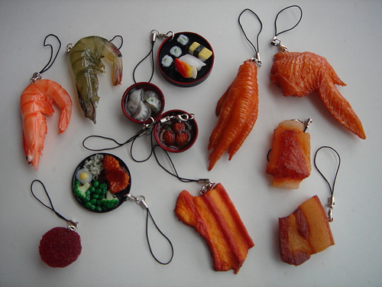
Food, Fake Food, Gum

Slide 12

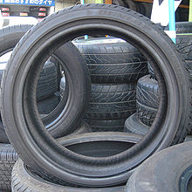
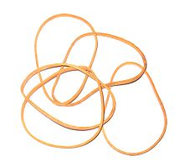
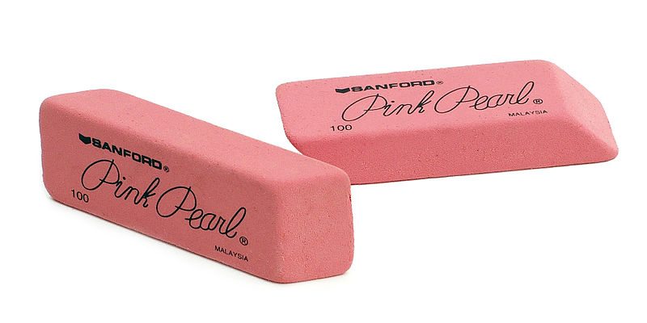
Utilitarian

Slide 13
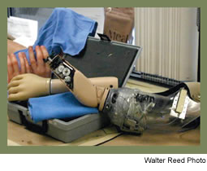

Medical and Prosthetic

Slide 14

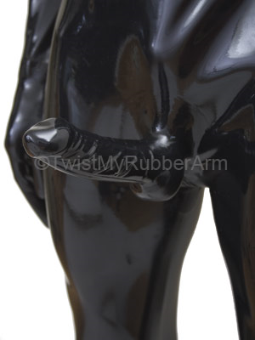
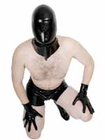
Fetish

Slide 15


Media Room

Slide 16
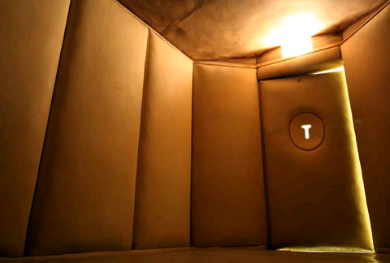
Should one start to appreciate rubber too much . . .

