Slide 1
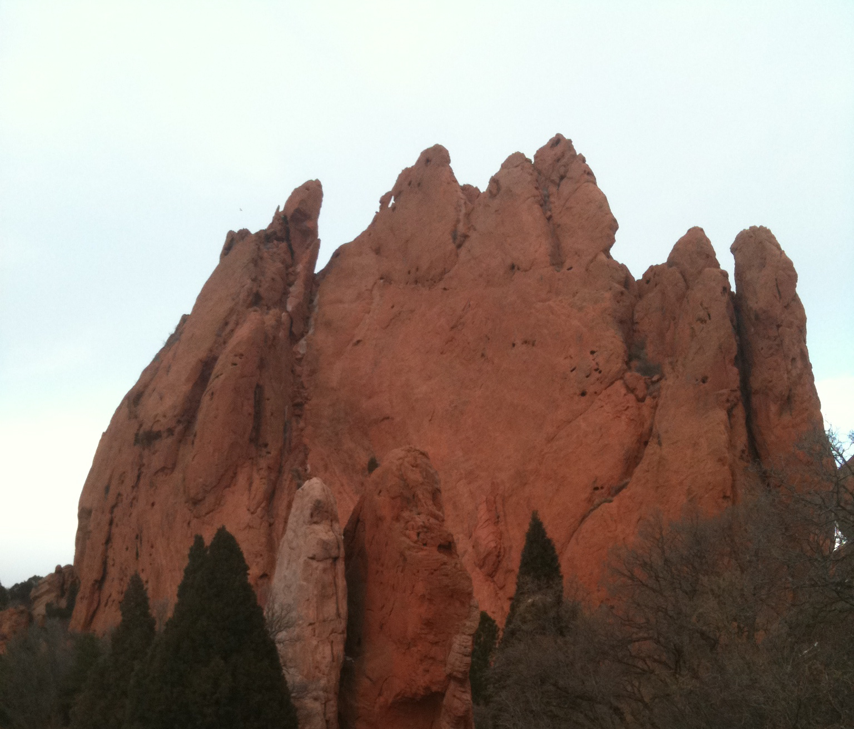
IMPACTS
GROUP 3

Slide 2
Immediate Impacts
Networking which led to increased access to data providers, tool specialists, educators; to others expertise
Rejuvenation in our own work through exposure from different perspectives
Learning about new tools, and seeing it through another’s eyes.
EET science content was improved through participation of scientists (and their accompanying data) in the Data Access workshops
Improving teaching through use of the chapter materials

Slide 3
Long-term Impacts
Teachers learning about data-driven analysis
New software development in response to better understanding of the needs of the community E.g.: RAMADDA
Better understanding of what data formats were needed led to increased availability
Learned the language of each role
Led to teacher professional development workshops and additional grant funding (Carla’s trainings, NSF ITEST)
Building a community of teachers with ability to comfortably using a tool leads to ease of integration new data sets
Increased geospatial understanding for learners
Teams began coming to EET meetings with a tools, data, ideas in mind because of experiences at earlier conferences

Slide 4
Sustainability
Teachers need support for software installation. Involvement of school administration early on could ease this challenge.
Pre-preparation would increase effectiveness and efficiency of teams when creating chapters
Correlate EET chapters with topics in popular science text books (possible funding source)
Complete in-progress chapters and ensure long-term website Maintenance, fix out of date tools, data, etc.
Simplified methods for conversion of chapters to online format (new template)
Less emphasis on data sheets, more on chapter content

Slide 5
Sustainability
Partnering with major science initiatives to highlight their research
Conduct Needs/gaps analysis before creation of new chapters Design/recruit teams based on needs/gap analysis
Difficulty maintaining contact with experts (data providers, tool specialists) Need enhanced long-term communication
All EET participants should use existing contacts for distribution of EET chapters
Finding the balance between too many and too few tools. Standardization leads to greater adoption and integration.
Scientists need to be involved up-front and with follow-through. Their input with the development of the case study, data interpretation, is essential
Listserv with all Data Access participants, database of experts to increase collaboration
Integrate pre-service teachers and faculty in chapter creation – may lead to use of chapter in science-ed courses

