Slide 1


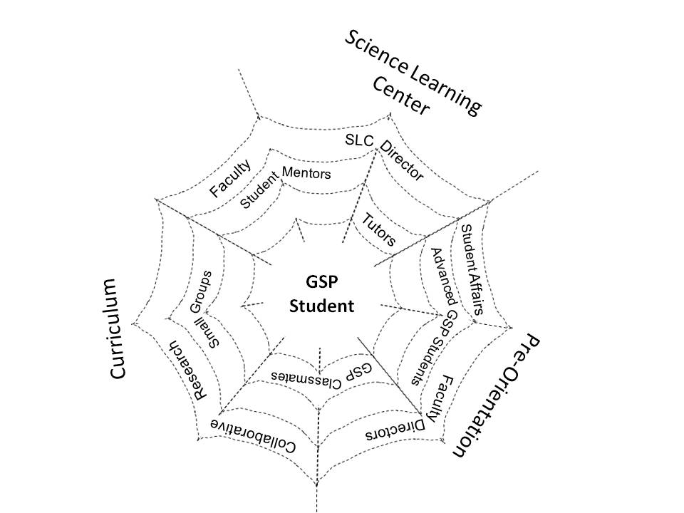
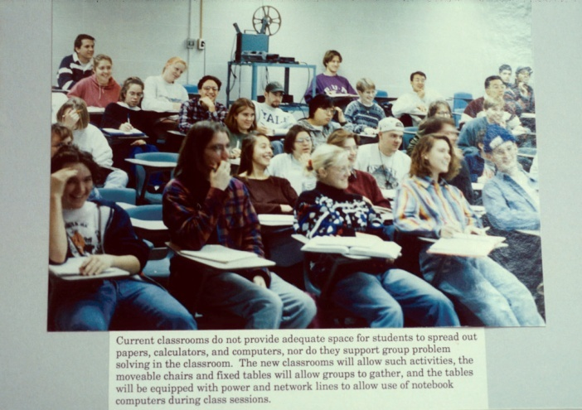
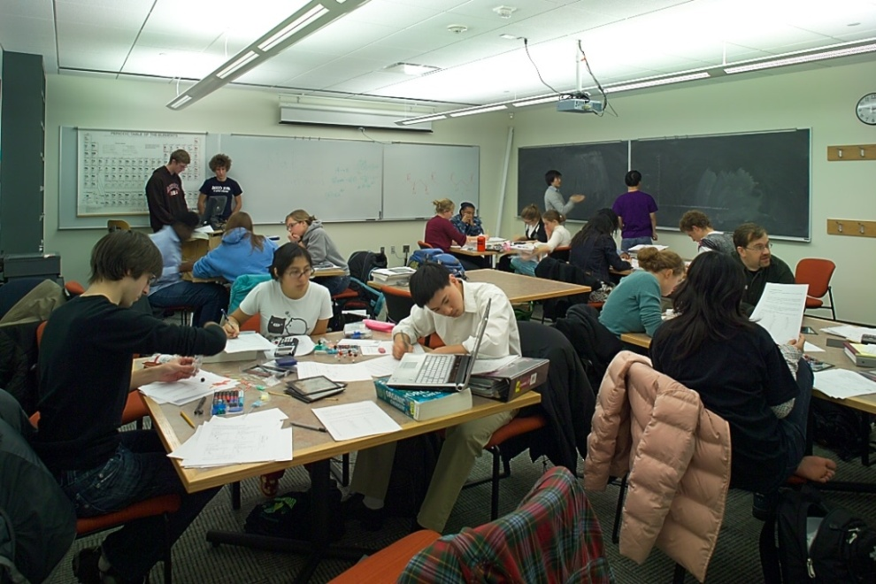
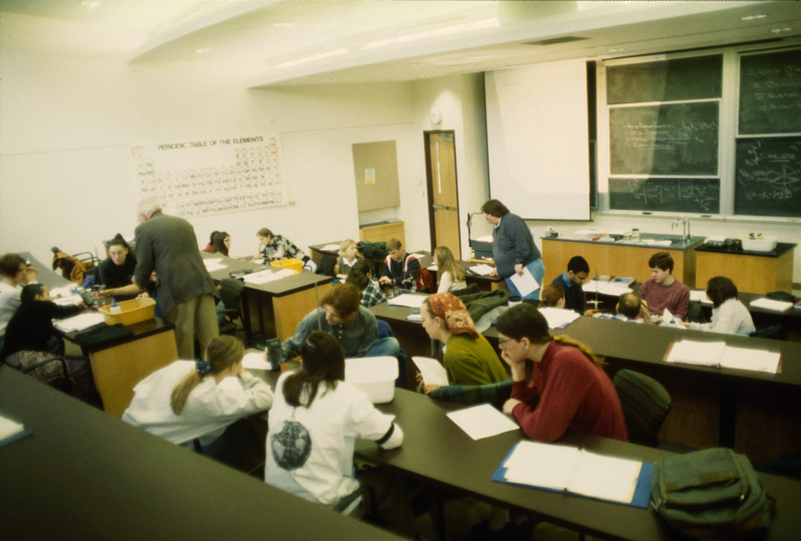
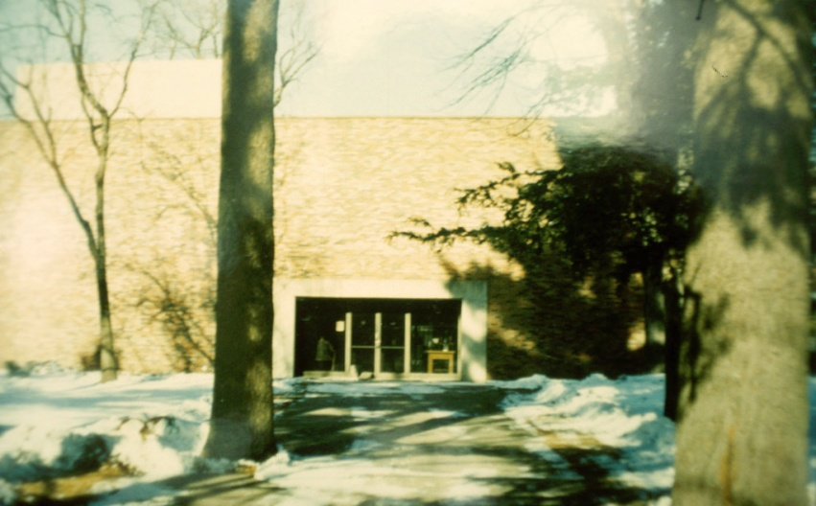
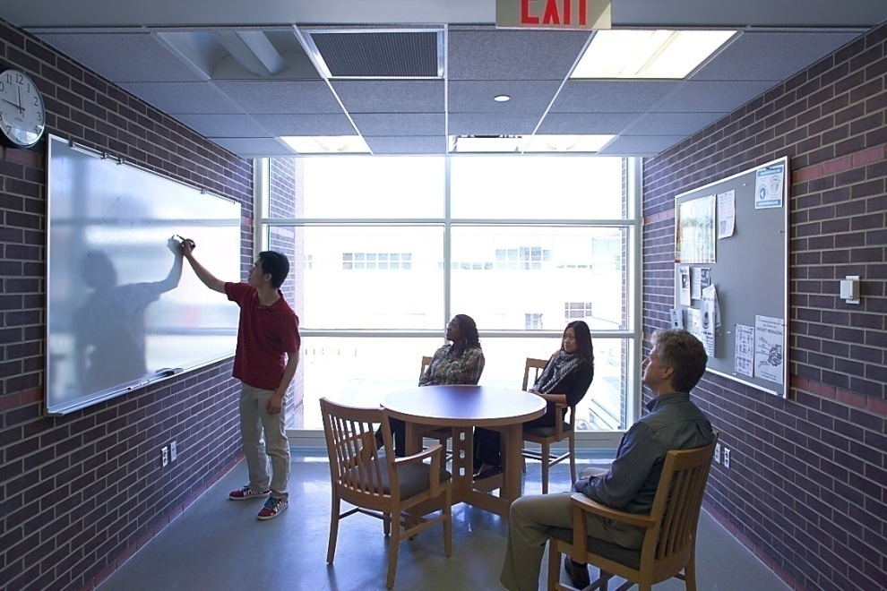
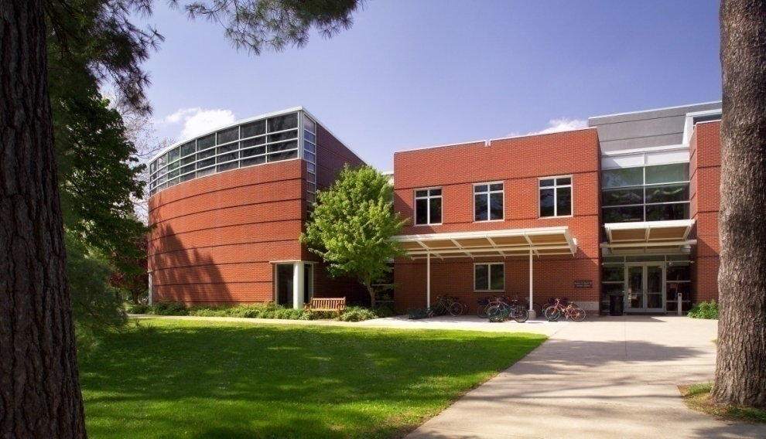
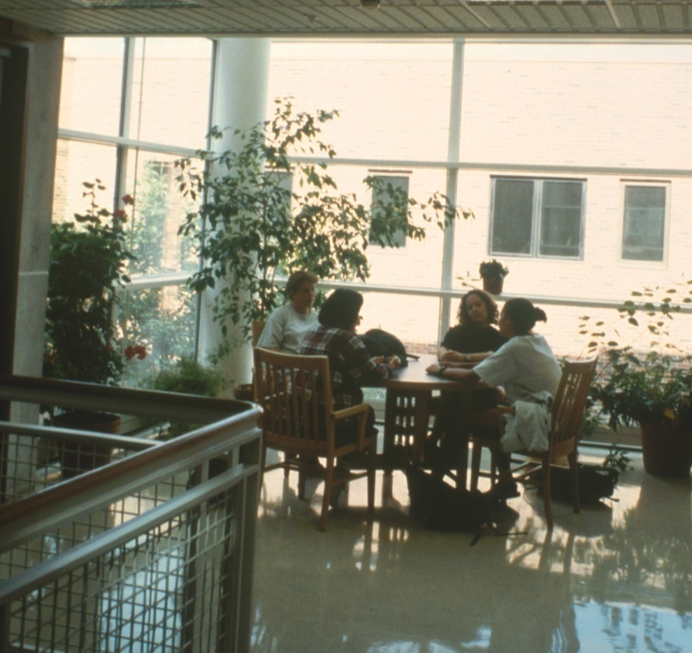
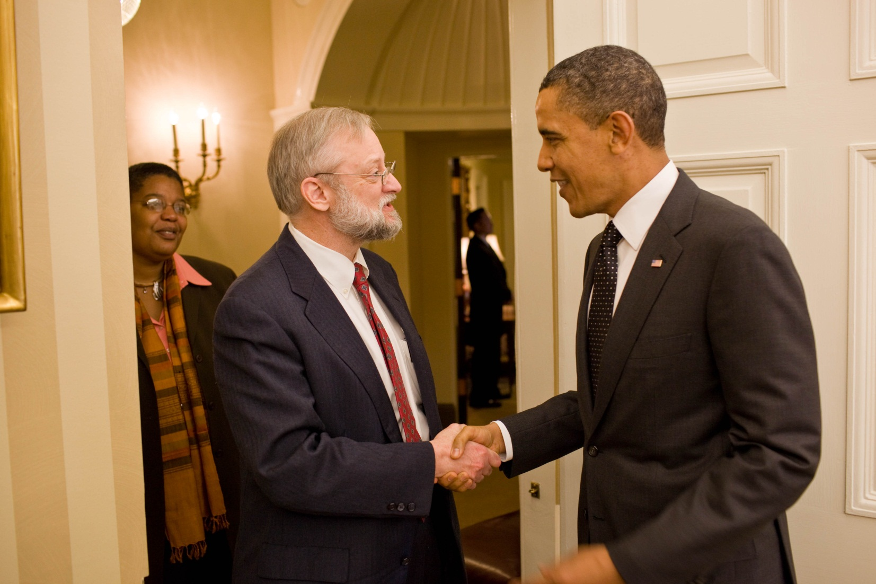
Results of Almost Two Decades of Reform Aimed at Inclusion in
Science and Mathematics
Jim Swartz, Dack Professor of Chemistry
Grinnell College, Grinnell IA
For my Committed Colleagues
Introduction
In the late 1980’s we began to worry in an organized way about the lack of women and students of color among our science graduates. There is some evidence that some students are more sensitive to problems with the curriculum and pedagogy and that changes will benefit all students.
Where we started
“Minority Student Retention Committee”
Some assertions that we were admitting the wrong students.
Data Analysis
What correlated with poor grades in introductory math and science?
No correlation with standardized exam scores or high school grades
Correlation with:
First generation college student
Graduation from high school with < 50% college-goers
Being a domestic student of color
Funding
Lilly Endowment - General program support including additional faculty
GTE-Focus - Summer research for New Science students
National Science Foundation - Undergraduate Course & Curriculum, Institutional Reform, CCLI, AIRE
Howard Hughes Medical Institute - Curricular Reform and Student/Faculty Research
Grinnell College
Goals and Program Elements of the Grinnell (New) Science Project
Barriers to the Successful Study
of Science
Acclimation to student life and lack of supportive community.
Different learning styles.
Role models and contexts for the study of science.
Program Elements to Address Barriers
Pre-orientation Program
Students are invited to campus a week prior to New Student Days to participate in a special pre-orientation
Curricular and Pedagogical Changes
Being informed by the work of Treisman, Tobias, Project Kaleidoscope, and of HBCUs, we decided to incorporate more engaged, personal elements into courses. Students are encouraged to work in groups and be part of a 'community of learners'. Several models were tried, including introduction of one-credit 'workshop' courses taken by some students concurrently with standard courses, partial revision of existing courses, and conversion of standard courses to a workshop format.
Early entry into student-faculty research
We established special short term research opportunities during academic breaks for students who were members of the target population
We generally increased the number of summer student-faulty research opportunities,
with some emphasis on early opportunities for students from
the target population
Foster Peer Mentoring through Science Learning Center
The Science Learning Center was established and a director appointed to:
Train and support mentors in courses
Tutor students and train peer tutors
Work with faculty members to improve student learning
Pedagogical Changes
Introductory Biology—A research course
Introductory Physics—Half sections are in workshop format
Introductory Chemistry—All sections use modular problems based materials and some are in a workshop format.
Introductory Computer Science—All sections use a workshop format
Goals
To foster acclimation to college life through participation in pre-orientation week
Alleviate anxieties of first year which may hinder academic performance and provide uncomfortable campus climate
Provide a small cohort in which relationships and a support network may be built
Introduce and acquaint students with faculty
Help students become comfortable with campus and acquaint students with services available
Pedagogical Goals of the GSP
To respond to different learning and teaching styles through interactive science and mathematics courses
Focus on helping participants excel rather than merely avoid failure
Emphasis on collaborative learning and small group teaching methods
Faculty sponsorship and support
Web of Mentoring
Problems with Introductory Biology
Field and information content is exploding
Course traditionally taught in a relay-style in large lecture sections with observational or ‘canned’ labs
Faculty have a hard time agreeing on ‘coverage’
Lots of content coverage, but students learn/retain little
Students get little sense of what biologists do
Example of Curricular and Pedagogical Change
Facilities Play a Key Role in Helping Students Feel Comfortable and Establishing Community
Facilities upgrades in two phases
Renovation and modest addition finished in 1997 (Bio., Chem., Physics)
Major addition and further renovation finished in 2007 (all sciences and science library)
Assessment
We included two types of assessment the early semesters the course was taught.
The first is course-specific and is given in a pre-test/ post-test format.
The second is a survey given at the end of the course and asks the same questions of students enrolled in all sections of the course.
Note that comparison studies of learning are not readily possible.
Before
Facilities to support pedagogical change
Pre-test Post-test
Data Analysis
The data to the right illustrate the results of an experiment to determine the effect of tetraethyl-ammonium (TEA) and 4-aminopyridine (4-AP) on the resting membrane potential of muscle cells in the superficial extensor muscle of the crayfish. What can you conclude about the effects of TEA and 4-AP on the resting membrane potential?
A New Approach – Introduction to Biological Inquiry
Research-based learning to move away from teaching biology as a collection of facts and toward teaching biology as it is actually practiced.
Each faculty member teaches a section focused on a unique biological question that is related to her or his research interests.
All sections teach similar skills such as using the scientific literature, designing experiments, analyzing data, and writing scientific papers.
Instead of the more traditional three lecture classes and one three-hour lab per week, each section is taught in the “workshop” format where lecture, laboratory, and discussion are integrated.
After
After
Before
Spaces that support community
After
1. This course gave me insight into the process by which biological knowledge is advanced.
After
A building that is welcoming
Evolution
Over time the pedagogical changes have both accelerated and mainstreamed.
The pre-orientation program has been mainstreamed and nearly all faculty members participate in some way.
Early research opportunities have, for the most part, moved to research experiences to embedded in courses.
We have received national recognition and some institutions are adapting and implementing some aspects of the project.
After
Presidential Award for Excellence in Science, Engineering, Mathematics, and Engineering Mentoring-- 2009, awarded Jan. 2011
Outcomes of Bio 150
Rate of D or F grades for students of color (SOC) fell markedly from about 12% to about 5%
Grades improved, generally, and the gap between SOC and other students narrowed substantially
2. Because of taking this course I am more confident in my ability to learn something about a scientific topic that is new to me.

