Slide 1



Investing for Retirement
SSAC2007:HG179.JM2.1
Planning your retirement early is your ticket to maintaining your life style after 60.
Core Quantitative Skills
Forward Modeling
Time value of money – Don’t count on social security to maintain your life style at retirement. What you need to know before you retire. Calculating how long your retirement money will last.
Supporting Quantitative Skills
Exponential Growth
Percentages
Data Analysis
Estimation
Visual Display of Data: XY Plots
Prepared for SSAC by
*Joseph Meyinsse –SOUTHERN UNIVERSITY*
© The Washington Center for Improving the Quality of Undergraduate Education. All rights reserved. 2007

Slide 2
Overview of Module
Although planning for retirement is easy, many people have had an unhappy retirement because they have failed to plan. They underestimated the time value of money and end up living below the poverty rate at retirement. You have to plan to grow your money and make it last. Whether you’re just getting started, already retired, or somewhere in the middle, this module can help.
Slides 4 and 5 define the Rule of 72 and asks you to recreate the example spreadsheet that applies the rule to a particular case.
Slides 6-8 discuss the future value of a one-time investment and asks you to recreate the example spreadsheet that performs the calculation.
Slides 9 and 10 discuss the future value of an account into which you make an annual deposit and asks you to recreate the example spreadsheet that performs the calculation.
Slides 11 and 12 ask you to adapt the example spreadsheets to calculate and graph the future values for two new investment scenarios
Slides 13 asks you to figure out the size of the annual deposit you would need to make at the beginning of each year, given a particular fixed interest rate, to retire with a million dollars in the account.
Slides 14-15 gives the end-of-module assignment.

Slide 3

Problem
Young people do not think about old age. Life will always provide a good life style. Why worry now?
Can Compound Interest provide the way to financial security at retirement?

Slide 4
Definition 1: The Rule of 72 - An Application of Compound Interest
Compound Interest is an example of exponential growth where the amount of interest generated each term increases because it is based on both the initial investment and the previously earned interest. The increasing future value of a deposit growing with compound interest can be calculated approximately from the Rule of 72, or exactly from the Compound Interest Equation.
The Rule of 72: The rule is a handy mathematical shortcut to find the number of years (Y) it will take for an investment to double at a given interest rate (r).
The Rule of 72 Equation
Y = 72/r
where
Y = number of years to double initial investment
r = interest rate (expressed as an integer; e.g., 8)
For example, if you want to know how long it will take to double your money at 8 percent interest, dividing 8 into 72 tells you that your investment will double in 9 years.

Slide 5
Working Example of The Rule of 72
If my initial investment of $5,000 doubles every 9 years, how much will I have in 36 years?
= Cell with a number in it
= Cell with a formula in it

Slide 6
Definition 2: Compound Interest Formula
Now we consider the same problem using the Compound Interest Equation. If you make a one time investment of $5,000.00 at age 24 at 8% interest a year, what will be the future value at age 60? While you are at it, calculate the value of the account for each year until you are 60 years old.
Compound Interest Equation
P = C (1 + r/n) ^{nt}
where
P = future value
C = initial deposit
r = interest rate (expressed as a fraction; e.g., 0.08)
n = # of times per year interest in compounded
t = number of years invested

Slide 7
Working Example Compound Interest
What is the future value of my initial investment of $5,000 in 36 years at 8% per year, using the compound interest formula?
Reproduce the table in one long pair of columns and then graph the data to look like the above graph.
Compare the results of Compound Interest with those of the Rule of 72.

Slide 8
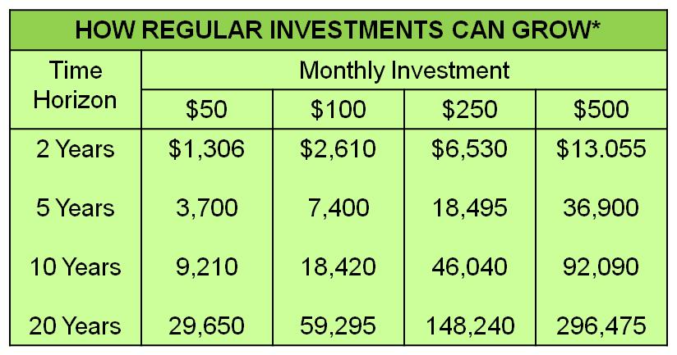
Working Example: The Magic of Compound Interest and Regular Deposits
The previous slide considered the Future Value of a Present Sum – the growth of a single deposit. Now we consider the Future Value of An Annuity – the growth of an For example, if you deposit $50 per month for two years you will have $1,306 at the end of the two years given 8% interest, although you deposited only $1,200 (see table).
* Assumes 8% annual return before taxes

Slide 9
Definition 3: Future Value of $5,000 Annual Investment
The Future Value of an Annuity is the money that accumulates at a future date when an individual invests equal amounts at equal intervals at a specific interest rate.
The general formula for an account receiving an annual deposit at the end of each year:
F = I [(1 + r)^{t} - 1)]/r
where
F = future value
I = annual investment at the end of each year
r = annual interest rate (expressed as a fraction; e.g., 0.08)
t = number of years
How would you revise the formula if the deposits were made at the beginning of each month?

Slide 10
Working Example: Future Value of $5,000 Annual Investment
What is the future value of my annual investments of $5,000 for 36 years at 8%?
Recreate this spreadsheet in preparation for an assignment in a later slide.

Slide 11
Assignment 1
Adapt one of your spreadsheets from an earlier slide to determine the future value when an investor deposits $10,000 at 9% annually for 20 years? Create a scatter graph where the Future Value is the y-axis and Year is on the x-axis.
Compute the results for future value for each year in the column labeled “Future Value”.
The general formula for an account receiving an annual deposit at the end of each year:
F = I [(1 + r)^{t} - 1)]/r
where
F = future value
I = annual investment at the end of each year
r = annual interest rate (expressed as a fraction; e.g., 0.08)
t = number of years

Slide 12
Assignment 2
You are 25 years old, and you have access to a retirement account that guarantees 10% interest. You want to retire with $500,000 in the account. If you make a one-time investment into the account, how much would the investment have to be, given that you think you can wait a while to make the investment? Plot a graph of Amount of Deposit (y-axis) vs. Years since Deposit (x-axis).
Compute the initial investment in the column labeled “Amount of Deposit”.
Compound Interest Equation
P = C (1 + r/n) ^{nt}
where
P = future value
C = initial deposit
r = interest rate (expressed as a fraction; e.g., 0.08)
n = # of times per year interest in compounded
t = number of years invested

Slide 13
Assignment 3
You are 30 years old, and you want to retire with $2-million in your retirement account. How much annual deposit do you need to make at the end of each year at a rate of 9 percent for 30 years ?

Slide 14
End of Module Assignment
What will the amount of money you need to retire depend on? Explain.
You have just invested $4000 (principal) towards your retirement account at 8 percent interest (rate) and now you are looking forward to see your money “grow” into $8000 (total) for its future value. How long (years) will it take?
If you deposit $10,000 into an account with a compound interest rate of 10%, what would your future value be after 20 years? What would be the difference in future values if you used a semi-annual (twice a year) compound interest rate instead?
Suppose you are 30 years old and wish to retire at age 65. What amount of money would you have to deposit at 8 percent rate for this one deposit to make you a millionaire?

Slide 15
End of Module Assignment (cont’d)
5. Complete the table below using the magic of compound interest.

