Slide 1

How Diverse Are We?
SSAC2007.E184.BG1.1
Comparing Racial Composition of NYC and USA, 1980-2000
In this module we will analyze and compare charts, calculate percentage composition and percent change for various ethnic groups.
Core Quantitative Issues:
Percentages
Quantitative Concepts and Skills
Proportion
Percent change
Stacked bar graphs
Line graphs (Excel)
Prepared for SSAC by
Bernadette Garam - Manhattan College, NY
© The Washington Center for Improving the Quality of Undergraduate Education. All rights reserved. 2007

Slide 2
Overview of Module
Diversity in the USA continues to grow at different rates and has different implications for locations affected by varying growth. The percentages of specific minority groups and the rates of their growth have drawn much public interest.
Slides 3-5 give background on the context. and Slide 6 gives background on the quantitative content of the module.
Slide 7 poses the problem: compare Census data on population distribution for Hispanics and Non-Hispanic race for NYC and the US. The data are presented as stacked bar graphs.
Slides 8 and 9 ask you to read and interpret the two sets of stacked bar graphs.
Slides 10-12 take you to the numerical data behind the stacked bar graphs and ask you to build spreadsheets to calculate the percentages of the population that consist of each of the racial/ethic groups listed in the table.
Slide 13 asks you to build a spreadsheet to chart the changing numbers in each of the racial/ethnic groups from 1980 to 2000.
Slide 14-16 guide you in calculating percent changes and how to talk about them.
Slide 17 uses the line graphs of Slide 11 to compare the diversity of NYC to USA and whether the diversity of either or both is increasing.
Slides 18-19 have the end-of-module assignment.

Slide 3
Basic Terms and Concepts
Race: Biologically, race is deemed meaningless since all human beings worldwide are the same.
Definitions of Race and Ethnicity are socially constructed by society based on history, values, culture.
Therefore, definitions of race and ethnicity continually change over time and across cultures. They differ from society to society; for example, the meaning of “black” in the US differs from the meaning of “black” in Brazil.
Ethnicity, like race, is socially constructed. It relates more to values assigned to cultural characteristics, and, though a few of the common characteristics could include physical similarity, they are not essential to the definition of Ethnicity.
The social concepts of Race and Ethnicity, however, continue to be of great significance in the world and domestically. It is often deemed to be the cause of armed conflicts and used as the basis for power - dominant/ subordinate - relationships among groups.
Prejudice and discrimination have traditionally developed based on race and ethnicity.
The diversity of the United States is unique in the world as we come to be known as a Nation of Immigrants.
The continual change in the mix and status of various ethnic groups continues to shape the country and thus the importance of studying these changes.

Slide 4

Basic Terms and Concepts
In the United States, the concept of Race was absent before the arrival of the Europeans.
Since then, the influx of diverse peoples encouraged the sorting and categorization of people according to color, physical characteristics, language, religion and other cultural characteristics.
The process of categorization and the process of assigning functions and status to specific groups contributed to the social construction of race and ethnicity; the positions of various groups relative to power in the society were also established.
Over time, some of the subordinate groups were replaced by new immigrants and the growing influence of several groups have attracted much public attention.
In modern times, there is increasing recognition of the value and contributory role of diversity in all aspects of society.
The definitions of race and ethnicity in the following slide are still commonly used.
4

Slide 5

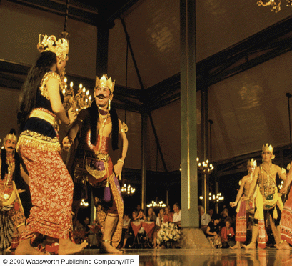

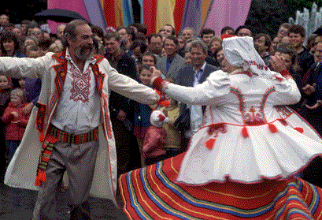
Basic Terms and Concepts
Race: A group of people who are generally considered to be …..
physically distinct in some way, such as skin color, hair texture or facial features and
are considered by self or others as a distinct group. (M.Marger 2003)
Ethnic Group: A group of people who are generally recognized by themselves and/or by others as a distinct group, with such recognition based on social or cultural characteristics. (M.Marger 2003)
5

Slide 6
Background on Proportions and Percentages
Percentage literally means “per one hundred.” Percentages are a standard way of comparing the size of two quantities of the same kind (in our case, numbers of people).
Percentages arise in this module in two contexts:
Parts of a whole. Because the subject is the racial composition of a population, we are automatically speaking of parts of a whole. For example, we will say that 18% of the population of New York City in 1980 was Hispanic according to the U.S. Census. Stating the part-to-whole as a percentage is much more convenient and allows much easier comparisons than stating the numerator-to-denominator ratio using the actual numbers of the Hispanic and total populations. Thus, the 18% (i.e., 18/100) is the result of
a proportion (equality of two ratios):
Percent change. Racial composition is not static; it changes from Census to Census. This module gives Census data on the changing numbers and changing percentages. Percent change relates to the size of the difference relative to the starting quantity, and the language describing such changes can get tricky. Consider, for example, a forest consisting of 20 oaks and 30 maples, and suppose it was logged so that it now contains 15 oaks and 15 maples. The number of oaks decreased by 25% (−5/20) and the number of maples decreased by 50% (−15/30). But note, the percentage compositions changed also. The oaks increased by 10 percentage points (40% to 50%) and the maples decreased by 10 percentage points (60% to 50%). The oak percentage (fractional part) of the forest, therefore, increased by 25% (10/40), and the maple percentage decreased by 17% (−10/60).

Slide 7
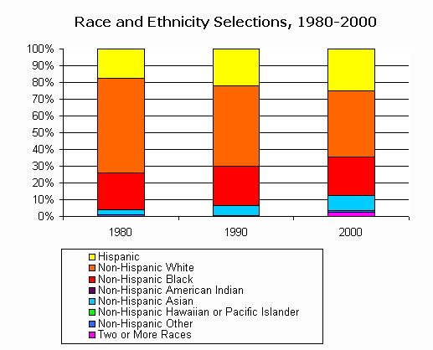
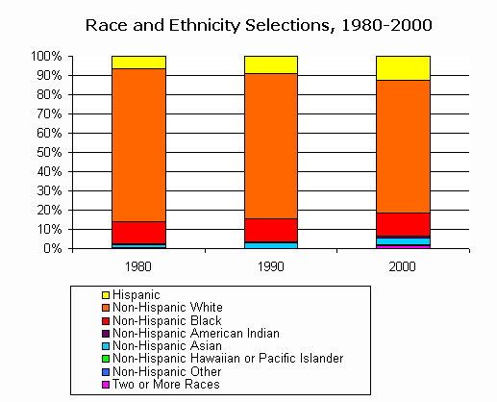
Problem: How does the diversity of NYC compare to that of the USA?
What conclusions can you draw from these stacked bar graphs? Compare the distribution of racial/ethnic groups in NYC vs. the USA. Which are growing? Diminishing? Is diversity increasing?
New York City
United States
Source: http://www.censusscope.org from the U.S. Census
From Census Scope: “On the 2000 Census questionnaire, ‘race’ and ‘Hispanic ethnicity’ are listed as separate questions. A person of Hispanic ethnicity is anyone who identifies with that social group, and so can be of any race. This can make data on race and ethnicity difficult to interpret.” (Throughout this module, we will refer to these groups as ‘racial/ethic’ groups.

Slide 8
Reading the Stacked Bar Charts for NYC
New York City
Examine the four major racial groups starting from the top end of the chart:
Hispanic (H),
Non-Hispanic White (HW),
Non-Hispanic Black (NHB)
Non-Hispanic Asian (NHA)
Use the graph to estimate the percentage of the NYC population composed of each of the four racial groups for each year, and write your answers on a piece of paper. Start with 18% for Hispanics for 1980.
Year | 1980 | 1990 | 2000
H
NHW
NHB
NHA
Did the NHW group decrease from 1980 to 2000?
Did H grow to exceed NHB in 2000?
Which if any groups doubled?
Is the diversity of NYC increasing?

Slide 9
Reading the Stacked Bar Charts for the USA
USA
Now, do the same for the bar charts for the composition of the USA population
Fill out the table on a sheet of paper, and answer the four questions.
Year | 1980 | 1990 | 2000
H
NHW
NHB
NHA
Did the NHW group decrease from 1980 to 2000?
Did H grow to exceed NHB in 2000?
Which if any groups doubled in size?
Is the diversity of the USA increasing?
Now, let’s look at the data behind the graphs →

Slide 10
Question 1: Did the NHW group decrease from 1980 to 2000?
Recreate these two spreadsheet
Note: Continuous decrease on both the spreadsheet and the graph
Note: Continuous increase on the spreadsheet(!) and decrease on the graph
Why the difference between spreadsheet and graph?
* Non-Hispanic only; in 1980 and 1990 "Asians" includes Hawaiians and Pacific Islanders.

Slide 11
Question 1: Did the NHW group decrease from 1980 to 2000? (2)
The spreadsheet and graph show different things. The spreadsheet lists the number of people in each of the various groups. The graphs show the percentage of the total population that each group composes. Thus the partial bars all add up to the same total, 100%. But, as the spreadsheet shows (Row 5), the total population (number of people) increases from column to column.
So, what are the actual percentages?
Remember, you estimated them from the graphs back at Slides 8 and 9.

Slide 12
Question 1: Did the NHW group decrease from 1980 to 2000? (3)
Create two new spreadsheets by Inserting a column alongside each of the data columns, and enter cell equations to calculate the percentages.
= Cell with a number in it
= Cell with a formula in it
For help with making these spreadsheets, click here.
Note –
Row 9: Numbers (yellow cells) increase and percentages (orange cells) decrease.

Slide 13
Question 2: Did H overtake NHB between 1980 and 2000?
Return to the two spreadsheets of Slide 10, delete the rows containing data on the total population and the groups other than the most numerous four.
Now, make line graphs showing the changing racial/ethnic composition of NYC and USA for 1980-2000.
For help with line graphs, click here
About the question: Did H overtake NHB? Compare the data presentation (the graphs) of this slide vs. that of Slides 6 and 7.

Slide 14
Question 3: Which if any groups doubled over the time period 1980-2000?
It may depend on what you mean – doubled in number, or doubled in percentage of the total? One needs to be careful when talking about changing quantities especially when the quantities may be cast as percentages.
First, make a spreadsheet that addresses both the changes in absolute quantities and the changes in relative quantities. Start (Columns B-F) with the first spreadsheet of Slide 12, delete the columns for 1990, and focus on the five largest racial/ethnic groups. Use Rows 8-13 for the absolute quantities, and Rows 15-20 for the relative quantities.
Add Columns G, H, and I for the various changes between 1980 and 2000:
G is the straight difference (e.g., for Row 6: E6-C6). H is the percentage growth (e.g., G6/C6). I is the ratio (e.g., E6/C6) expressed as a percent.

Slide 15
Question 3: Which if any groups doubled over the time period 1980-2000? (2)
Looking at the information in the spreadsheet, NHA increased in numbers by 112% from 1980 to 200, meaning it was 212% (or 2.12 times) as large in 2000 as it was in 1980 (Row 13). At the same time, the percentage of NHA increased by 3.2 percentage points, or by 105%, meaning that the percentage in 2000 was 205% (2.05 times) as large as it was in 1980 (Row 14). Thus NHA doubled in both numbers and percentage in that time interval. No other racial/ethnic group doubled in either size or percentage in 1980-2000.
Note: It would be a mistake to say that the number of NHA was 2.12 times larger in 2000 than in 1980. It would also be incorrect to say that the percentage of NHA increased by 3.2% from 1980 to 2000.

Slide 16
Question 3: Which if any groups doubled over the time period 1980-2000? (3)
Now, make a similar spreadsheet for USA, starting with the second spreadsheet of Slide 12.
From 1980 to 2000, while the population of the USA increased 24%, NHA increased 190% (meaning it almost tripled) in number and increased 134% in its percentage of the total (meaning the percentage more than doubled). Meanwhile H increased 142% in number (more than doubling) making its percentage 95% larger (meaning the percentage of H did not quite double). In comparison to the case of NHC, there is a large disparity between the percent increase in number vs. percent increase in its percentage of the whole. Why is that?
Note the use of percentage points in Column G.

Slide 17
Question 4: Is diversity increasing?
Retrieve the two sets of line graphs in Slide 13.
Diversity can be viewed as how nearly equal in size the constituent groups are. With that measure in mind, compare the diversity of NYC to USA. Which is more diverse? Is diversity increasing?
Note: the graphs are not labeled to identify which is NYC and which is USA. You can tell immediately by looking at the axes. It is always a good idea to look at the axes of a graph to get your bearings before jumping into the content.

Slide 18
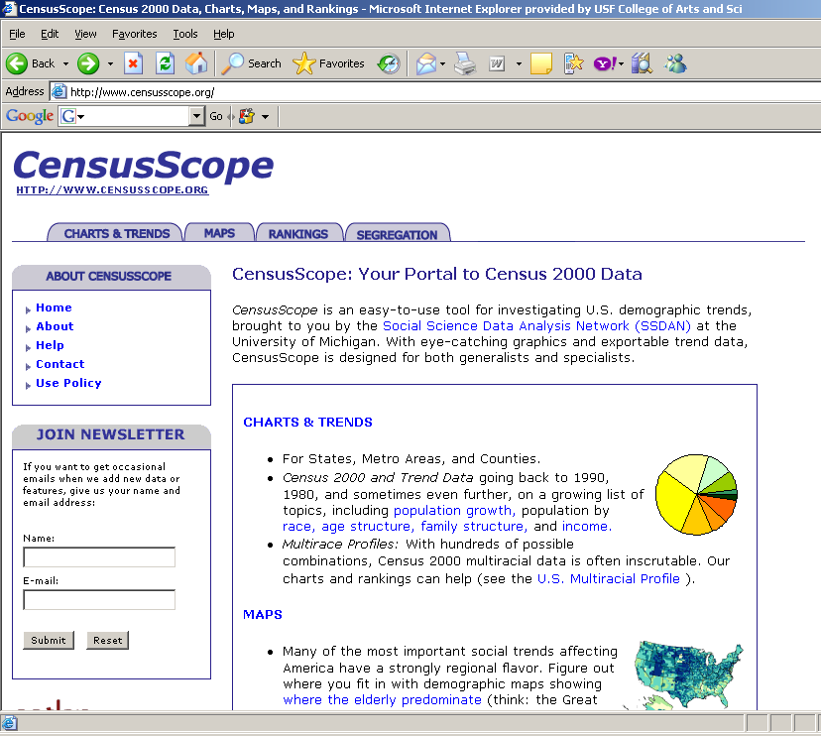
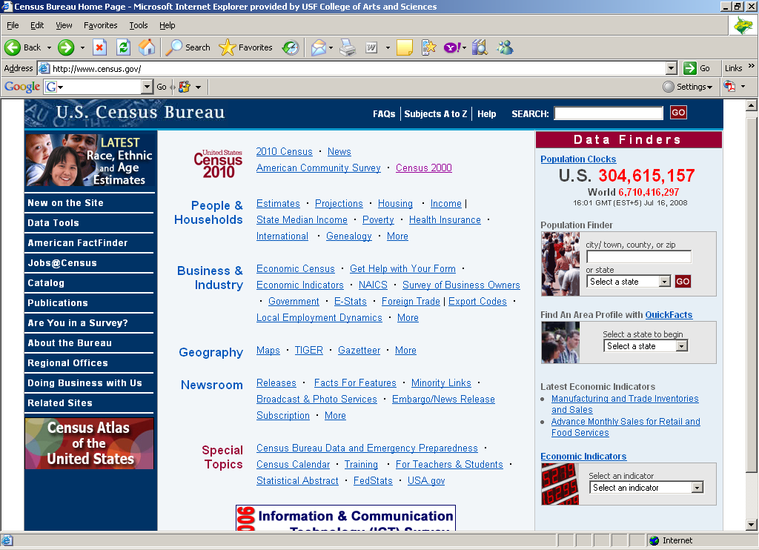
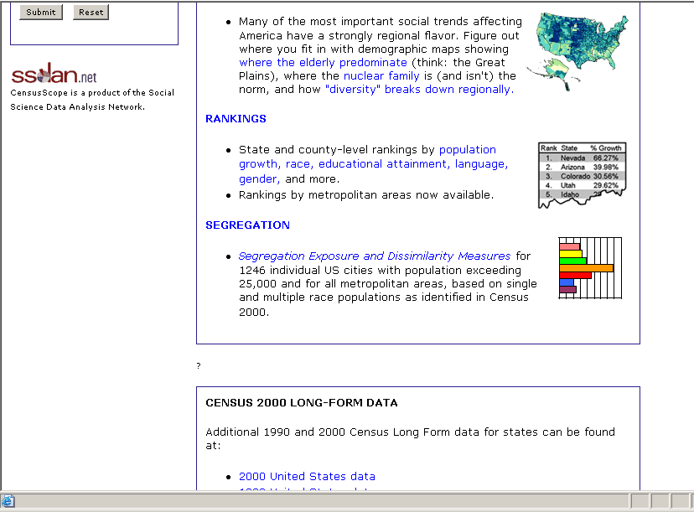
End-of-Module Assignment: Sources of Data
http://www.censusscope.org
The charts and data in Slides 5-8 are from CensusScope, a tool for investigating data from the US Census. Familiarize yourself with CensusScope, as well as the information-rich site of the U.S. Census Bureau. You will need them both to complete the end-of-module questions on the next slide.
http://www.census.gov

Slide 19
End-of-Module Assignment: Questions
Part 1. Go to www.census.gov.
Notice at the upper right corner, there is an estimate of the current U.S. population. How much has the population grown since the 2000 Census (number and percent)? Create a small spreadsheet to perform the calculations.
Revisit the site in a day (24 hours, if possible). How much larger are the US and World populations? What percentage of the world’s one-day population growth is contributed by the US?
Find the latest estimate for the population of NYC from the search box beneath the USA estimate. How much has the population grown since 2000 according to the data found in this way?
Notice that the data for 1990 and 2000 found in this search differ from the data in Slide 7. Why do you suppose that is? (You will find out when you do Part 2.)
Part 2. Go to http://www.censusscope.org.
On the home page, under “Charts & Trends,” click on “Race.” The stacked bar for the USA (Slide 7) will come up. On the left side, change location to New York, NY. Now answer (d) of Part 1.
On the “change location” box, search for another metro area of interest to you. Duplicate your NYC spreadsheet and repurpose the copy to show the population number and percentages of your selected location (like Slide 12)
Similarly, prepare a spreadsheet that shows a Census-to-Census percentage change for your selected location (like Slide 14).
Similarly prepare a line graph showing the changing racial composition for your selected location (like Slide 13).
Write a paragraph comparing the racial composition of your selected location to that of NYC. Include a comparison of how the respective compositions changed from Census to Census.

Slide 20
Help with line graph in Slide 13
Highlight Block B5.E8 (i.e., all the cells from Cell C4 to E8).
Click on the Chart Wizard.
Select “Line,” select the appropriate subtype, and click “Next.”
At Step 2, “Chart Source Data” be sure to select “Series in rows” under the “Data Rows” tab. Then “Next.”
At Step 3, “Chart Options” label the Y axis under the “Titles” tab. Then “Finish.”
On the completed graph, right click on any of the lines, select “Format Data Series” and format the lines and markers under the “Patterns” tab. Experiment with the widths of lines and the shapes and sizes of the markers. Select “Custom” and experiment with the colors.
Return to Slide 13

Slide 21
Help for the spreadsheets of Slide 12
= Cell with a number in it
Start
= Cell with a formula in it
Highlight a cell in Column D, click on “Insert” and then on “column.” Repeat to insert the other two columns for percentages.
To enter the percentages, use the formula =C8/C$6 for orange Cell D8, and then copy and paste it into all of the other orange cells. Why does this work?
To format the orange cells, highlight the numbers in Column D, click on “Format,” then on “Cells,” then “Number” (on the tab), and then on “Percentage.” Repeat for the other columns of orange cells.
Finish
Return to Slide 12

