Slide 1
The Digital Divide
SSAC2007:HN49.MA1.2
A Question of Equal Access to Computer Technology
Core Quantitative Concept
Weighted Averages (or Weighted Rates)
In a democratic society, we like to think that all citizens have equal access to resources such as education, books, computers and Internet availability.
Do all American citizens have equal access to computers and technology?
Supporting Quantitative Concepts and Skills
Formulas
Rates
Data Analysis (Subtotals)
Prepared for SSAC by
Maryann Allen – Colby-Sawyer College
© The Washington Center for Improving the Quality of Undergraduate Education. All rights reserved. 2007.

Slide 2
Problem
The ability to use computers and the Internet as tools for solving problems is rapidly becoming an essential skill for successful employment both in the United States and throughout the world.
In a democratic society, we like to think that all citizens have equal opportunity to choose a career path and become gainfully employed. When the ability to use computer technology is a critical skill for a particular job, people who lack access to computers and the Internet are at a distinct disadvantage in the job market compared to their more experienced peers.
In the United States, do all American citizens have equal access to computers and technology?

Slide 3
Overview of Module
In this module, you will use Excel to calculate rates of computer usage and Internet connection in each of the fifty states. You will then learn how to use the subtotal tool in Excel to summarize data. In the process, you will discover that inappropriate use of the subtotal tool can lead to errors, and you will learn how to avoid these types of errors.
Slides 4-5 introduce the concept of the digital divide, and describe how spreadsheets can be used to calculate rates of computer usage and Internet penetration.
Slide 6 describes how the Subtotal tool in Excel can be used to quickly summarize a dataset, and presents key points on using Subtotals successfully.
Slides 7-9 illustrate the concept of weighted averages.
Slides 10-12 step you through the process of using the Subtotals tool to summarize the digital divide data set by region.
In slides 13-14 you will use the subtotal tool, in conjunction with some formulas, to calculate the weighted average Internet connection rate by region.
Slide 15 contains questions for you to answer after working through this module.

Slide 4
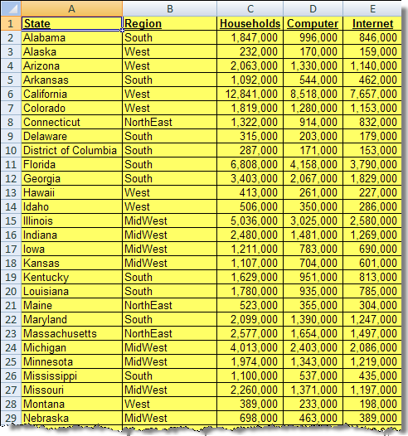
Getting Started
The Excel data file you will use in this module can be opened by clicking on the US Digital Divide icon to the right. (You need to be in “Normal View,” not “Slide Show.” See End Notes). After the file opens in Excel, click the Office Button, scroll down to Save As…, and save the file to your PC.
The Excel file contains 52 rows of data from various regions within the United States.
There are five fields for each line of data:
  State
  Region
  Number of Households
  Computer (in household)
  Internet connection (in household)
Data from US Census

Slide 5
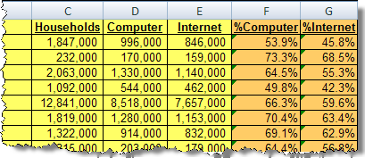
Rates of Computer Ownership and Internet Connection
In Column F, we will calculate the percentage of households with computers for each state. In Column G, we will calculate the percentage of households connected to the Internet in each state.
In Cell F2, enter a formula to calculate the percentage of households with a computer.
In Cell G2, enter a formula to calculate the percentage of households connected to the Internet.
Use the fill handle to copy the formulas in Cells F2 and G2 through Row 52.
Format the cells of Columns F and G as percentage, if not already formatted.
Examine the rates of computer ownership and Internet connection in various states. (The filter feature of Excel is a useful tool to quickly scan the data.)
Need help entering and copying formulas?
Click here
Need help using filters in Excel?
Click here

Slide 6
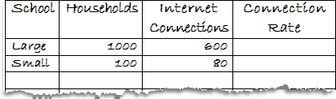
Using Subtotals (Keys to Success)
The Subtotal tool in Excel enables you to quickly summarize a large list of data. Before we start using the tool, there are two essential concepts that are critical to using the Subtotals tool successfully:
Before entering Subtotals, the data set must be sorted on the column that you wish to Subtotal; and
When an average is calculated on a column of data in Excel, it is a straight average of the numbers in the list, not a weighted average.
In order to examine the issue of straight average vs. weighted average, let’s look at the problem using an example:
Your high school was one of two high schools in a single school district. The school you attended was the larger school located in the center of town, serving 1000 households, 600 of which were connected to the Internet. A much smaller school, located on the edge of town, serves 100 households, 80 of which are connected to the Internet. Let’s do some basic math using pencil and paper using this example.
Calculate the Internet connection rate for both schools.
(Connection Rate =
Internet connections ÷ households)

Slide 7
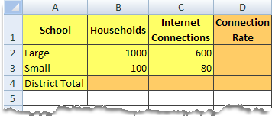
Calculating Averages (Straight or Weighted)
Continuing with our example:
By calculating the Internet connection rate, you can see that 60% of the households served by the large school are connected to the Internet, while 80% of the homes served by the small school are connected. So, now, what is the average rate of Internet connection for the whole school district?
To answer this question, we need to understand the concept of weighted averages.
In our example, the Internet connection rate for the entire district cannot simply be determined by averaging the rates for all schools in the district. Because the two schools in the district are of different sizes, an accurate determination of the average requires that the calculation be weighted for the size of each school.
Let’s use Excel to illustrate how a weighted average should be calculated.
Insert a new worksheet in your Digital Divide Excel file.
Enter the data as shown to the right.
In Cells D2 and D3, enter formulas to calculate the Internet connection rate for the large school and small school respectively.

Slide 8
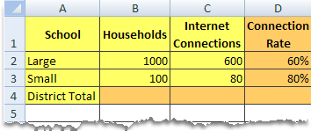
Weighted Averages (continued)
In Cells B4 and C4, enter formulas to calculate the total number of households and Internet connections for the entire district.
In Cell D4, we need to enter a formula to calculate the Internet connection rate for the entire district. Since this must be a weighted average, the rate for the entire district will be calculated using the total number of Internet connections for the district (Cell C4) and the total households (Cell B4) for the district, as shown below.
District connection rate = Internet connections in district ÷ Households in district

Slide 9
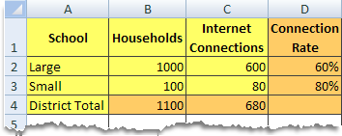
Weighted Averages (continued)
In Cells D4, enter a formula to calculate the Internet connection rate for the entire district as described below.
Formula to calculate the Internet connection rate for the entire district:
District connection rate = Internet connections in district ÷ Households in district
Notice (as shown below) that an incorrect rate will be obtained if the district connection rate is calculated by averaging the connection rates of the two schools.
Calculation of District Internet Connection Rate
Correct calculation (using weighted averages) | Incorrect calculation (averaging rates)
District Connection Rate = 680 ÷ 1100 = 62% | District Connection Rate = (60% + 80%) ÷ 2 = 70%

Slide 10
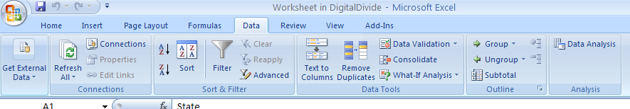
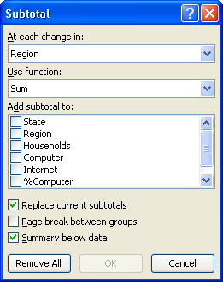
Inserting Subtotals
In Excel, there are many useful tools for summarizing and analyzing data. In this exercise, we will use the Subtotal tool to summarize the digital divide dataset.
To access the Subtotal tool, click the Data tab on the Excel ribbon, and click on Subtotal.
This opens the Subtotal Dialog Box as shown to the right.

Slide 11
Inserting Subtotals (continued)
The Subtotals Dialog Box asks you to select three key pieces of information:
“At each change in”: (in the dropdown list of column headings-or data fields)
  As you may recall from Slide 6, the data set must be sorted by whatever field you choose here prior to inserting subtotals.
“Use function”: (in the dropdown list of ways to summarize the data)
“Add subtotals to”: (series of check boxes for all of the fields in the data set)
We want to group the data by region and add the values in the Household, Computer and Internet columns for each region.
Choose Region from the first dropdown list. (Note that the data must be sorted by Region prior to inserting subtotals. This signals Excel to insert a row whenever the data in that column change from one value to another. Hence the need to sort by this column prior to inserting subtotals.)
Choose function Sum (because we want to add up the values for each region).
Click the checkboxes for Households, Computer, and Internet.
Click OK

Slide 12
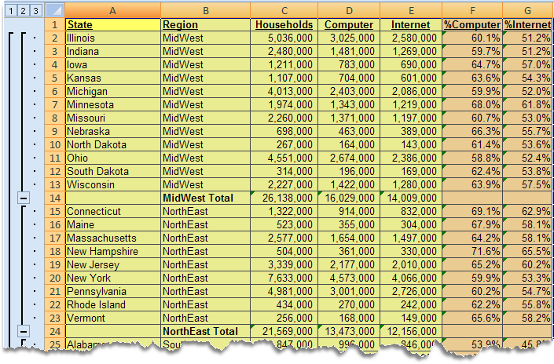
Results of Subtotals
Notice that the Subtotal tool changed your spreadsheet in two important ways:
Subtotal rows were inserted for each region (Column B).
Outline buttons and bars were added to the left of the row numbers. Clicking the various outline buttons will show and hide specific rows of the spreadsheet:
  Click to show only the row containing the Grand Total.
  Click to show only the rows containing the Subtotals..
  Click to show all rows.
Click the outline button to show only the rows with subtotals.

Slide 13
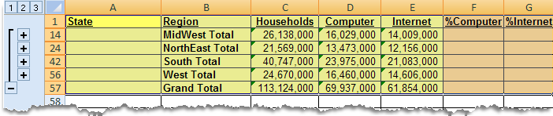
Results of Subtotals (Using Outline Buttons)
As shown below, your Excel sheet will now display only the rows containing the subtotals and the grand total. The remaining rows are hidden, and can be displayed by using the outline buttons as described in Slide 12.
In Cell F14, enter a formula to calculate the percentage of households with a computer.
In Cell G14, enter a formula to calculate the percentage of households connected to the Internet.
Copy the formulas in Cells F14:G14, and paste them into the remaining subtotal rows. (Note that using the fill handle here will copy the formulas into all contiguous cells, even those that are currently hidden).

Slide 14
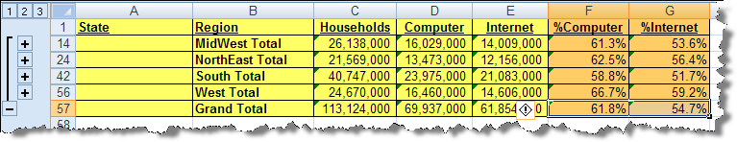
Subtotals completed
Now you have calculated the weighted percentages of households with a computer and with Internet connection for each region in the data set. As you can see from the results, availability of computers and Internet connection rates vary throughout various regions in the United States.
Important Note:
When the Subtotal tool is used to calculate an average, it calculates a straight average. If you used the subtotal tool to calculate the average number of households with a computer and with Internet connection for each region, these quantities would have been calculated as straight averages of the percentage of households with a computer and with Internet connection within each region, yielding incorrect results.
This underscores the need to understand how technological tools perform calculations. Otherwise, erroneous results can occur.

Slide 15
End of Module Assignment
Open the Excel file below (click on the icon in Normal Mode). This file lists various countries on the continents of North and South America along with the population and number of Internet users in each country. Use this file to complete the following tasks:
  In Cells E2:E32, enter a formula to calculate the percentage of the population that are Internet users.
  Use the Subtotals tool in Excel to determine the total population of each continent, and the total number of Internet users on each continent.
  Use the outline button to display only the rows with subtotals.
  In Column E of the subtotaled rows, enter a formula to compute the Internet usage rate for each continent.
Is there a Digital Divide between the continents of North America and South America?
Print a copy of the results of your subtotals.
Remove the subtotals from the Excel sheet (Data tab, Subtotals button, click remove all).
Use the subtotals tool in Excel to calculate the average rate of Internet Usage on each continent. (At each change in continent, use function average, click the Rate checkbox). Use the outline button to display only the subtotaled rows. Print a copy of the results.
Compare the Internet usage calculations that you printed in steps 3 and 5. Explain why the results are different.
Write a paragraph that describes why it is necessary to understand how technological tools perform calculations before interpreting results.

Slide 16
End Notes
“Normal View,” “Slide Sorter View” and “Slide Show” refer to the icons on the Power Point at the lower left corner of the Normal and Slide Sorter Views. The icons do not display in the Slide Show. If you are viewing the module in Slide Show view, click on the icon for the Normal View in order to retrieve the data set. Return to Slide 4.

Slide 17
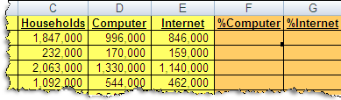
Entering and Copying Formulas
When entering formulas in Excel, you first enter an equal sign (=) to indicate that the cell will contain a formula rather than data or text. After you enter the equal sign, you can enter the formula either by using the keyboard, or by using the mouse to click on the cells you want to include in your formula as you are entering it.
Enter a formula to calculate the percentage of households with a computer in cell F2 (=
The formula in Cell F2 can be copied to Cells F3 through F52 using the Fill Handle. Notice the small black box at the bottom right corner of the active cell (E2).
Hover your mouse over the small black box in lower right hand corner of Cell F2. You will notice that the pointer for the mouse changes from its usual appearance to a small black plus sign.
When the black plus sign appears, click the mouse, and drag down to Cell F52. The formula will be copied as you drag the mouse down the column.
Click here to return to module.

Slide 18
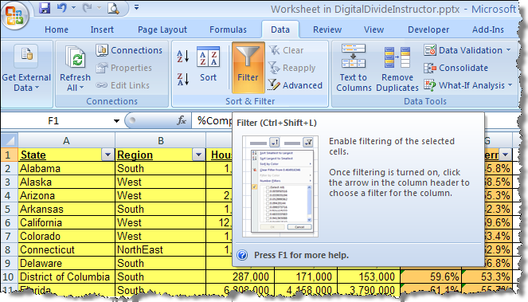
Using Filters
When examining a table of data in Excel, it is useful to be able to quickly look at various columns, and determine specific information, such as minimum, maximum, or data items meeting specific criteria. The filter tool in Excel nicely serves this purpose.
To use the filter tool, click on the Data tab of the Excel Ribbon, then the Filter button.
This turns on the Auto filters in each column of your data.
The Drop down arrow added to each column allows you to select any data item in that column, and show only rows with that value.
Click here to return to module.

Slide 19
General Information
Aside from standardizing and creating a more professional look, neutral color patterns have been chosen to improve the digital contrast and allow for better visual perception. Text box colors are less bright than previous module schemes, yet still contrast with the slide background, and are color-coded based on content.
Blue boxes: General information such as overviews, module introductions, instructions, and assignments.
Green boxes: Active commands such as questions, problems, tasks, and assignments.
Red boxes: Important information such as hints, tips, and interjections.

