Slide 1
Determining How to Calculate
River Discharge
SSAC2007.GB1205.NAB1.1
HOW MUCH WATER IS FLOWING IN THE RIVER?
Quantifying discharge gives us an understanding of the hydrologic characteristics and the fluctuations in the amount of flowing water in river or stream (lotic) environments. Can you think of natural and human-derived factors that would lead to changes in river and stream discharge?
Core Quantitative Skills
Area of trapezoid
Supporting Quantitative Skills
Number operations: Products and sums
Reading graphs
Prepared for SSAC by
Nicholas A. Baer, Colby-Sawyer College, New London, NH
© The Washington Center for Improving the Quality of Undergraduate Education. All rights reserved. 2007

Slide 2
Overview of Module
Discharge (Q, the volume of water flowing per unit time past a specific point) in a river or a stream (lotic environment) is used by scientists to understand the physical forces and potential impacts on the chemical, physical and biological aspects of the aquatic environment. For instance, engineers must know the hydrologic variability of a river before designing and constructing a bridge. Also, discharge can be used to determine the rate of contaminant flows, and impacts of an accidental spill into a river. Additionally, ecologists utilize discharge information to understand the ability of the lotic system to process nutrients moving through the aquatic environment.
This module will illustrate how to determine discharge, and have you use relevant field data to calculate stream discharge in two examples.
Slides 3-6 Introduction to concepts and data.
Slides 7-8 Example spreadsheets and measurement tools.
Slides 9-10 Statement of problem, data collection, manipulation, and calculation.
Slides 11-12 Examining rating curves.
Slides 13-14 End-Module Exercise and Pre-Post Test.
Slides 15-17 Appendix.

Slide 3
Problem
You will spend the first part of this exercise learning about river discharge, how it is measured and used in assessing lotic systems. The module then focuses on expanding your understanding of discharge as you use Excel spreadsheets to calculate discharge using an existing data set. Lastly you will determine the discharge of a river from field data. You will compile data from a river cross-section and carry out the calculations using Excel.
Calculate the discharge (Q) of the Ashuelot River using the data set provided. Then expand your understanding by using Excel to compile the physical measurements and water velocities from the Blackwater River in order to determine its discharge. What additional information do you need about this river to help resource managers or engineers working within or around this river system?

Slide 4
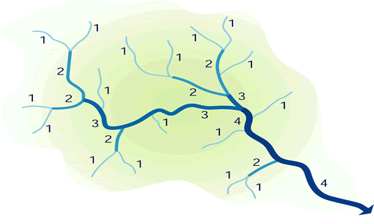
What environmental factors will alter the discharge of a river at any given location?
Understanding Discharge
Discharge (Q) of a river continues to increase as you move further down the watershed, due to increases in watershed area and the addition of tributaries contributing to the flow. Selecting the same point along the river to measure discharge over time lets us know the variability of the flow that is moving through the watershed.
Photo courtesy of www.geographyalltheway.com
Base flow of a river is considered the discharge due to ground-water seepage into the river. This low flow level is influenced by season and precipitation.
Horton’s Law of stream ordering classifies increases in stream size by larger numbers. Stream order number increases only when two or more streams of the same size meet. For example, a 2nd-order stream starts where two or more 1st-order streams meet. Discharge measurements will depend on the size of the stream being measured and the size of the watershed contributing to the stream flow.

Slide 5
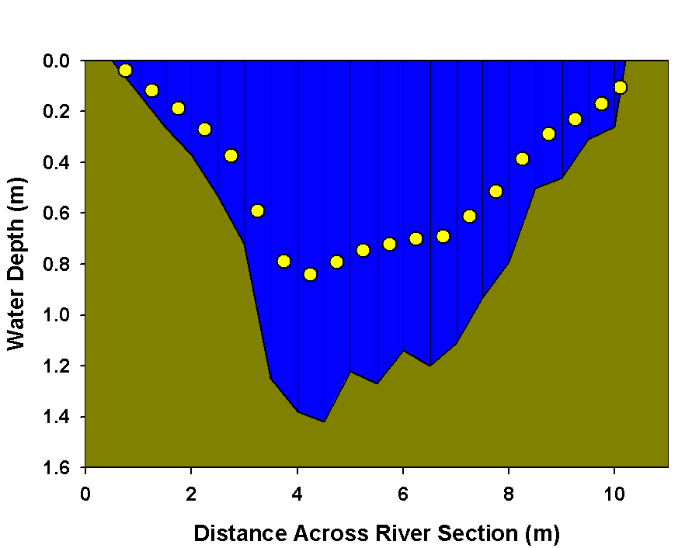
What forces do you think cause the average velocity to occur at 0.6 of the depth?
How to Calculate Discharge
In order to calculate discharge (Q), you need two key pieces of data:
1. The velocity (V) of the water (m/sec) moving by a specific section of the river, and
2. The cross-sectional area (A) (m²) of the river.
Q= V x A
Where:
Q = Discharge
V = Water Velocity
A = Area
Velocity (V) is measured at 0.6 depth (represented by the yellow circles) from the water surface, because the velocity there provides an estimate of the average in the water column.
River Cross-section with Velocity Points
Friction between the water and the river bottom substrate slows the water. Therefore the fastest-moving water is at the surface and the slowest-moving water is along the river bottom. This is one reason why many organisms have adapted to live at the river bottom (benthic region) as the force of the water is reduced there.
Water velocity measured at 0.6 depth.

Slide 6
What one geometric shape can be used to determine the area for each of these segments of the cross-section ?
How to Calculate Discharge
The cross-sectional area (A) is determined by measuring the area of smaller geometric shapes across the river section. Since the velocities are also measured within each of these smaller sub-sections, greater accuracy of the river discharge can be accomplished.
River Cross-section with Velocity Points
♦
♦
♦
♦
So: What is this 4-sided figure with only 2 parallel sides? Do you remember the equation for its area?
Once you have calculated discharge (Q) for one segment, then you sum all the segments together to get total discharge.
Q_{total} = Q₁ + Q₂ + Q₃ + …. + Q_{n}

Slide 7
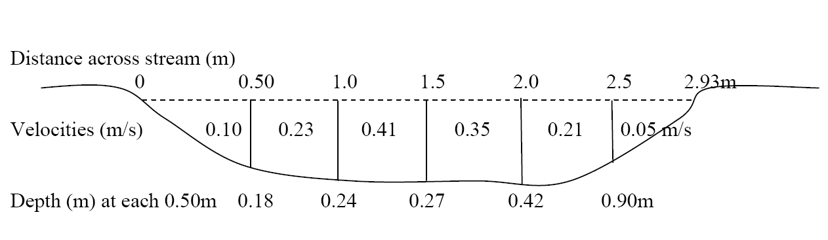
What is the equation for the area of a trapezoid?
Sample River Cross-Section and Spreadsheet
Example Field Data
After measuring the distance across the river channel, one measures the water depths at equally spaced intervals. The depths and distances are then used to calculate the area within each cross-section segment.
Click for more information about a trapezoid.
= cell with a number in it
= cell with a formula in it

Slide 8
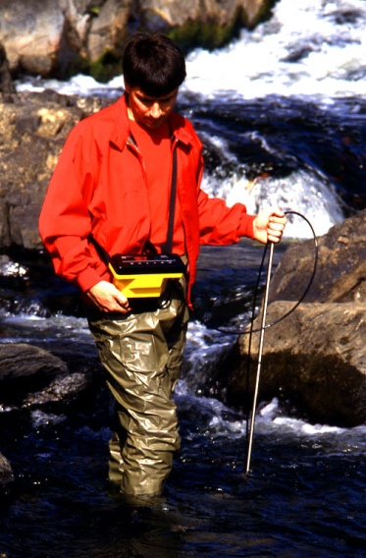
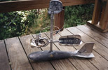
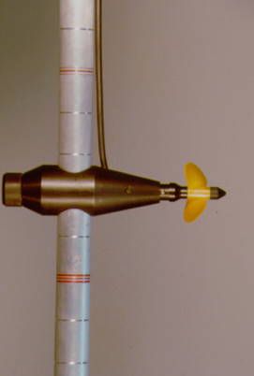
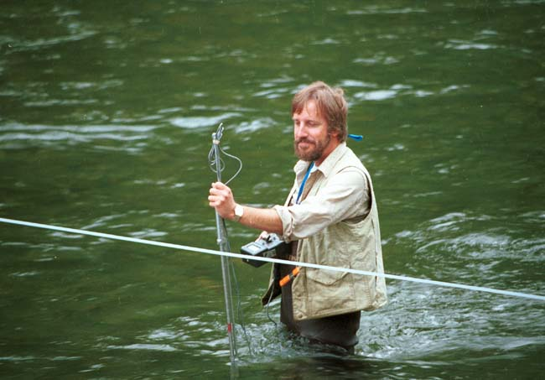
How do we go about measuring water velocity in the stream or river?
There are various tools that can be used to measure the water velocity, ranging from the simple – floating oranges – to sophisticated acoustic Doppler technology. All methods are intended to determine how fast the water is moving per second. This measure of water velocity is then used along with the cross-sectional data to calculate the volume of water moving per unit of time (the discharge, Q).
Methods used to measure water velocity include:
● Timing a floating object
● Propeller rotation speed
● Electromagnetic
● Acoustic Doppler
Photo courtesy of www.usgs.gov
Photo courtesy of www.marsh-mcbirney.com
Photos courtesy of www.swoffer.com

Slide 9
What types of human- derived influences can alter the discharge?
Setting up Your Spreadsheet
Using the template, calculate the area and discharge for each segment of the river cross-section, and determine the total discharge (Q) of the river.
Depths 1 and 2 represent the vertical depths on the sides of the trapezoid (as in Slide 6).
Click on the Excel icon to download a datasheet template to get started.

Slide 10
Now that you have been introduced to calculating discharge, use the diagram below to create a spreadsheet and calculate the discharge for the Blackwater River. You will have to estimate the water depths and segment widths based on the diagram.
Calculate Discharge Using Field Data
0.0
0.01
0.03
0.11
0.0
0.31
0.23
0.47
0.62
0.44
0.39
0.38
0.79
NOTE: Velocity is noted within each segment section and are measured in meters per second (m/s).
Click on the Excel icon to download a datasheet template to get started.

Slide 11
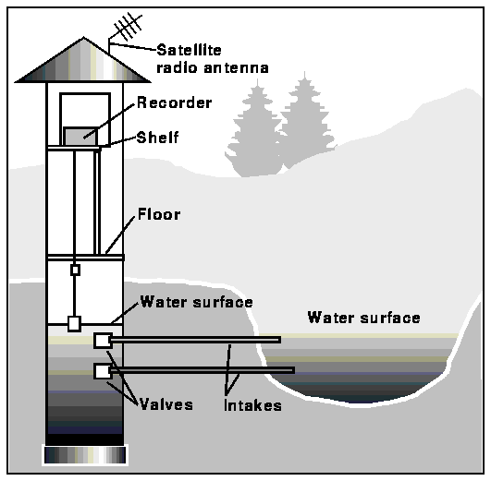
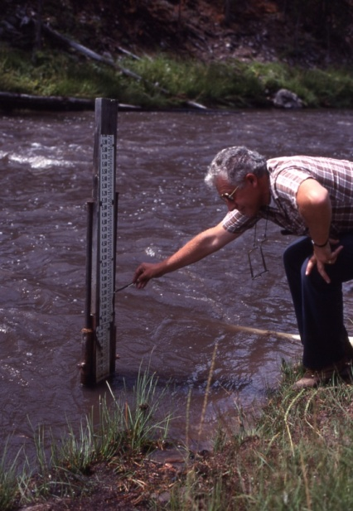
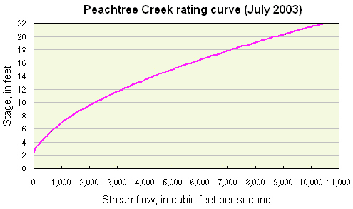
Based on the graph above, what is the discharge if the stream stage measures 12 feet in height?
Using Discharge Measures to Develop a Rating Curve
A rating curve is determined by taking discharge measures at different flow rates, during the slow drier periods (base flow) and during the seasonal floods. In this way we are able to develop a relationship between stream stage (height of water on the vertical axis) and discharge (on the horizontal axis). It allows us to evaluate changes in discharge for a flowing water by simply measuring the height of the water.
See this USGS link for more information:
http://md.water.usgs.gov/publications/presentations/md-de-dc_rt98/sld017.htm
Photo courtesy of www.usgs.gov
Photo courtesy of www.nps.gov
Gaging stations can measure the stream stage which can then be used to determine the relative discharge using the rating curve for that stream.
graph courtesy of www.usgs.gov

Slide 12
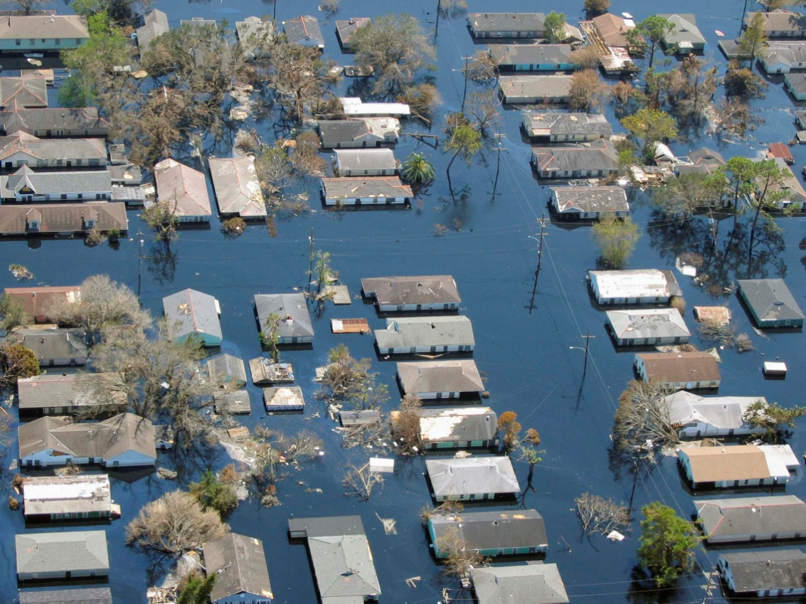
Assessing Changes in Discharge Measures
Collecting discharge measures over a long period of time allows engineers, resource managers, and scientists to identify when changes in flow rates occur and the potential causes.
Potential environmental influences on discharge include:
Drought
Storm Events
Climate Change
Seasonality
Potential human influences on discharge include:
Land Use Changes
(agriculture, development)
River alterations
(dams, dikes, diversions)
Photo courtesy of www.noaa.gov

Slide 13
End of Module Assignment
Turn in the following assignments:
A. Your spreadsheet showing your calculated discharge from the field diagram exercise.
B. Your responses to the questions for evaluating the graph.
2. The Merrimack River has a base flow of 731 ft³/sec. You just returned from taking measurements of the area and mean velocity for the river. The area is 166.2 ft² and the mean velocity is 3.52 ft/sec. What is the current discharge (Q)?
3. Based on your calculated discharge in question #2, predict what the time of year and the climate are when this discharge was measured.
4. Identify three environmental or human factors that would affect a river or stream discharge.

Slide 14
Trapezoid
A trapezoid is a four-sided object with only one set of parallel sides.
B
A
E
C
D
Area_{Trapezoid} = ((B + D)/2)* E
Return to Module

Slide 15
Slide 9 Spreadsheet Template
To access the live spreadsheet, end the slide show so that you can double click on the template to activate the spreadsheet. You can either work directly in PowerPoint or copy the table into a blank Excel worksheet. Be sure to save your work.
Return to Module
15
Notes:
15

Slide 16
Slide 10 Spreadsheet Template
Use the spreadsheet template below fill in the appropriate values from the cross-sectional diagram in Slide 10. Use this information to calculate the area and discharge for each segment of the river cross-section, and determine the total discharge (Q) of the river.
Return to Module
16
Notes:
16

