Slide 1
Designing Learning Outcomes
for
Teaching the Process of Science
B. R. Bickmore
Brigham Young University

Slide 2
A DIFFICULT Problem
“Scientists make only one universal assumption in their work: Reality is real.”
    Sprackland, R. G. (2005) Teaching About Origins: A Scientist Explains Why Intelligent Design Isn’t Science, Am. School Board J. 192:26-30.

Slide 3
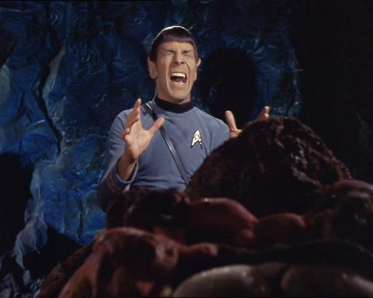

Slide 4
Science Is…
“the art of the soluble.”
    Peter Medawar, Nobel Laureate biologist

Slide 5
Wu Wei
無爲
A principle of action…
  “without doing, causing, or making”
  “without meddlesome, combative, or egotistical effort.”
    Benjamin Hoff, The Tao of Pooh
In harmony with The Way Things Are

Slide 6
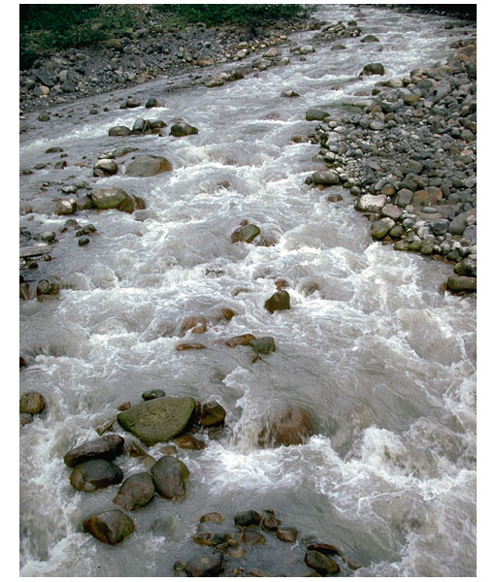

Slide 7
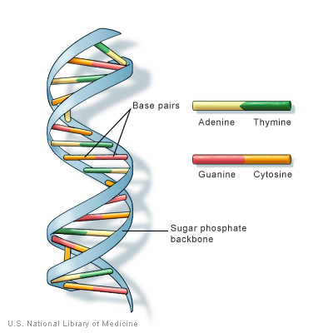
Example: Heredity

Slide 8
Backwards Design
Learning Outcomes
Activities
Assessment
L.D. Fink (2003) Creating Significant Learning Experiences

Slide 9
Designing Learning Outcomes
Continually contemplate and recast the nature of the problem
  in the context of specific sets of students
  in the context of specific strategies to address it
Find the weak spots where action breeds spontaneous positive feedback.

Slide 10
A Problem
Naïve Realism Among Students
  Science = Discovery of Facts
    Corollary: Science Course = Memorization of Facts and Dinking Around With Magic Equations
    Corollary: If someone can show any tentativeness or creativity connected with an unpopular theory, we can dismiss it as “junk science”!

Slide 11
A Compounded Problem
Science-Religion Conflict
  If students come in thinking BOTH that science is supposed to be “just the facts” AND anti-religion, they generally won’t even be listening to anything you say.
      Smith (1994) JRST 31:591-597.
      Abd-El-Khalick and Akerson (2004) Sci. Ed. 88:785-810.
      Bickmore et al., (in press), J. Geosci. Ed

Slide 12
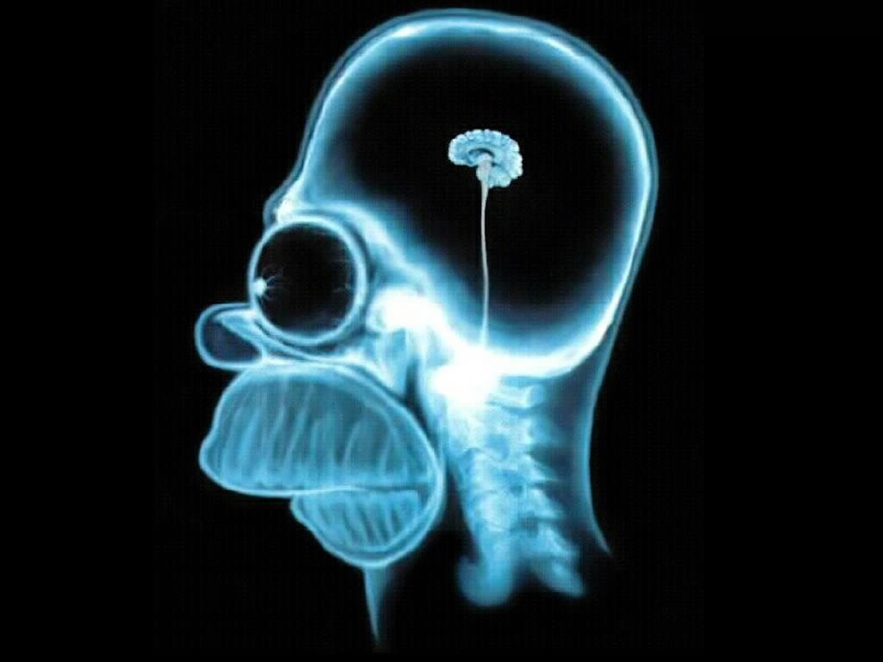
Thinking in Black and White

Slide 13
Course #1
Physical Science 110B
  Earth Science for El. Ed. Majors
  2 credits, includes lab
  about 130 students per semester
  about 98% women
  generally don’t think of themselves as “science people”
  about 98% Latter-day Saint (Mormon)

Slide 14
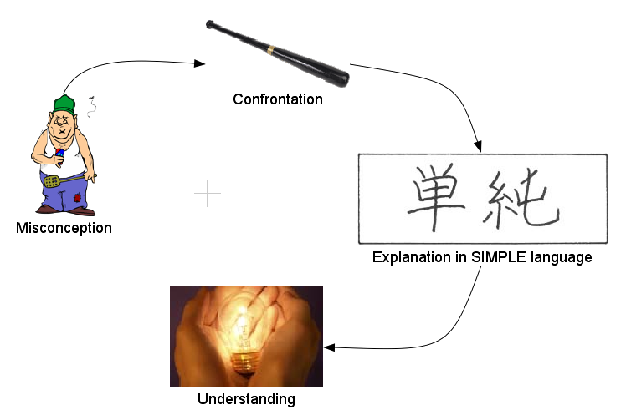
Strategy for Conceptual Change
Experimentation
Experimentation
      see Guzzetti et al. (1997) JRST 34:701-719.

Slide 15
http://serc.carleton.edu/teacherprep/resources/activities/storytelling.html

Slide 16
“Science as Storytelling”
“Science is the modern art of creating stories that explain observations of the natural world, and that could be useful for predicting, and possibly even controlling, nature.”
  “storytelling” = our bat

Slide 17
“Science as Storytelling”
The “Rules” of scientific storytelling.
  Reproducibility of observations
  Predictive power
  Prospects for improvement
  Naturalism
  Uniformitarianism
  Simplicity
  Harmony

Slide 18
“Science as Storytelling”
Why Naturalism?
  Supernatural explanations are less likely to generate precise, new predictions.
  Hard to place limits on which supernatural explanations are acceptable
  Do we really want science balkanized into Christian, Hindu, Buddhist, Muslim factions?
  Even if the assumption of Naturalism is only mostly true, it can still be useful (simplifying assumptions).

Slide 19
“Science as Storytelling”
Science and Religion
  IF
    scientific explanations cannot appeal to supernatural causes
  BUT
    religious explanations can,
  THEN
    we might as well accept the fact that they might conflict once in a while

Slide 20
“Science as Storytelling”
Throughout the semester, I will stop after explaining a concept and ask, “Which parts of what I just said are observations, and which parts are stories?”

Slide 21
Student Response
“The explanation of ‘Science as Storytelling’ has helped me see that theories don’t have to be and aren’t necessarily considered to be absolute total truths. It just means scientists have observed things in our world and are trying to explain it considering the ‘rules’ of science. I’m more willing now to think about theories instead of just immediately rejecting them. I don’t feel so threatened by theories now because they don’t have to be absolute truth.”

Slide 22
Student Response
“Mostly, I just feel more forgiving towards scientists. If I can think of their stories as the best explanations so far instead of them trying to shove it down my throat as the absolute truth, I can be more accepting and feel less threatened.”

Slide 23
Student Response
“In my opinion, the world is fine with science and theology as separate fields, as long as we have both. Wherever they overlap is good too, and where they go against each other it gives us the opportunity to have an opinion about [it] and figure out why. Things don’t work out entirely harmoniously. ‘There will always be vexation and strife,’ to quote Jane Austen. When two ideas conflict there is a place for all mindsets to put their theories forward. As we see science as a story, it makes it easier to accept or at least be tolerant of others’ ideas.”

Slide 24
Prying the Cracks
Made possible an ongoing, radical course redesign.
  Theme: “Earth Stories”
  “Cast of Characters”
  Making up scientific stories

Slide 25
Course #2
Geol. 445: Geochemistry
  6-12 advanced undergraduates and graduates
  took freshman chemistry, but forgot most of it
  took Calculus, but forgot most of it

Slide 26
A Problem
Most of these students treat equations like Moses brought them down from Mt. Sinai. They don’t understand where the equations came from, the simplifying assumptions made, etc. This hampers their ability to properly apply these equations in complex geochemical models.

Slide 27
Strategy
Math tutorials
Deriving equations
Picking apart equations
Pointing out fudge factors
STELLA and MINEQL+ modeling

Slide 28
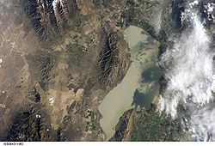
Course #3
Geol. 446 Applied Geochemistry
  team-taught by two geochemists
  We have only run the class once, so far.
  3 students

Slide 29
A Problem
Real scientific problems are usually much more complex than anything they have encountered in school, so even if students have all the tools they need, they can still look like deer in the headlights when they are confronted with a real problem.
  End up spinning their wheels in grad school for years.

Slide 30
Strategy
Pretended to be a geotech firm, and gave “Team Greenhorn” their first assignment.
  Come up with a model of P cycling in Utah Lake to help decide whether to put P-removal facilities on the water treatment plants in the area.
    Did literature search
    Wrote a proposal to UT-DWQ
    Did back-of-the-envelope “sanity check” calculations
    Decided what kind of data they needed to collect to get a better handle on the problem.
    Collected the data (XRD, AA, XRF, IC, selective dissolution)
    Created a STELLA model of P cycling in lake.
    Made water quality predictions based on different input scenarios for the model.
We had NO IDEA what the results would be, but it turned out well.

Slide 31
Discussion?
Where are the weak points at which we can profitably attack inadequate conceptions of the process of science for different categories of students?

