Slide 1
POGIL Exercise
Cellular Respiration

Slide 2
Add slides to this power point to review the structure and major function of the mitochondria.

Slide 3
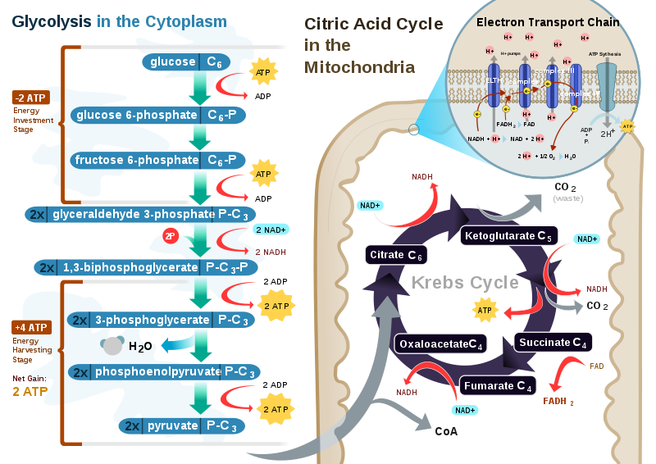
http://search.creativecommons.org/

Slide 4
POGIL Activity for Cellular
Respiration
Use the previous slide or another
model of Cellular Respiration
with the critical thinking
questions and Application
questions on the next two slides.
I usually provide slides depicting the
activities mentioned in the application
questions.

Slide 5
Model 13 Cellular Respiration: Critical Thinking Questions Name _________________
Principals of Biology
1. In what part of the cell does glycolysis take place?
2. List the reactants and products of glycolysis.
3. Describe the event that occurs when pyruvate enters the mitochondria?
4. In what major area of the mitochondria does the Krebs Cycle take place?
5. List the reactants and products of the Krebs Cycle.
6. Identify the major structure or area where the Electron Transport System
take place?
7. What particle is transferred to the Electron Transport System from the
Krebs Cycle?
8. What reactant molecule is essential for electron transport to occur?
9. What molecule is the final electron acceptor of the ETS?
10. Describe two main functions of the ETS.

Slide 6
Model 13 Application Problems:
1. If a person moved from San Diego, CA to Estes Park, CO (elevation 7500 ft.),
what would be the effect on cellular respiration for this person?
2. In terms of cellular respiration, why is it necessary to incorporate plants into
a terrarium along with fauna (animals)?
3. What effect might smoking cigarettes have on cellular respiration?
4.Describe any disease symptoms that might be related to the interference or
interruption of the processes of cellular respiration.
5. According to your model of cellular respiration, what could be happening
when a runner must revert to walking?

