Slide 1


ENGAGING 2YC STUDENTS IN RESEARCH: PREPARATION FOR TRANSFER AND THE WORKFORCE
Jan Hodder
COSEE-Pacific Partnerships
Oregon Institute of Marine Biology, University of Oregon

Slide 2
WHY GIVE STUDENTS OPPORTUNITIES TO CONDUCT RESEARCH?
There is very little research that focuses exclusively on 2YCs students
Learning science by doing science
Increase skills, confidence and motivation
Increase technical skills
Increase interest in a STEM career
Insight into what graduate school is like

Slide 3
WHAT RESEARCH TELLS US ABOUT DESIGNING UNDERGRADUATE RESEARCH EXPERIENCES
No formulaic combination of activities
Repetition of opportunities to explore research
Start early in the college career (or earlier)
No need for separate programs for underrepresented students
Russell et al. 2007 Benefits of Undergraduate Research Experience Science
15,000 students who had a research experience in STEM or Social Science

Slide 4
THE 2YC STUDENT RESEARCH CONTINUUM
2YC
2YC/4YC
4YC
Lots of Places
Research in class w/in the curriculum
Special research class
Research with 2YC faulty outside of class
2YC/4YC collaboration w/in the curriculum
2YC/4YC collaboration outside the curriculum
2YC students go to a 4YC something
2YC students go somewhere else
Internships
Service learning

Slide 5
THE 2YC STUDENT RESEARCH CONTINUUM
2YC
2YC/4YC
4YC
Lots of Places
Research in class w/in the curriculum
Special research class
Research with 2YC faulty outside of class
2YC/4YC collaboration w/in the curriculum
2YC/4YC collaboration outside the curriculum
2YC students go to a 4YC something
2YC students go somewhere else
COSEE Pacific Partnership’s PRIME program
2YC/4YC collaboration – Allison Beauregard
Research in the classroom – Bob Blodgett

Slide 6


The PRIME Program
Promoting Research Investigations in the Marine Environment
A Summer Internship Program for Community College StudentsBased at Four West Coast Marine Laboratories
PRIME is designed to give community college students the opportunity to develop research through hands-on experience working with marine scientists.
2008 – 2012 = 43 students with 32 scientist mentors
Notes:
Community colleges have become an important pathway for students intending to complete a baccalaureate degree. Students at these institutions have few opportunities to engage in science research experiences and even fewer opportunities in ocean and estuarine sciences. To address this need, the National Science Foundation funded Center for Ocean Science Education Excellence – Pacific Partnerships (COSEE-Pacific Partnerships) developed a community college internship program. Through partnerships with ocean and estuarine scientists, informal marine science educators, and community colleges, the Promoting Research Investigation in the Marine Environment (PRIME) program provides eight-week long summer internships for community college students. Interns develop research, communication, and outreach skills through hands-on experiences working with scientists and informal educators. The overarching goals of PRIME are to build partnerships between community colleges, marine science laboratories, and informal science education institutions; to develop a partnership/program model that may be implemented at other marine science laboratories; and to increase science and ocean literacy among community college students. Through participation in PRIME, interns increase their understanding of the process of science and how research is conducted and applied, increase their understanding of marine science content, gain professional skills in communicating science effectively, and increase their awareness of the availability of ocean careers while learning skills to help them pursue these careers. An overview of the scientist-educator partnerships model developed through PRIME will be presented and specific internship examples will be used to highlight the program, the roles of the partners and participants, and program products and successes.

Slide 7
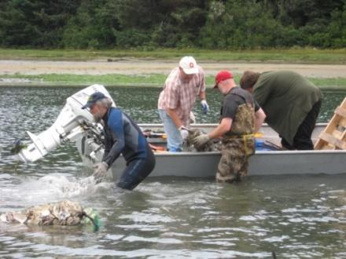
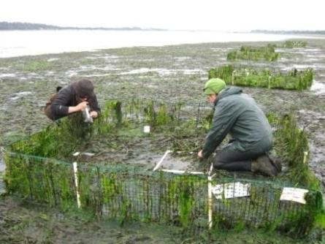
HOW PRIME WORKS- BEFORE THE INTERNSHIP
Recruitment of scientists and discussion of project
Advertisement of PRIME opportunity to 2YC faculty
Student applications
Selection by COSEE staff and scientists
Notes:
Research topics prechosen - eight weeks is not long enough for them to develop a proposal and conduct their research - Why
Expectation of mentors
(this is essential, word of mouth is important. These are not students who search for research opportunities like REUs do). - Statement of interest, letter of recommendation from faculty at cc, transcriptsAt SPMC much greater demand than capacity to host. 18 applicants, at least 12 strong candidates, 2 positions filled

Slide 8
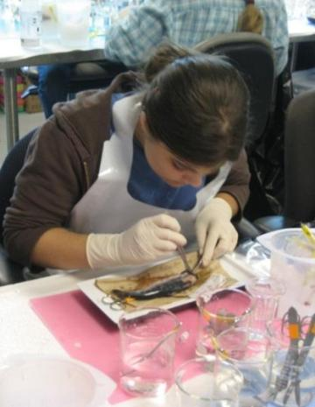
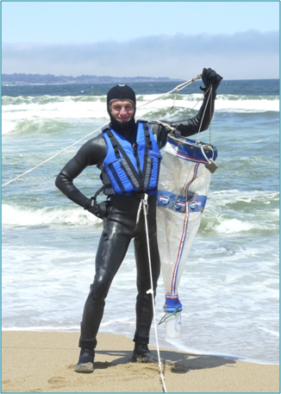
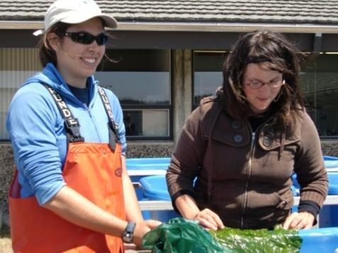
HOW PRIME WORKS – THE INTERNSHIP
Eight to ten weeks
Stipend
Housing at marine lab
Participation in marine lab activities
PRIME program activities
Notes:
To address this need, we developed the eight-week Promoting Research Investigations in the Marine Environment (PRIME) program with four students from community colleges in Oregon during summer 2008.
The overarching goals of PRIME are to build partnerships between community colleges, marine science laboratories, and informal science education institutions; to develop a partnership/program model that may be implemented at other marine science laboratories; and to increase science and ocean literacy among community college students.
In the fall, COSEE-PP works with scientist and educators at our partner organizations to identify mentors and internship projects for the following summer. We then utilize the connections we’ve made with community college instructors through our other to recruit students for the program.
The first year we had interns at OIMB, the Hatfield Marine Science Center (HMSC), the South Slough National Estuarine Research Reserve, and the Oregon Coast Aquarium. The participants lived at the two marine stations during the 8 week internship and spent 35-40 hours per week conducting lab, field, and/or site work; working on weekly journal assignments; attending seminars; and participating in other marine lab and PRIME program activities. These activities were developed to expose participants to the broad spectrum of research and educational activities that take place at marine the laboratories and informal science education institutions.
Based on the success of the 2008 student program, we expanded the PRIME 2009 summer program to include two internships at the Shannon Point Marine Center in Anacortes, Washington in addition to the four opportunities at OIMB, HMSC, South Slough, and the Oregon Coast Aquarium.
All interns are required to give a final presentation on their work however the format of the presentation varies between sites.

Slide 9
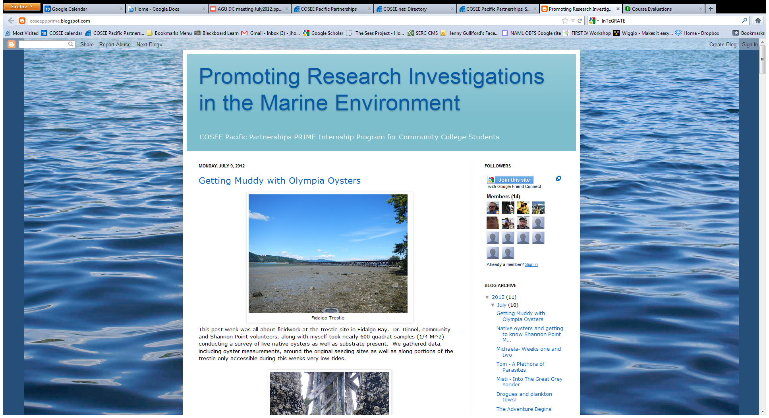
Activities that link the PRIME students
coseeppprime.blogspot.com/

Slide 10
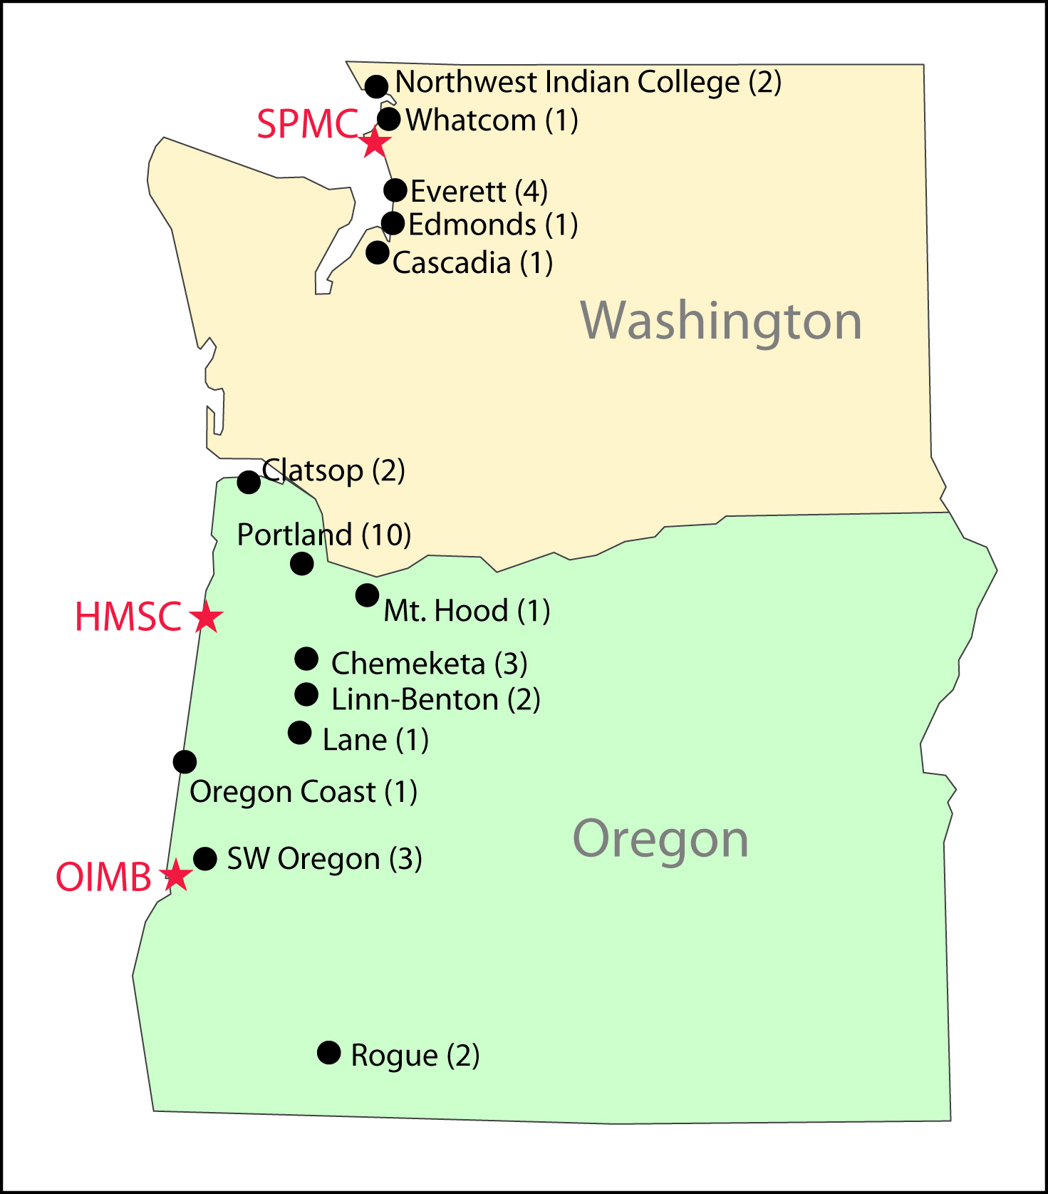
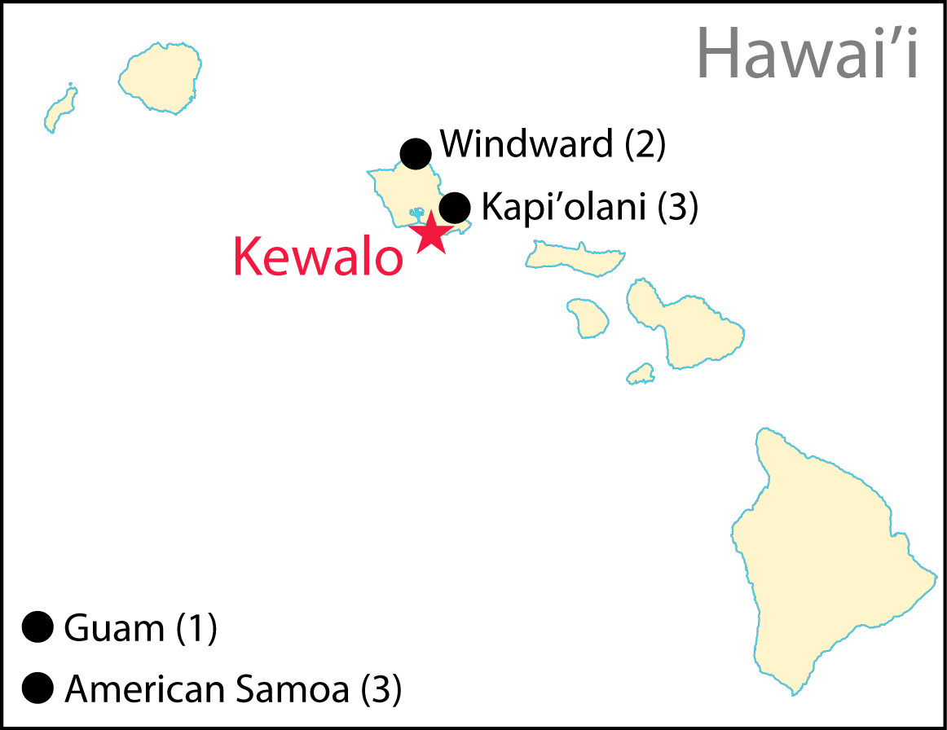
COSEE PRIME: Participants (2008 – 2012)
18 community colleges
43 participants
23% from underrepresented groups
  Pacific Islander (7)
  Native American (2)
  African American (1)
Notes:
- Minority representation is strong, even when Hawaii is excluded (~10%).
- The community colleges represented by PRIME interns are generally within close proximity (~1-2hr) of the marine lab, building on the partnership between marine labs and regional community colleges.

Slide 11
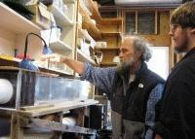
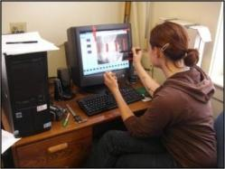
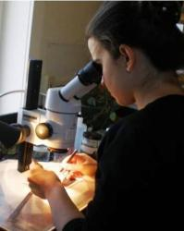
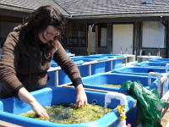
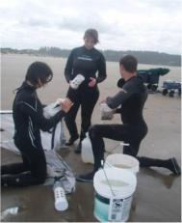
Examples of PRIME Research Projects
Hatfield Marine Science Center
The Interactions Between Macroalgae and Eelgrass In Oregon’s Estuaries
The Role of Sandy Beach Surf-zones as a Habitat for Juvenile Chinook Salmon
Oregon Institute of Marine Biology
Surfzone Hydrodynamics and the Delivery of Larvae
Wound Healing in Larval Invertebrates
Kewalo Marine Laboratory snd Hawaii Institue Of Marine Biology
Microhabitats of Coral-reef Holes: The Biogeochemistry Analysis
Effects of Ocean Acidification on Biofilm Bacterial Populations
Shannon Point Marine Center
Effect of Climate Change and Ocean Acidification on Plankton Communities
The Significance of Pea Crab Larvae in Summer Plankton Assemblages
Notes:
- Projects are aligned with the expertise and ongoing research of each investigator/mentor. The mentor’s research provides the general umbrella or framework for the internship project, which then provides boundaries for a project that the student works to develop with their own objectives, hypotheses and experimental design. This can involve a good deal of handholding, but is a valuable part of including them in the process of science.

Slide 12
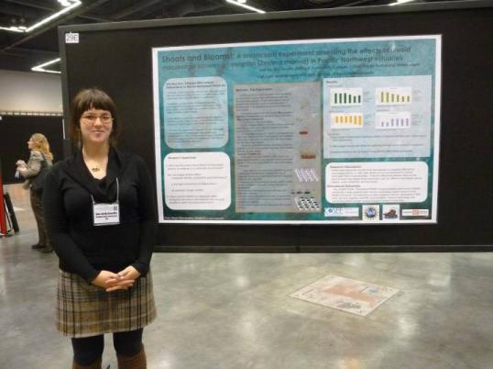
Outcomes: Pathways to Higher Education and Research
Presentations at scientific meetings (10 so far)
Co-authors on publications resulting from their work (2 so far)
Transfer to four year colleges (>50%)
Participation in additional mentored funded research experiences (5 so far)
Beginning graduate programs (3 so far)
Notes:
Over half of the students involved in PRIME have transferred to four year colleges, with two of them moving on to graduate programs this fall.

Slide 13
Lessons Learned: Essential Elements of Success
Establish a strong connection with 2YC faculty for recruiting students
Personal referrals from people whom the students trust are important
Prepare mentors and provide guidance
Emphasize experiencing the “process of science”, not just a tech position
Maintain a structured program within the internship experience
Establish a strong sense of cohort identity
Engage the interns in the process of science

Slide 14
Lessons Learned: Essential Elements of Success
Encourage participation of “non-traditional” students
Create overlap with other mentored research programs
A critical mass of students having a shared experience
Support and follow-up after completion of the internship
Invest in a program coordinator for a successfully run program
Time and effort required is substantial and extends well beyond the internship period

Slide 15
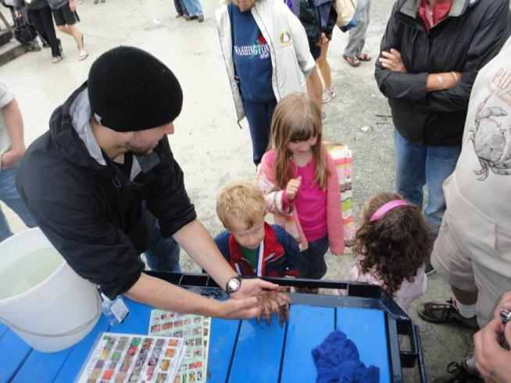
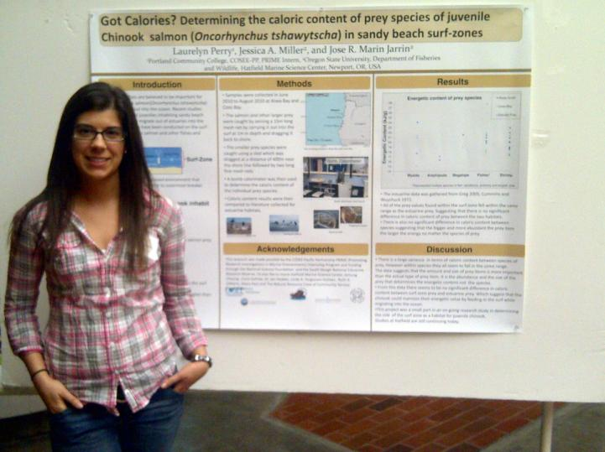
“The opportunities for community college students to work at a lab conducting research are few and far between and I feel honored to have been chosen… Going forward I feel better prepared to tackle any challenge which may present itself during my academic or professional career …”. Ben Holzman, PRIME 2011, Cascadia Community College
"[PRIME] helped me narrow down what field of study I wanted to major in... I am ready to start making changes in my life to ensure that I graduate soon and start working towards grad school. .....I have a passion about school that I lost because of the same routine after three years of being in school. I am ready to start this fall term with a new strive and determination.”
Laurelyn Perry, PRIME 2010 Portland Community College

Slide 16
DISCUSSION GROUPS
What are best practices for the various types of undergraduate research?
2YC
2YC/4YC
4YC
Lots of Places
Research in class w/in the curriculum
Special research class
Research with 2YC faulty outside of class
2YC/4YC collaboration w/in the curriculum
2YC/4YC collaboration outside the curriculum
2YC students go to a 4YC something
2YC students go somewhere else
Pick one (or more)
Designate a recorder/reporter

