Slide 1
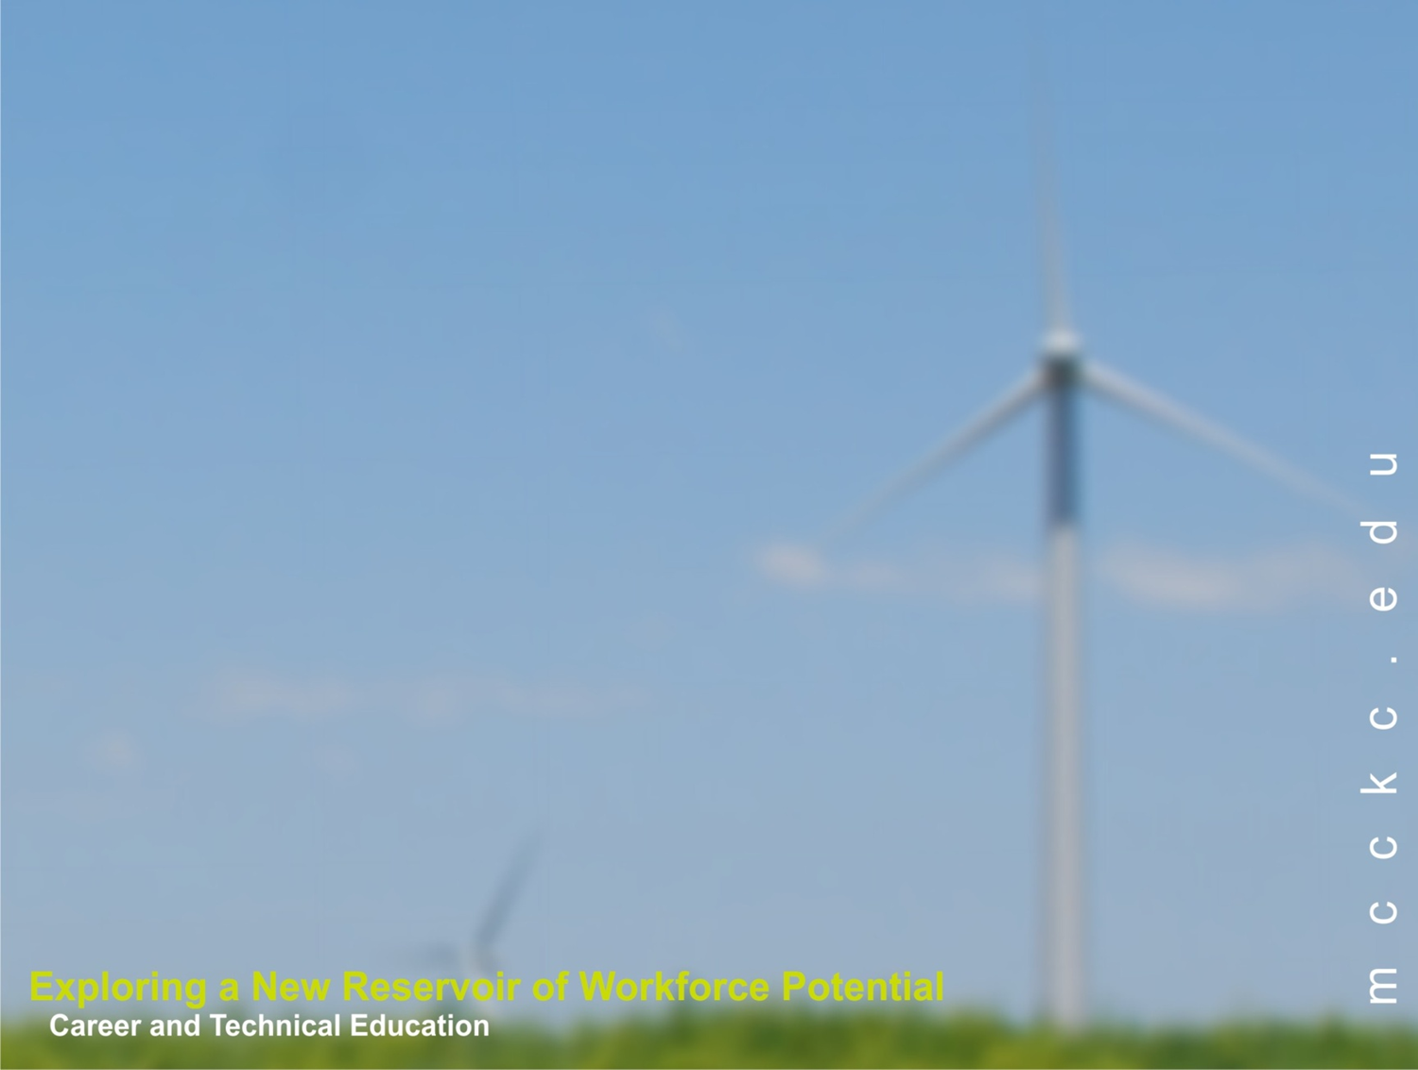
Geoscience and Career and Technical Education at the Two-Year College
Ben Wolfe
ben.wolfe@mcckc.edu
Metropolitan Community College – Kansas City

Slide 2
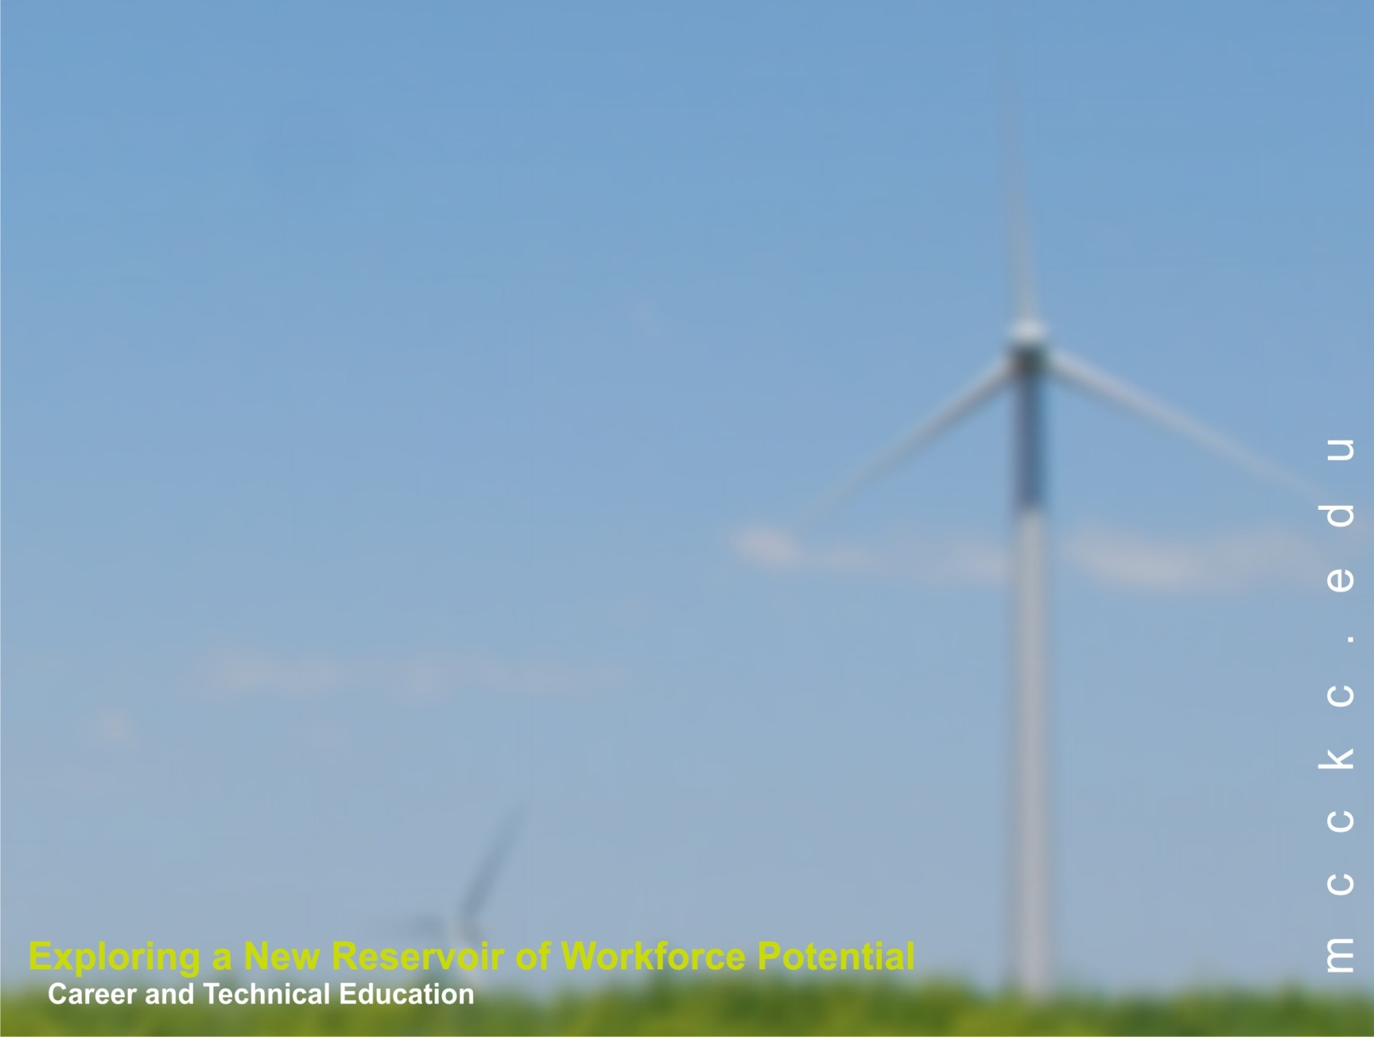
What Is a Green Collar Worker?
  Carpenters
  Roofers
  Electricians
  Plumbers
  HVAC technicians
  Renewable energy installers
  Renewable energy salesforce
  Utility line-workers
  Maintenance
  Operating engineers
  Welders
  Oil/Gas drilling workers
  Auto mechanics
  Manufacturing/Assembly workers
  Environmental technicians
  Hazardous materials removal workers
  Tech support
  Engineers
  Programmers
  Accountants
  Code inspectors
  Drafters
  Energy auditors
  Building managers
  And more…
Notes:
Notice the importance of traditional jobs (both blue and white collar). The green collar jobs are often minor variations of old jobs, hence our focus on building from traditional trades.

Slide 3
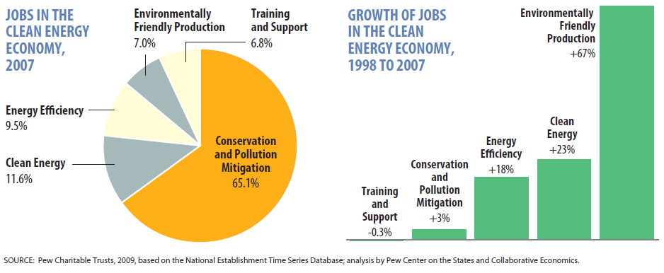
Notes:
Think about who does “pollution mitigation”. And on the right notice the connection to manufacturing.

Slide 4
What Role Can Community Colleges Play?
Starting point for many students, and in particular for the economically disadvantaged
Many green jobs require more than a diploma but less than a four-year degree
Major feeder to 4-year colleges and research universities and also directly to the workforce
Responsive to community and employers – community colleges are required to have external advisory boards for career programs

Slide 5
What Role do Geosciences Programs Play?
Geoscience and earth science curricula already address climate and environmental issues
When offered a choice of lab science, many students prefer environmentally themed courses
Energy industry is evolving – adapting to where the jobs are helps keep courses relevant
Geoscience courses are both a source and a destination for the environmentally conscious
Geosciences link with many career programs

Slide 6
Some Geoscience-Related “Green” Career Programs
Solar technology
Environmental engineering technology
Energy management
Ground-source heat pump installation
Extraction technology

Slide 7
What Role do Geosciences Programs Play?
Although many jobs are CTE-related they need a strong foundation in earth science concepts:
  Earth process and materials
  Fossil fuels
  Atmospheric processes and pollution
  Global climate change
  Energy fundamentals
  Alternative energy sources (e.g. geothermal)

Slide 8
An Example from MCC
  Creation of energy CTE A.A.S. degrees and certificates
    A.A.S. and Certificate option in Photovoltaic Systems
    Certificate in Energy Management, Efficiency, and Conservation

Slide 9
An Example from MCC
Created GEOL 180 Energy and the Environment
  Cornerstone course for all renewable energy programs
  Required for the Electric Utility Line Technician degree
  Required course in energy CTE A.A.S. degrees and certificates
    A.A.S. and Certificate option in Photovoltaic Systems
    Certificate in Energy Management, Efficiency, and Conservation
    HVAC 240 Ground Source heat pumps
  Installed small wind turbine and solar array as demonstration and working model for classes
Key Results:
  Increased enrollment and retention in geosciences courses
  Exposed CTE students in traditional technical programs to potential geoscience technical careers

Slide 10
Talk to your local employers!

