Slide 1
Demonstrating Success
Now that you’ve planned all these innovative projects, how would you recognize success when you saw it?
How would you demonstrate that success to a skeptical outsider?
  Colleagues
  Administrators
  Legislators & Agencies

Slide 2
Outcomes Assessment
Assessment, Evaluation, Accountability
Regardless of purpose, all are driven from evidence-based outcomes
  Measurable or observable
  Need not be quantitative, but must be treated systematically
  Measures should speak to specific goals related to your program innovations

Slide 3
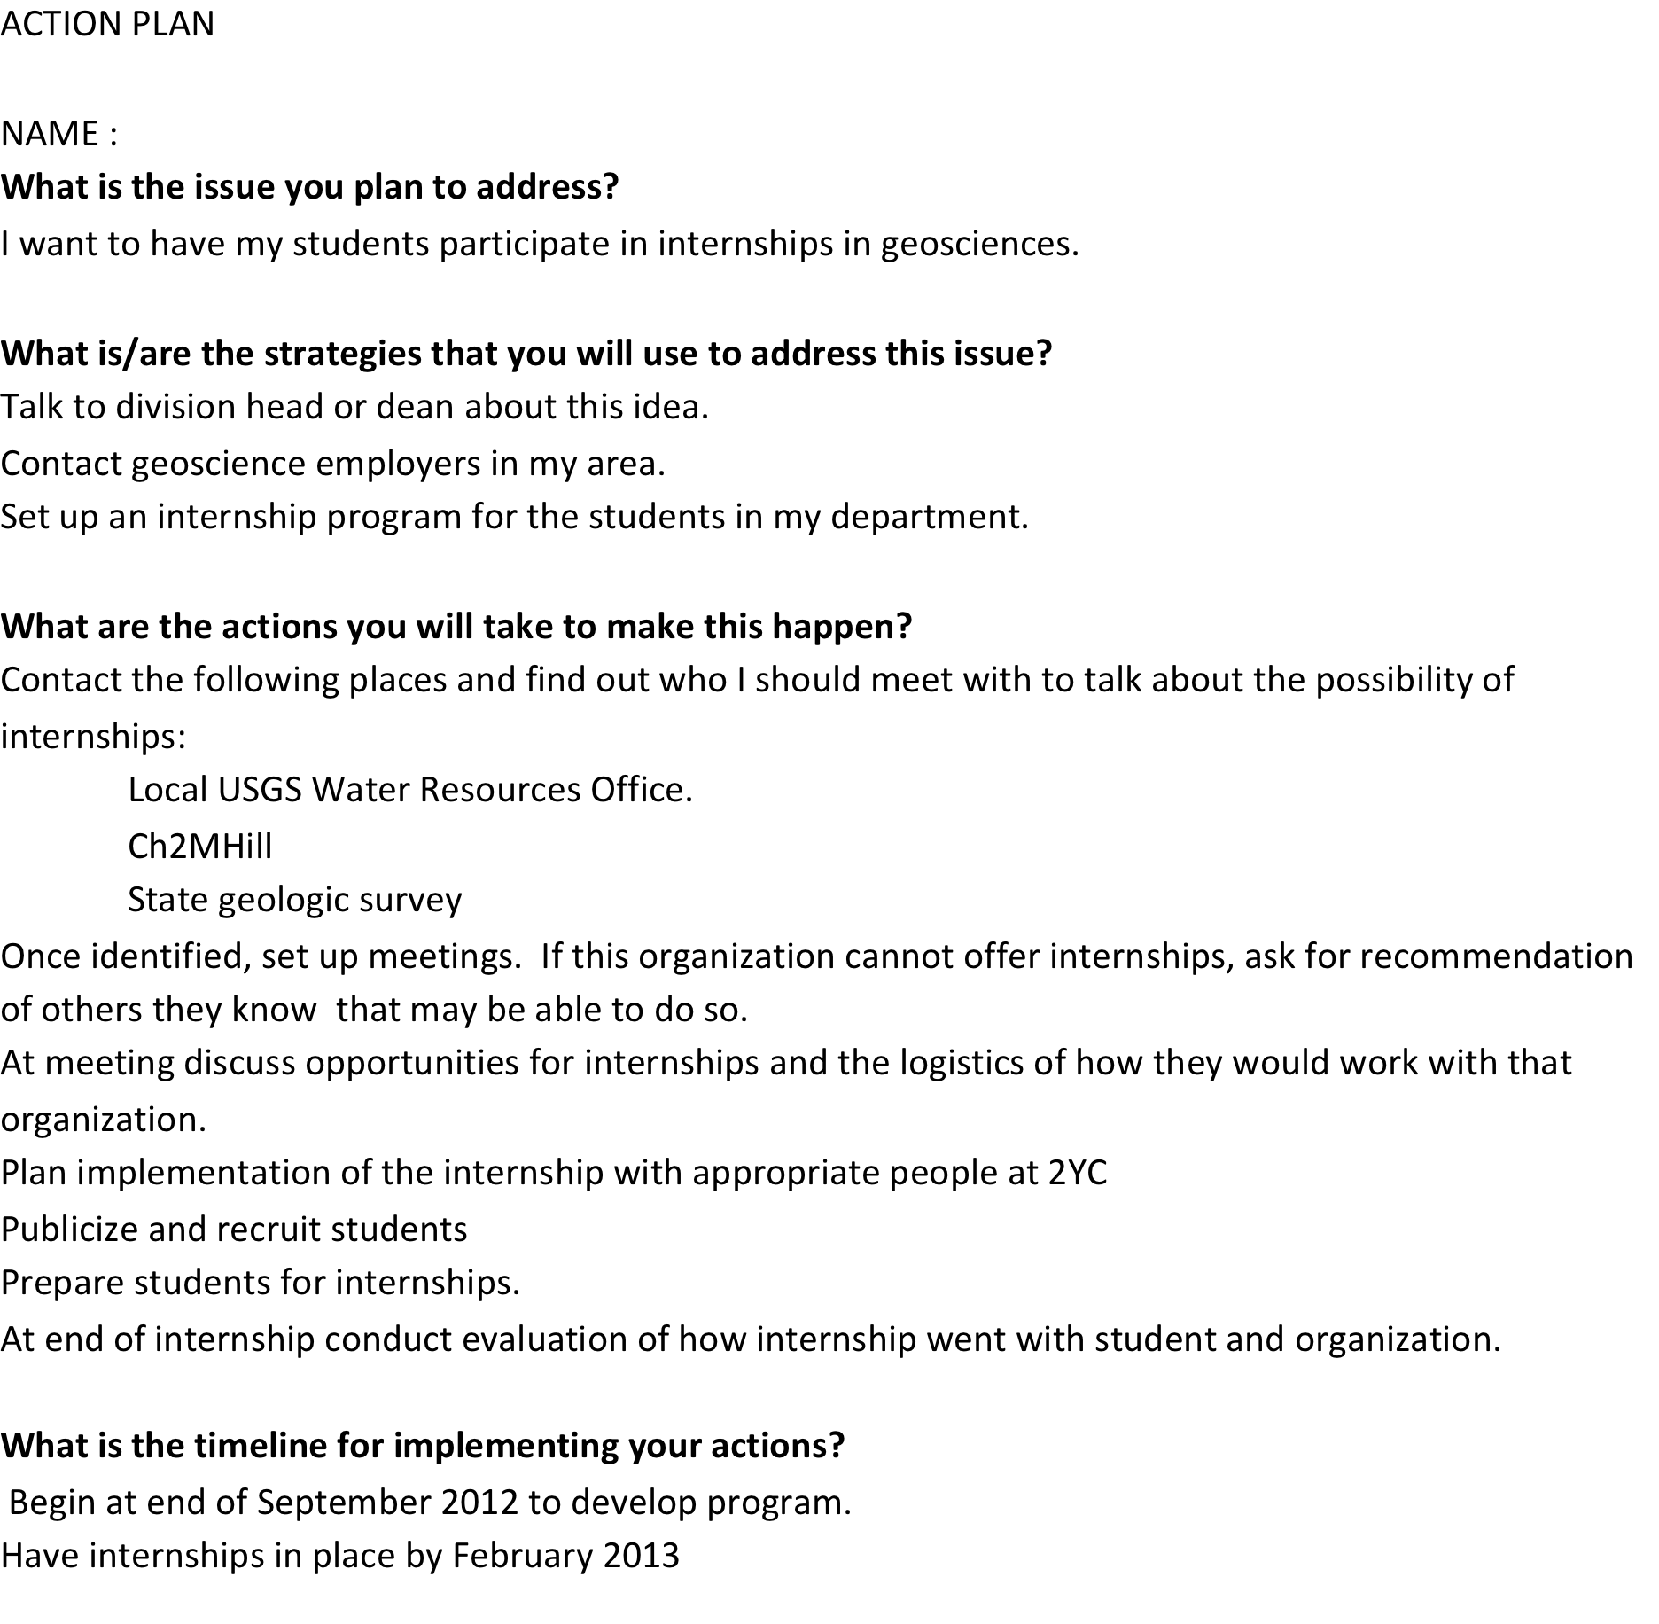
Good for timeline accountability, or evaluation of progress – not assessable outcomes yet
Focus fine-grained observations or measures on outcomes most likely to indicate success of the program as it grows

