Slide 1
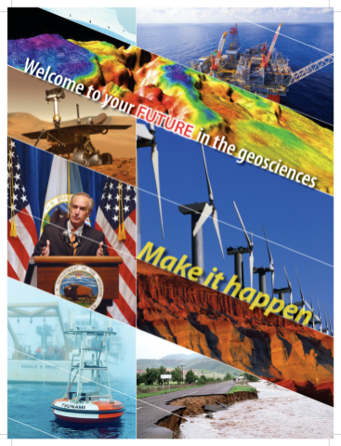
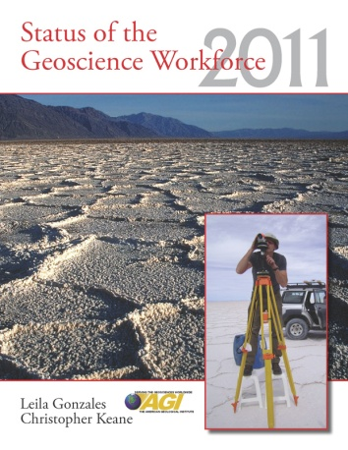
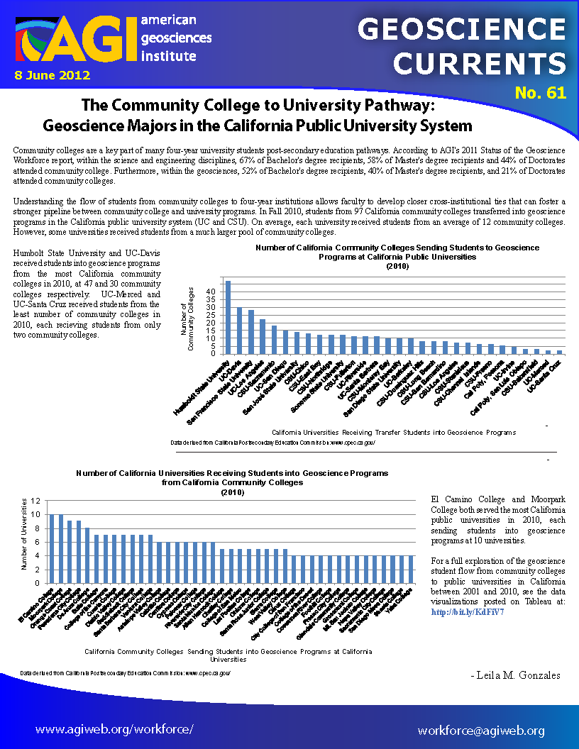

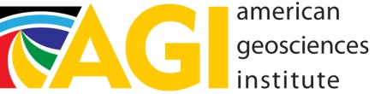
Current Trends in the Geoscience Workforce
Heather Houlton
Christopher Keane
Carolyn Wilson

Slide 2
The American Geosciences Institute
Non-profit federation of 50 geoscientific and professional associations.
  Founded in 1948
  Over 250,000 geoscientists represented.
Main purpose:
  Provide information services.
  Strengthen geoscience education.
  Increase public understanding of the role of the geosciences in society.
Focus areas:
  Education
  Outreach
  Information Services
  Communications
  Workforce
  Government Affairs
  Environmental Affairs

Slide 3
US Geoscience Enrollments
1955
-
2010
40
,
000
35,000
30
,
000
Undergraduate
Students
25,000
20,000
15,000
10,000
Graduate
5
,
000
0
6
8
0
2
4
6
8
0
2
4
6
8
0
2
4
6
8
0
2
4
6
8
0
2
4
6
8
0
5
5
6
6
6
6
6
7
7
7
7
7
8
8
8
8
8
9
9
9
9
9
0
0
0
0
0
1
9
9
9
9
9
9
9
9
9
9
9
9
9
9
9
9
9
9
9
9
9
9
0
0
0
0
0
0
1
1
1
1
1
1
1
1
1
1
1
1
1
1
1
1
1
1
1
1
1
1
2
2
2
2
2
2
Year

Slide 4
Where do Geoscientists
Work?

Slide 5
Where Geoscientists Work
By Degree

Slide 6
2010
Snapshot of Geoscience Degrees
~140 2YC with Geo Programs
28 of these report awarding 83 Associate’s degrees in Geoscience
  20% awarding rate
~700 4YC with Geo Programs
421 of these awarded Bachelor’s degrees
  65% awarding rate

Slide 7
2YCs
Geoscientists who attended
Bachelor’s level:
  52% attended a 2YC at some point
  19% received an Associate’s degree
Master’s level:
  47% attended a 2YC at some point
  9% received an Associate’s degree
Doctorate level:
  17% attended a 2YC at some point
  4% earned an Associate’s degree

Slide 8
How much
can you earn?
Money

Slide 9
Average Annual
by Industry
Salaries

Slide 10

Attrition, Growth and Replacement
in the next 10 years in the U.S.
262,627 geoscience jobs today
Geoscience Grads Continuing on to Geoscience Careers
~130,000 geoscientists expected to retire
Bachelor’s: 30%
Master’s: 43%
Doctorate: 66%
72,000 geoscience job growth by 2021 (BLS)
15,000 total new graduates (MS or PhD)
45,000 total new graduates if hiring BS/BA
OR
Net deficit of over 150,000 geoscientists by 2021

Slide 11
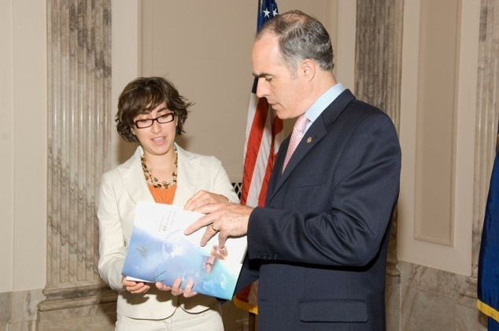
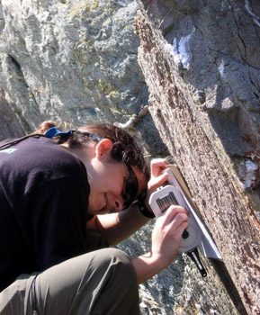
What are geoscience employers seeking?
Strong math and problem solving skills
An Understanding of fundamental concepts
Having Flexibility in working environment
Willingness to travel
To proficiently communicate
  science concepts
Having field experience

Slide 12
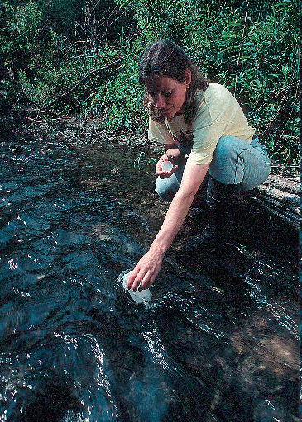

How to help your students get started on their geoscience career?
Share your professional NETWORK!
Encourage them to join professional membership societies
Take students to regional or annual meetings
Check out AGI’s Geoscience Careers Networking Lunches at the annual meetings!
Include students on 2YC email listervs
Continue to develop your own personal network!

Slide 13
Questions?

