Slide 1
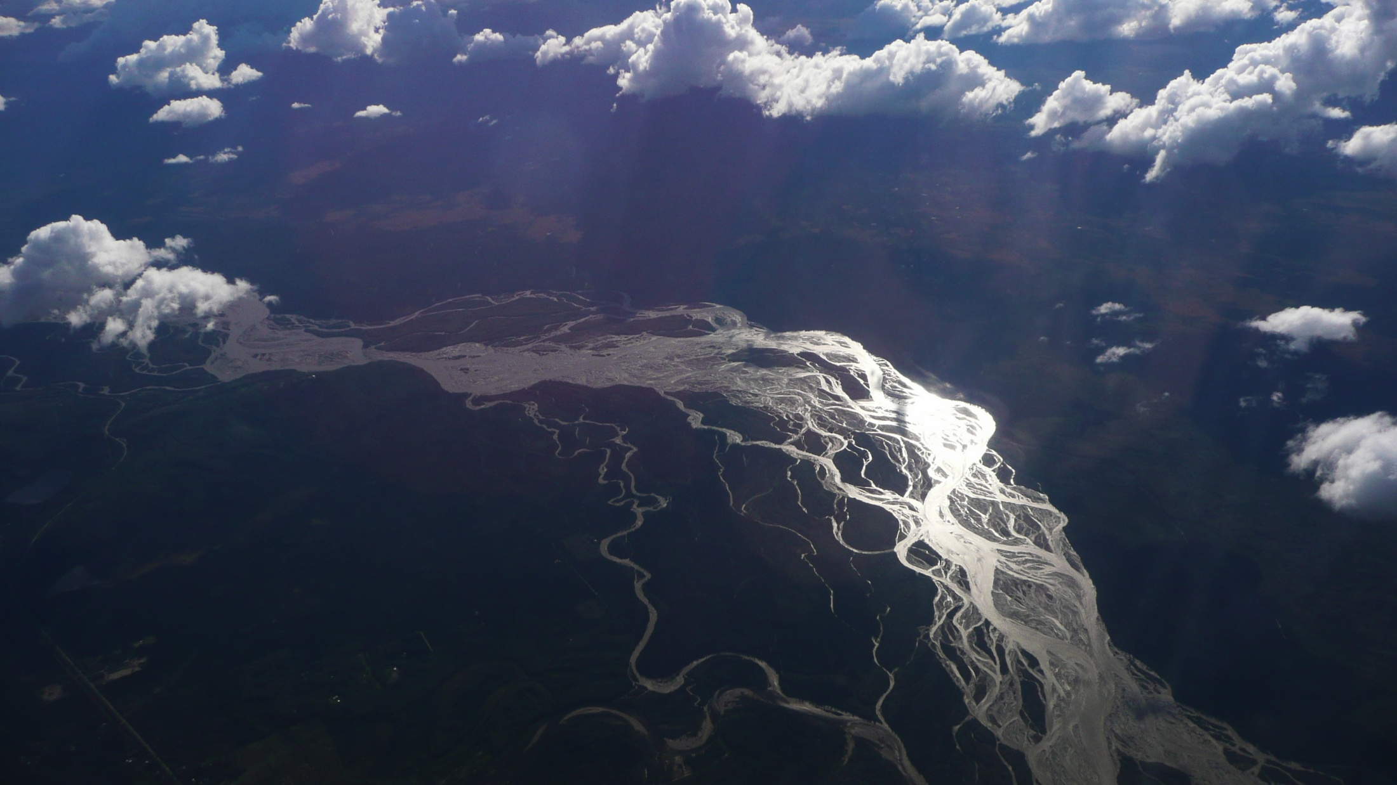
Geotechnical Employment
Kathy Troost
ktroost@uw.edu
kt@troostgeosciences.com

Slide 2
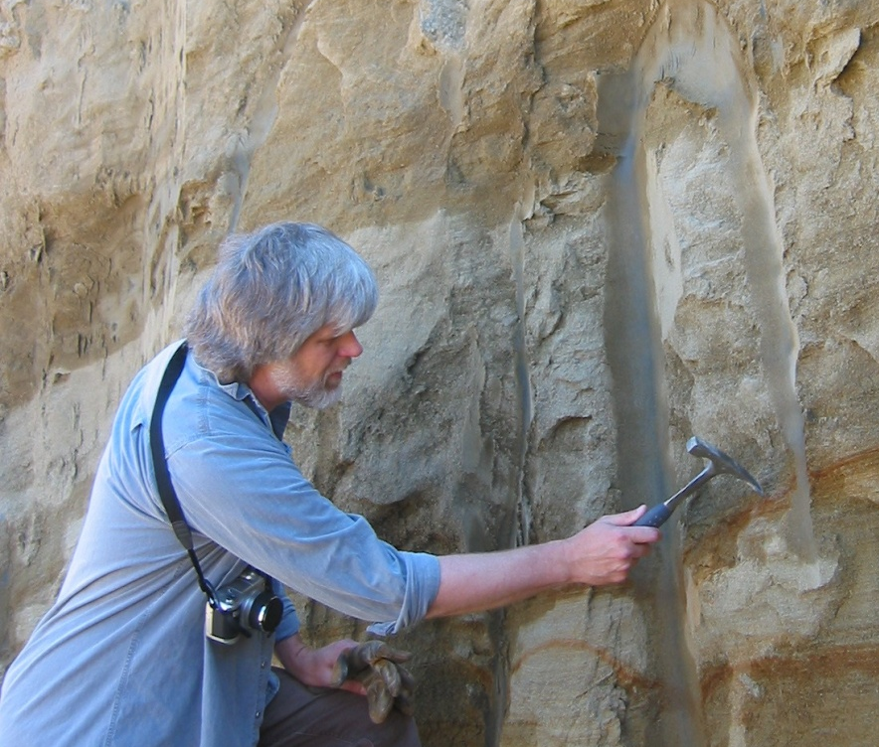
Background
33-year career
Most students end up in Consulting
Most jobs are in Private Sector
Most jobs require MS
Networking is key

Slide 3
Employment Sector for AEG Members
50%
40%
30%
20%
10%
0%

Slide 4
Salary and Degree

Slide 5
Salary and Degree
Mid to Senior Level
Entry Level

Slide 6
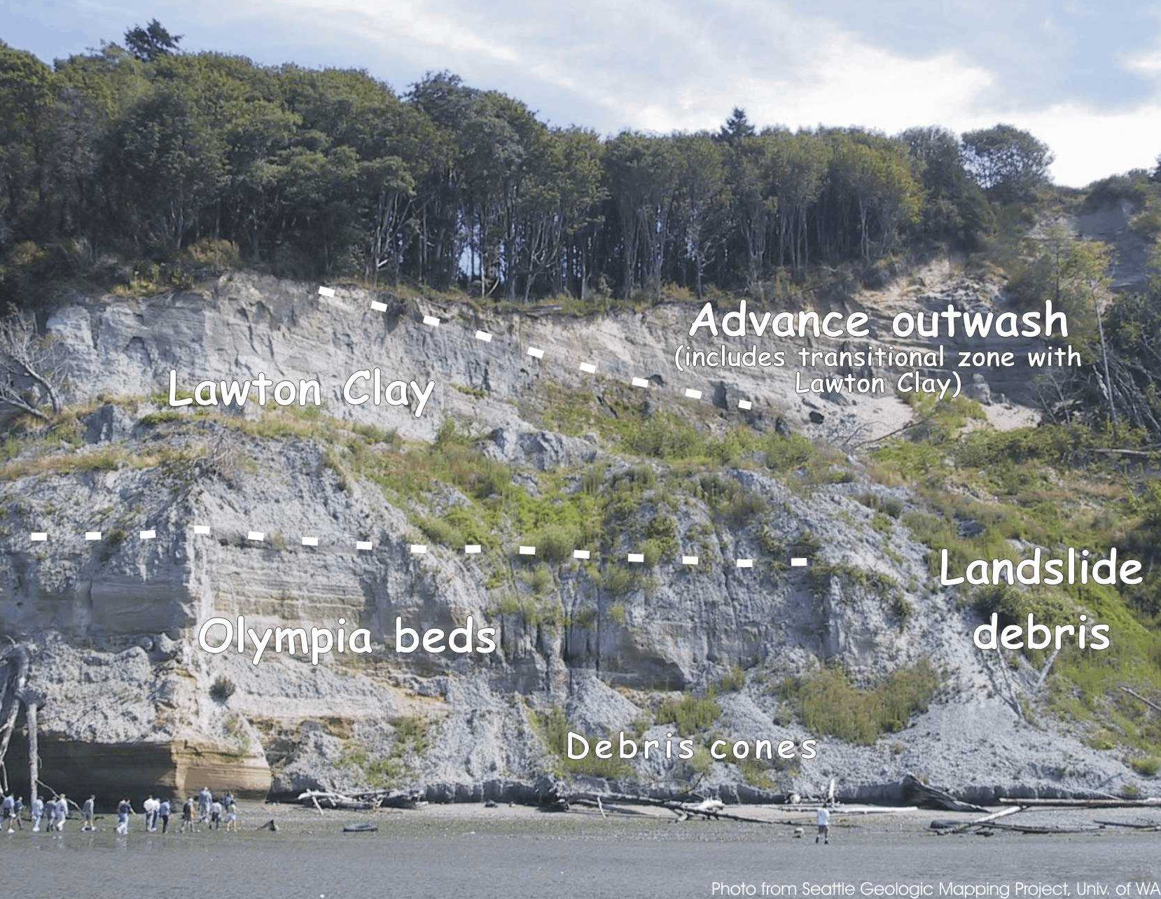
Desirable Employee Qualities
Vary by position
Engaging and energetic
Flexible: tasks, travel, hrs
Independent worker, team player
Responsible
Capable and competent

Slide 7
Desirable Employee Qualities
Vary by position
Engaging and energetic
Flexible: tasks, travel, hrs
Independent worker, team player
Responsible
Capable and competent
1
2
3

Slide 8
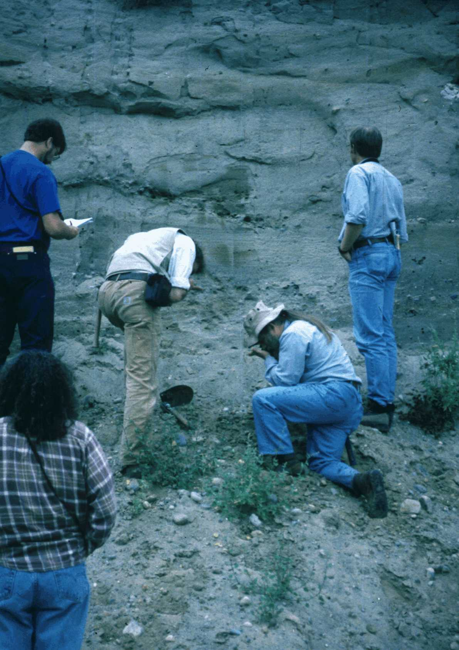
Preferred Skills
Computer savvy
GIS a bonus
Strong math background
Good communication
Field Experience
40-hour OSHA training
Prep for Licensing

Slide 9
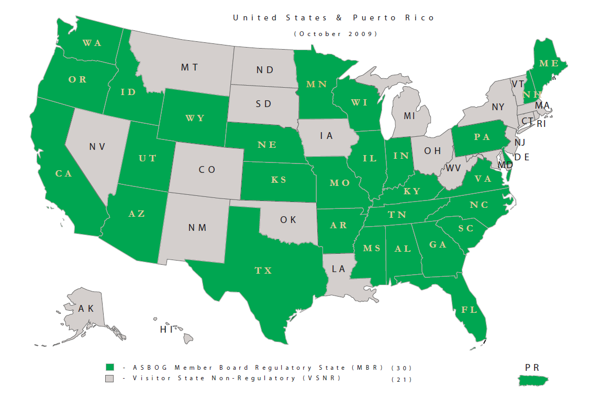
States Requiring Licensure
Notes:
Learn about licensure

Slide 10
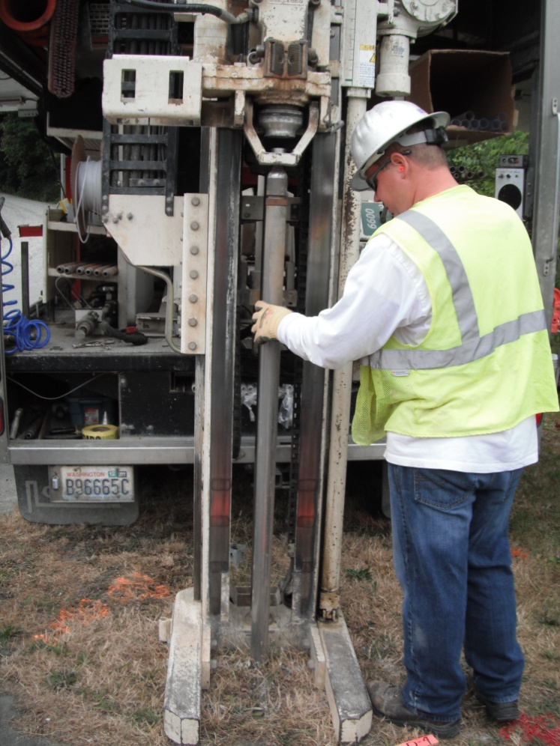
Steps for
Finding a Job
Network, network, network
Join professional societies, volunteer
Identify type of work desired
Market select companies
Find internships
Review websites
Contact technical people

Slide 11
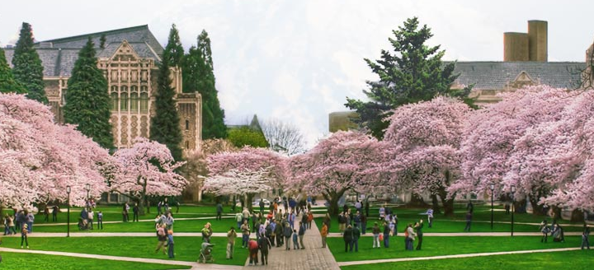
New Professional Masters Program in Applied Geosciences
Transfer Thursday
  Facebook, Twitter, Linked- In, Blogs
  Considering Recruiting Program
University of Washington

Slide 12
Social Media
http://environmentlink.wordpress.com/
http://uwess.wordpress.com/
https://www.facebook.com/pages/University-of-Washington-Earth-and-Space-Sciences
http://twitter.com/uw_ess
http://www.ess.washington.edu/ess/
http://www.ess.washington.edu/ess/education/grad/appliedFAQ.html
http://www.ess.washington.edu/ess/education/grad/appliedms.html

