Slide 1
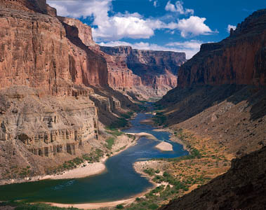
SCAPE
(Sustainable Communities and Place-based Education)
a curriculum that combines classroom learning, online tools, and field research

Slide 2
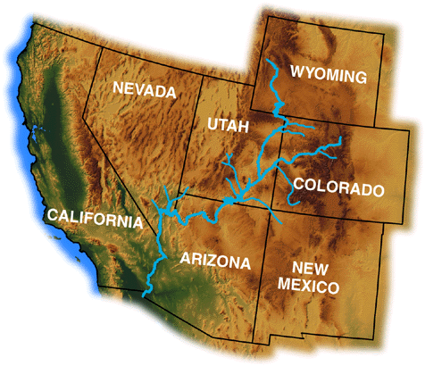
Lead Institute:
Arizona State University
Some of the PIs:
H. Rowe (ECRI, Life Sci. Dept.), D. Collins (School of Art), M. Elsner,
H. Hartnett (Dept. of Chem. & Biochem), and many others...
Partners: Chambers Studios, Vallejo, CA; and The Telluride Institute, Telluride, CO.
We propose to build SCAPE, a pilot high school science education project that combines online learning and field observations linked to “living classrooms” along the Colorado River watershed.

Slide 3
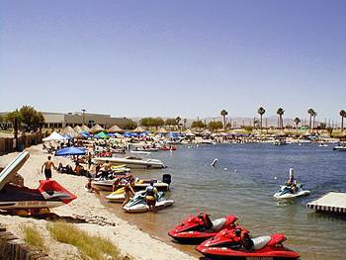
SCAPE: pilot project that provides an authentic science education experience for high school students. Students learn how to be effective stewards of the environment by linking their experience of “place”—i.e., their own personal habits and patterns of living—with the conditions and evidence found at specific geographic locations,, their “living classroom” and to a network of living classrooms along the Colorado River system.

Slide 4
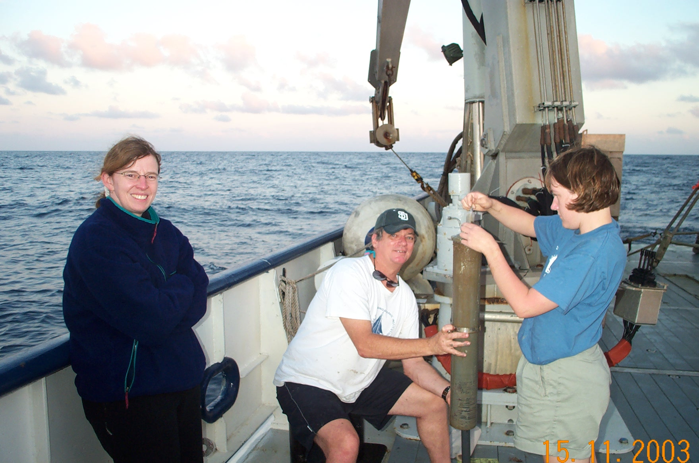
Gulf of Mexico
H. Hartnett
me
undergrad

