Slide 1


RESOURCES FOR
OCEAN CAREER INFORMATION
Developed by Jan Hodder, Oregon Institute of Marine Biology jhodder@uoregon.edu

Slide 2
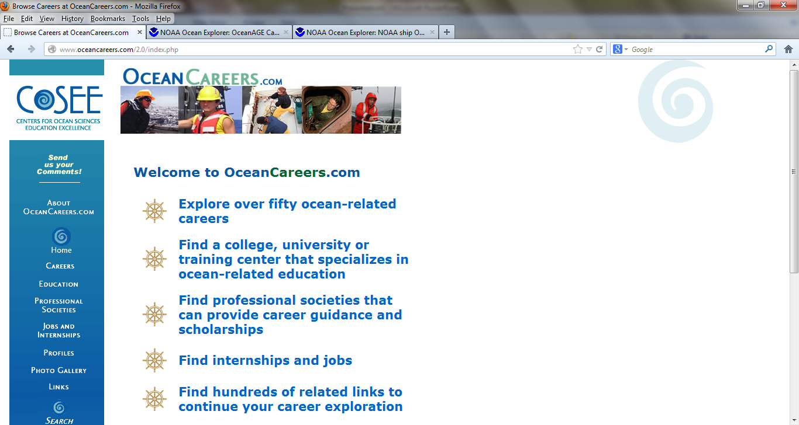

http://www.oceancareers.com/2.0/index.php

Slide 3
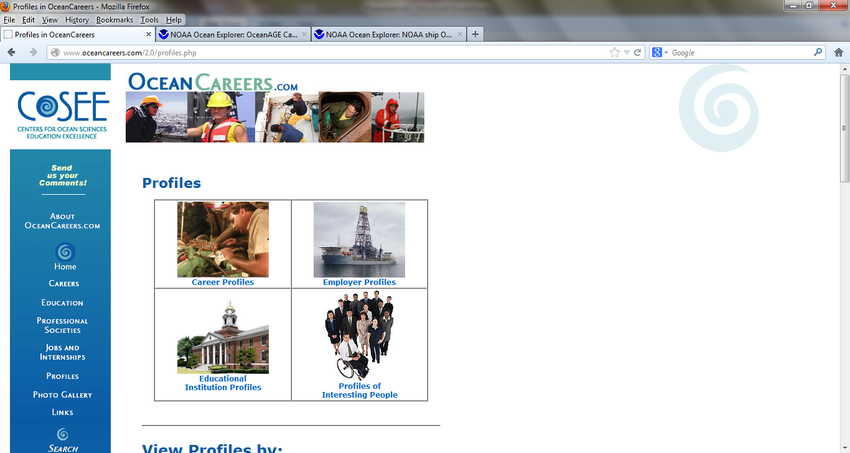

Slide 4
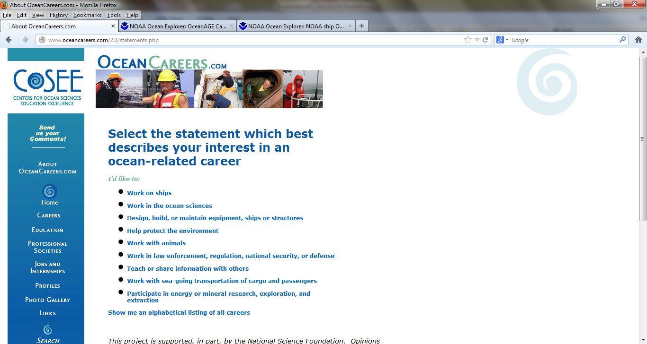

Slide 5
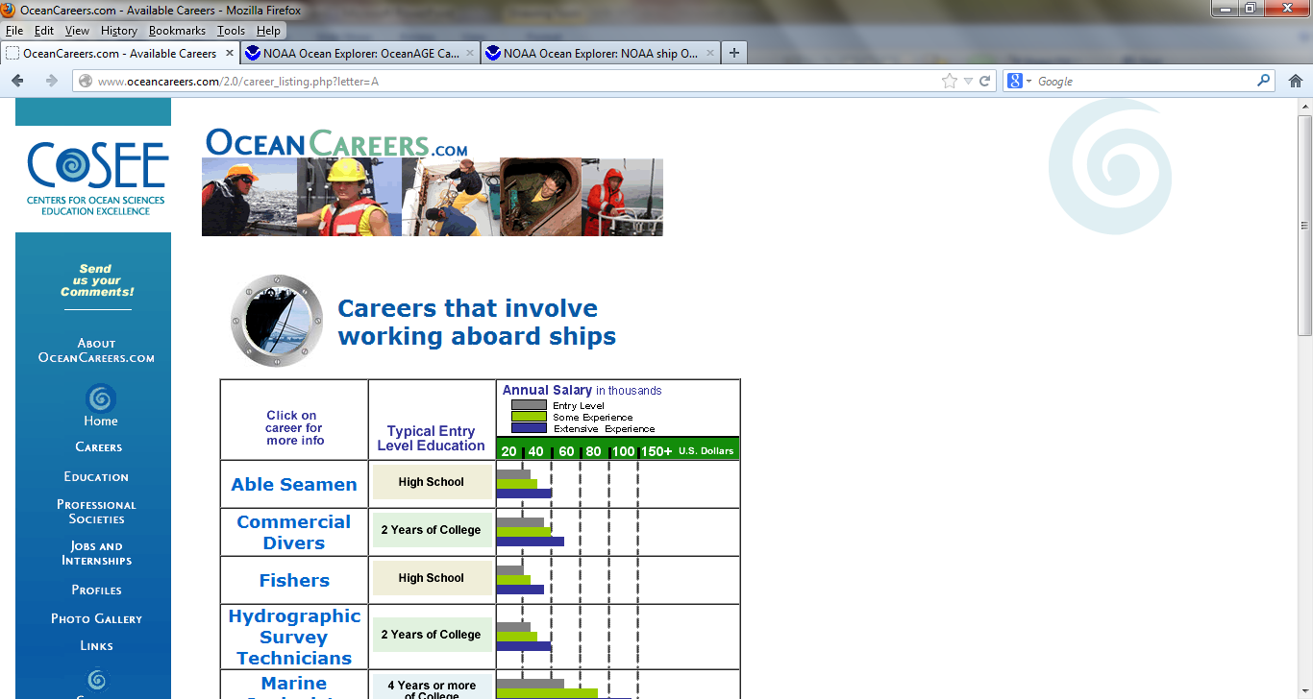

Slide 6
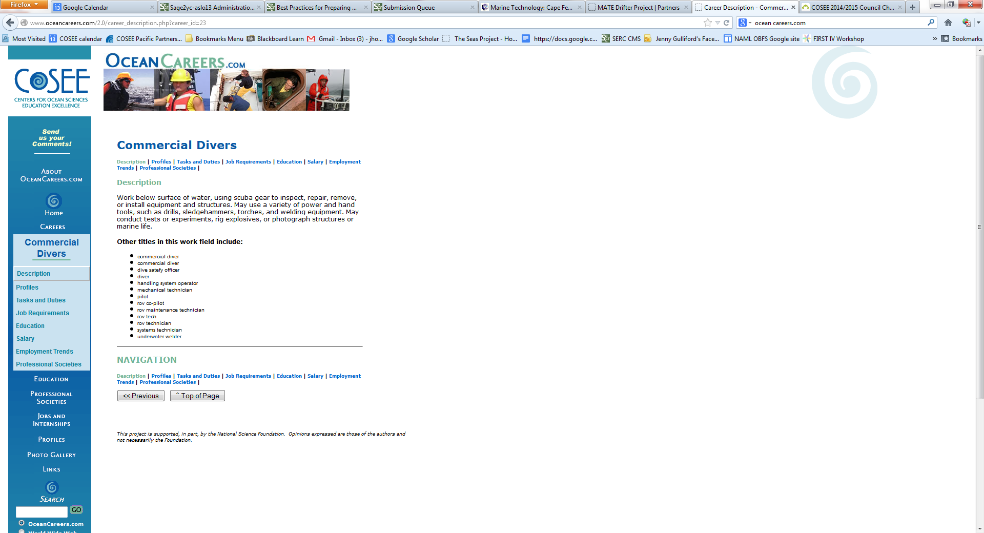

Slide 7
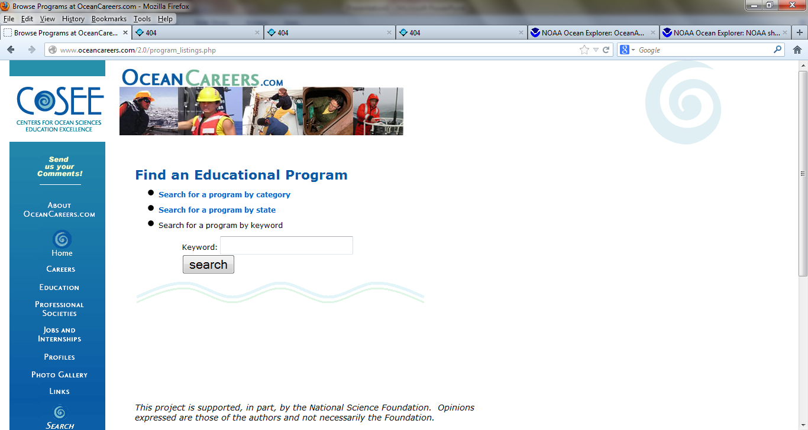

Slide 8
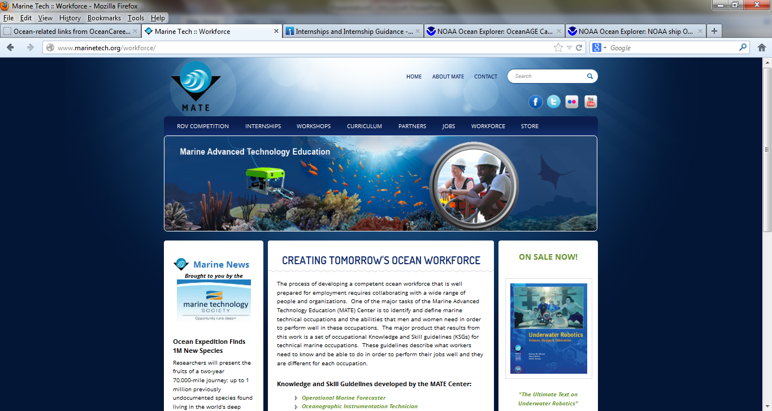
http://www.marinetech.org/

Slide 9
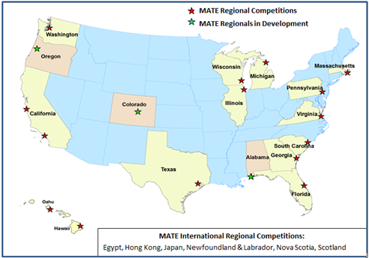
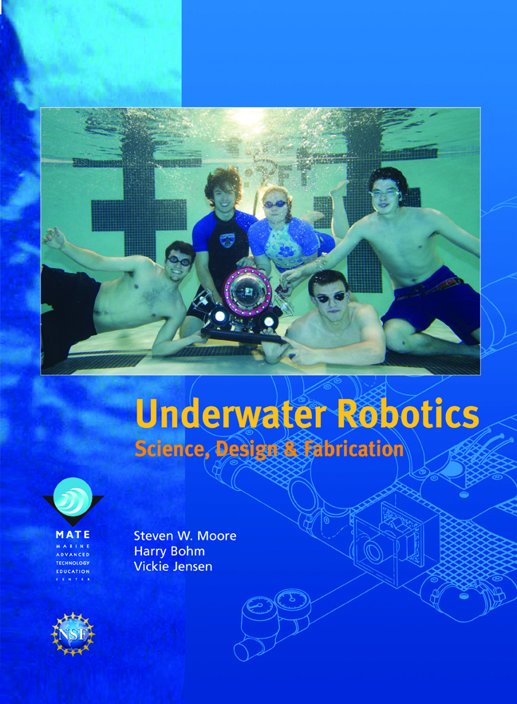
Underwater Robotics Competitions

Slide 10
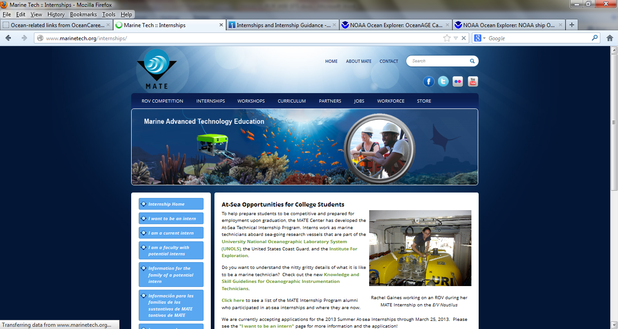
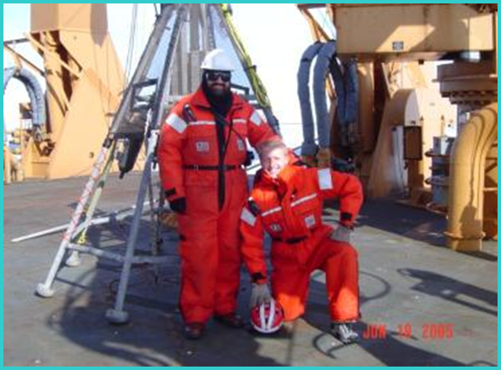
http://www.marinetech.org/internships
MATE Center’s Technical Internship Program

Slide 11
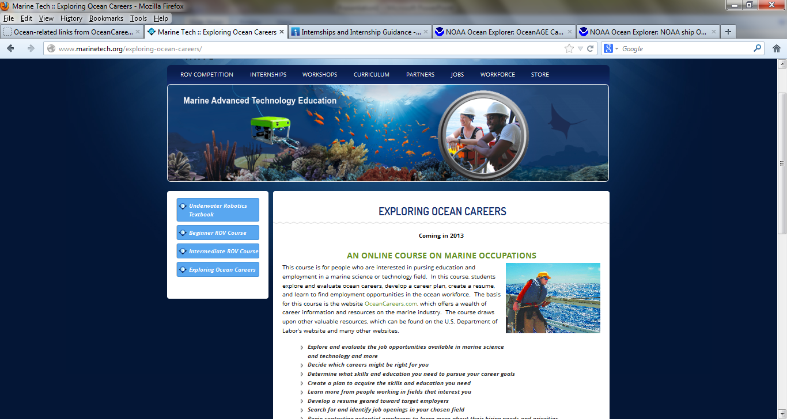

Slide 12
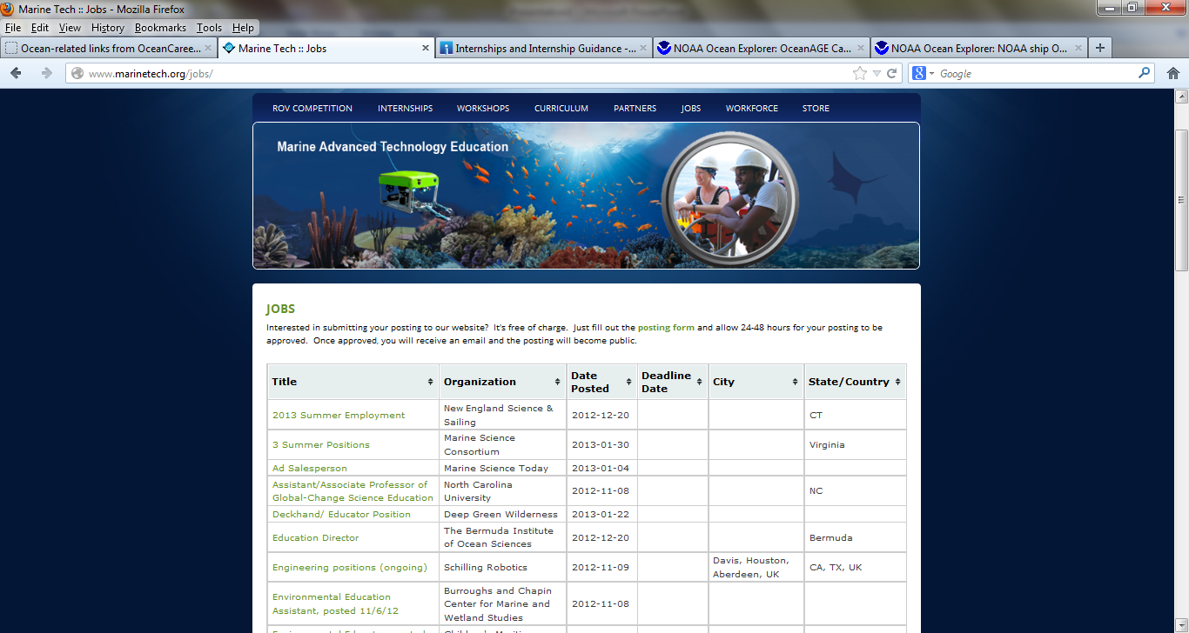

Slide 13
Knowledge and Skills Guidelines for Marine Science and Technology
Aquaculture Technician
Hydrographic Survey Technician
Marine Technician
Oceanographic Instrumentation Technician
Operational Marine Forecaster
ROV Technician

Slide 14
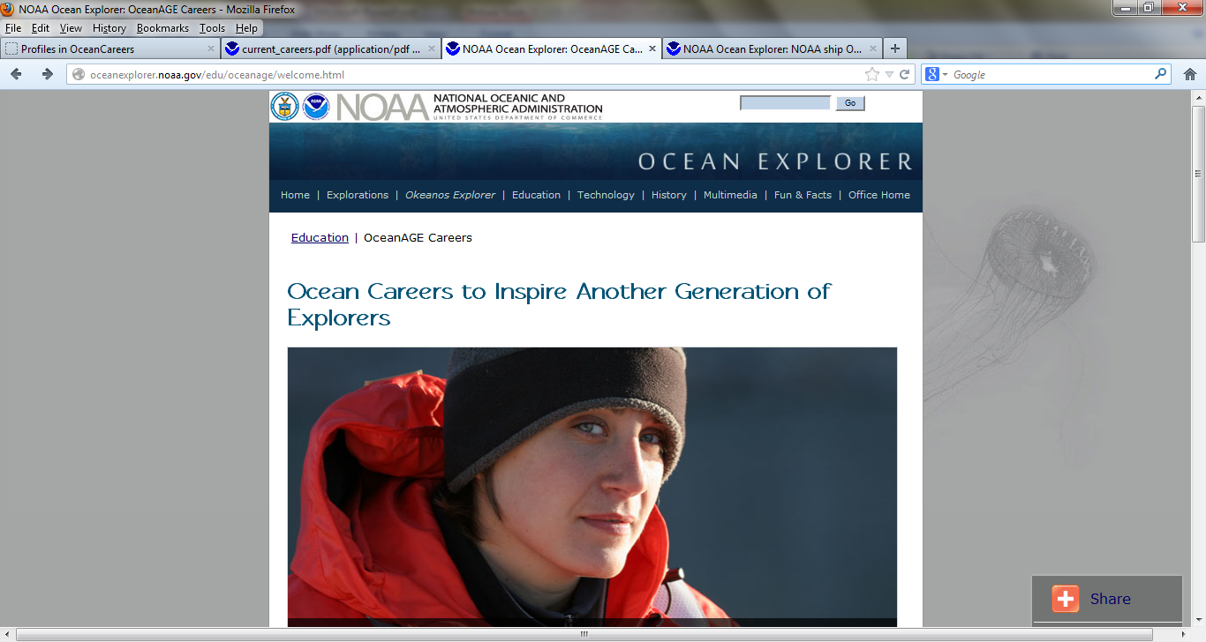
http://oceanexplorer.noaa.gov/edu/oceanage/welcome.html

Slide 15
OceanAGE Careers
Ocean Careers to Inspire: Another Generation of Explorers
OceanAGE is an interactive online ocean careers offering that inspires students from all backgrounds to learn more about oceanography and to pursue the mathematics, science and technology coursework required to become more ocean literate.
Collection of interviews from scientists and crew in Ocean Explorer research expeditions.
http://oceanexplorer.noaa.gov/edu/oceanage/
and http://oceanexplorer.noaa.gov/edu/oceanage/interviews/welcome.html

Slide 16
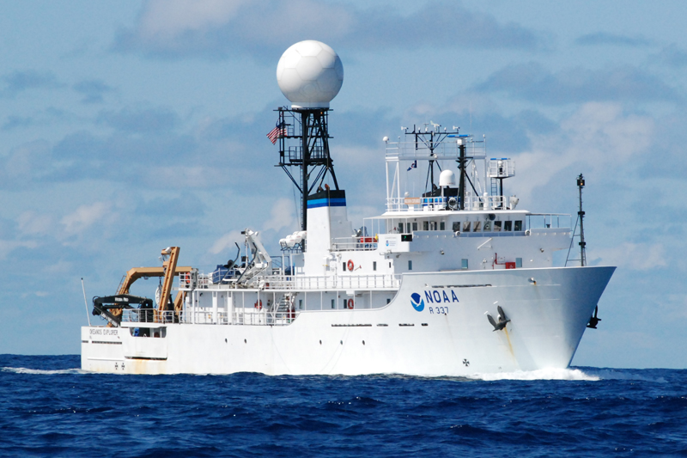
Careers on the NOAA ship Okeanos Explorer
http://oceanexplorer.noaa.gov/okeanos/explorers/explorers.html

Slide 17
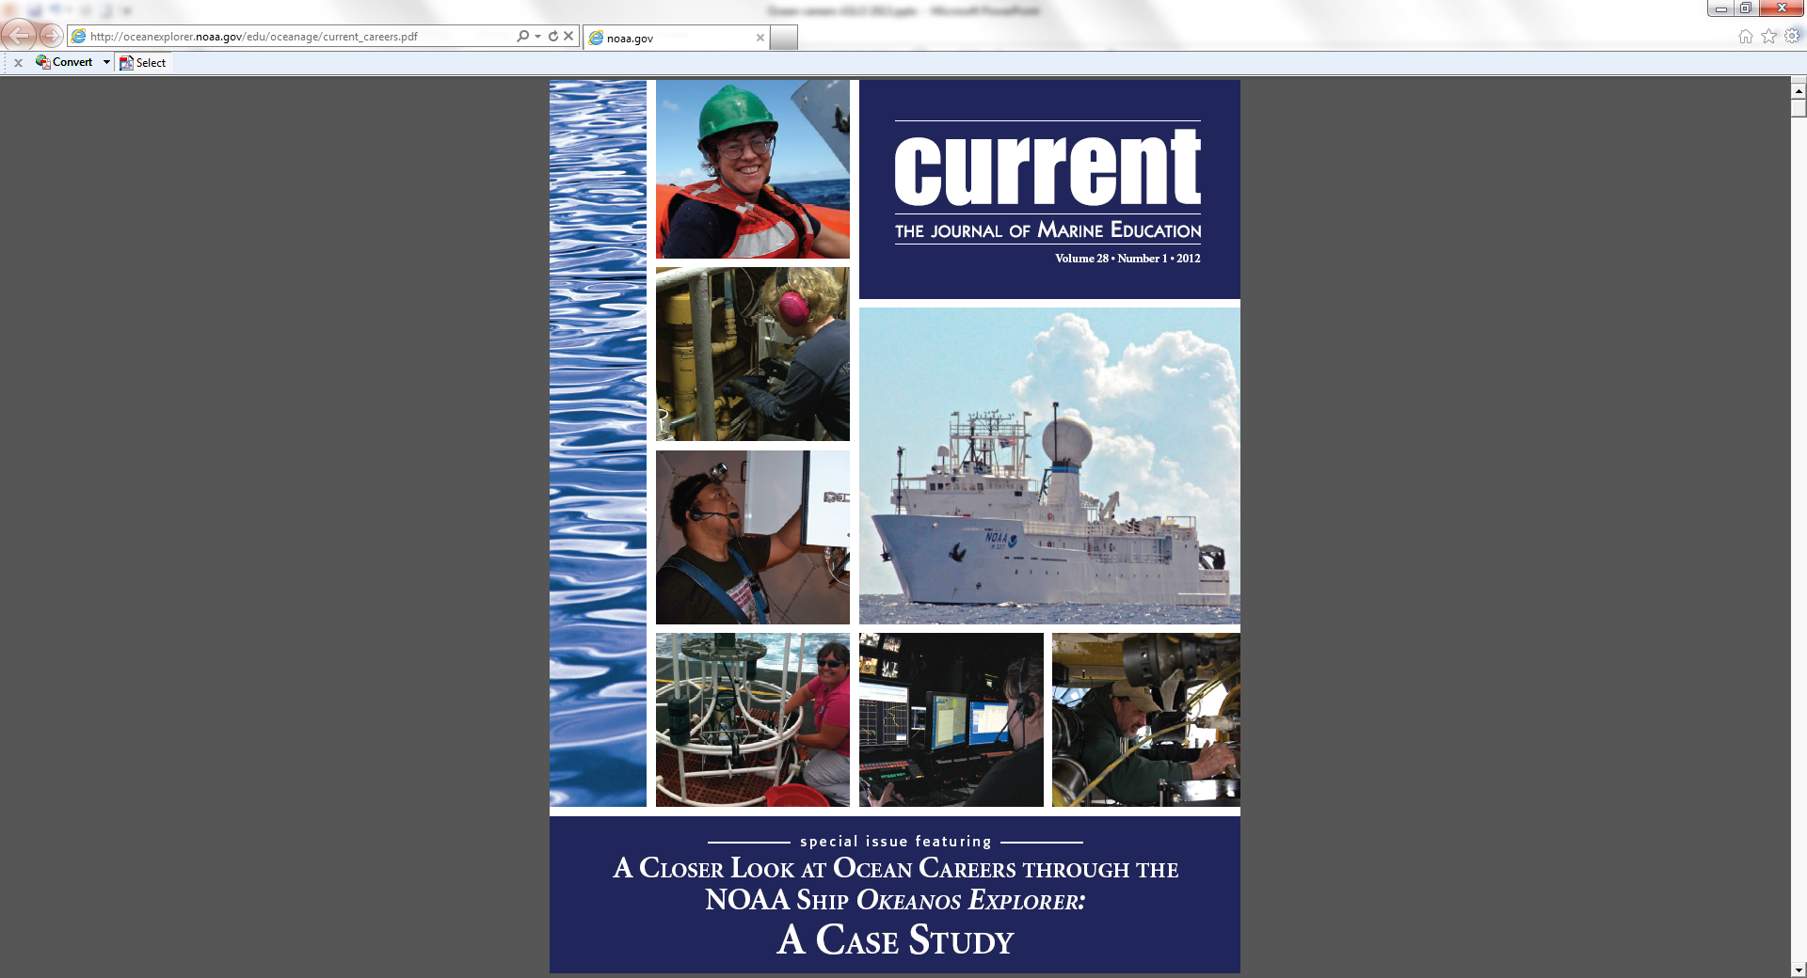
A special issue of Current
The Journal of Marine
Education
Available on line at:
http://oceanexplorer.noaa.gov/edu/oceanage/current_careers.pdf

Slide 18
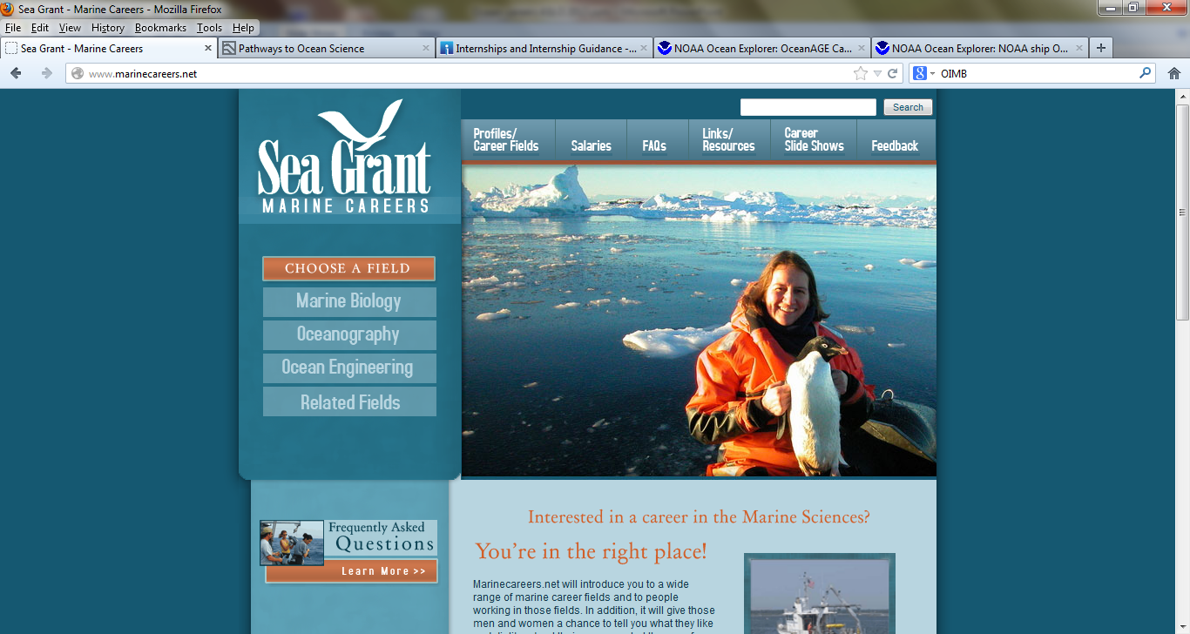
http://www.marinecareers.net/

Slide 19
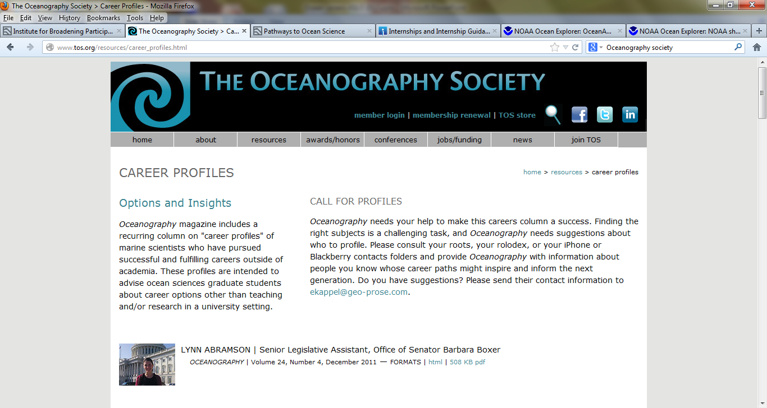
http://www.tos.org/resources/career_profiles.html

Slide 20


OCEANOGRAPHY ONLINE
Instant, Open Access
to Every Article

Slide 21
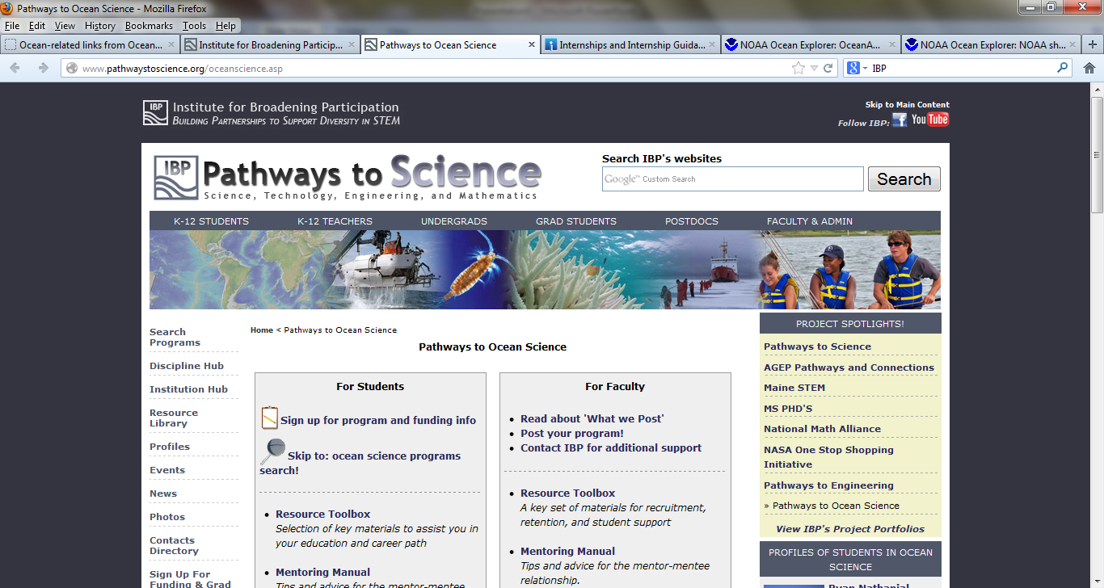
http://www.pathwaystoscience.org/oceanscience.asp

Slide 22
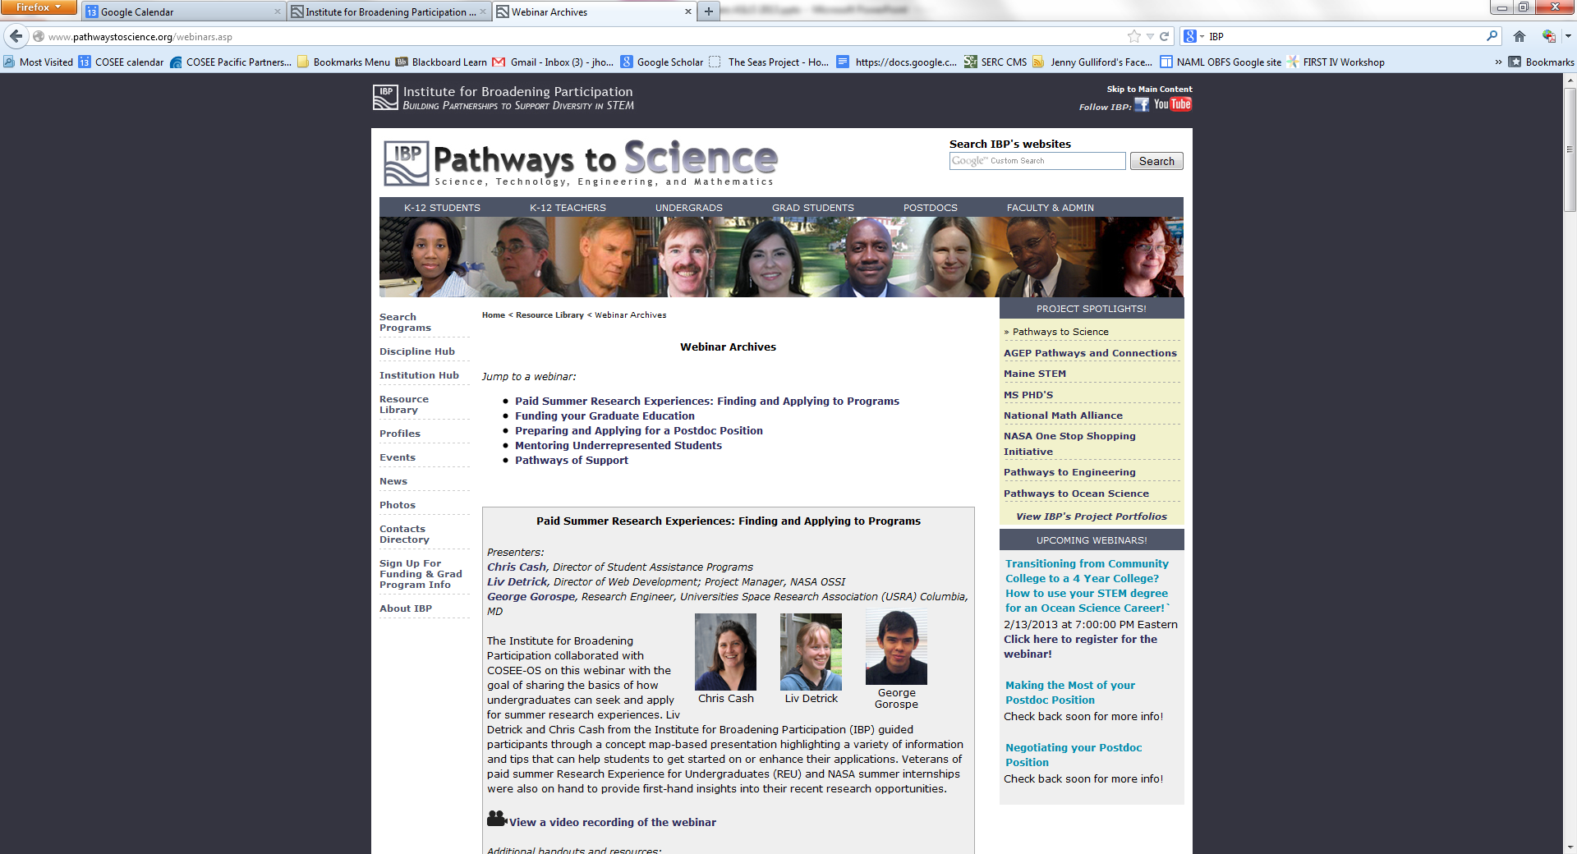
http://www.pathwaystoscience.org/webinars.asp
IBP webinars

Slide 23
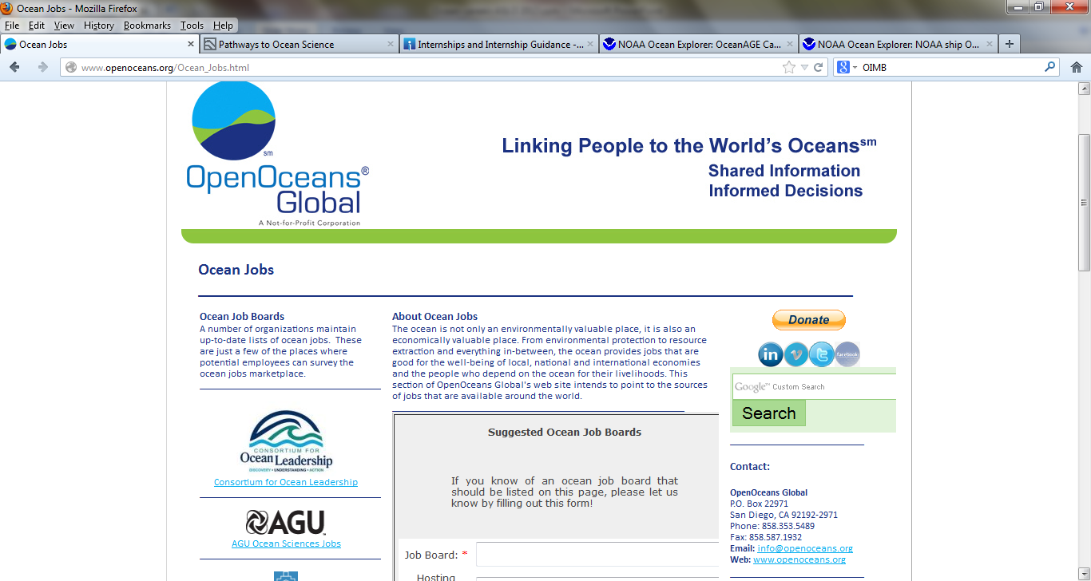
http://www.openoceans.org/Ocean_Jobs.html

Slide 24

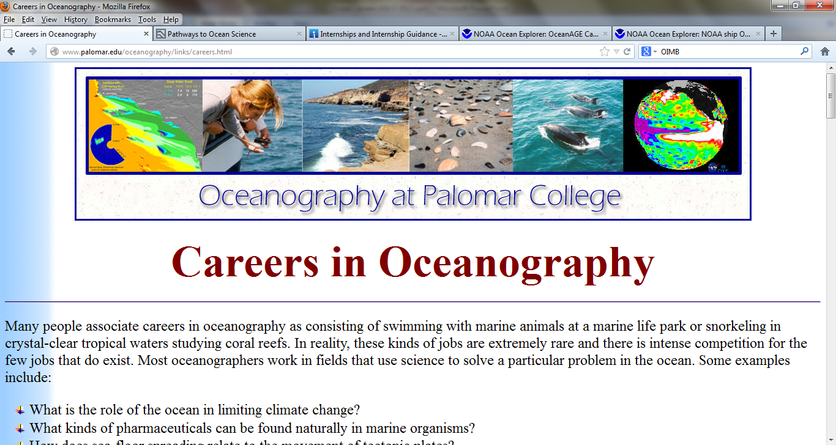
http://www.palomar.edu/oceanography/links/careers.html

Slide 25
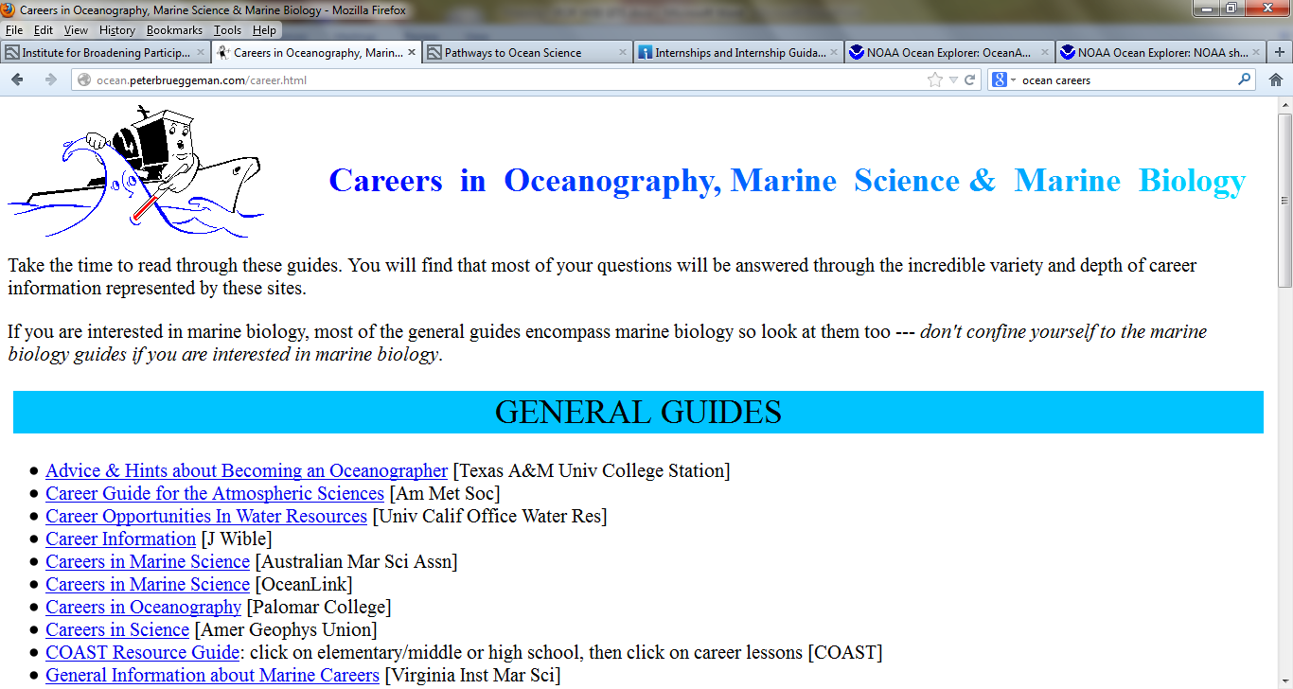
http://ocean.peterbrueggeman.com/career.html

Slide 26
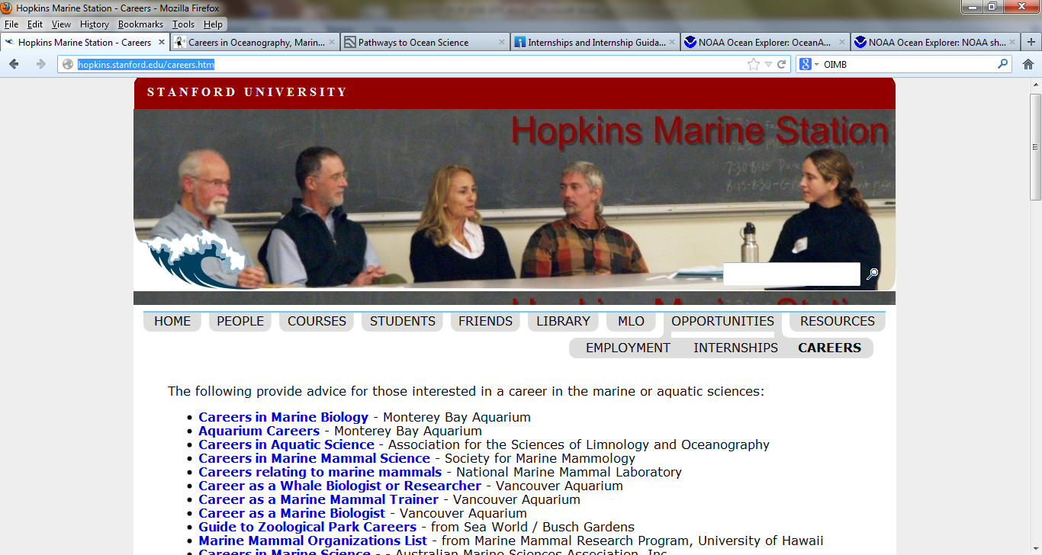
http://hopkins.stanford.edu/careers.htm

Slide 27
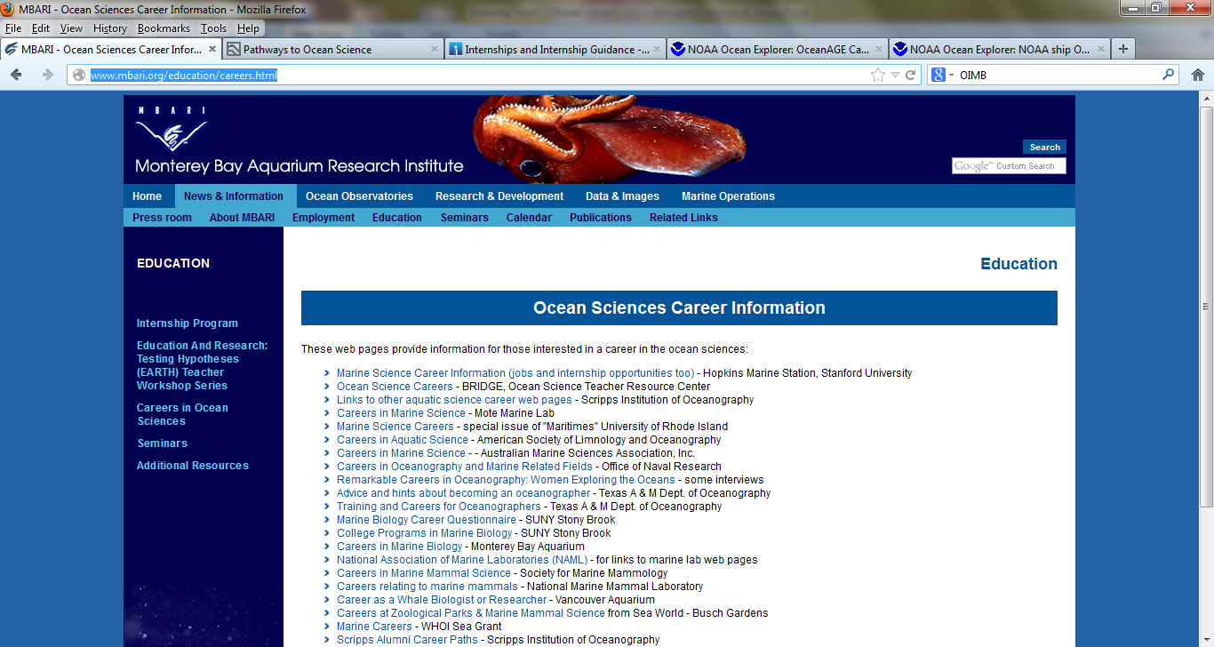
http://www.mbari.org/education/careers.html

Slide 28
HOW DO WE USE THESE RESOURCES?
WHAT OTHER RESOURCES WOULD BE USEFUL?

