Slide 1


Palomar College STEM Grants
by Al Trujillo atrujillo@palomar.edu
Dept. Earth Sciences Palomar College San Marcos, CA
US Dept. of Education Title V/HSI STEM Grant
($3.75 million – 5 years) &
NSF-STEP Grant ($1.96 million – 5 years)
Mission: Increase low-income and under-represented student participation in STEM programs and strengthen the STEM transfer pathway

Slide 2
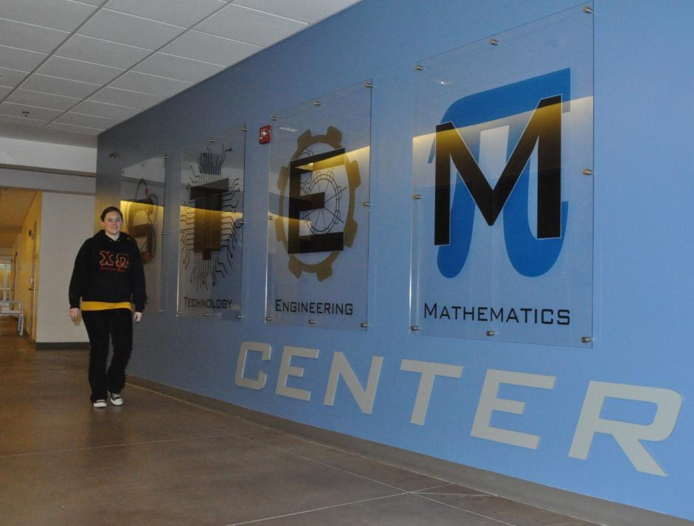
Creation of an On-Campus STEM Center
Includes:
STEM counseling and transfer advising
Mentoring
Outreach
Service learning

Slide 3
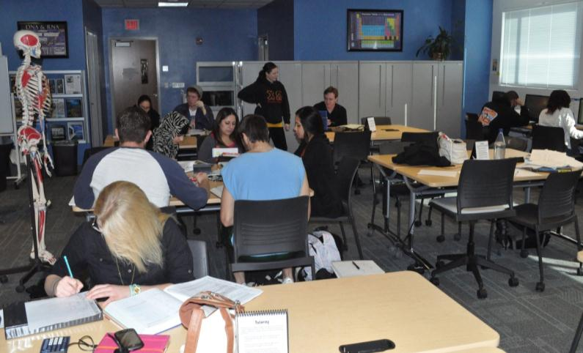
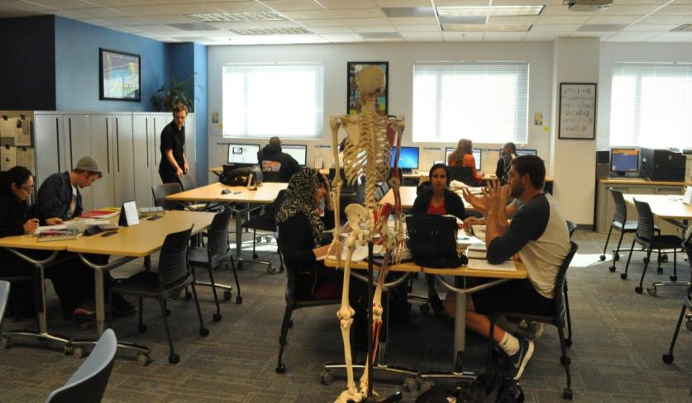
Specialized Student Support Services
Student group/work/ study space
Tutoring in 13 disciplines
Computer and laptop use
Student workshops

Slide 4

Palomar College STEM Grants
by Al Trujillo
Dept. Earth Sciences Palomar College San Marcos, CA
atrujillo@palomar.edu
More details at:
http://www2.palomar.edu/stem/center.htm
This presentation available online at:
http://www2.palomar.edu/users/atrujillo/

