Slide 1

The Oxnard College STEMinar
Planning from College to Career
Shannon Newby
February 17, 2013

Slide 2
Welcome to Oxnard College
Hispanic serving institution in Oxnard, CA (Ventura County midway between Los Angeles and Santa Barbara)
~70% of students plan on getting an AA and/or transferring
Many are first members of their family to attend college

Slide 3
STEMinar Background
3-year HSI STEM grant awarded to Oxnard College in 2008
One of grant goals was to increase STEM career awareness among students of Oxnard College
STEMinar created as a trial course and funded by grant

Slide 4
What’s a STEMinar?
Increase student awareness of different academic and career pathways
Students explore different pathways leading to career options
Students create immediate, short-term, and long-term educational and career plans

Slide 5
How we did it
Individual computer activities
STEM speakers
Group discussions
Mock interview

Slide 6
Computer Tools
AgileGrad*: Education planning software
CareerLocker: Career exploration software
  http://careerlocker.com/Default.asp
Vocational Biography: virtual job shadow for vocational jobs
  http://www.vocbiosonline.com/login.php
Used to create 2-3, 4-6, and 7-10 year plans

Slide 7
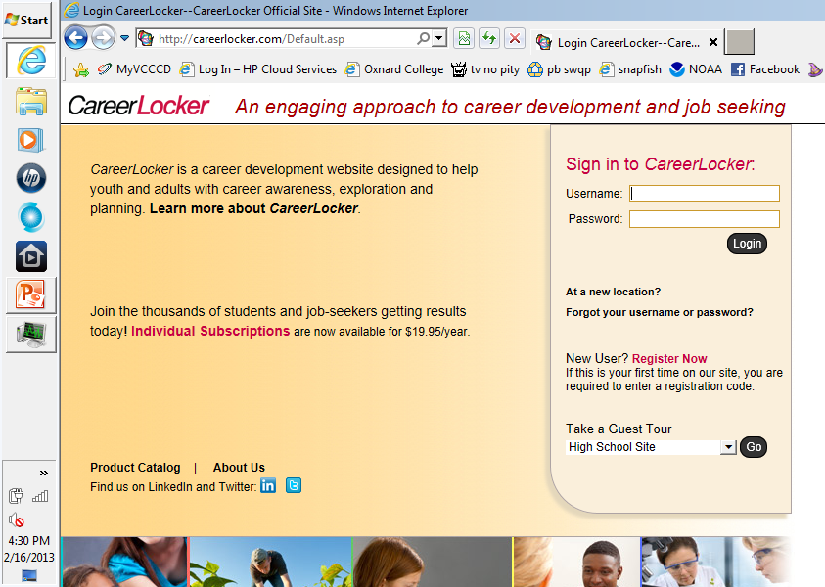
CareerLocker

Slide 8
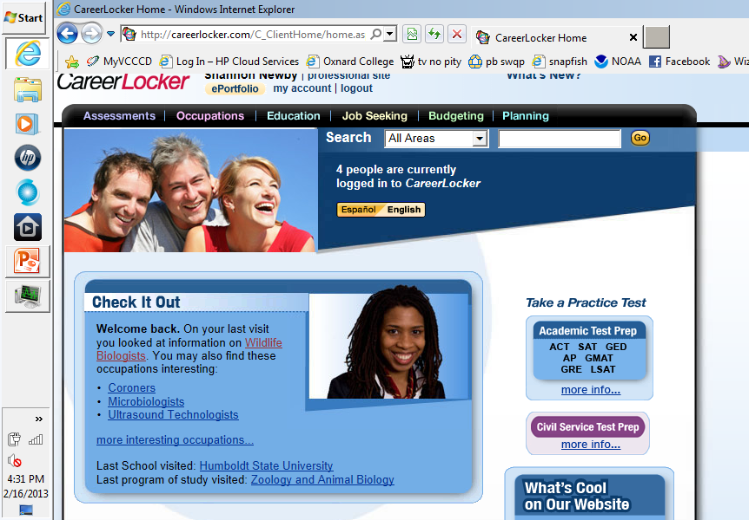

Slide 9
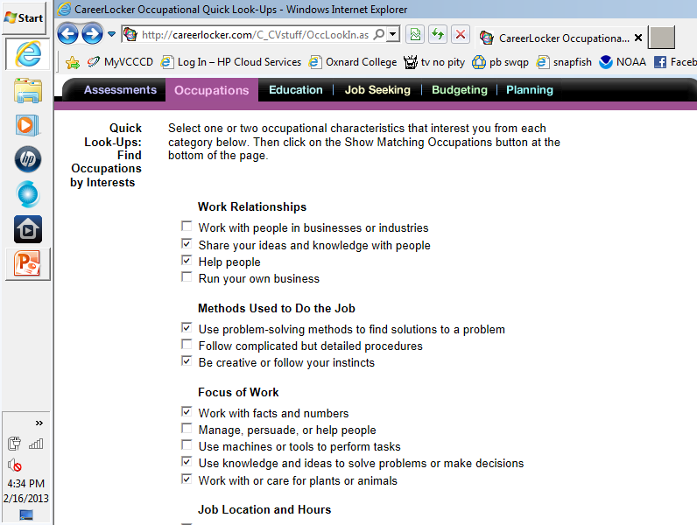

Slide 10
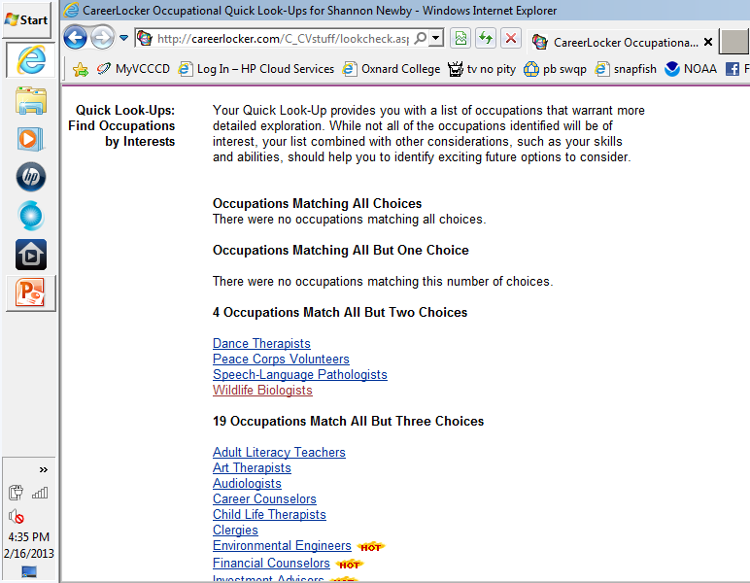

Slide 11
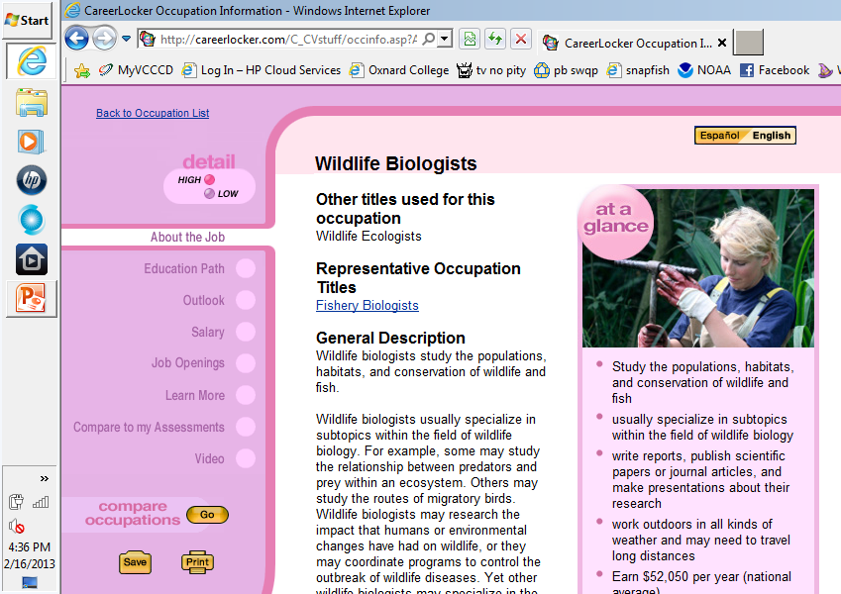

Slide 12
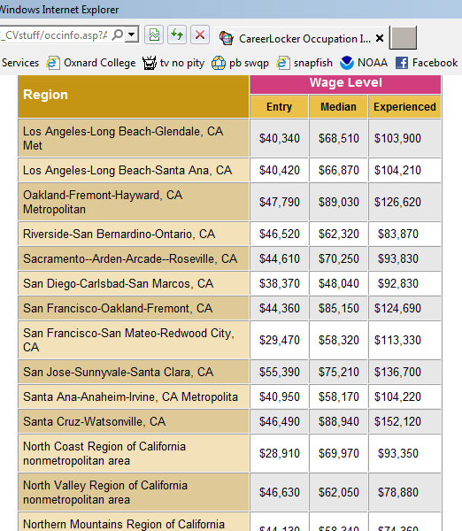
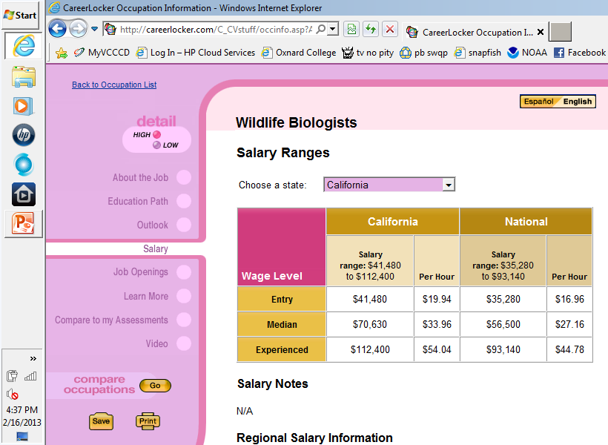

Slide 13
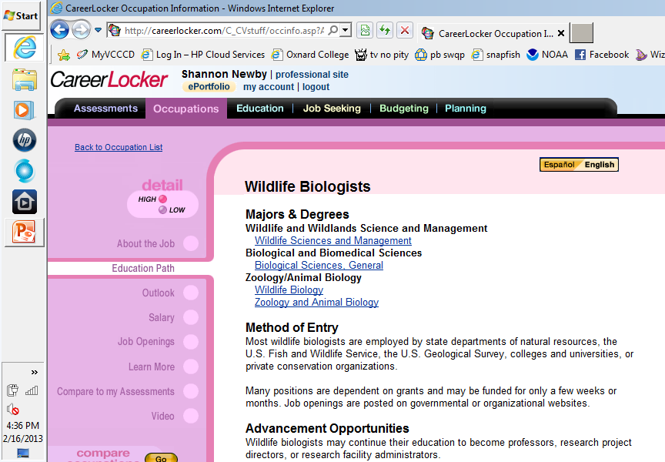

Slide 14
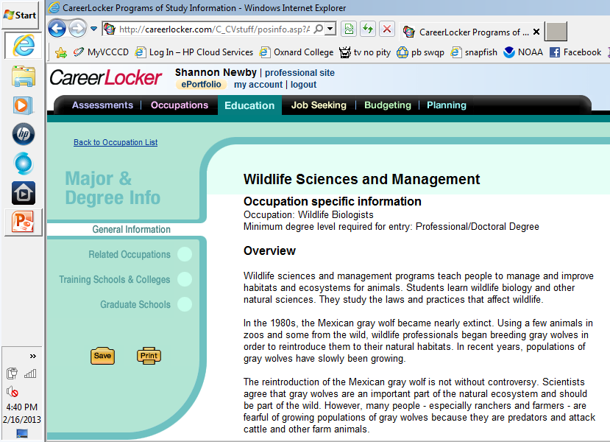

Slide 15
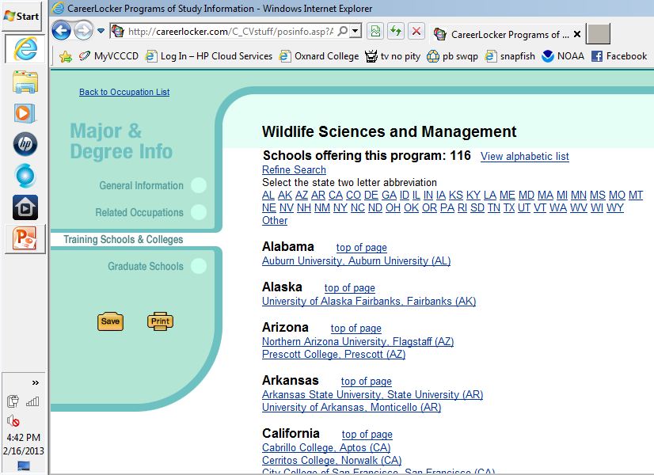

Slide 16
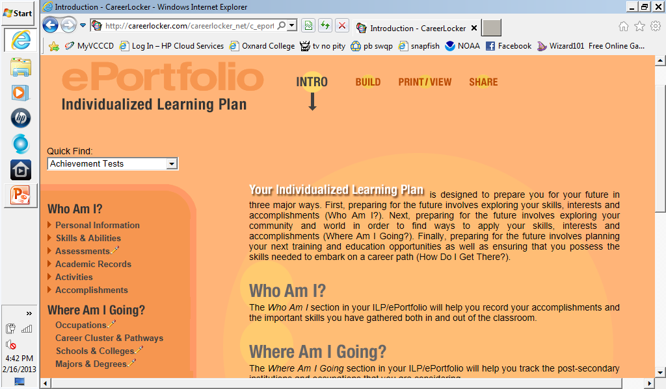

Slide 17
Speakers
Careers covered
  Geologist Graphic Designer (WoW)
  Fire technology NWS Meteorologist
  Veterinary chiropractor FWS Biologists
  Public Health Laboratory Microbiologist
Speakers focused on what their job was and the path that led them there, as well as what they liked and disliked about their position

Slide 18
Discussion
Computer activity worksheet results
Pre-speaker preparation
Interview skills
C.V. vs. Resume

Slide 19
Mock Interview (final exam)
Students had to find a real internship related to the career they were interested in.
Then created an application for the internship (even if not yet eligible for the position)
Brought in individually for an interview
  Interview panel: myself, Dean, Grant Director, local CareerLocker representative (former Oxnard College Instructor)
  Had to supply application, c.v., and year plans
  Each panel member had score sheet for interviewee

Slide 20
SAGE Funded Summer STEMinar
High school focused
4 week course, meet 3 days a week
Modifications:
  No interview
  No in-class speakers
  Field trips
    Insectary and fish hatchery
    Wetland restoration site
    Los Angeles Zoo
    Anacapa Island

Slide 21
What Worked
Helped students already interested in STEM careers gain focus and plan for their goal
  Ex: student interested in engineering didn’t realize there were different types
Speakers gave students an opportunity to learn about what careers actually entailed, the different ways people got to their career, and network
Students became more aware of the variety of STEM careers and expressed more interested in exploring STEM career options

Slide 22
What didn’t work
Course was non-transferrable and grant ended so was an early victim to budget cuts
While successful in increasing student awareness and interest in STEM careers BUT many students in the class were already interested in STEM
Once students interested in STEM often lacked math skills and/or study skills and/or coping skills for when struggled so became discouraged

Slide 23
Return of the STEMinar
Issue 1: Transferability
  Why: California Community Colleges have begun policy of maximum unit “penalty” to encourage transfer or completion of degree
  Santa Barbara City College has STEM 101 which transfers to California State Universities
  Create a STEMinar Freshman Interest Group (F.I.G.). F.I.G.’s are at several 4-year schools nationwide so could be more relatable when applying for transfer

Slide 24
Issue 2: Preaching to the Choir
  If transfer issues are resolved then more likely to get counselors on board to promote class
  Outreach to area high schools to promote participation in course by students

Slide 25
Issue 3: STEM is “hard”
  Addressing study skills:
    Different study methods
    Why having a textbook (or access to one) helps and how to use it
    How to bounce back from a bad exam grade
    Ways to improve critical thinking
  Addressing lack of fundamental math and English
    Emphasize why STEM is worth the wait
    Explain WHY these things matter
    Get started early

Slide 26
Acknowledgements
Department of Education Title V CCRAA HSI STEM Grant
SAGE
Cynthia Herrera, Carolyn Inouye, Bob Tholl
Juan Smith, Andrea Baltazar

