Slide 1
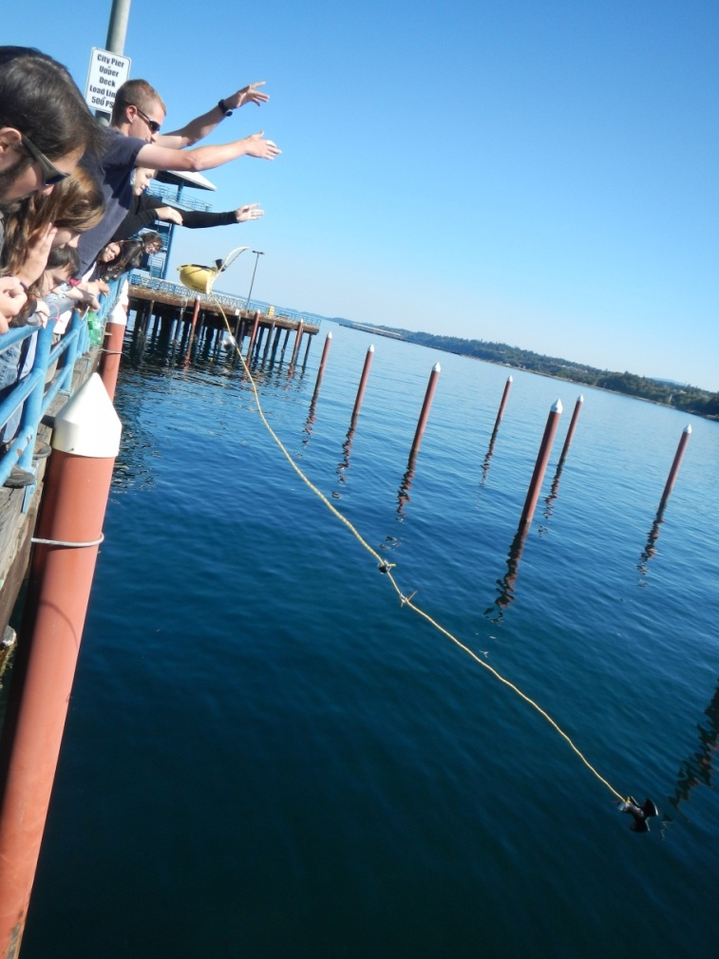
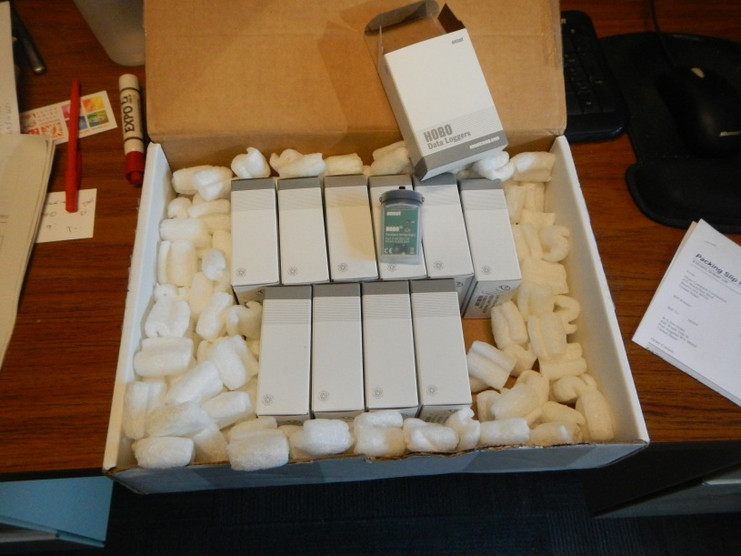
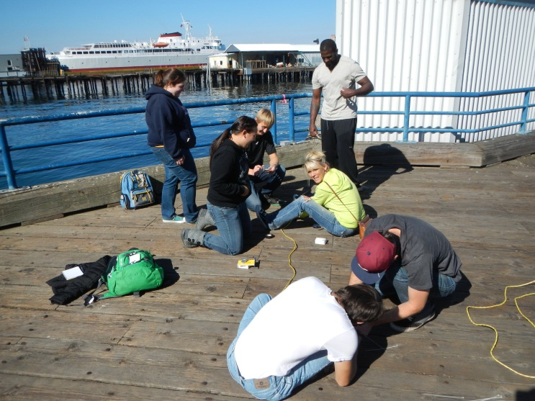
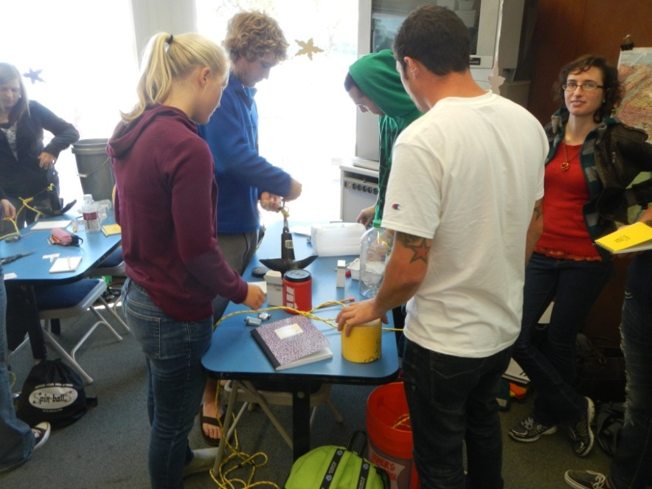
Ocean Observing Moorings
Deployment!
Motivate students
Promote consideration
Teamwork, Excel
TS analysis, ocean measurement
HOBOs by Onset…cheap, robust
Ian Miller
Coastal Hazards Specialist
Washington Sea Grant
&
Adjunct Faculty
Peninsula College
immiller@u.washington.edu
360 417 6460
Mooring engineering and construction

Slide 2
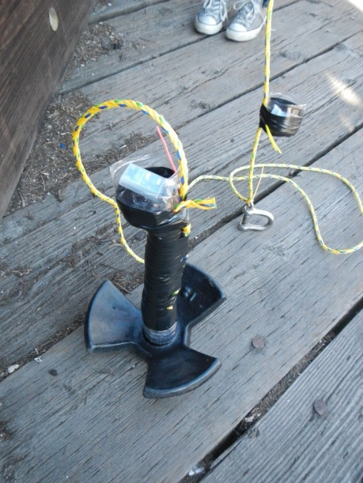
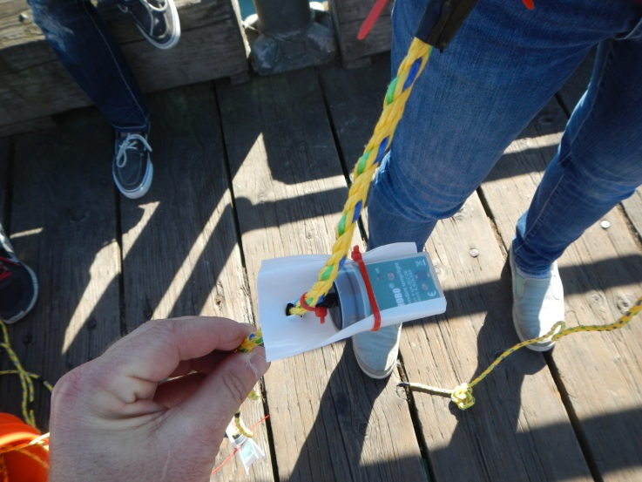
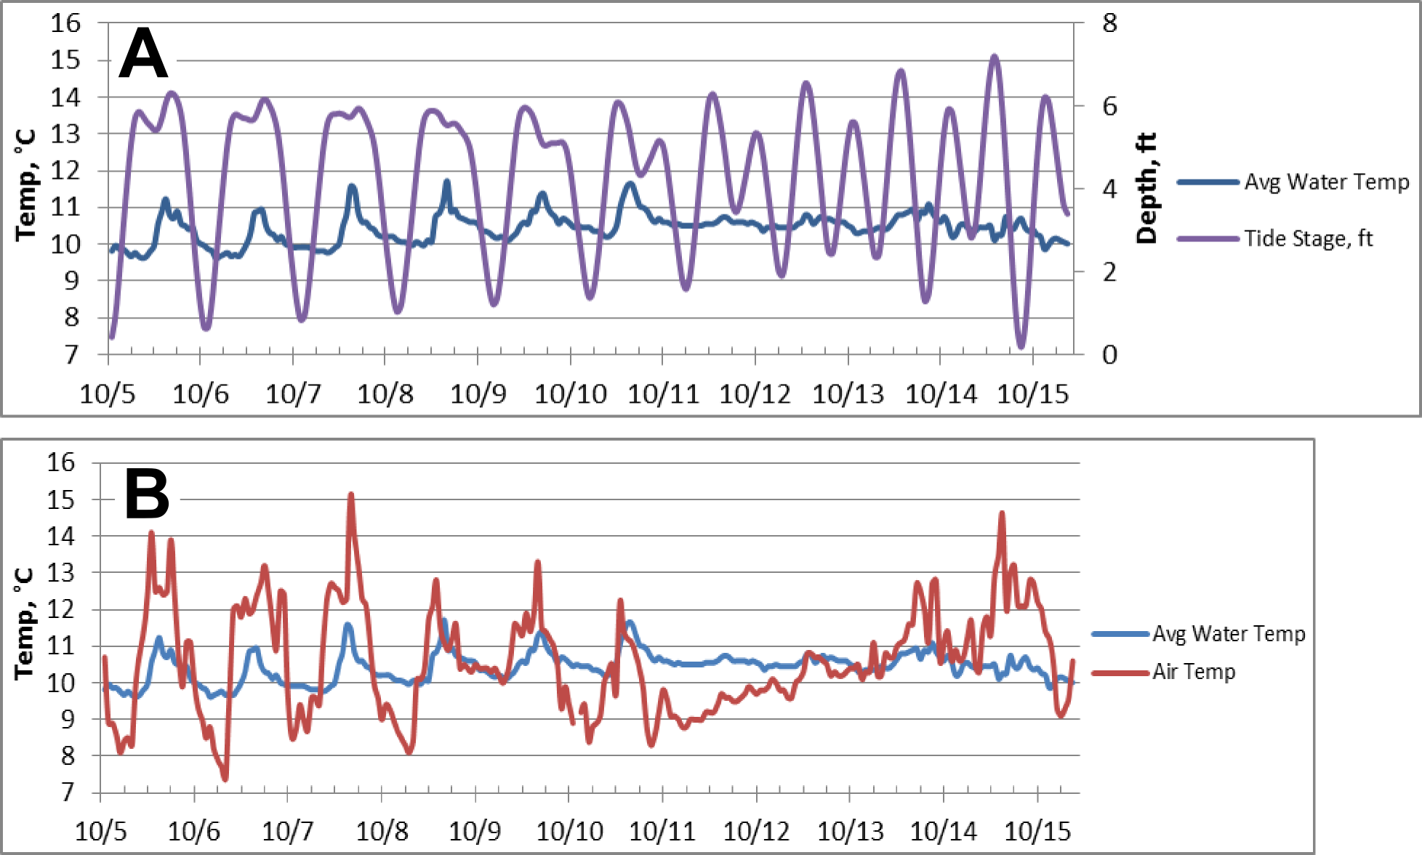
Recovery and Analysis
Data integrated into assignment, and reinforced lessons on tides, mixing, heat flux….
Ian Miller
Coastal Hazards Specialist
Washington Sea Grant
&
Adjunct Faculty
Peninsula College
immiller@u.washington.edu
360 417 6460

Slide 3
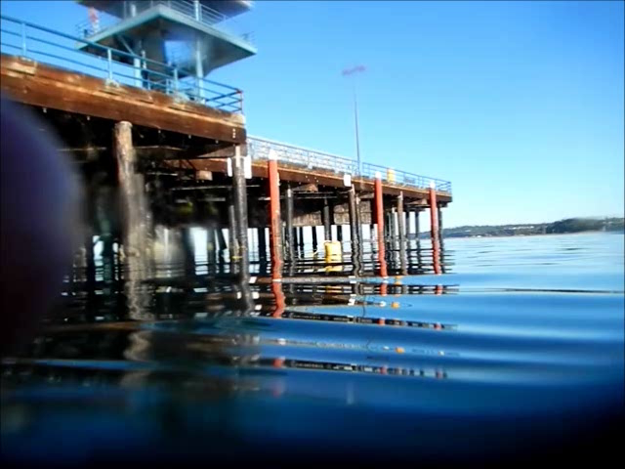
More At:
“Fun With HOBOS” at the CoastNerd Gazette http://coastnerd.blogspot.com/2012/10/fun-with-hobos.html
A forthcoming article with student Eliza Dawson in the Onset newsletter www.onsetcomp.com
Ian Miller
Coastal Hazards Specialist
Washington Sea Grant
&
Adjunct Faculty
Peninsula College
immiller@u.washington.edu
360 417 6460

Slide 4
