Slide 1

Educating Tomorrow’s Workforce
Shelley Jaye
Instructor of Geology

Slide 2
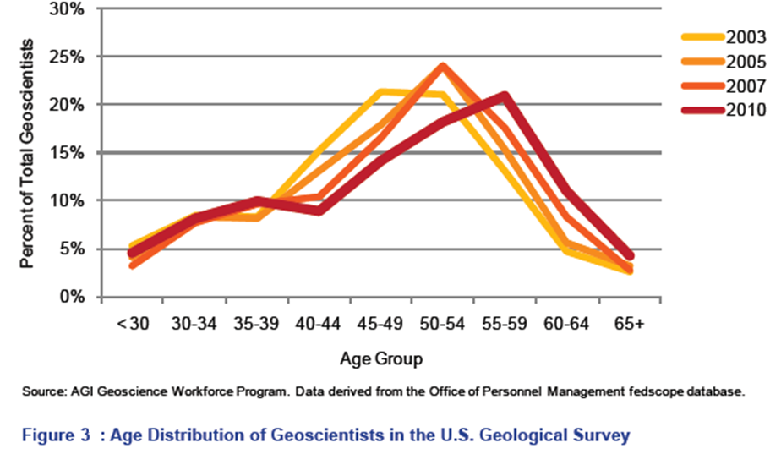

Slide 3

Teaching advanced geoscience courses at NOVA has led to a new partnership and degree program
Internships and
Part-time employment
Physical Science
Technicians

Slide 4
PHYSICAL SCIENCE TECHNOLOGY
Associate of Applied Science Degree

Slide 5
Summer 2012
7
2
Remain part-time
employees
Internships and
Part-time employment
Physical Science
Technicians
Undergraduate Research
Opportunities at NOVA

Slide 6
Future
NSF Proposal submitted to write the curriculum plan for the AAS in PST
  Will be written/developed regardless
  Outreach to local/state/country-wide geotechnical companies
    Inform them about new AAS in PST
    Troll for
      Internships
      Jobs

