Slide 1
Licensing and Certification of Geologists–
Implications for Education
Presented by
Jonathan H. Goodwin, PhD.
Illinois LPG # 196-00331
CPG # 5173
Notes:
1

Slide 2
Why States License Geologists
Information from geoscience investigations is increasingly important to the public, industry, and local, state and federal government agencies
Licensure helps assure that geoscientists offering their services to the public are adequately trained, experienced, and competent
Many other professions with the potential to impact the physical, social or financial welfare of the public are regulated through licensure

Slide 3
What is ASBOG®?
National association formed to provide a coordinating link between the licensing boards of the states
Through committees, ASBOG provides guidance to member boards on matters of common interest
ASBOG creates and rigorously maintains the examinations used by member boards to assess minimum competency to practice geology
Via a model law and direct contact, ASBOG assists states seeking to enact legislation

Slide 4
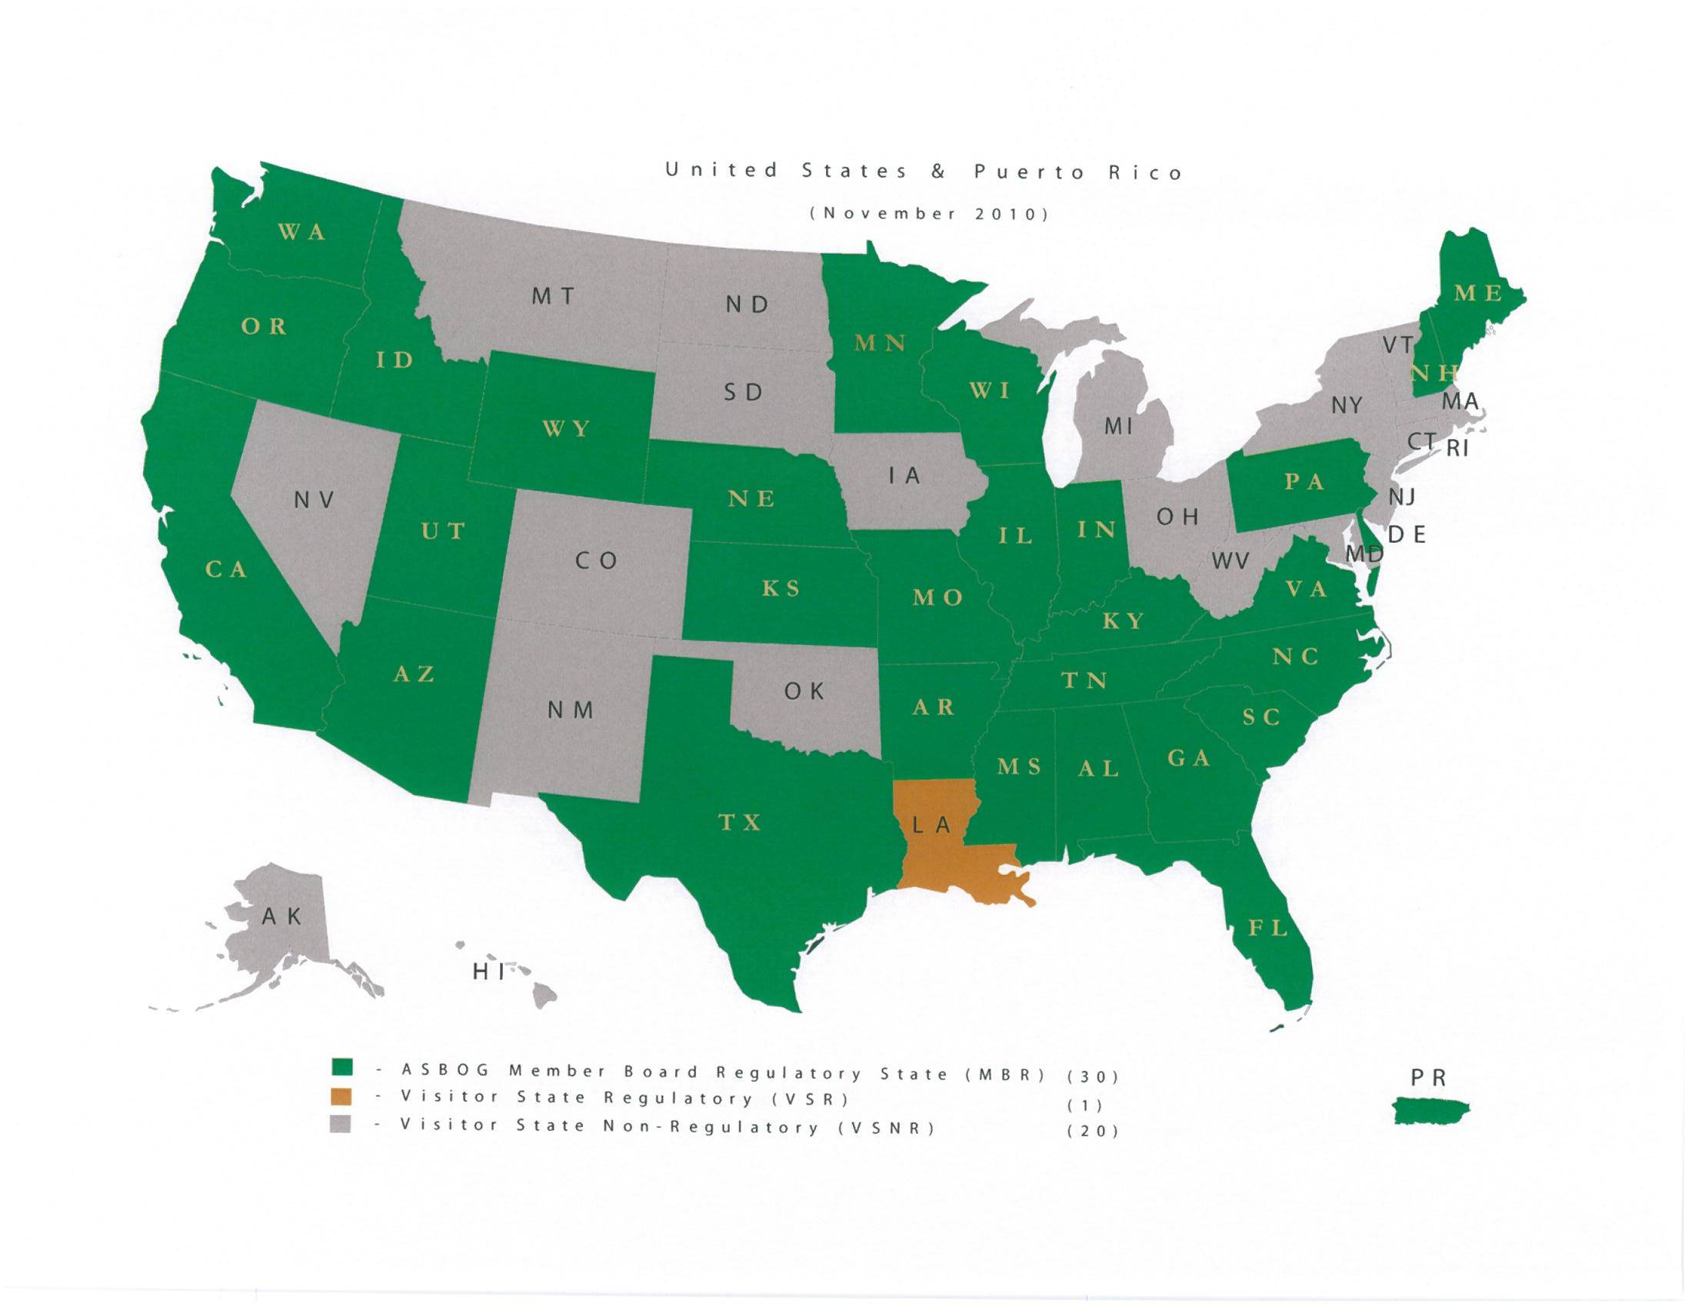

Slide 5
Typical Requirements for Licensure in ASBOG States
Minimum of 30 semester hours (45 quarter hours) of course work in specified upper-level geoscience courses
BA/BS or higher degree in geology or closely related field
Passing scores on the ASBOG competency examinations
At least 4 years of post-degree work experience, typically with 2 years or more supervised by a licensed geologist

Slide 6
ASBOG Competency Examinations
Fundamentals of Geology Examination
Tests knowledge that a person with a bachelor’s degree in geology should have.
Comprises 140 multiple choice questions.
Practice of Geology Examination
Tests knowledge of the practical application of geological principles expected after 4 years of experience
Comprises 110 multiple choice questions

Slide 7
ASBOG WEB SITE
Detailed information about the examinations is available in the candidates handbook at:
www.asbog.org

Slide 8
Developing the Exams
43 Task Statements in the survey are arranged in 8 content domains (subject areas)
Geologists rate the importance of each task statement in their practice
Questionnaire also asked about 13 ethical issues typically encountered by geologists
Responses to the survey determine the number of exam questions for each subject area

Slide 9
Developing the Exams
3,994 licensed geologists and 2,000 professors of geology in the 30 ASBOG jurisdictions received the questionnaire
2,604 were returned (43%)
1835 licensed geologists in 10 Canadian provinces received the questionaire
515 were completed/returned (28%)
Notes:
Information in slides 10 and 11 could just be stated while showing slide 12

Slide 10
Content Domains of the Examinations
Percent of
Content Domains Items by Domain
FG% PG%
General Geology: field geology, geophysics, imagery, 20 21
modeling, and graphical methods
B. Mineralogy, petrology and geochemistry 11 5
C. Sedimentology. Stratigraphy & paleontology 12 5
Quaternary geology, geomorphology & surficial processes 13 8
Structure, tectonics & seismology 11 9
Hydrogeology & environmental geochemistry 11 19
Engineering geology 11 17
Economic geology & energy resources geology 11 16
TOTALS 100 100

Slide 11
Developing and “Scoring” the Exams
Questions for each exam are drawn from large databases for each task statement
Tests are administered twice each year (spring and fall)
Shortly afterward, Subject Matter Experts review the examinations.
If necessary, a question may not be scored, or two answers may be accepted as correct
Notes:
Discuss comments received from test-takers; statistics on how well questions perform; double-scoring of questions; rejection of incorrectly keyed questions.

Slide 12
Developing and “Scoring” the Exams
After review, examination is rescored by the statisticians and the final scores are sent by ASBOG to the licensing boards. It is up to the licensing boards to inform the candidates.
The next examination to be administered also is carefully reviewed by the SMEs and any poorly worded or otherwise unacceptable questions are replaced.

Slide 13
Guidelines for the Examinations
Examinations are developed following guidelines in the Standards for Educational and Psychological Testing published by American Educational Research Association; American Psychological Association, and National Council on Measurement in Education

Slide 14
“Scoring” the Examinations
Exams are scored using a “criterion-referenced” procedure that assesses the difficulty level of each test question in relation to the expectation of “minimum competency”
Passing score, under this system, is 70

Slide 15
Figure 1
ASBOG
®
FG & PG Examinations
Passing Rates by Administration
1
st
Time Candidates vs. All Candidates
(March 2008 - October 2010)
Fundamentals of Geology - All Candidates
Practice of Geology - All Candidates
Fundamentals of Geology - 1st Time Candidates Only
Practice of Geology - 1st Time Candidates Only
100
90
82
80
81
79
81
80
80
74
70
71
71
72
70
75
69
67
68
67
70
60
66
60
58
57
59
58
50
55
Percent Passing
40
30
20
10
0
Mar-08
Oct-08
Mar-09
Oct-09
Mar-10
Oct-10
Administration Date

Slide 16
What is Certification?
For geologists, Certification is provided by the American Institute of Professional Geologists, founded in 1963.
AIPG currently has a little more than 6,000 members in the US and abroad
Applications to become a Certified Professional Geologist cost $50, plus annual AIPG dues of $145

Slide 17
Certification Requirements
BS/BA or higher degree in geoscience
36 semester hours/54 quarter hours of upper level courses in geoscience (transcripts to be submitted by each school attended)
8 years experience in the practice of geology (Masters degree is 1 year’s experience; PhD is 3 years’ experience

Slide 18
Certification Requirements
Must have 3 sponsors who can attest to your character and competence. Two must be CPGs themselves.
Application is reviewed by the local chapter of AIPG as well as the national headquarters.
Application forms are lengthy and reviews are extensive and careful.
Legal judgments or convictions (especially for malpractice) are disqualifying

Slide 19
Advantages and Disadvantages
Provides some legal recognition of your qualifications in states that do not license geologists.
Organization provides support such as group health insurance and meetings
To work in a state with licensing, you’ll have to have a license to practice
Licensing provides stronger “policing” of malpractice and, therefore, stronger protection for the public.

Slide 20
Other Professional Certifications
National Groundwater Association certifies ◊ Groundwater Professionals
American Association of Petroleum Geologists certifies
◊ Petroleum Geologists
◊ Petroleum Geophysicists
◊ Coal Geologists

