Slide 1
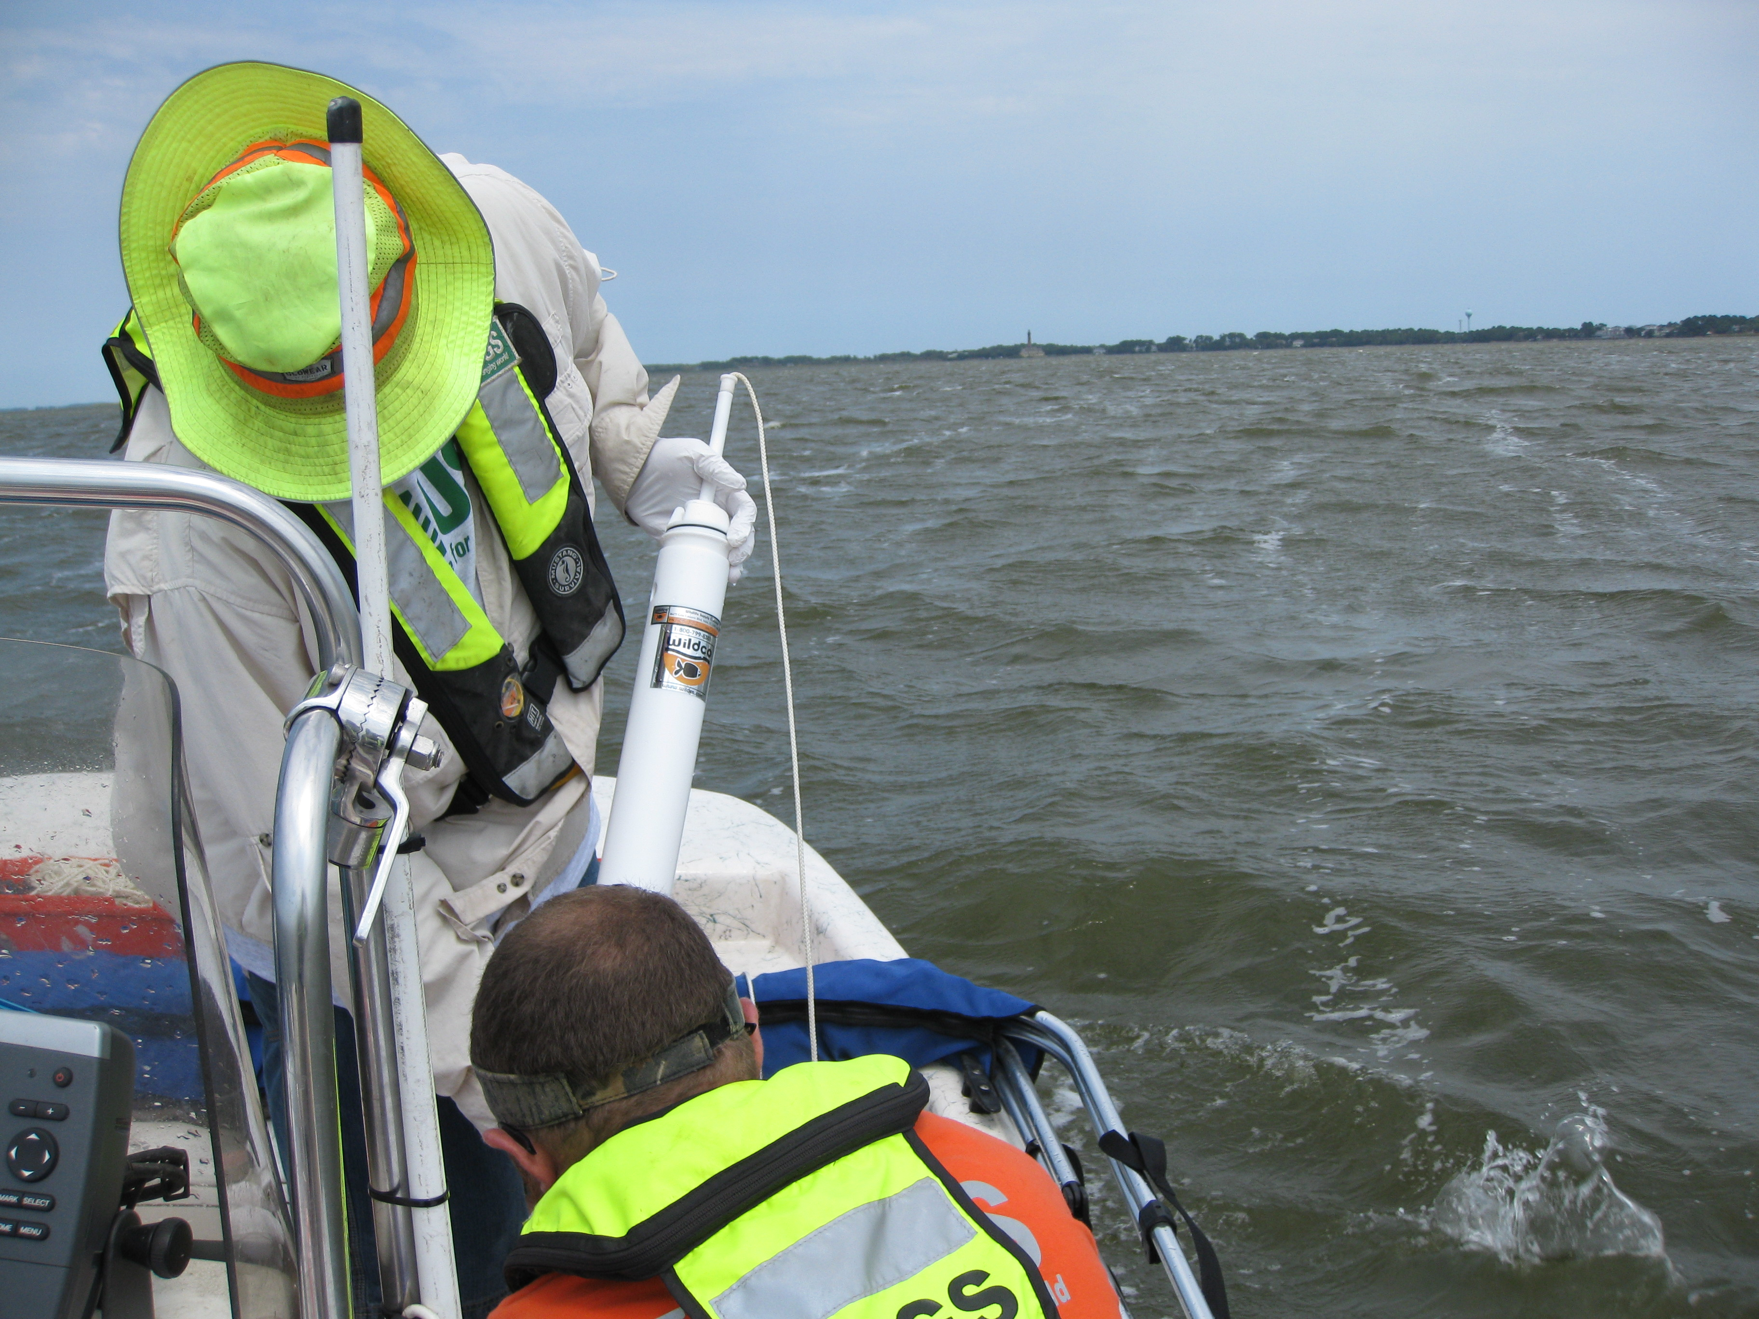
USGS
Hydrologic Technician

Slide 2
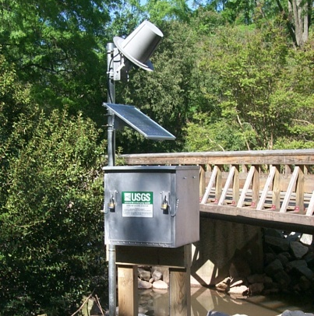
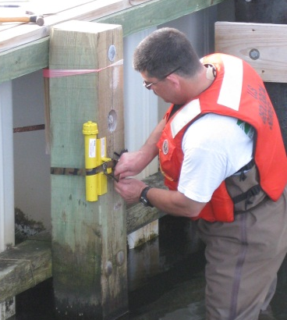
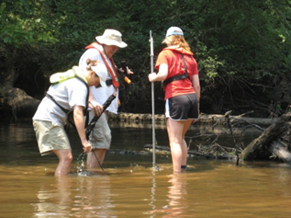
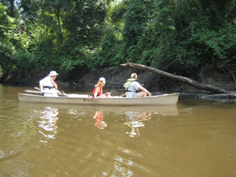
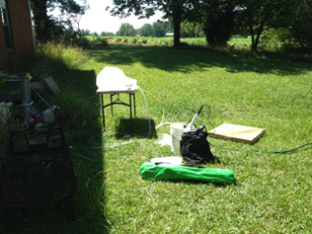
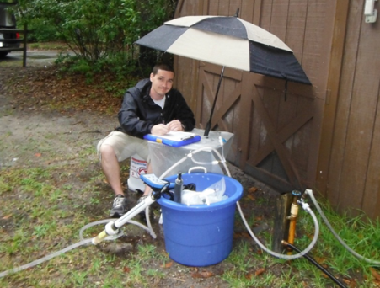
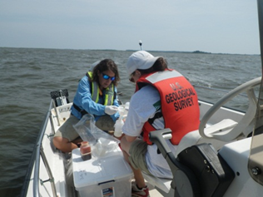
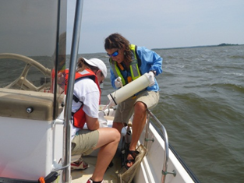
Fieldwork
Surface Water Sampling
Biological Sampling
Groundwater Sampling
Phytoplankton Sampling
(Albemarle Sound)
Notes:
USGS Hydrologic Technicians are involved in number of sampling activities……

Slide 3
Interested???
Bachelors or Associates in Environmental Field (Geology, Biology, Environmental Sciences)
Self-starter, motivated, dedicated, ability and desire to work as part of a team
Seek out internship opportunities as a student
Enroll www.usajobs.gov – post resume and set up email notification of employment opportunities
Notes:
If you think this type of job is for you… having a degree in a related science field is a must…. Other important characteristics are being a self-starter, motivated, dedicated, ….etc… it helps to seek out internship opportunities as a student and for all employment opportunities including student internships enroll at USA jobs

