Slide 1

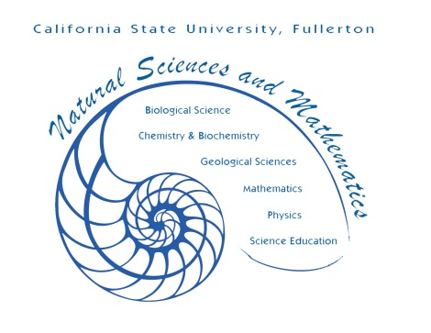
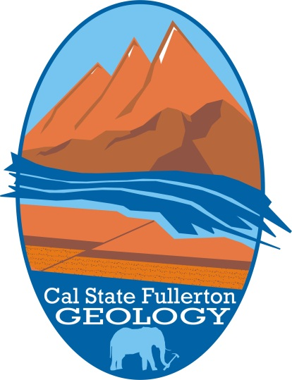
CSUF Geology Program
~120 students and 11 full-time faculty
Two Degree Paths
  B.S. Geology
    Traditional Geology degree
    Montana field camp
    Undergraduate Thesis
  B.A. Earth Sciences
    Flexible classes
    Acceptable for multi-subject science credential
  Scholarships
    Louis Stokes Minority Access Program
    Internships
    NAGT Field Camp Scholarships
    STEM² program for transfer students (stem2.fullerton.edu)

Slide 2
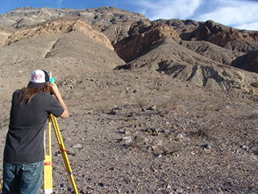
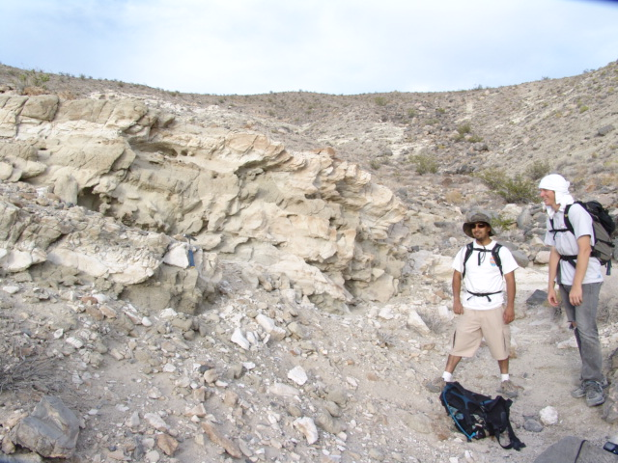
B. S. Geology
Core Classes
  Physical Geology
  Historical Geology
  Mapping
  Surface Processes
  Earth Materials
  Igneous/Metamorphic Petrology
  Structural Geology
  Sedimentology/Stratigraphy
  Geochemistry/Geophysics
  Undergraduate Thesis
  Field Camp

Slide 3
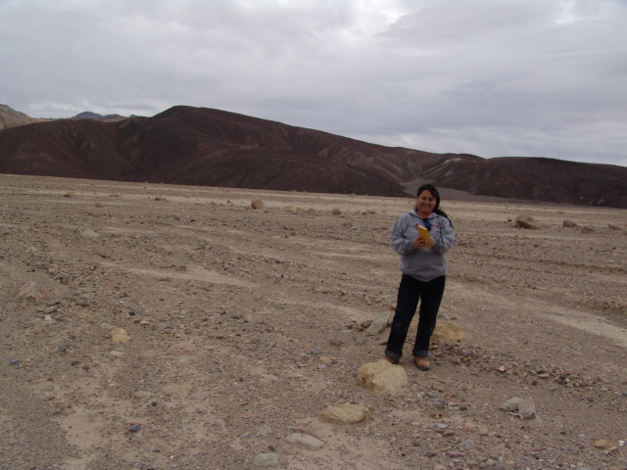
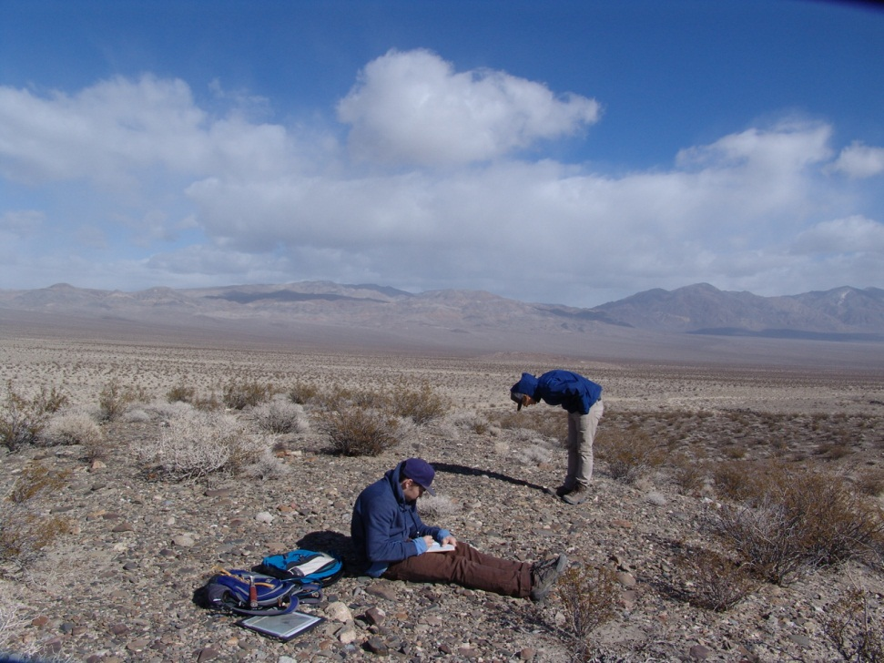
B.A.
Earth Science
Core Classes
  Physical Geology
  Historical Geology
  Mapping
  Surface Processes
  Oceanography (upper division)
  Environmental Planning/Advanced Earth Science
  ~30 Undesignated units
  2nd Year of degree
    ~30 students

Slide 4
What to Bring to CSUF
for B.S.
for B.A.
Geology
  Physical Geology + lab (101)
  Historical Geology
Math
  2 semesters of calculus (Math 150A & 150B) or
  1 semester of introduction to calculus and 1 semester statistics (Math 130 & 338)
Chemistry
  2 semesters with one lab (CHEM 120A & 125 or 120B)
Physics
  2 semesters with at least 1 lab (PHYS 225/225L and 226 or PHYS 211/211L and PHYS 212)
Biology
  1 semester (BIO 101)
Geology
  Physical Geology + lab (101)
  Historical Geology
Math
  1 semester of upper division math
Chemistry
  1 semester with one lab (CHEM 120A)
Physics
  1 semester with lab
Biology
  1 semester (BIO 101)
Geography
  Physical Geography (110)

Slide 5
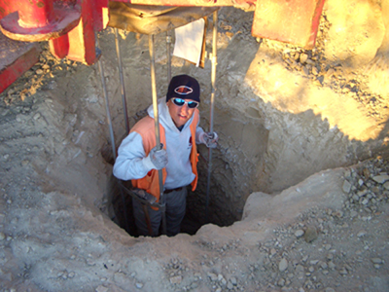
CAN I get a job from CSUF?
>90% employment as geologists
Internships
  Department internship (paid) program
    The Reynolds Group; Rock Springs Mining; So Cal Coastal Water Research
  Internships frequently lead to full-time employment.
  B.S. starting salaries are $40,000-$50,000
  Companies (last 5 years):
    Chevron – Houston/Bakersfield
    Anadarko – Denver
    NMG Geotechnical – Irvine
    Mountaineer Keystone – Pittsburgh
    GeoVision - Corona
    Harder & Assoc. – Yorba Linda
    URS – Santa Ana
    Wildermuth - Irvine
    Exponent - Irvine

Slide 6
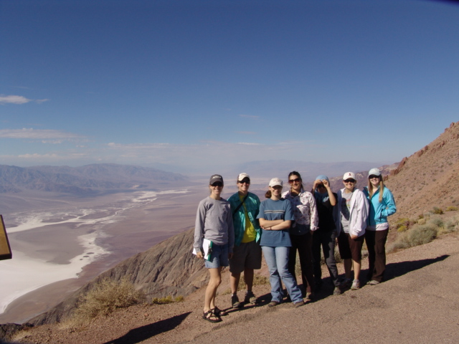
CAN I CONTINUE MY EDUCATION from CSUF?
Graduate School
2000-2011
  97 graduates
  47 (48%) to graduate school
  Wisconsin, Colorado School of Mines, Texas-Austin
  M.S. starting salaries are $50,000-$100,000
  Most graduate students are on graduate fellowships, so the cost of an M.S. degree is low.

Slide 7
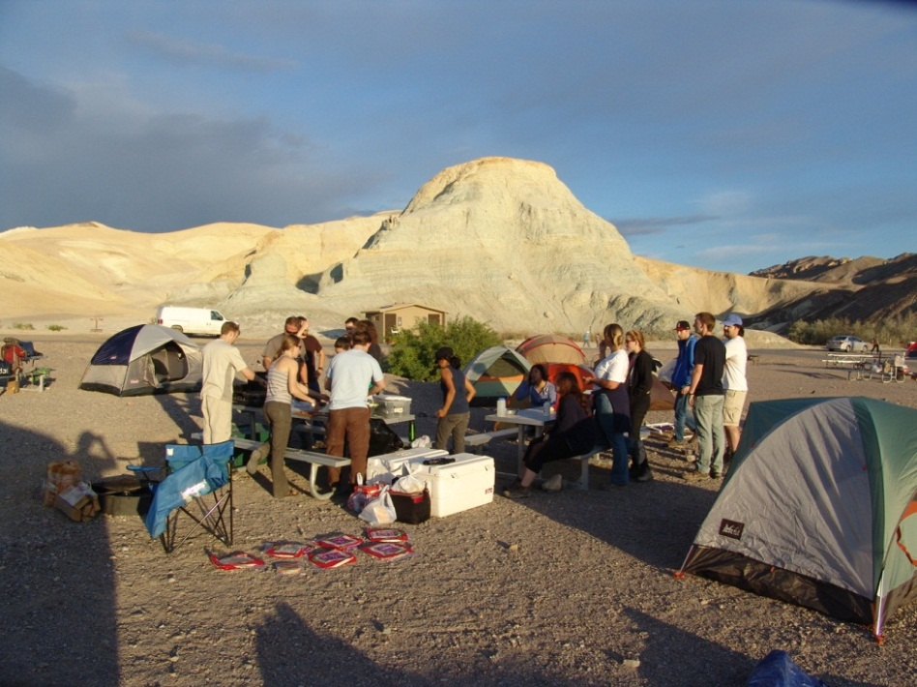
The Most Important TOOLS
Enthusiasm
  Show up for class on time
  Be willing to do the work
  “Act” like you want to be there
Chemistry
  Get along and help out
Flexibility
  Set aside the time to do well; good things will happen
  Be willing to try new things
Commitment
  Put in a little extra time
  I can “help” anyone, but I can’t “do” it for you.

