Slide 1
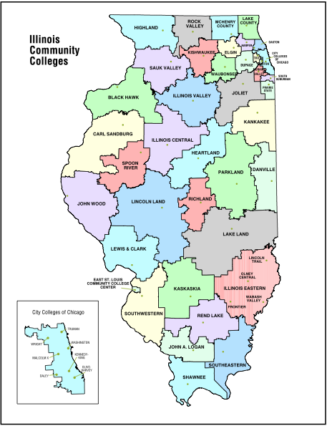
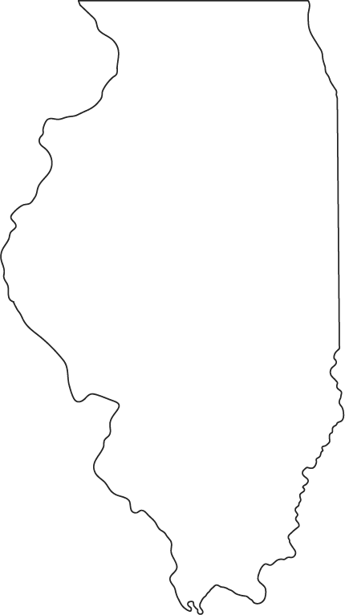

IAGI
6th Annual Meeting
1 March 2013

Slide 2
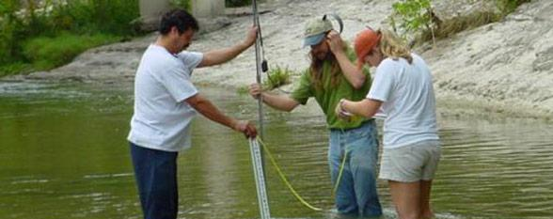
What are we preparing our students for
Workforce
  Key Elements and Types
Transfer to 4YC
Beyond
  M.S.
  Ph.D.
  Career

Slide 3
Workforce Key Elements
Focus on local natural resource, environmental, and geospatial needs
Degree programs have both college-transfer and technical courses
Faculty have practical experience and at least AAS or BS degrees
Mandatory internships
A.A.S. degrees and Certificates

Slide 4
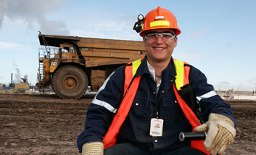
Workforce Students
Urgent need for experience or income
Strong mechanical, electronic, computer, or lab skills
Limited advanced math education or aptitude
Strongly place-bound outlook

Slide 5
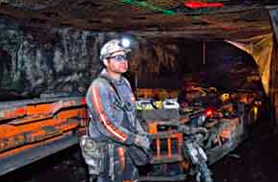
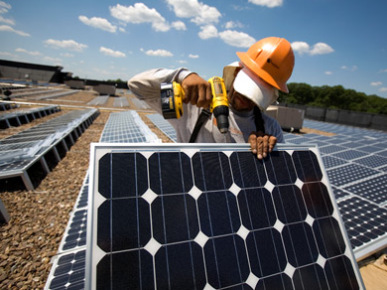
Employment Opportunities
Hydrologic or hydrographic technician
Water or soil sampling technician
Well logging specialist
Well drilling/sampling technician
Mapping/site assessment assistant
Erosion and sediment control technician
Land/Water management & conservation
Environmental science / technology
Coal Mining Technology
Oil and gas
Green collar worker

Slide 6
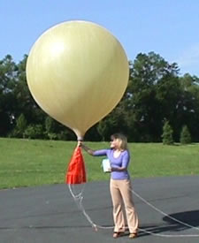
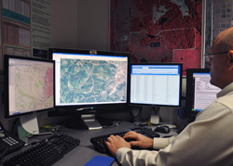
Employment Opportunities
Regulatory compliance specialist
Geophysical equipment operator
Oceanographic/limnologic technician
GIS or remote sensing technician
Weather observer

Slide 7
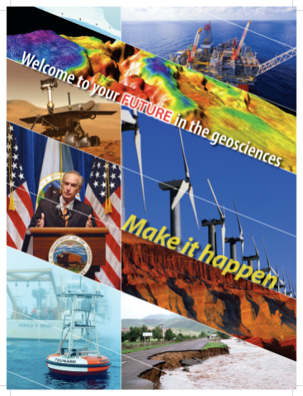
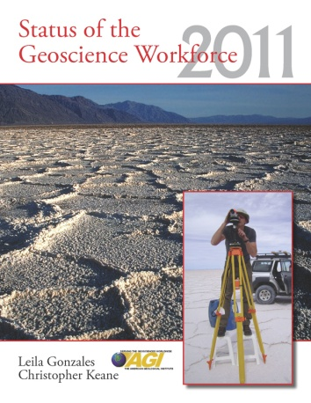

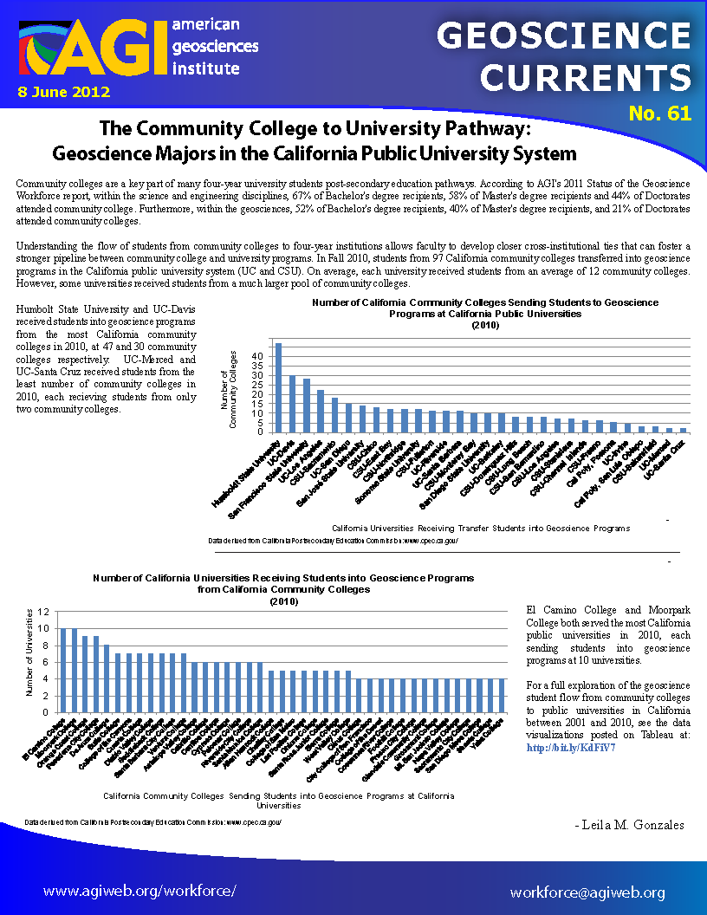

Geoscience transfer
Heather Houlton
Christopher Keane
Carolyn Wilson

Slide 8
Snapshot of Geoscience Degrees - 2010
~140 2YC with Geo Programs
28 of these report awarding 83 Associate’s degrees in Geoscience
  20% awarding rate
~700 4YC with Geo Programs
421 of these awarded Bachelor’s degrees
  65% awarding rate

Slide 9
Geoscientists who attended 2YC’s
Bachelor’s level:
  52% attended a 2YC at some point
  19% received an Associate’s degree
Master’s level:
  47% attended a 2YC at some point
  9% received an Associate’s degree
Doctorate level:
  17% attended a 2YC at some point
  4% earned an Associate’s degree

Slide 10
Where Geoscientists Work – by degree

Slide 11
AGI, 2010, Geoscience Currents

Slide 12
Where do Geoscientists work

Slide 13
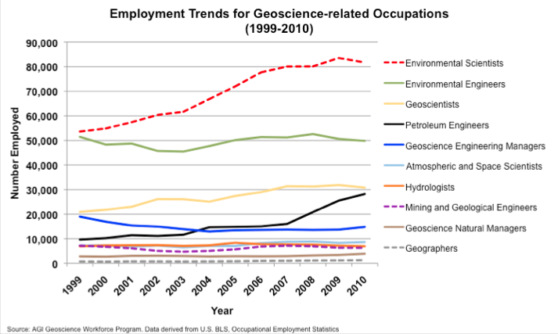
AGI, 2011, Geoscience Currents

Slide 14
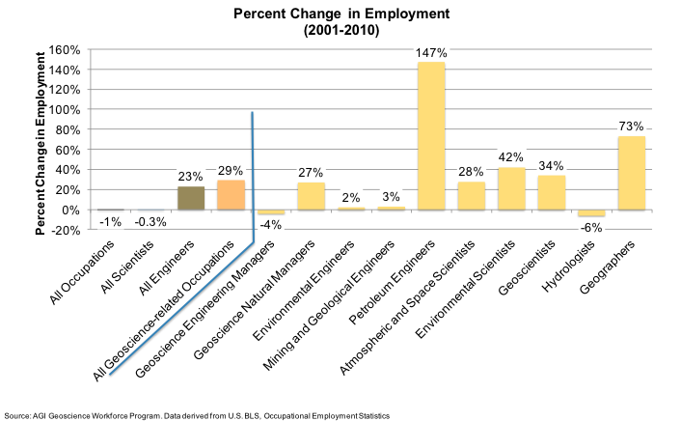
AGI, 2011, Geoscience Currents

Slide 15
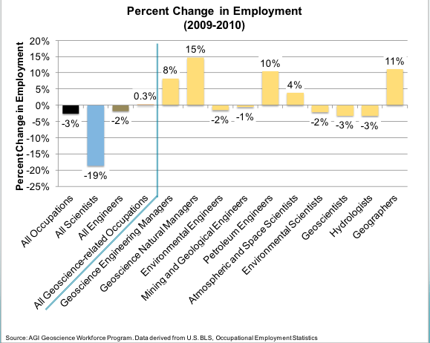
AGI, 2011, Geoscience Currents

Slide 16

Attrition, Growth and Replacement
in the next 10 years in the U.S.
262,627 geoscience jobs today
Geoscience Grads Continuing on to Geoscience Careers
~130,000 geoscientists expected to retire
Bachelor’s: 30%
Master’s: 43%
Doctorate: 66%
72,000 geoscience job growth by 2021 (BLS)
15,000 total new graduates (MS or PhD)
45,000 total new graduates if hiring BS/BA
OR
Net deficit of over 150,000 geoscientists by 2021

Slide 17
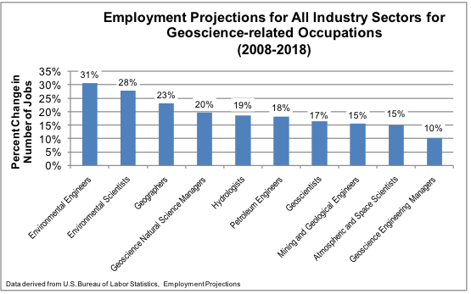
AGI, 2011, Geoscience Currents

Slide 18
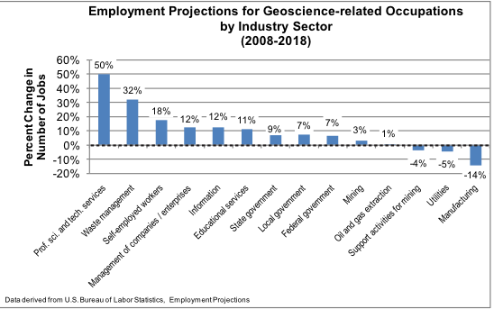
AGI, 2011, Geoscience Currents

Slide 19
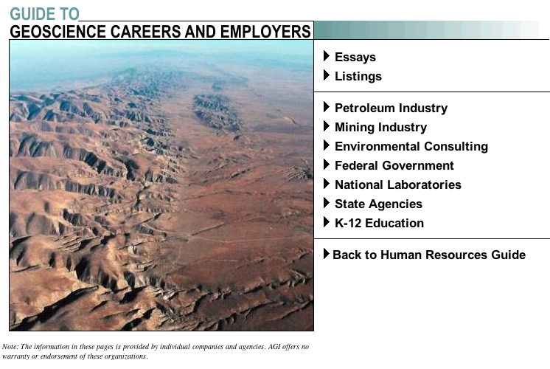
http://guide.agiweb.org/employer/index.html

Slide 20
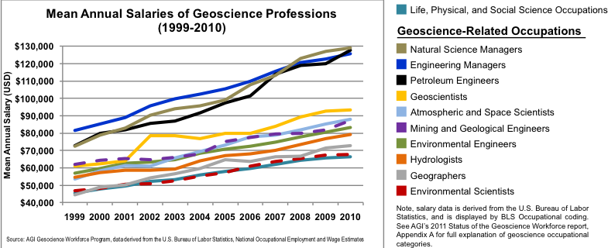
AGI, 2011, Geoscience Currents

Slide 21
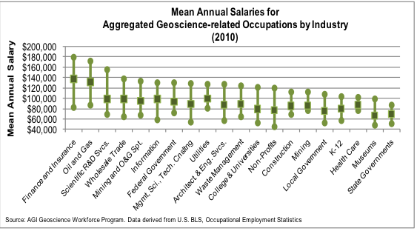
AGI, 2011, Geoscience Currents

Slide 22
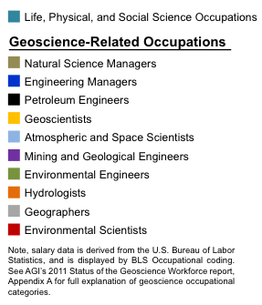
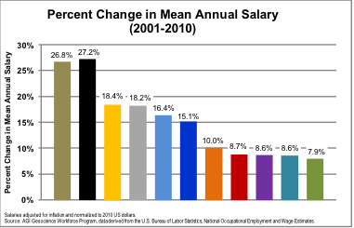
AGI, 2011, Geoscience Currents

Slide 23
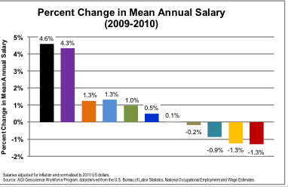
2009-2010
Geoscience increase 1.1%
All Life, Physical & Social Sciences decrease 0.9%
All US occupations increase 0.2%
AGI, 2011, Geoscience Currents

Slide 24
What can I earn?
B.S. Oil & Gas $88,500 (AAPG Explorer, 2011 survey)
B.S. Environmental/Hydro $31,366 (2009 AGI survey)
M.S. Oil & Gas $99,000 (AAPG Explorer, 2011 survey)
M.S. Environmental/Hydro $47,500 (2009 AGI survey)
Ph.D. Oil & Gas $108,300 (AAPG Explorer, 2011 survey)
Ph.D. $72,600 (2009 AGI survey)

Slide 25
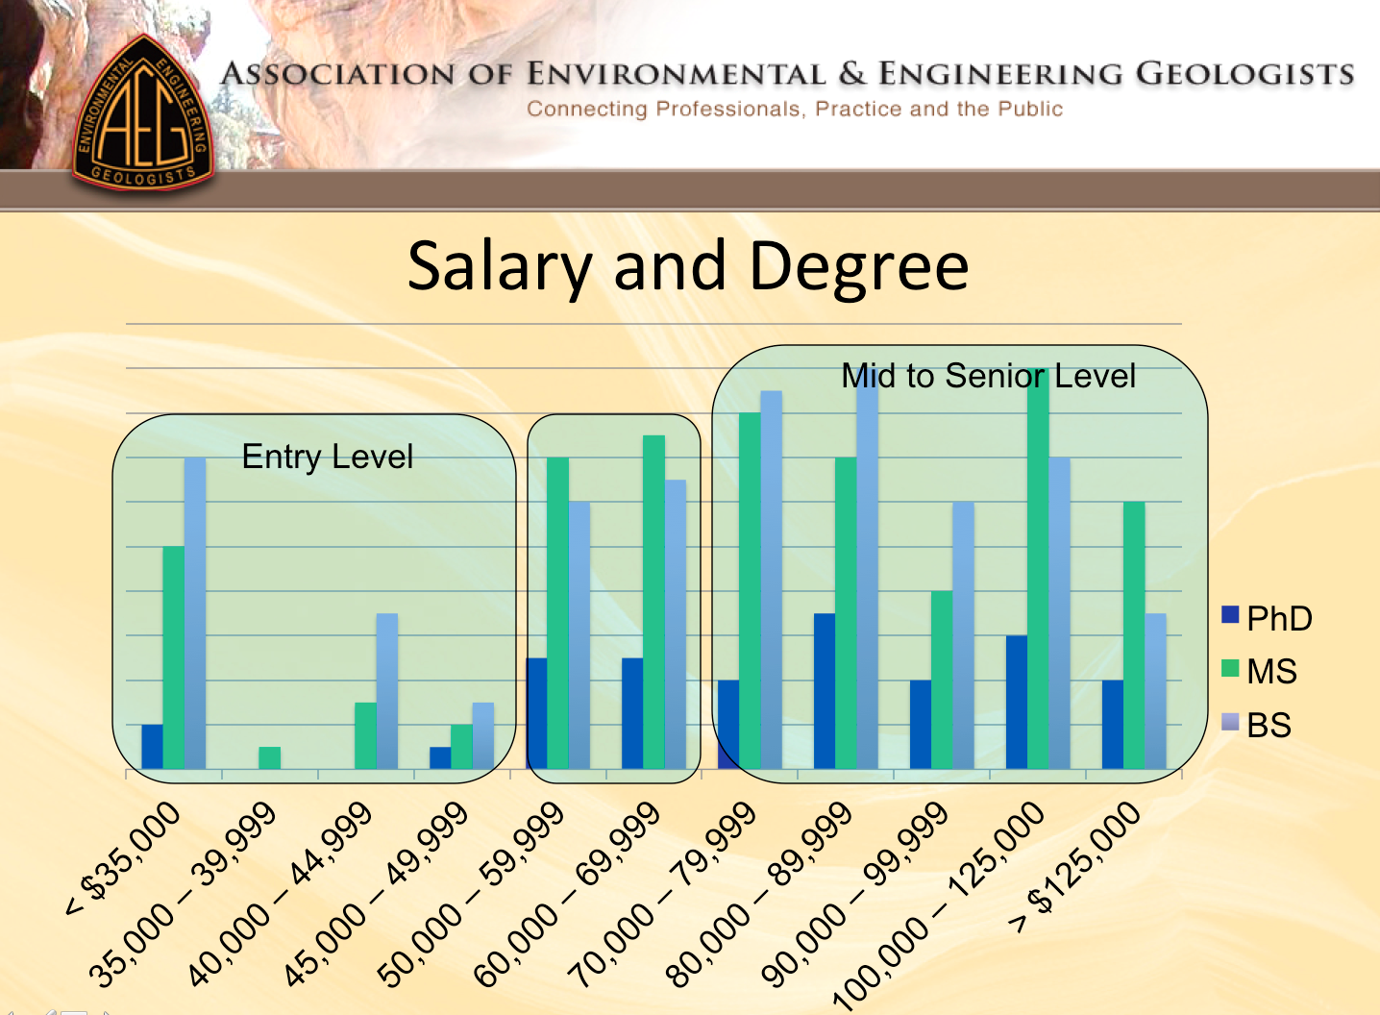
July 2012

Slide 26
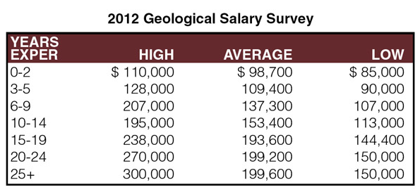
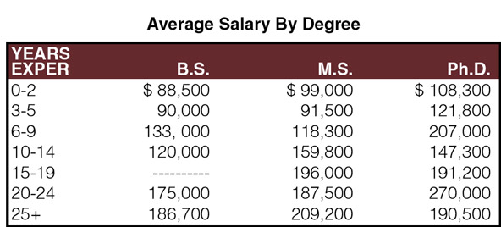
AAPG 2012
8% inc in 2010,
2% inc 2012
44% >25 years
Experience,
2012

