Slide 1
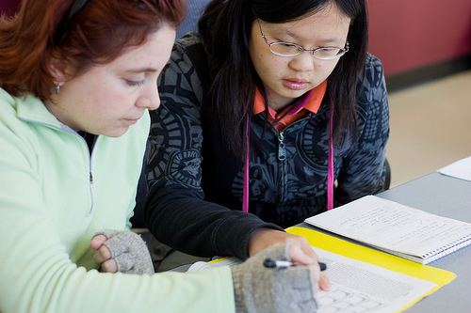
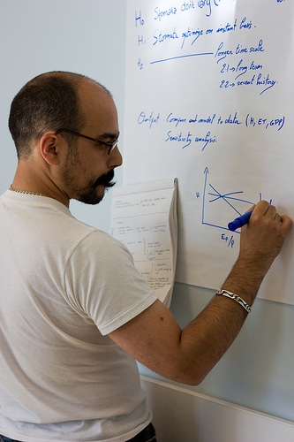
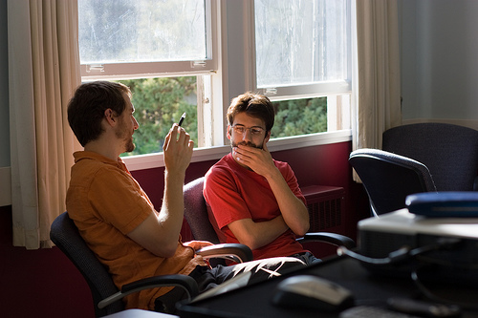
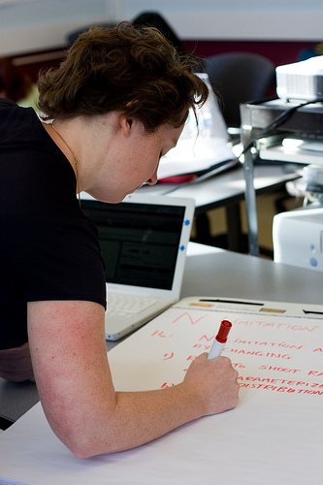
Summer Synthesis Institutes
A Novel Approach for Transformative Research and Student Career Development
Jennifer Wilson, University of Illinois
Caroline Hermans, City University of New York

Slide 2
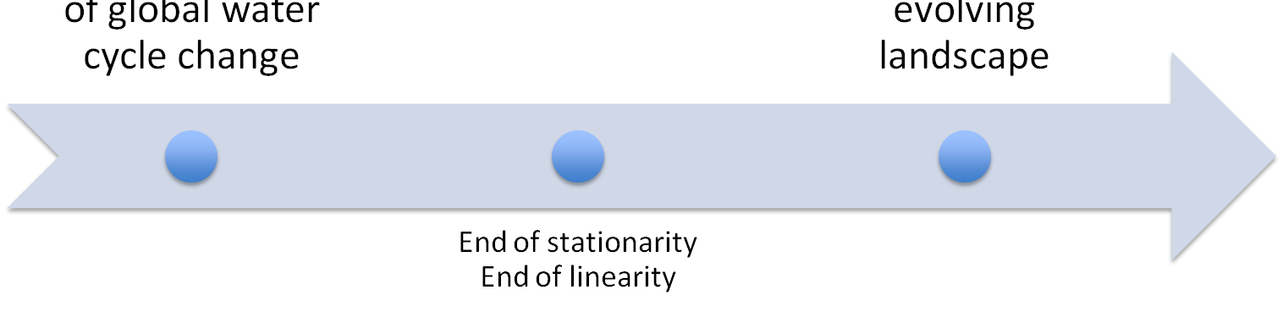
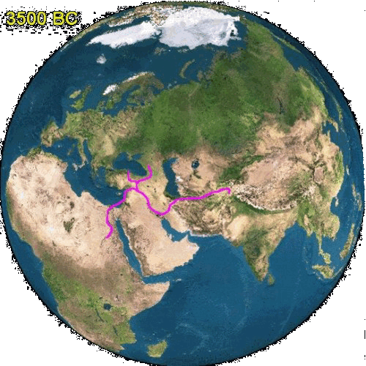
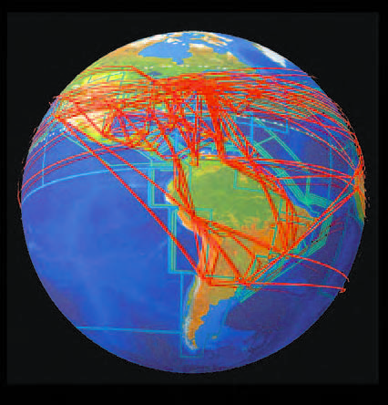
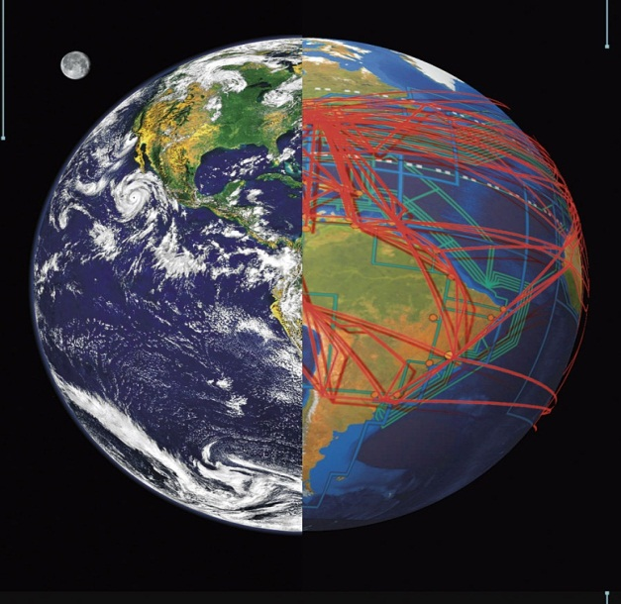
PRAVEEN KUMAR
The Context
Natural systems don’t exist, they evolve
HUMANS AS DRIVERS
OF GLOBAL WATER
CYCLE CHANGE
END OF STATIONARITY
END OF LINEARITY
START OF COMPLEXITY
HYDROLOGY
OF AN EVOLVING
LANDSCAPE

Slide 3
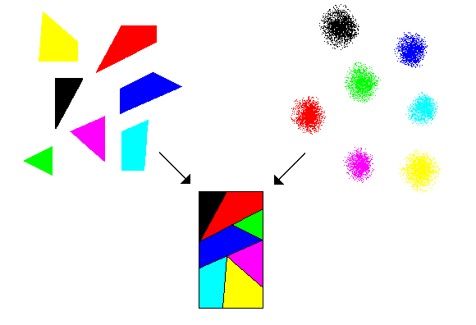
The Solution
synthesis as a scientific & process mechanism
for understanding evolving hydrologic systems
“making mutually intelligible previously fragmented knowledge or understanding or different disciplinary perspectives of the same phenomenon across times, places, scales and/or disciplines”

Slide 4


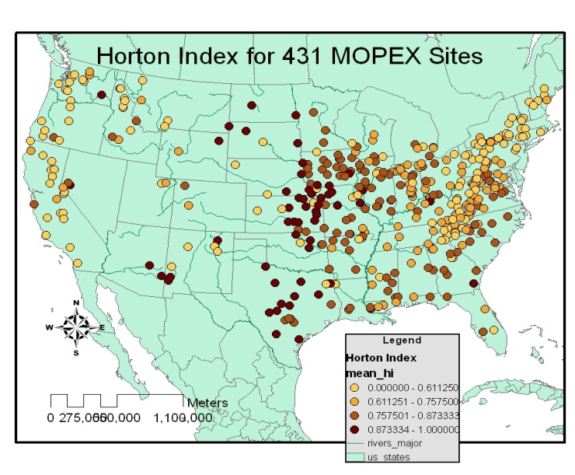
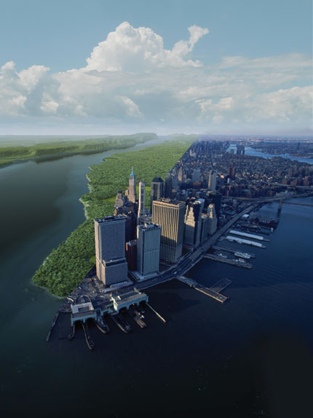

Two ‘Hydrologic Synthesis’ Projects
University of Illinois
PI, M. Sivapalan
City University of New York
PI, C. Vörösmarty
SCIENCE
Using patterns to improve predictability
Reconstructing the hydrologic record
PROCESS

Slide 5
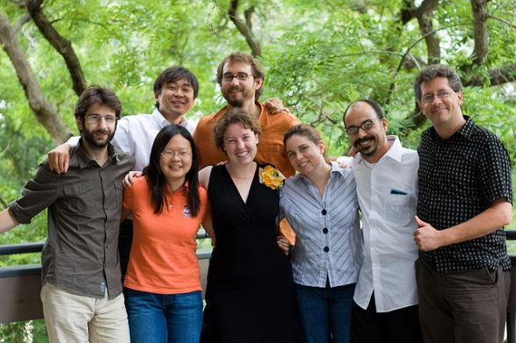
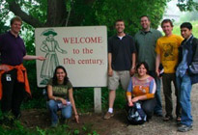
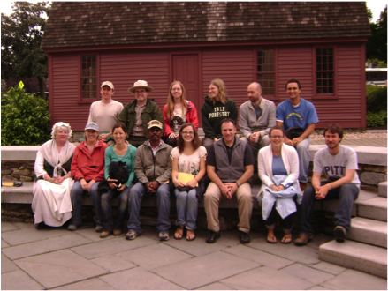
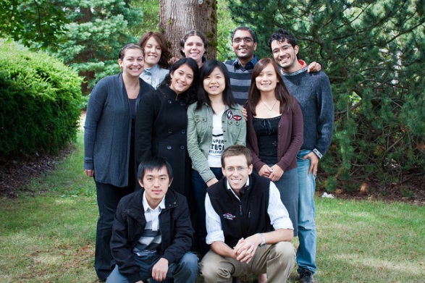
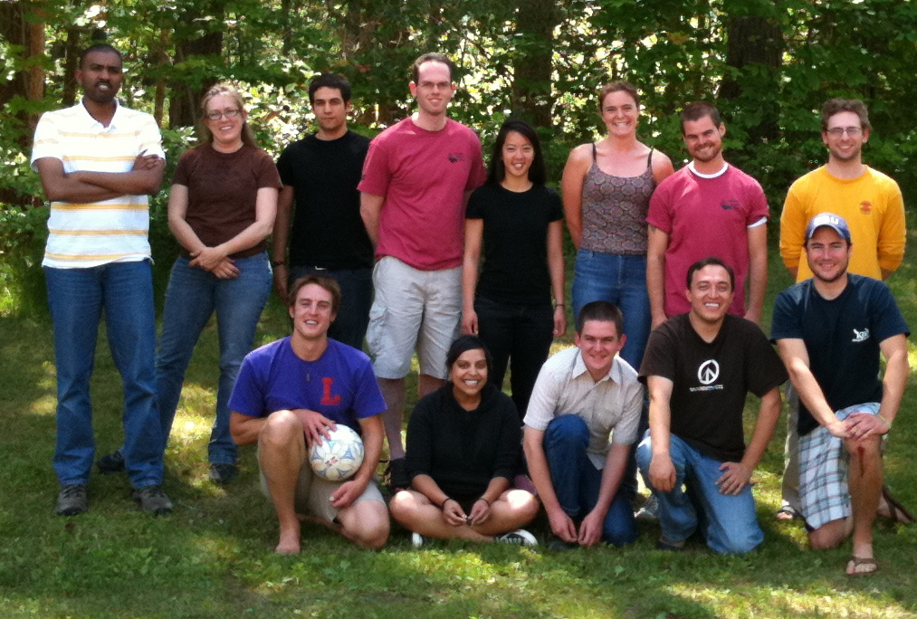
5 Synthesis Summer Institutes
2009
2008
2010
2009
50+ students from early MS to final year of PhD
2010
UIUC: Vancouver, BC | CUNY: New York, NY
UIUC: sub-disciplinary | CUNY: inter-disciplinary

Slide 6





The Outcomes
5 special sessions at AGU Fall Meeting: 2008 - 2010
60+ papers: from in preparation to published

Slide 7
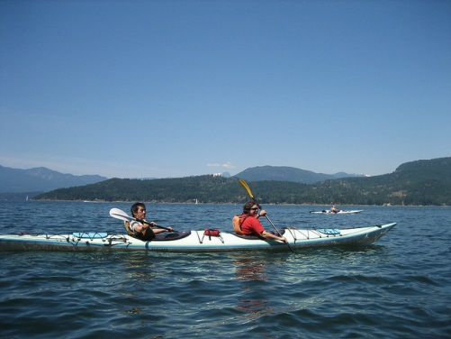
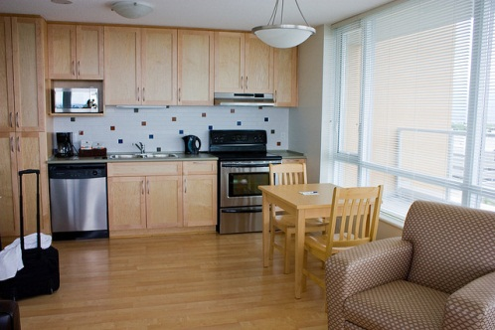
Logistical Details
IN-RESIDENCE MENTORS
COLLABORATIVE COMPUTING
Always available, serving as mentors and peers in research
Field schedules can make planning difficult
$ incentive lacking in these projects, but needs to exist for sustainability
UIUC team used Central Desktop collaborative workspace
CUNY team identified need for robust soft data collection system
RECREATION OPPORTUNITIES
Need to find balance between de-stressing & distraction
LIVING ARRANGEMENTS
Residential living helps students bond
Can facilitate a culture of evening work
FINANCIAL DETAILS
A residential summer institute costs
$75-100K, depending on the location, number of students and whether the students are paid a stipend
Fewer living-based (mostly academic) interpersonal conflicts at the graduate student level

Slide 8
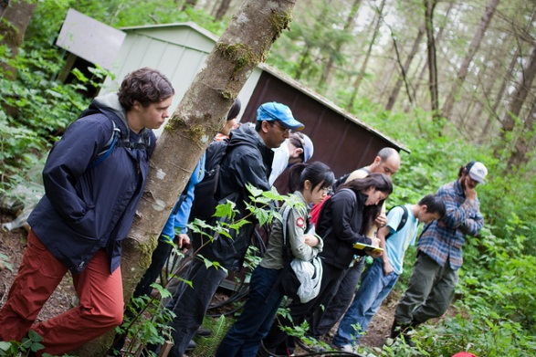
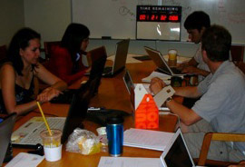
Team Dynamics
Role of the Mentor
To reinforce a positive work environment
To coach students out of their comfort zone
To break down any language barriers – disciplinary & cultural
Leaders
Helpers
Doers
Followers
experience

Slide 9
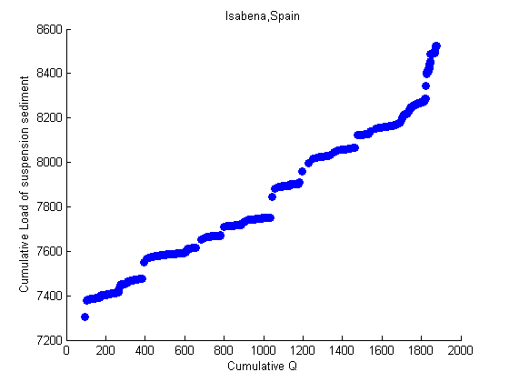
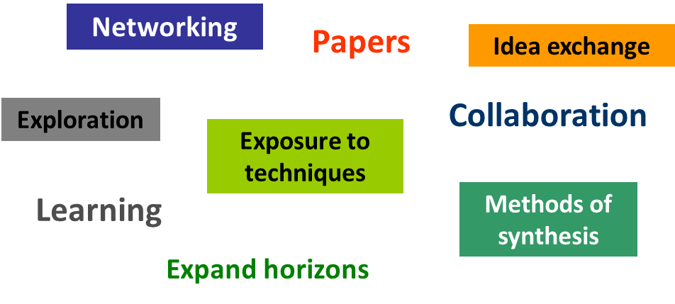
Value of Immersion & Intensity
“Many obstacles to effective collaboration can only be
removed from the path by
intensive collaboration.”
- Tom Raadgever,
in Does collaboration enhance learning?
UIUC team working on a paper for HP Today

Slide 10
18 Months of Summer
Planning topics
Recruiting mentors
Advertise for students
SUMMER
INSTITUTE
Follow-up work
Paper submissions
…
students & mentors working on their own research
students & mentors working on their own research
JAN
MAR
MAY
JUL
SEP
NOV
JAN
MAR
MAY
JUL
AGU abstracts
Collaborative
writing & editing
Deliver reading materials
Host introductory webinars
AGU posters & talks

Slide 11
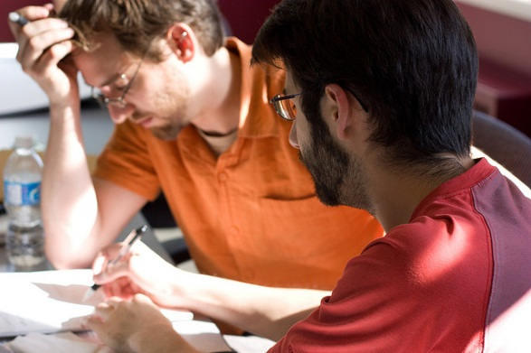
Career Impacts
“…a stellar group of students… challenging the mentors to keep up…requires LOTS of experience [by mentors]…rewards are tremendous…”
- mentor
“The students have been exposed to a whole new way of doing research, a lesson they will carry with them for the rest of their career.”
- mentor
“The summer institute was 6 weeks of the most
intensive, productive work I have ever done.”
- student
“I left committed to approaching science
in novel ways & in collaborative partnerships.”
– student
“I had an amazing experience this summer…what I wasn't expecting was to learn so much about the research process and how to work with others.”
– student

Slide 12
Lessons Learned
Ask references about a student’s ability to work in a team environment
There is a delicate balance of pushing students to achieve & overworking them
Don’t plan everything completely –creativity is essential to the process
Minimization of distraction & required residency is essential to immersion
Build in extra time for cross-training, don’t pigeon-hole students based on expertise
Strong mentorship is key to successful student experience/outcomes
Understand group dynamics and coach students on ‘how-to’s’ of collaboration and team work
Buy-in from students’ advisors is helpful for follow-up engagement & success
Organized recreational activities or field trips, at the beginning of the summer assist with team-building
Be flexible and willing to change course if group process not working

Slide 13
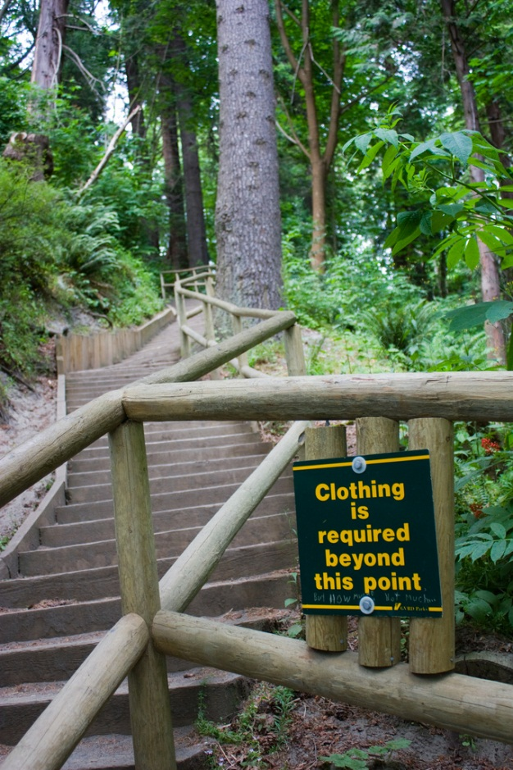
Thurs: Predicting Behavior of Freshwater Systems in a Changing Environment
Thurs & Fri: Detecting and Predicting Change in Coupled Human-Water Systems I
QUESTIONS?
Jennifer Wilson
jswilson@illinois.edu
Caroline Hermans
chermans@ccny.cuny.edu

