Slide 1
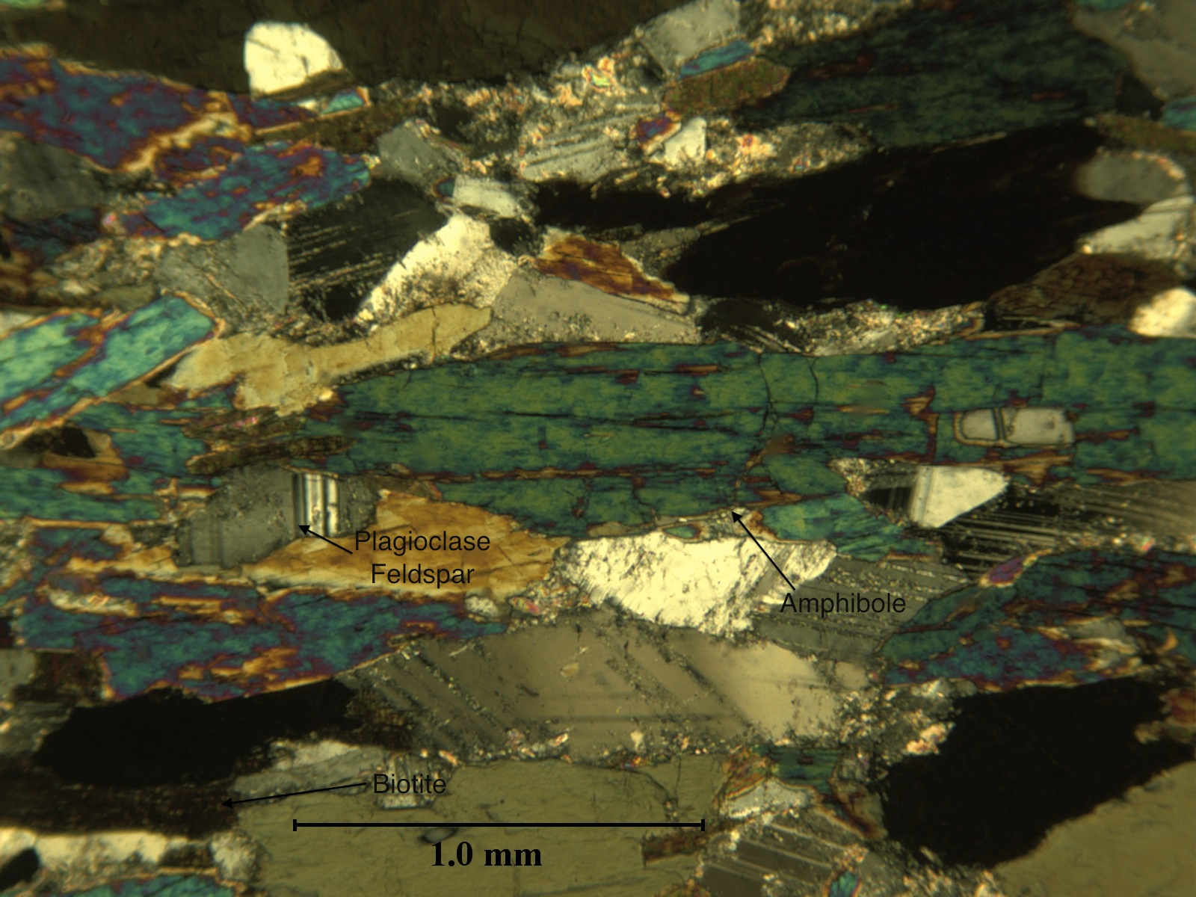
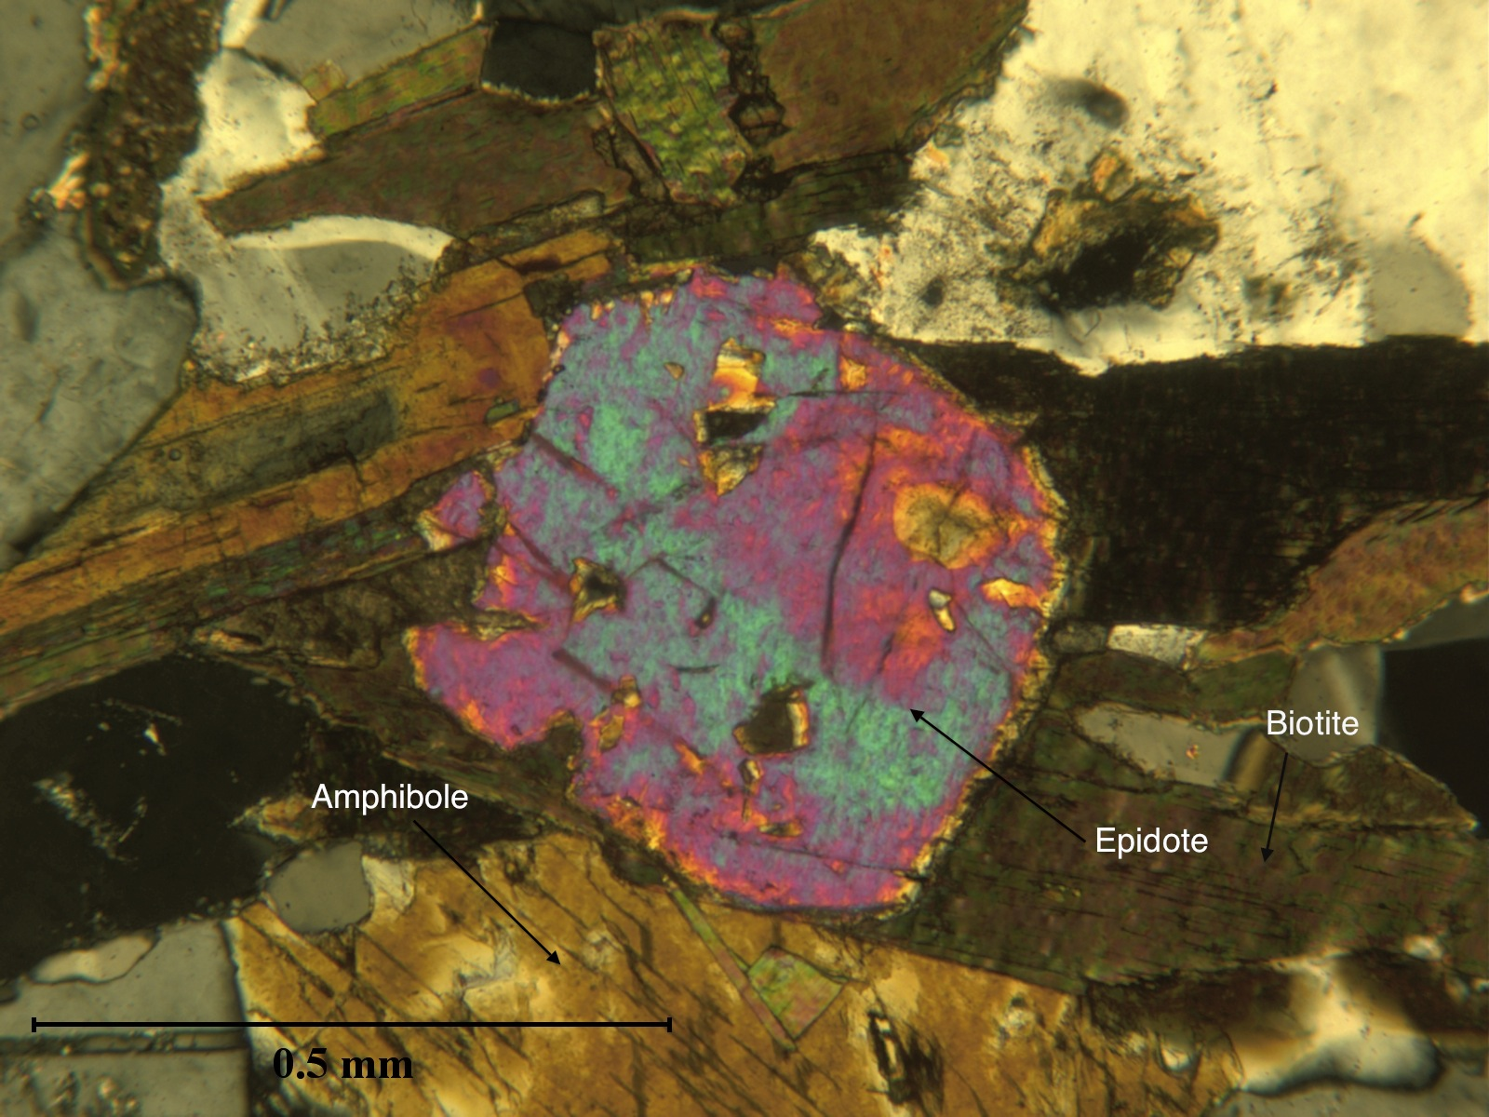
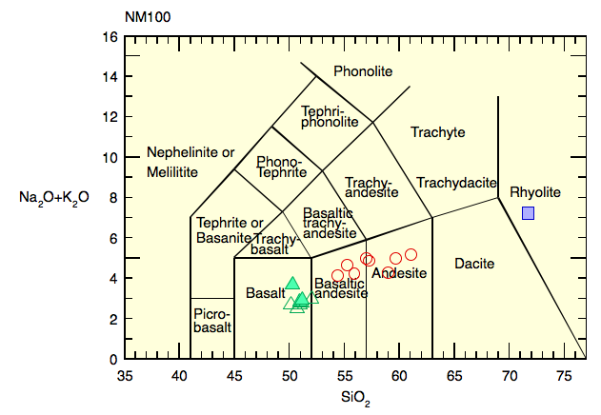
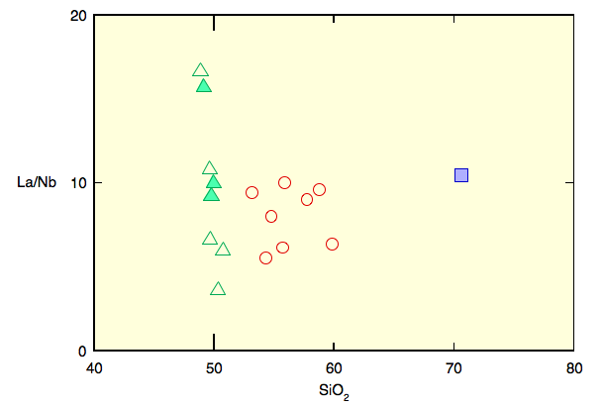
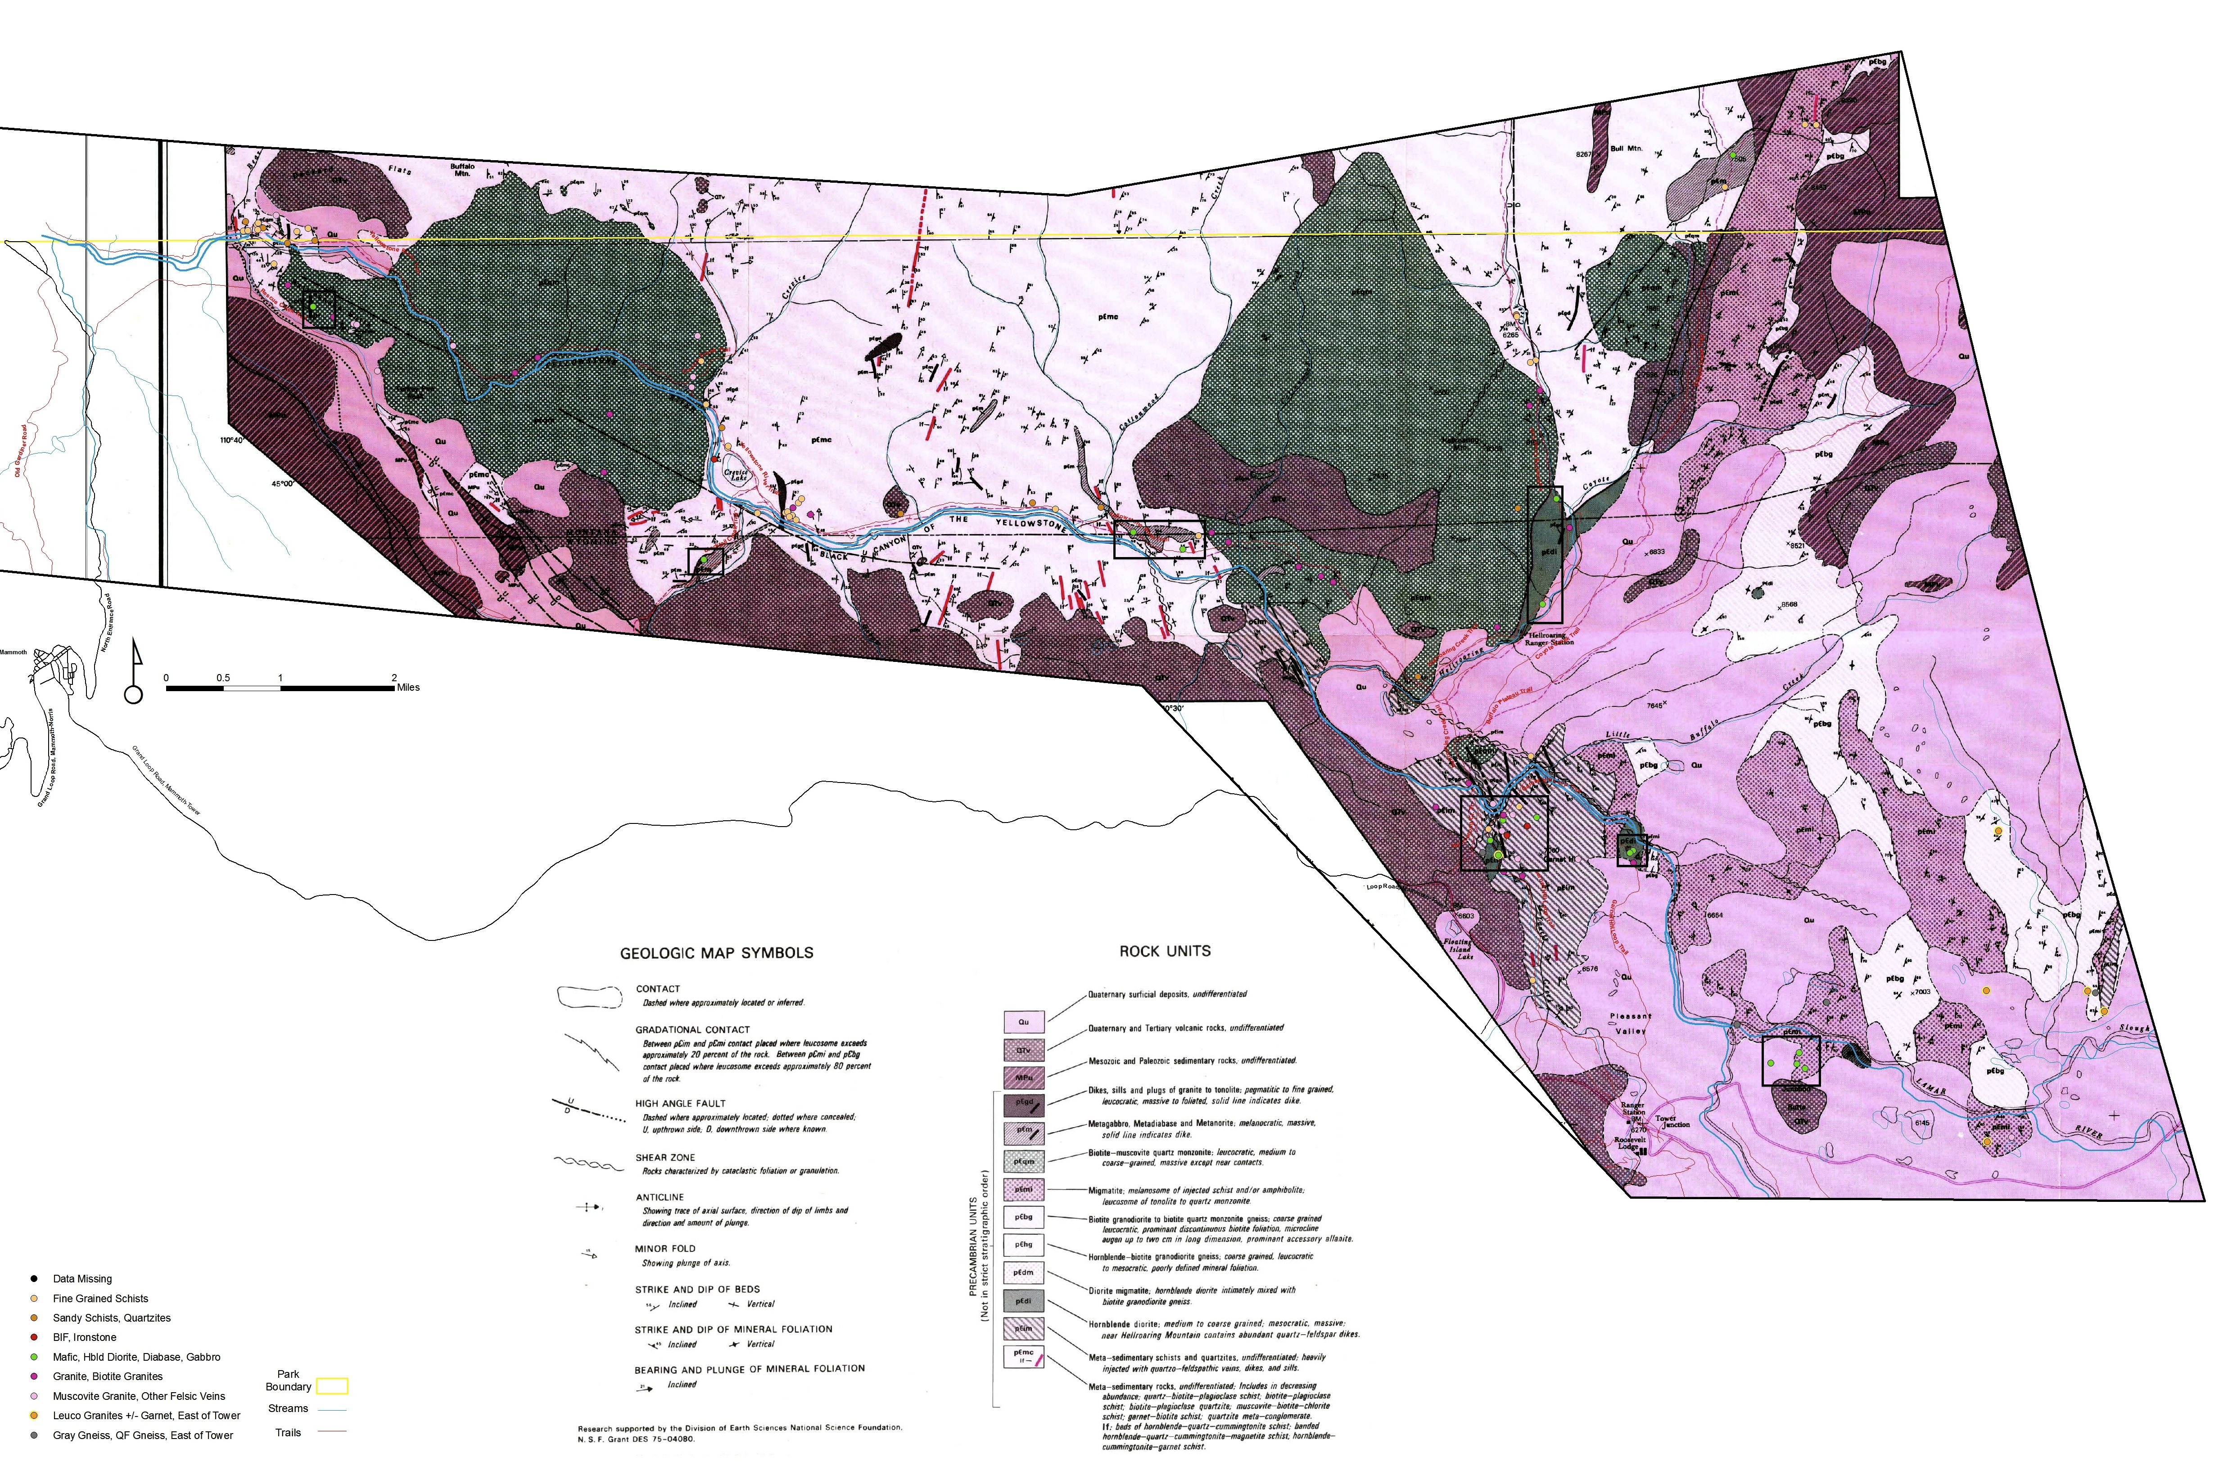
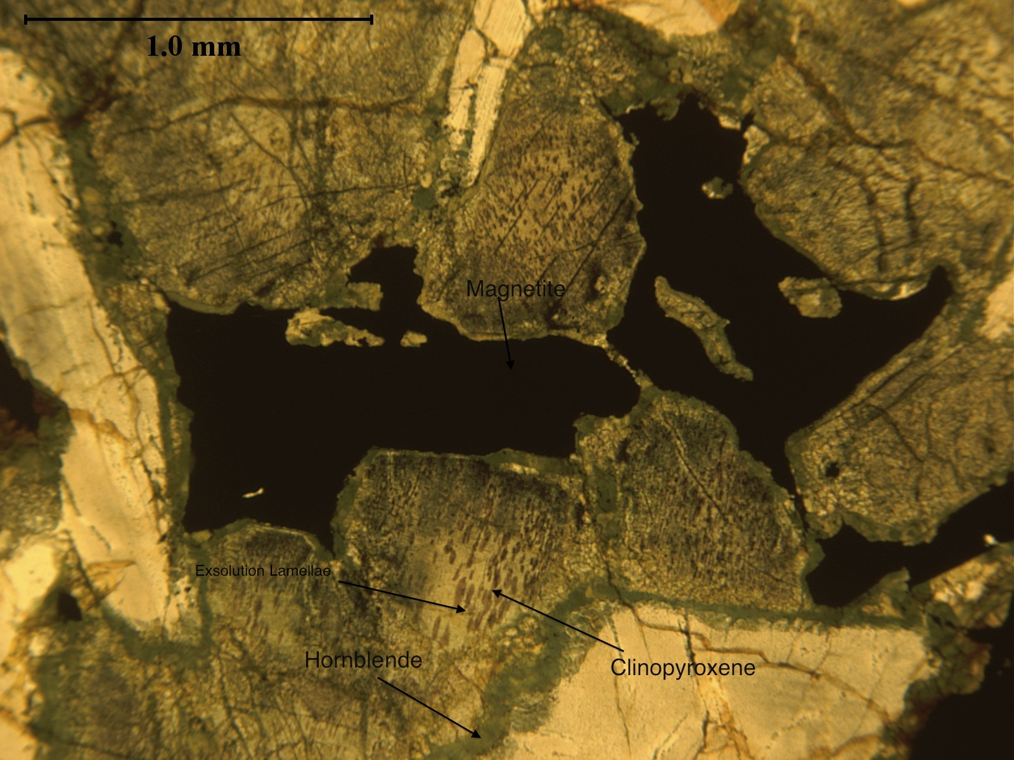
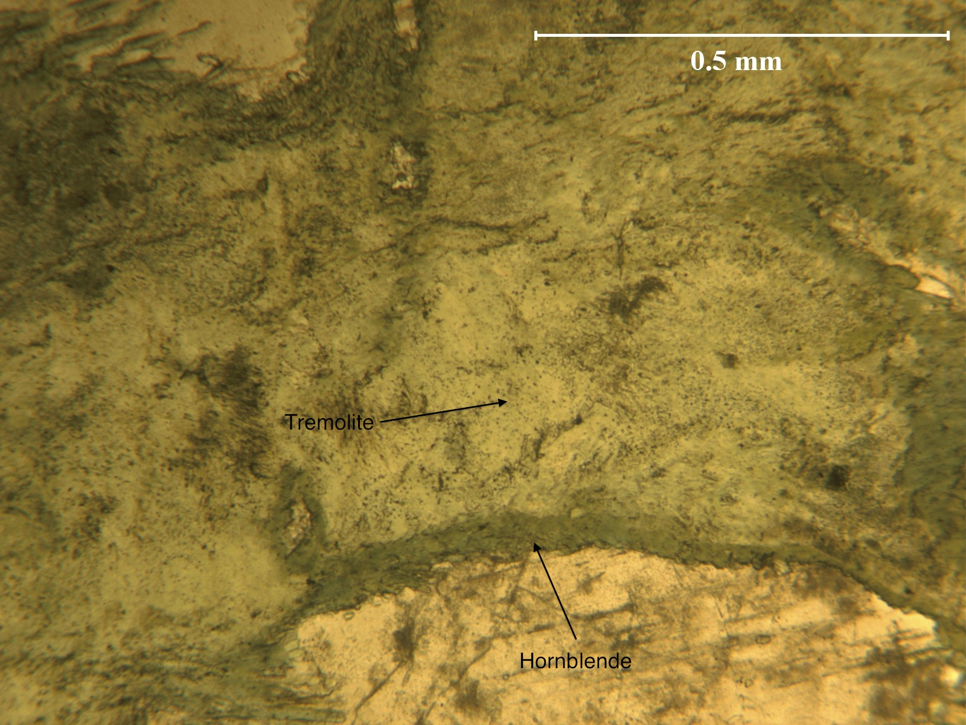
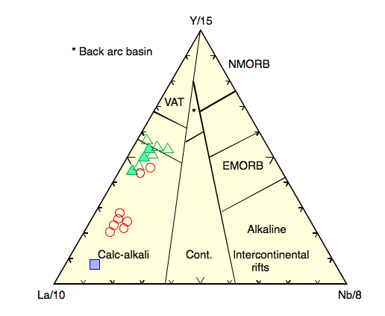
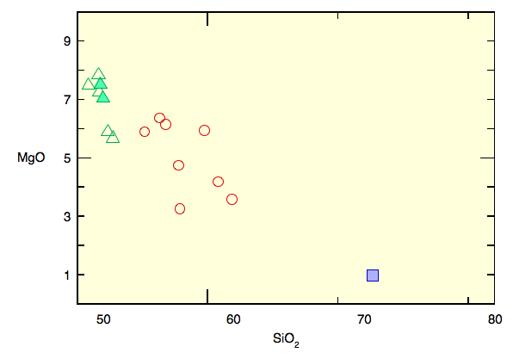
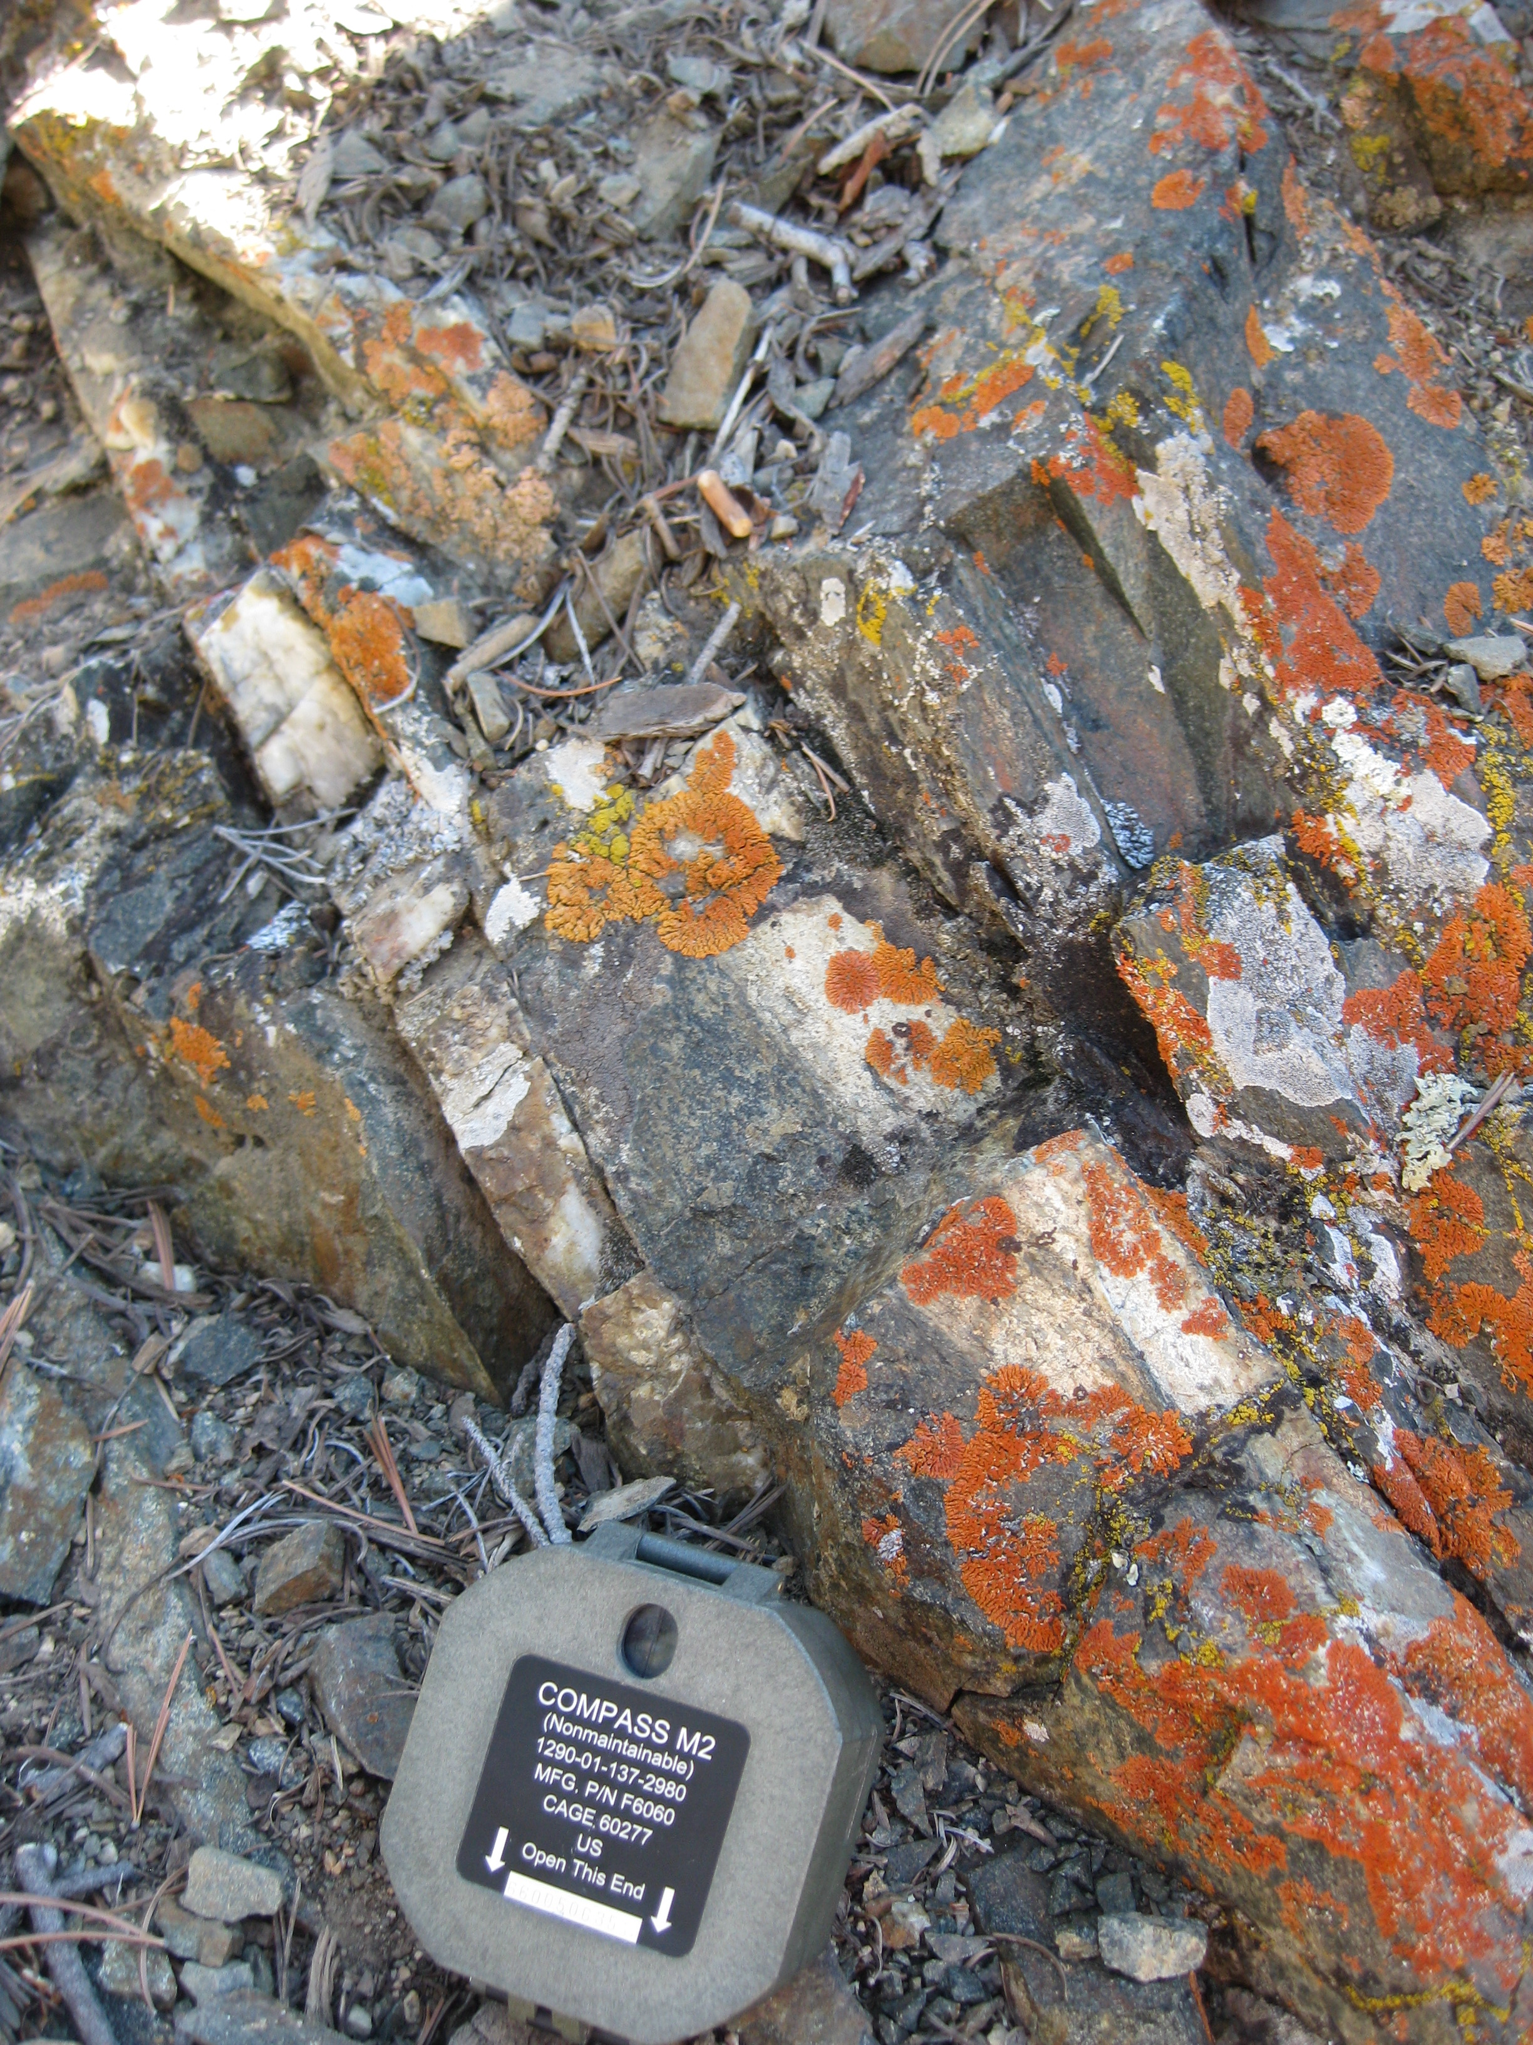
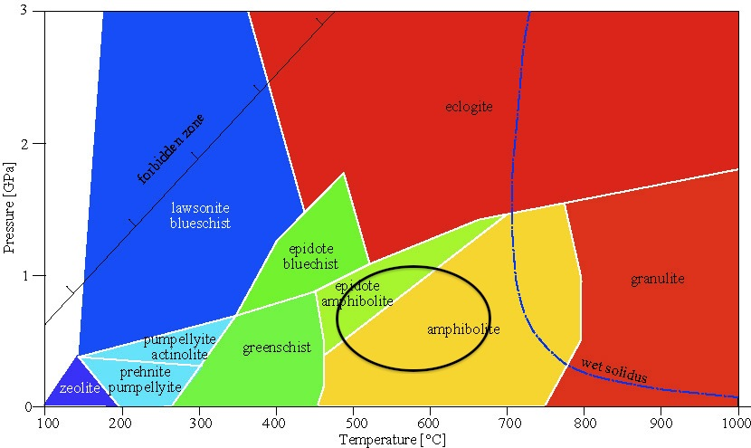


Evolution of the Precambrian Rocks of Yellowstone National Park (YNP): Mafic to Intermediate Plutons
Patrick Maloney¹, Stanley Mertzman^{1,} Darrell Henry², David Mogk³, Paul Mueller⁴, and David Foster⁴
¹Franklin and Marshall College, ²Louisiana State Univ.,³Montana State Univ., ⁴Univ. of Florida
Introduction and Scientific Rationale
Field Relations
Petrography
Geochemistry
Geochronology
Conclusions
Mafic and Intermediate igneous rocks are exposed throughout northern Yellowstone National Park. These were briefly described and mapped by Casella et al. (1988) as amphibolites, hornblende diorites, and metagabbros scattered throughout the study area in small, isolated patches. The purpose of this study is to:
Describe the field relations, petrology and petrography of the mafic plutons in the study area,
Characterize the geochemistry of this suite of rocks and determine the age(s) of crystallization, and,
Use these data to interpret the petrogenetic processes, tectonic setting and role in the evolution of this Archean continental crust.
Many of these mafic bodies occur as sheets that cut regional foliation or as tens of meters-scale lenticular bodies that are generally conformable with foliation. On Garnet Hill, the mafic bodies occur in an injected migmatitic complex that cuts across, quartz monzonitic and tonalitic stocks and regionally metamorphosed pelitic schists.
Pb²⁰⁷/Pb²⁰⁶ LA-ICP-MS Age Date
Age was obtained for Hornblende Diorite Body from Garnet Hill to determine its temporal relationship to the Quartz Monzonite stocks
Pb²⁰⁷/Pb²⁰⁶ ratios were used to determine the age of zircons contained within the rock using Laser Ablation Inductively Coupled Mass Spectrometry (LA-ICP-MS)
10-PM-7-14-01: 2.815 ± 0.009 Ga (2σ)
10-DM-7-03-03: 2.798 ± 0.004 Ga (2σ)
Samples can be split into 2 distinct geochemical groups: Mafic and Intermediate
Petrography shows evidence of variable retrograde and prograde metamorphism in the epidote-amphibolite and amphibolite facies
  Variable amounts of metamorphic fabric
Generally characterized by calc-alkaline geochemistry
  Indicative of a subduction-related origin
Trace element geochemistry shows depletion of HFSE (La, Y, Nb)
  Origins are in a subduction-tectonics setting
    Continental Arc
    Nb depletion indicates altered subcontinental mantle as the source
Similar to the Long Lake Magmatic Complex (cogenetic) in mineralogy, geochemistry, and age (2.8-2.9 Ga)
  Possibly a shallower crustal equivalent of LLMC
Depth of Emplacement was 12-15 km based on thermobarometry of metamorphic assemblages in country rock (metapelitic schists)
Discrimination diagram plotting total alkali vs. SiO_{2.} Samples plot in the basalt, basaltic andesite, and andesite range. This range is similar to the LLMC.
La/Nb vs. SiO₂: La/Nb ratios show depletion of Nb, which is indicatve of subduction related processes. La & Nb are both HFSE (relatively immobile)
Rattlesnake Butte Amphibolite
Perpendicular to ridge axis
Amphibolite knob (differential weathering) is cut by Rattlesnake Butte quartz monzonite
Amphibolitic, salt and pepper texture on weathered surface. Fresh surface exhibits strong alignment of dark green to black hornblende laths in a subophitic, amphibolite texture with plagioclase
Felsic veins and quartz boudins injected from qtz monzonite into amphibolite are subparallel to metamorphic fabric of Amphibolite
Main foliation of amphibolite: 007, 77° E & 009, 69° E
10-PM-7-13-03: Amphibolite with hornblende and biotite grains that define foliation.
10-DM-7-03-03: Textural equilibrium of hornblende, epidote, and biotite
Geochemical Characteristics-Majors
Majors | GROUP 1: MAFIC |  | GROUP 2: INTERMEDIATE
 | Maximum | Minimum | Maximum | Minimum
SiO₂ | 50.7 | 48.82 | 58.83 | 53.18
TiO₂ | 1.18 | 0.38 | 0.93 | 0.53
Al₂O₃ | 14.98 | 13.93 | 17.72 | 14.83
Fe₂O₃ | 7.35 | 1.67 | 3.6 | 1.7
FeO | 11.79 | 5.51 | 6.47 | 5.48
MnO | 0.23 | 0.18 | 0.18 | 0.13
MgO | 10.25 | 5.69 | 6.36 | 3.26
CaO | 10.81 | 8.89 | 8.85 | 5.75
Na₂O | 2.37 | 1.65 | 3.52 | 2.61
K₂O | 1.47 | 0.33 | 2.24 | 1.05
P₂O₅ | 0.11 | 0.05 | 0.5 | 0.07
Fe₂O₃T | 15.32 | 10.05 | 10.13 | 8.7
low-silica adakite field
high-silica adakite field
Geochemical Characteristics-Trace
Trace | GROUP 1: MAFIC |  | GROUP 2: INTERMEDIATE
 | Maximum | Minimum | Maximum | Minimum
Rb | 54 | 9.5 | 88 | 25.9
Sr | 150 | 79 | 481 | 171
Y | 32.1 | 14.4 | 24.9 | 9.9
Zr | 102 | 30 | 124 | 59
V | 305 | 174 | 264 | 137
Ni | 204 | 62 | 96 | 35
Cr | 525 | 51 | 295 | 38
Nb | 3.3 | 0.6 | 4.7 | 1.6
Ga | 15.9 | 11.4 | 19.1 | 15.7
Cu | 120 | 42 | 86 | 24
Zn | 120 | 76 | 95 | 84
Co | 64 | 55 | 47 | 36
Ba | 178 | 73 | 804 | 306
La | 15 | 10 | 45 | 15
Ce | 33 | 15 | 107 | 26
U | 1.5 | <0.5 | 1.3 | <0.5
Th | 9.1 | <0.5 | 11.9 | <0.5
Sc | 48 | 34 | 32 | 19
Pb | 2 | <1 | 2 | <1
10-PM-7-19-04: Augite grains with reaction rims of hornblende. This is a metamorphic overprint on the igneous clinopyroxene.
10-PM-7-15-01: Amphibole grains with tremolite cores and hornblende rims.
MgO vs. SiO₂: Harker Diagram showing a negative trend of MgO; fields of high and low-silica adakites are outlined; these are similar to the LLMC, Beartooths, MT.
Discrimination Diagram using trace elements (La, Y, Nb) to show calc-alkaline chemistry, which is indicative of origin in a subduction environment
Metamorphism
Geologic map of northern Yellowstone National Park; Casella et al., 1982
Garnet Hill Hornblende Diorite
Subophitic texture containing hornblende, plagioclase feldspar, and small amounts of biotite
Very weak metamorphic fabric present
Cross cuts the Garnet Hill migmatite, folded metasediments, and quartz monzonite
Felsic veins are locally injected into diorite with small amounts of migmatization locally developed at contacts
Clinopyroxene-Bearing Mafic Rocks
  Augite (relict igneous), hornblende, biotite, plagioclase feldspar, quartz, and titanite, with accessory apatite, zircon, magnetite. Primary magmatic phases are replaced by amphibolite and epidote-amphibolite facies assemblages.
Amphibolite Facies
  Hornblende, plagioclase feldspar, biotite, chlorite, and quartz is the main paragenesis with accessory apatite, zircon, and magnetite.
  Epidote (+/-chlorite) is in equilibrium with biotite and hornblende in some samples.
Samples have been variably metamorphosed under medium pressures and temperatures in the amphibolite facies with differing degrees of metamorphic fabric present. Relict igneous textures and minerals (clinopyroxene) have been overprinted by metamorphic processes, both prograde and retrograde (see photomicrographs above).
Acknowledgements
This project was supported through the NSF REU program, Division of Earth Science grants EAR 0852025, 0851752, and 0851934.
Special thanks to YNP staff, Christie Hendrix, Stacey Gunther, Carrie Guiles, Bridgette Guild and Hank Heasler for their support and interest.
Lenticular mafic pluton with crosscutting vein from Crevice Quartz Monzonite Pluton
Metamorphic Facies Diagram showing range of metamorphism (Epidote-Amphibolite and Amphibolite Facies)

