Slide 1
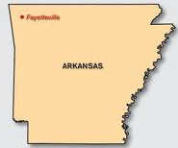


Ten Questions about Developing
& Delivering a QR Course
Shannon W. Dingman
Bernard L. Madison
University of Arkansas
THE WORK REPORTED HERE IS SUPPORTED BY THE NATIONAL SCIENCE FOUNDATION, DUE-0715039

Slide 2
References
Shannon W. Dingman & Bernard L. Madison. (2010). Quantitative Reasoning in the Contemporary World, 1: The Course and Its Challenges. Numeracy, Volume 3, Issue 2, Article 4.
Bernard L. Madison & Shannon W. Dingman. (2010). Quantitative Reasoning in the Contemporary World, 2: Focus Questions for the Numeracy Community. Numeracy, Volume 3, Issue 2, Article 5.

Slide 3
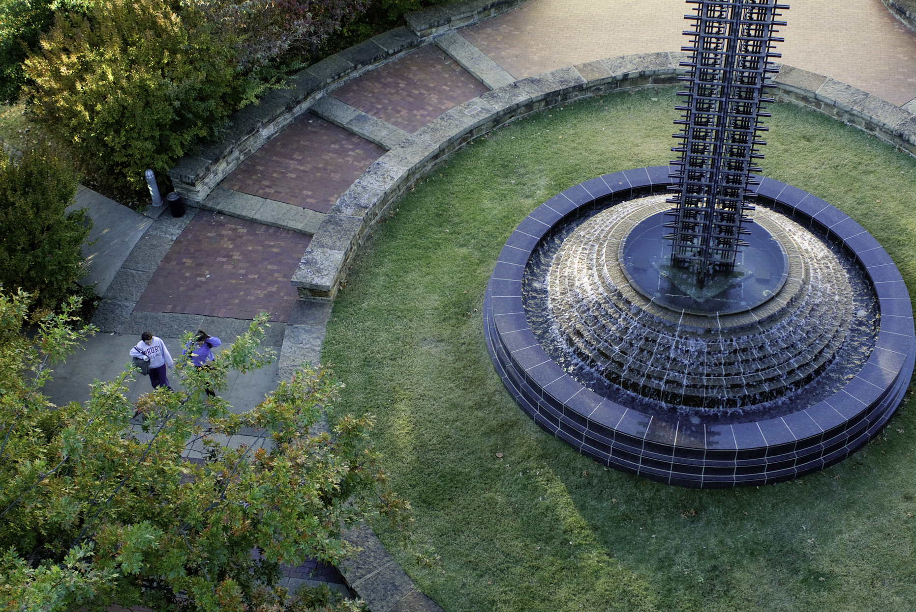
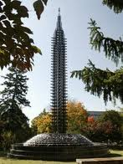
What is the context of the QR course at the University of Arkansas?
Fulbright Peace Fountain
University of Arkansas Campus
E. Fay Jones – Architect
22,000 students
Land Grant and State University
Ozark Mountains of NW Arkansas
Fayetteville, Arkansas
MATH 2183 - Mathematical Reasoning in the Quantitative World
One semester (two 80-minute periods/week)
Prerequisite of college algebra
Satisfies BA degree requirement
Terminal “math” course for most of the students
No QR across the curriculum on campus - some talks in process
Offered first in Fall 2004 to 26 students
About 500 students last year, 8 sections this term (~300 students); 17 sections scheduled for spring and probably 3 in summer. Could have 1000 students this year.
Expansion supported by NSF grant (QRCW) – expanded to Central Washington University, Hollins University, and a few other places.

Slide 4
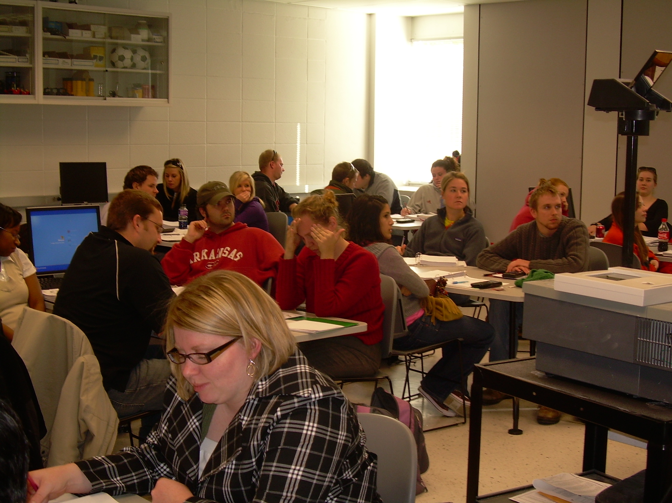
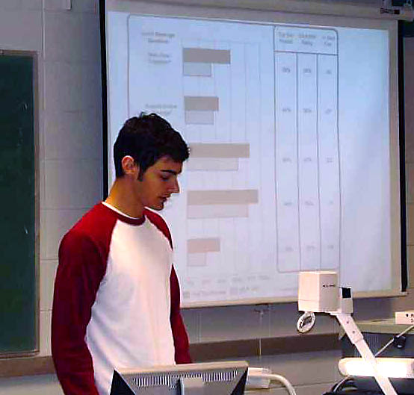
How would you describe the typical Math Reasoning student?
Mostly traditional
More women than men
Major in arts, humanities or social sciences
Not fond of mathematics/statistics
Not confident in quantitative reasoning
Mixture of upperclassmen and freshmen
Some athletes
Some special needs students
Some honors students

Slide 5
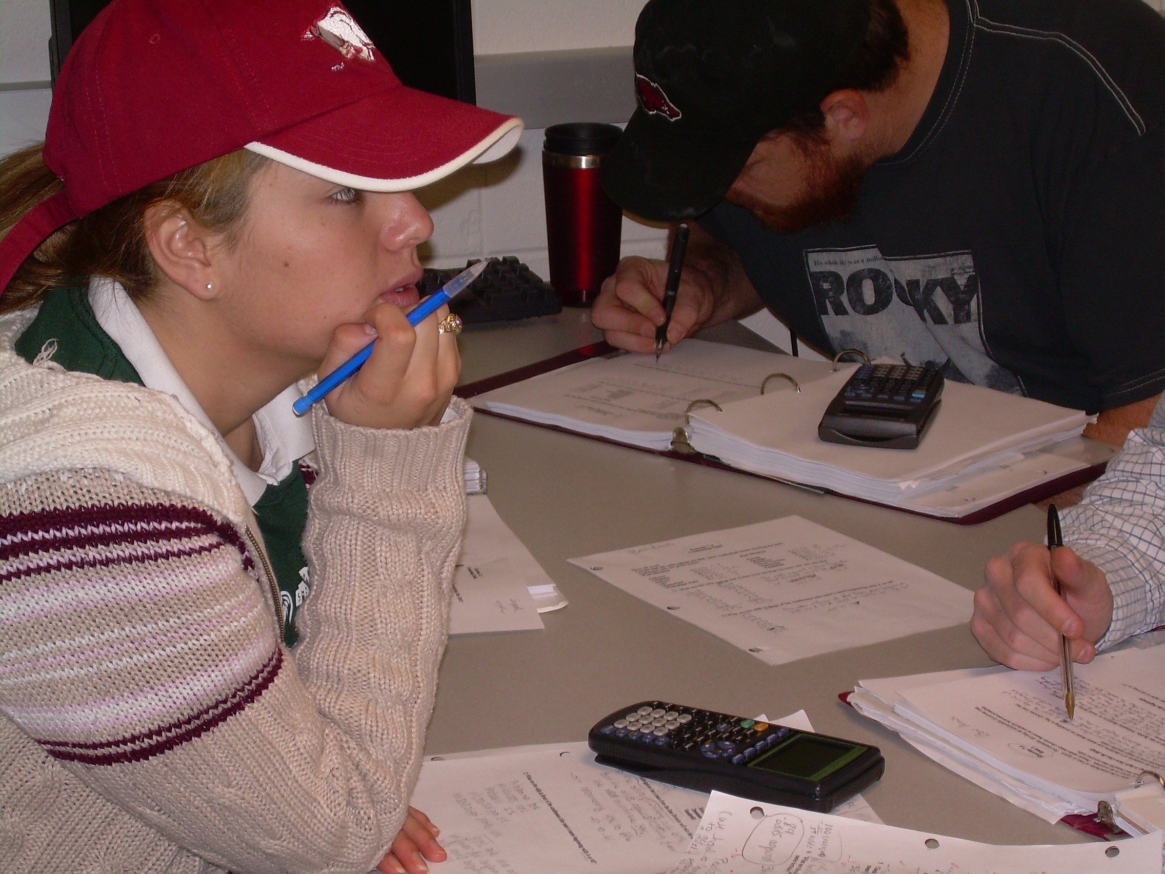
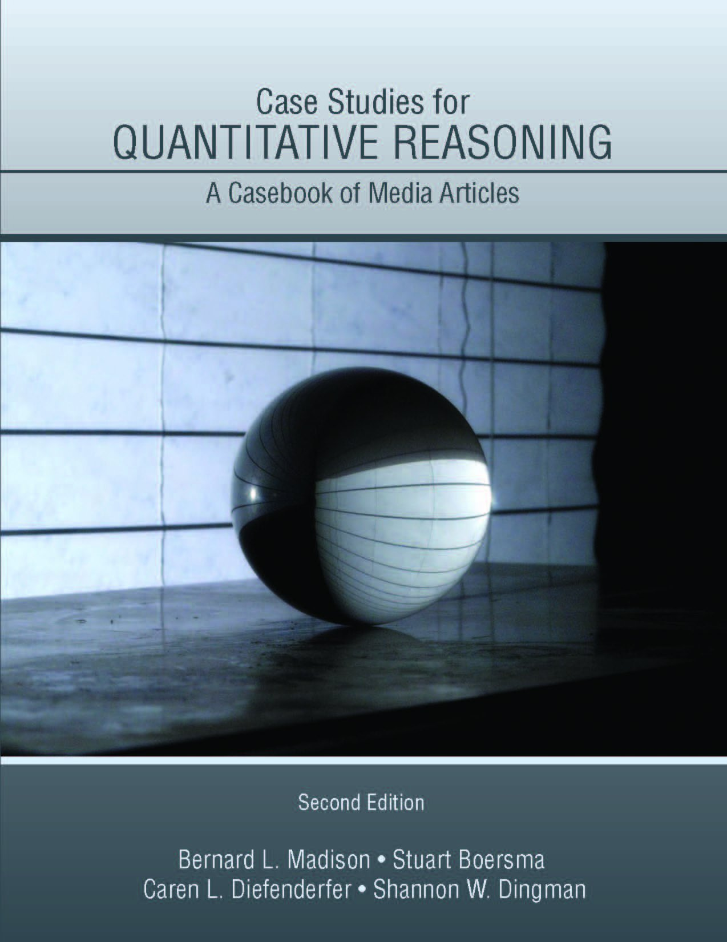
What tools/methods do you use?
News of the day
Group work
Casebook of 24 Media Articles
Calculators
Document Projector

Slide 6
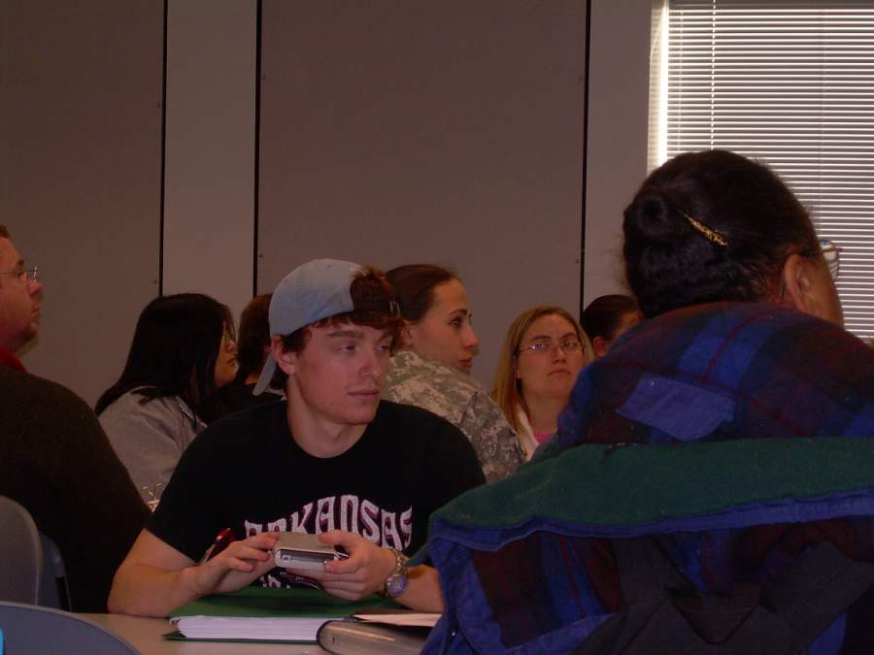
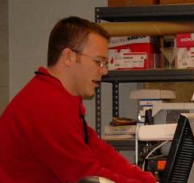
What principles govern the delivery of the course?
Increase student confidence
Increase relevance of math/stat to students
Enhance quantitative argument – giving evidence
Enhance communication (writing & talking about quantities)
All problems are authentic contextual problems
Algorithms and formulas are not emphasized
Interactive classrooms are essential
Develop venue for continued practice

Slide 7
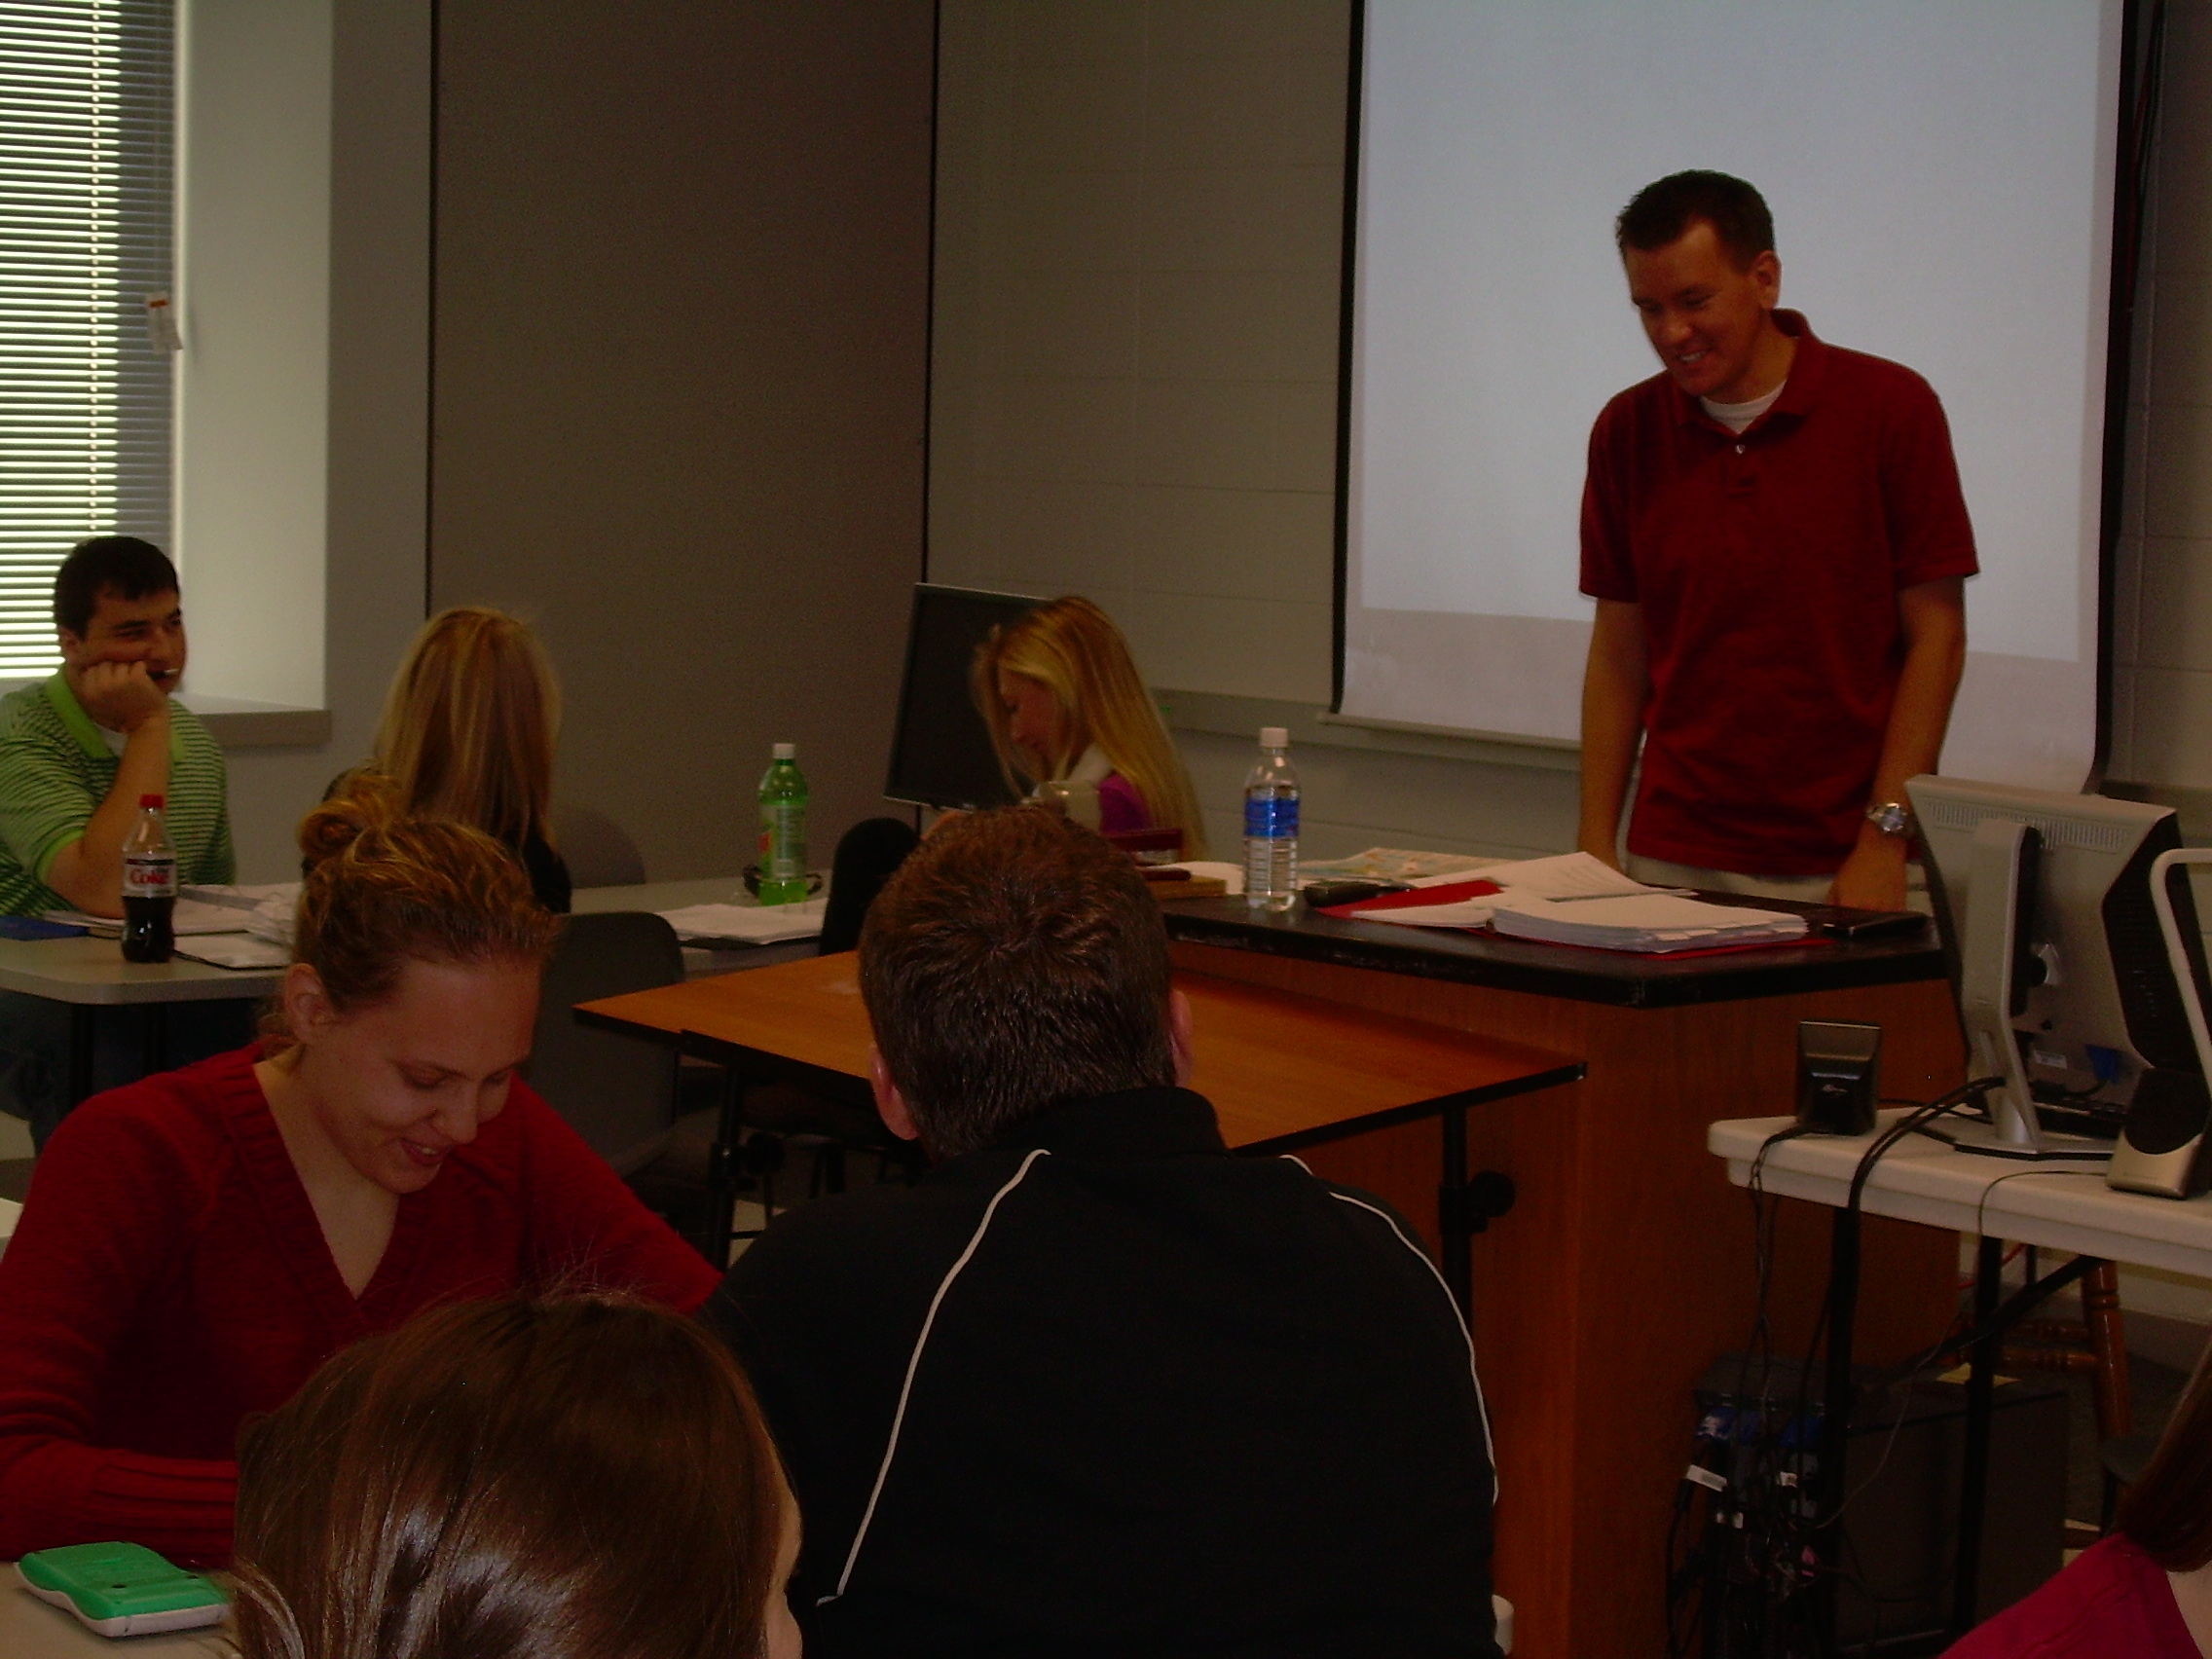
What pedagogical practices are applied in instruction?
Collaborative learning/group work
Inquiry-based approach to teaching
No content coverage requirements
Minimal (but some) scaffolding
Multiple approaches encouraged

Slide 8
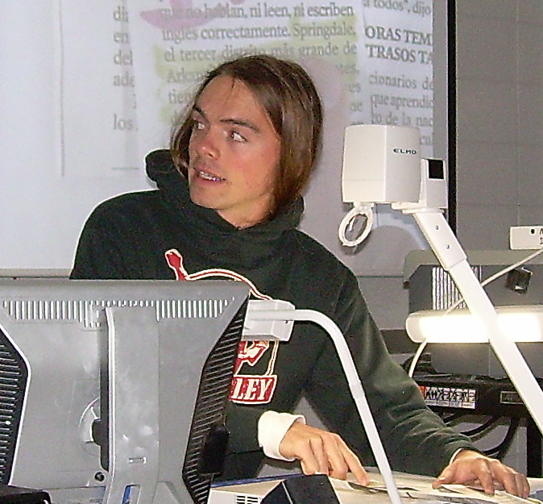
What are the major challenges faced in teaching the course?
Lack of productive disposition
Lasting effects of traditional mathematics courses
Lack of student curiosity
Weak problem solving skills
Difficulty orienting new instructors to the pedagogical approach of the course – scaling up
Assessment

Slide 9
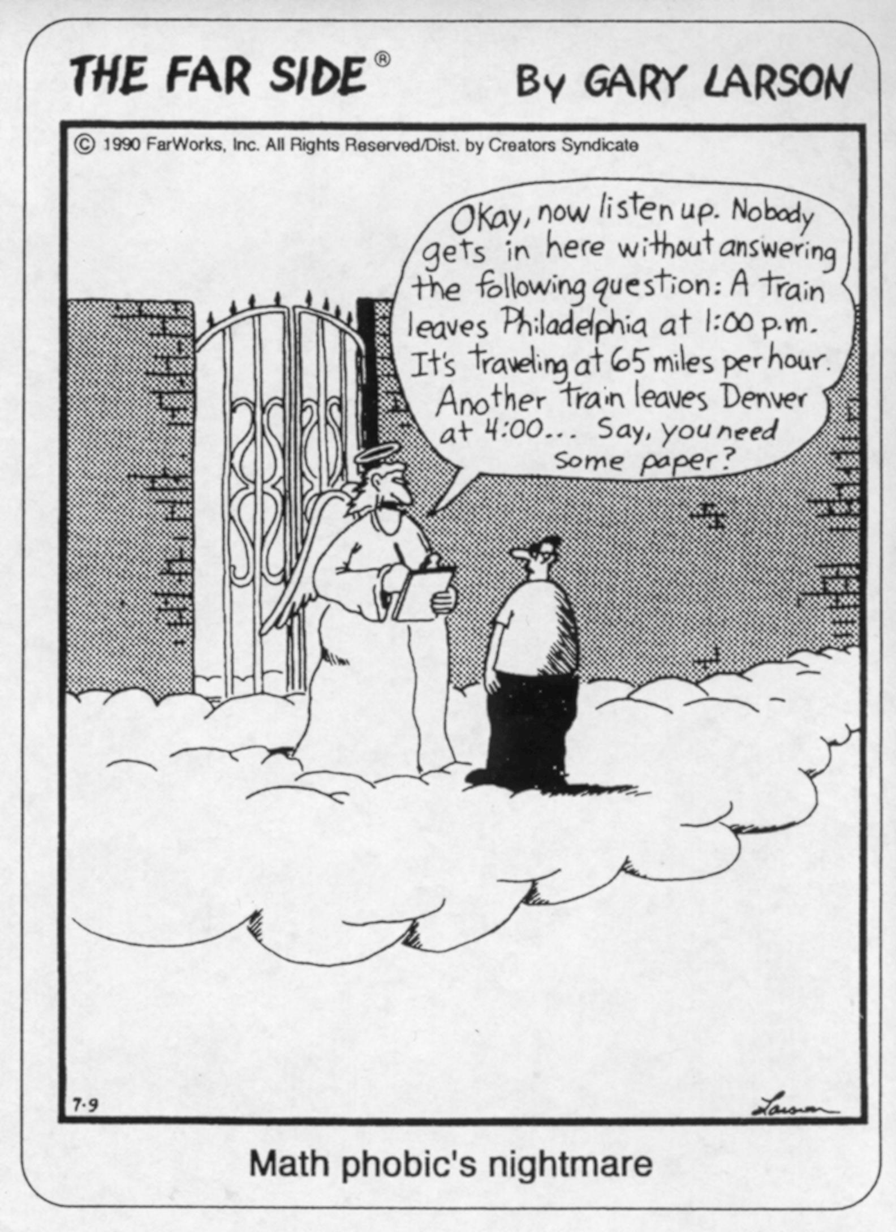

Slide 10
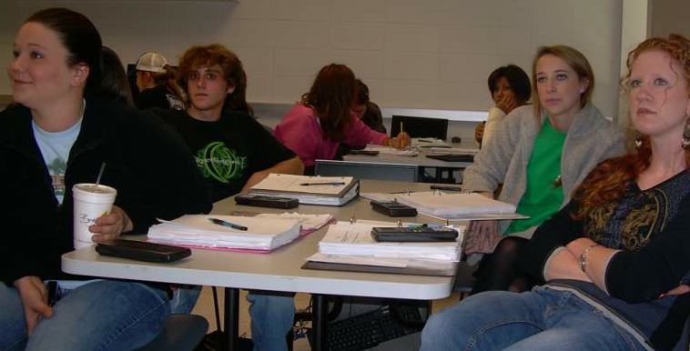
What problems regarding the development of student’s QR skills have been observed?
Avoidance of algebra
Transfer of learning to new contexts
Weak critical reading skills
Weak quantitative comparisons skills
  Percentage measures/bases
  Indexes
Weak understanding of quantities
  Lack of quantitative benchmarks
  Lack of practice
  Weak arithmetic skills
Careless use of language in public media
Persistent incorrect bases for percents
Uncorrected student misconceptions (“Bigger is better”)

Slide 11
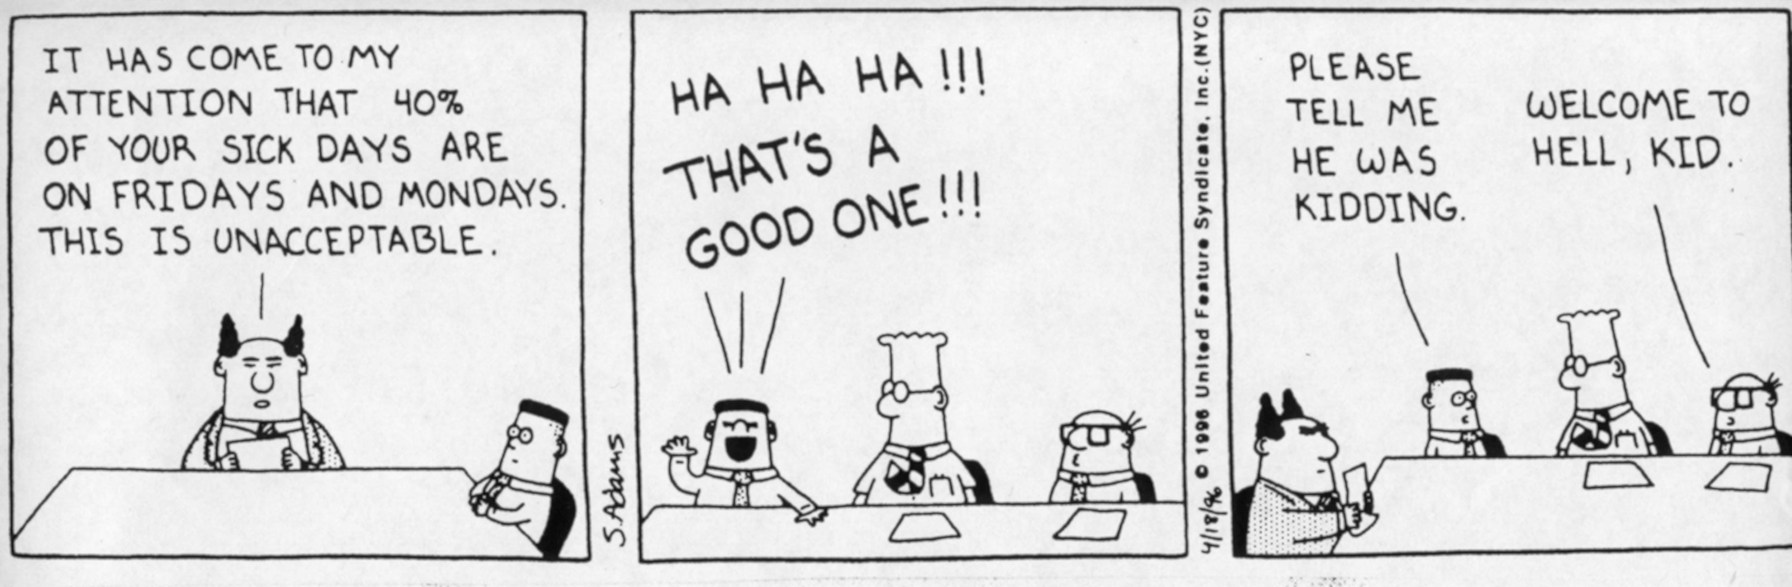
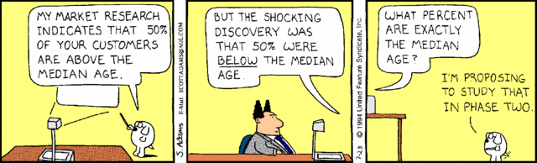
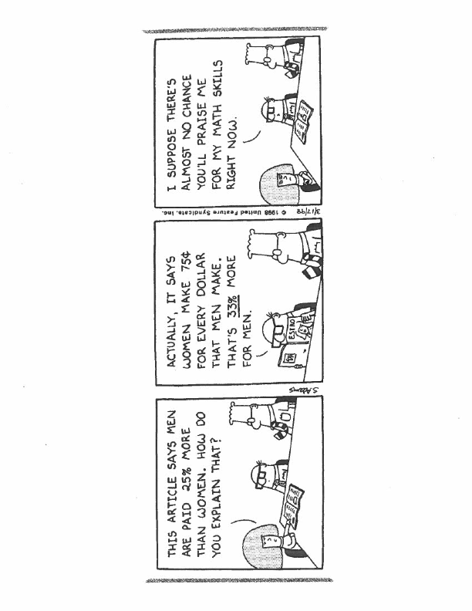
Dilbert is a good source of not-so-funny QR mistakes

Slide 12
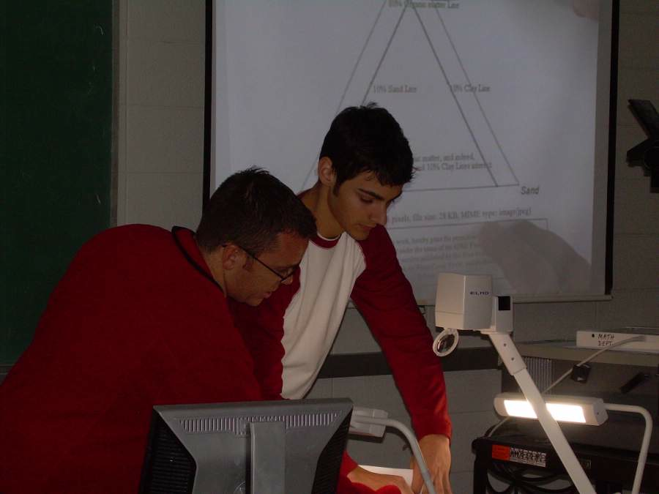
How has the course been evaluated?
Student evaluations
Survey of faculty advisers
Survey of former students
Pre-/Post-test
Student retention and success rates

Slide 13
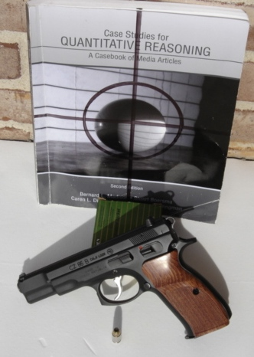
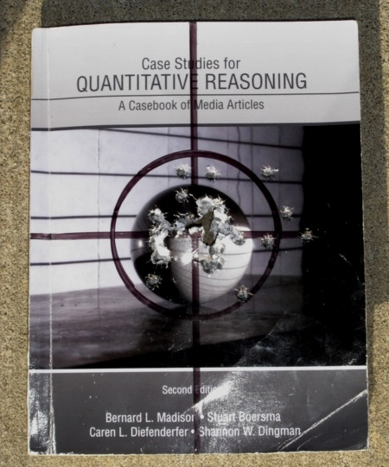
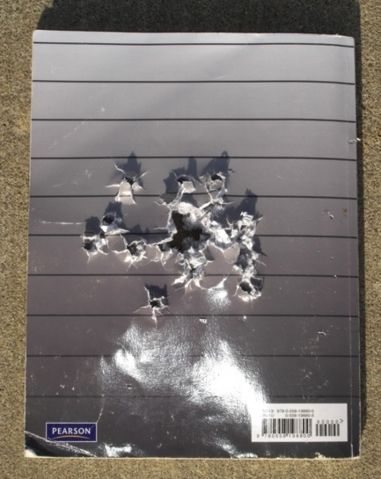
One student found an unusual use for the textbook after the course was finished.

Slide 14
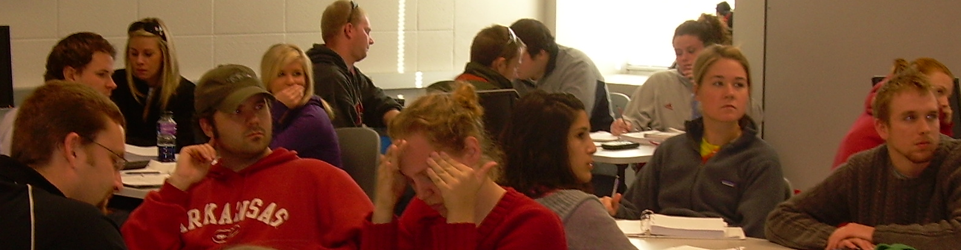
Results from Pre- and Post-QRCW Attitude Surveys, Spring 2008
% of QRCW Students Agreeing or Strongly Agreeing
Statement pre-QRCW post-QRCW
I am comfortable talking about mathematics. 26% 33%
I enjoy doing mathematics. 18% 26%
Lots of things I do everyday involve mathematics. 26% 32%
I expect to find mathematics important in my 38% 42%
future occupation and everyday life.

Slide 15
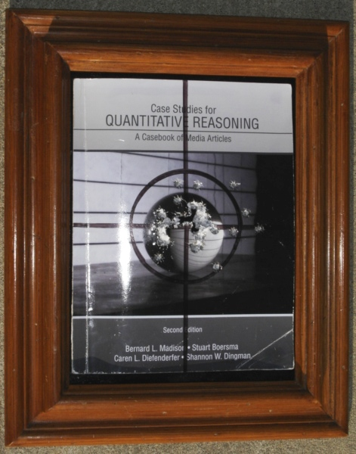
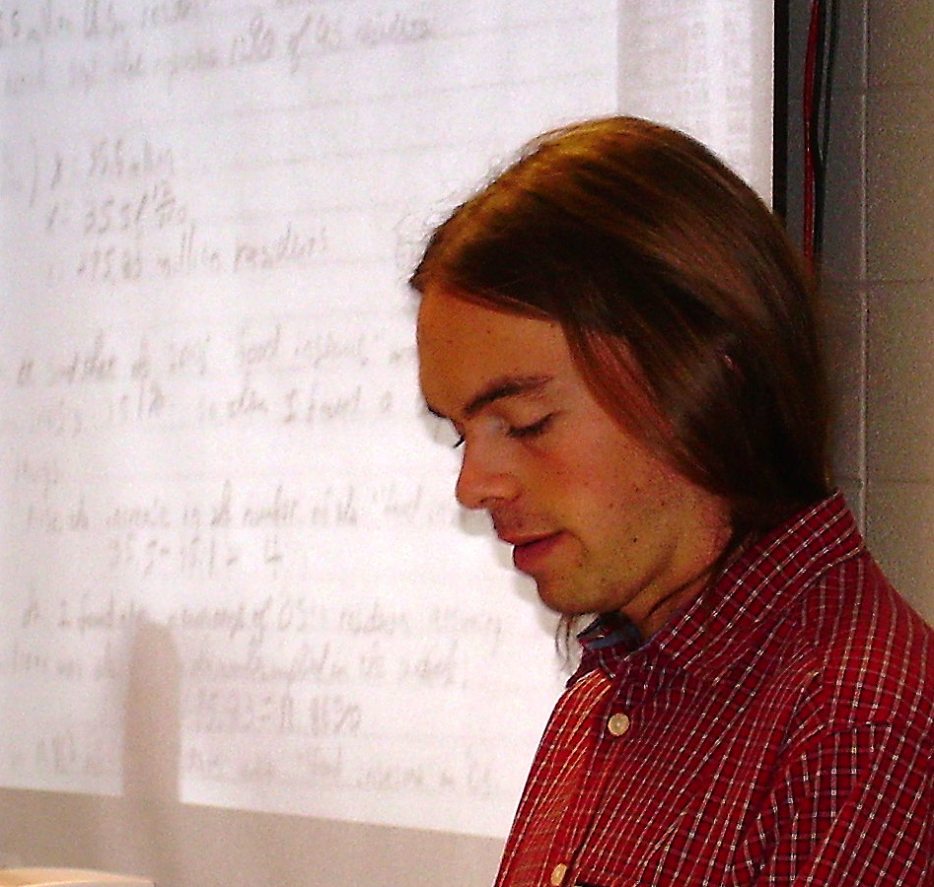
How often have you practiced analyzing quantitative content of public media (newspaper, magazine, advertising flyer, online material, etc) articles since you finished the Mathematical Reasoning course?
 | Number of Respondents | Percentage (%)
Never | 3 | 7%
Rarely | 23 | 55%
Regularly | 10 | 24%
Often | 6 | 14%
This student probably did.
This one probably did not practice QR but wanted to remember the course!

Slide 16
How has your confidence with quantitative reasoning changed since the course?
 | Number of Respondents | Percentage (%)
Decreased | 1 | 2%
Stayed the same | 12 | 29%
Increased | 29 | 69%
How has your view of the importance to you of quantitative reasoning changed since the course?
 | Number of Respondents | Percentage (%)
Decreased | 3 | 7%
Stayed the same | 7 | 17%
Increased | 32 | 76%

Slide 17
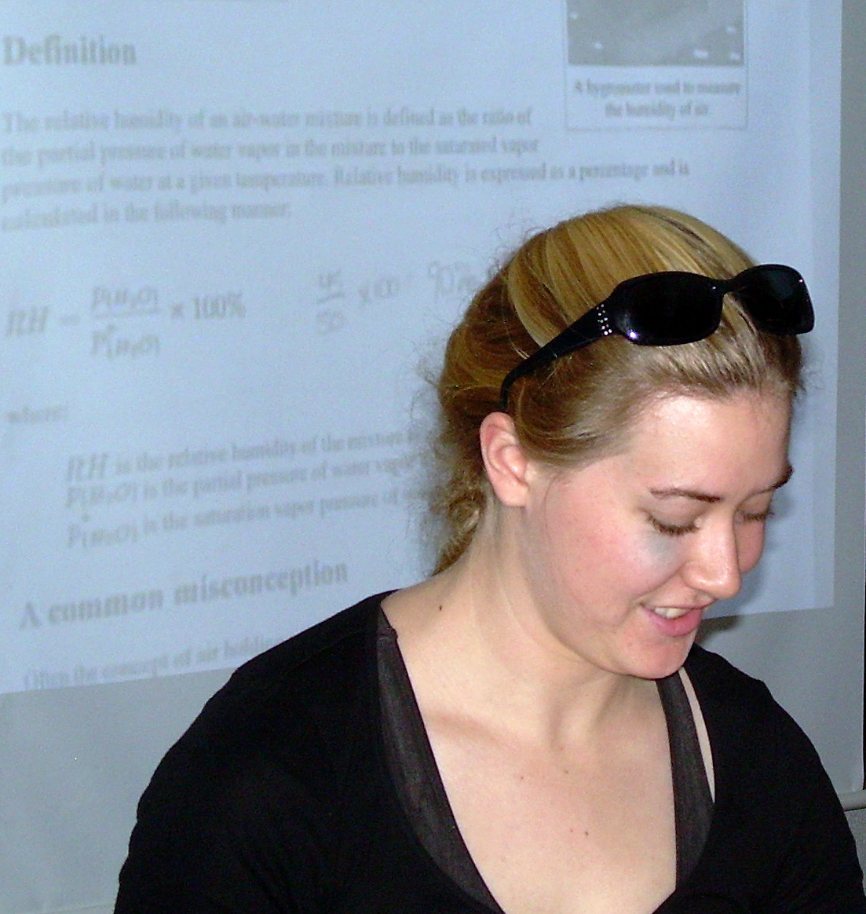
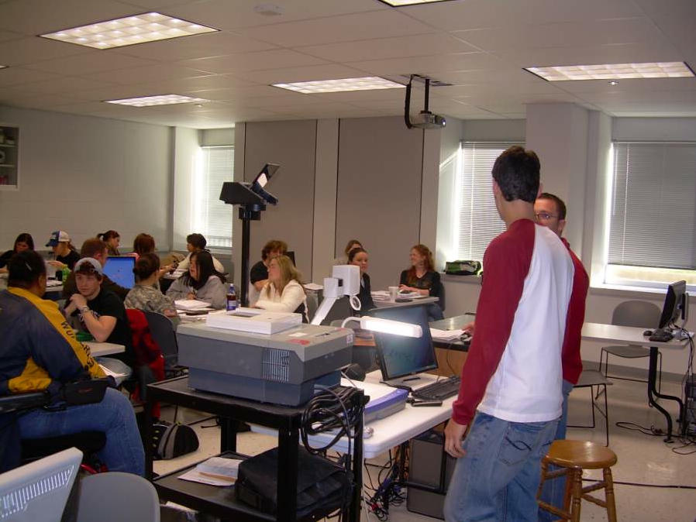
What lessons have we learned regarding making a one-semester QR course effective?
Build course with a basis for continued practice
Make connections to the students’ lives and their experiences
Communicate with faculty across the institution
Let reasoning drive the course (avoid content coverage requirements)

Slide 18
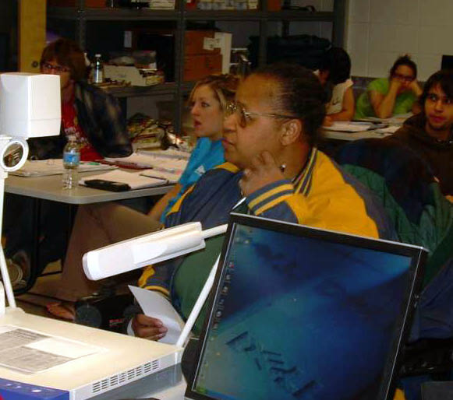
What are the future plans regarding teaching and learning QR?
Further examination of assessment issues surrounding QR
Investigation of student learning via “Think Aloud” sessions
Integrated course with English composition
QR across the curriculum?

