Slide 1




Teaching Quantitative Reasoning with the News
- Stuart Boersma, Central Washington Univ.
- Caren Diefenderfer, Hollins University
- Shannon Dingman, U. of Arkansas
- Bernie Madison, U. of Arkansas
Supported by the
National Science Foundation DUE-0715039

Slide 2
What is Teaching Quantitative Reasoning with the News?
Using newspaper articles as content for the critical analysis of quantitative information.
Quantitative comparisons, graphical analyses, and elementary modeling can all be approached and supported with case studies comprised of media articles.
The daily newspaper has numerous examples illustrating the need to be able to deal critically with quantitative information in today's society.

Slide 3
Why Teach Quantitative Reasoning with the News?
Creates a more exciting learning atmosphere by using variable content, a healthy dose of unpredictability, and exposure to numerous non-mathematical topics;
Gives numerical topics a real context.
Indicates the relevance and importance of quantitative reasoning to
  Present day issues as well as
  Everyone’s lives
Naturally allows a teacher to spiral through important themes.

Slide 4
How to Teach QR with the News
Longer “How To” article at SERC’s Pedagogy in Action:
http://serc.carleton.edu/sp/library/teaching_news/index.html
Instructor needs to choose appropriate articles
  Interpret the magnitude of a quantity,
  Discuss how quantities were measured and who did the measuring,
  Check assertions,
  Convert an absolute change into a relative change or vice versa,
  Become familiar with language used to represent and compare quantities.
Students need to contribute as well by:
  Bringing in articles throughout the course.
    Can focus on hometown papers or different geographic regions
  Writing and explaining their thoughts and impressions in complete sentences.

Slide 5

Risk: relative and absolute
What is the selling point of Lipitor?
For what type of people has Lipitor proven to be effective?
What were the results of the clinical study?
Example of such a clinical study.

Slide 6
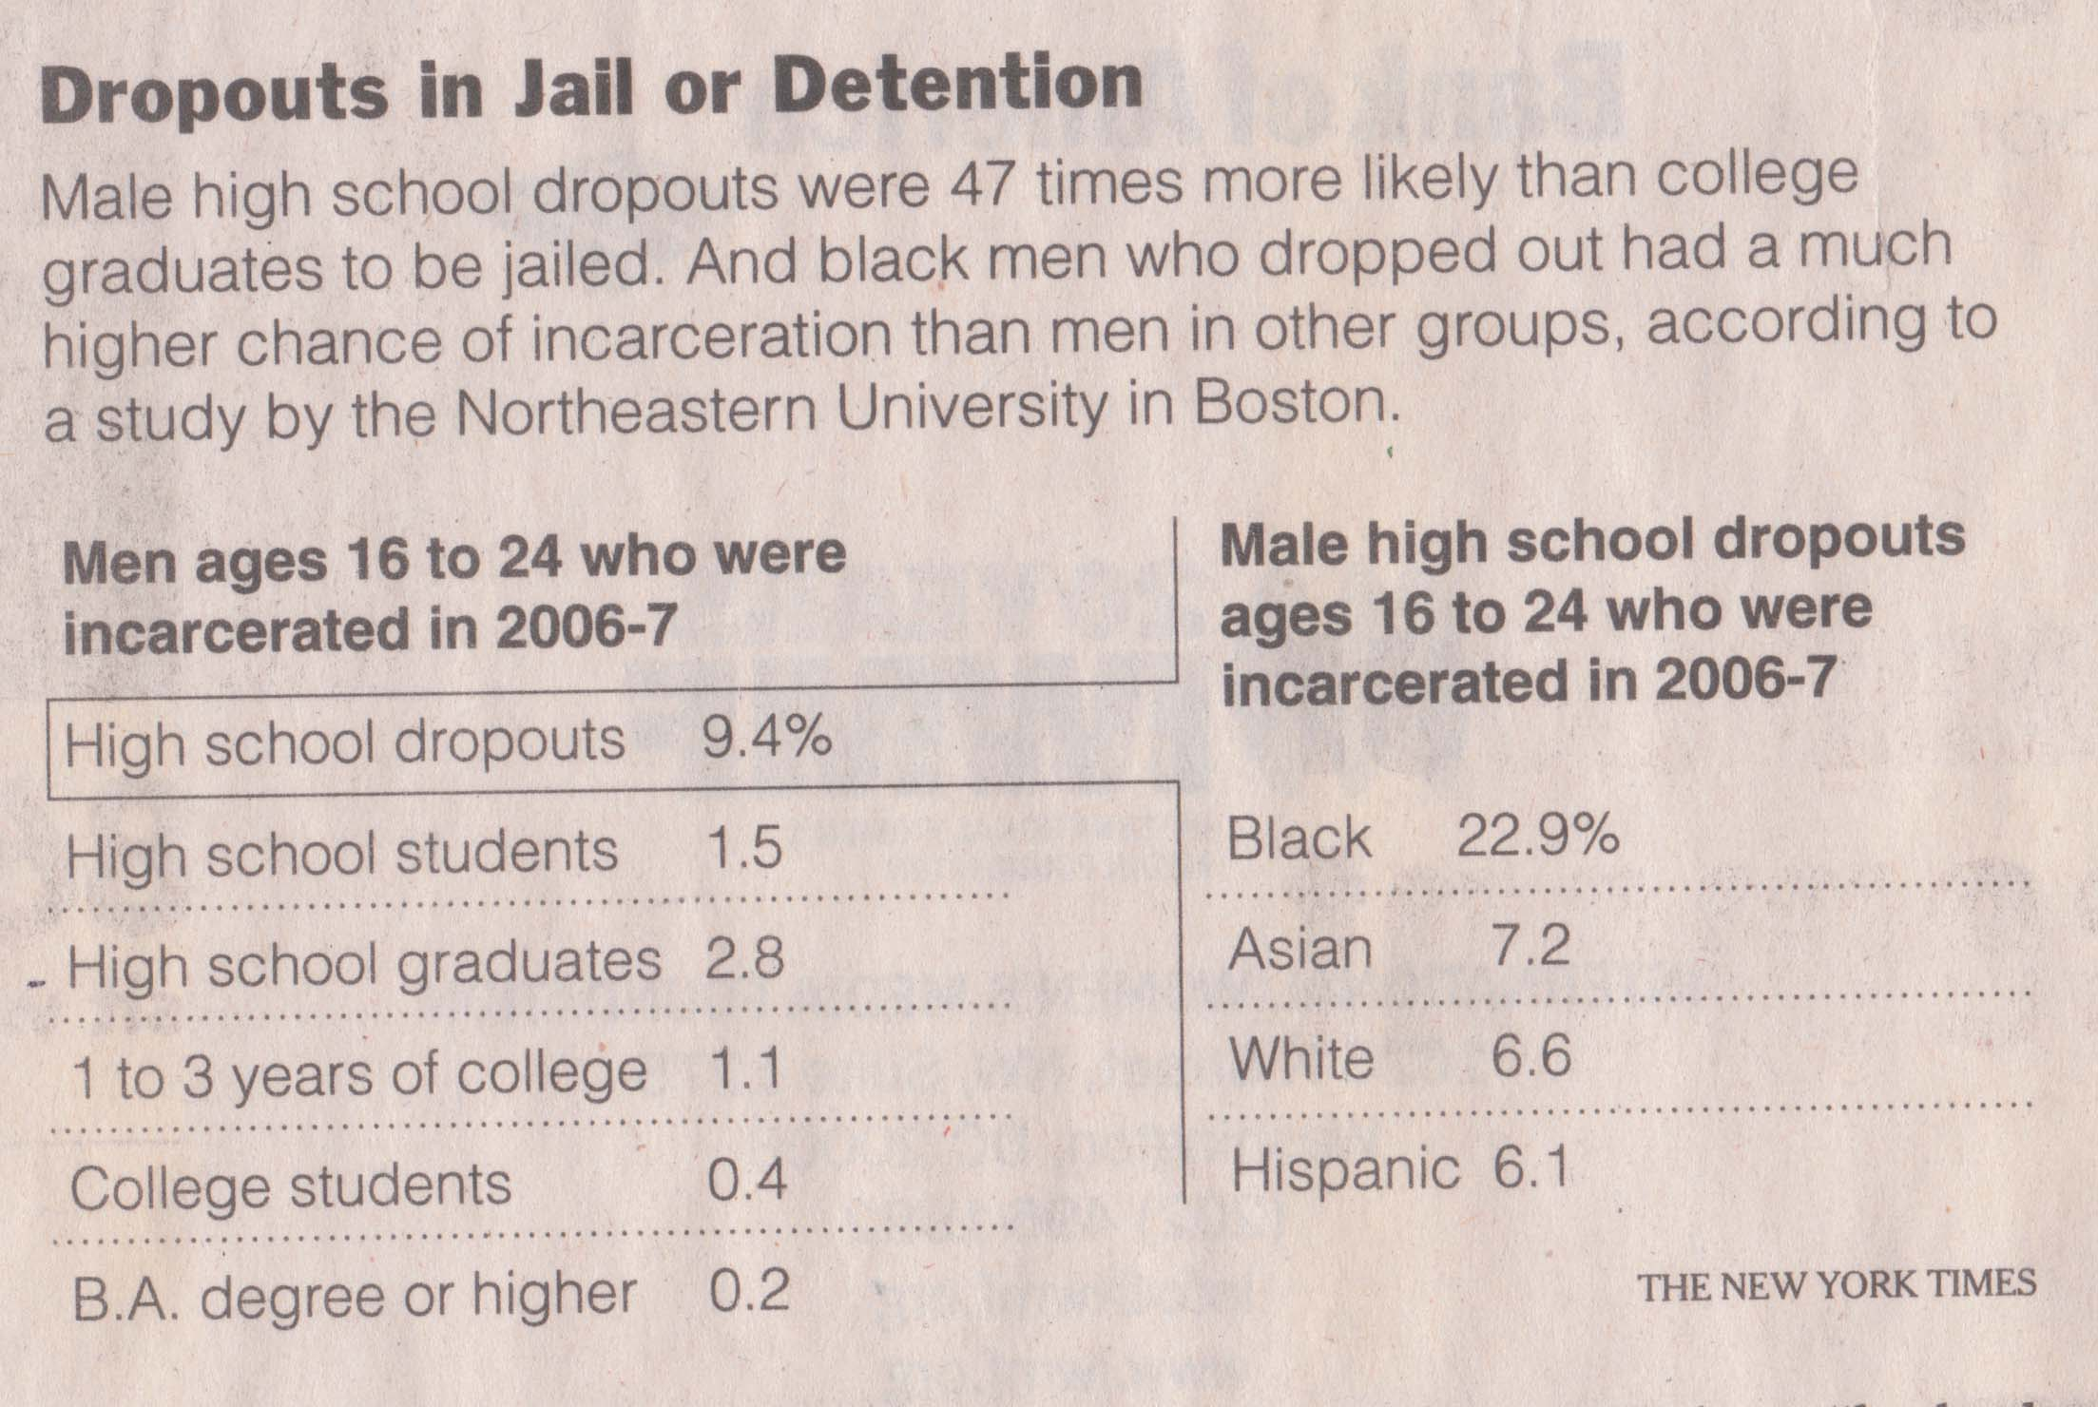
Use of Language

Slide 7
Read Case Study 4.3 pp. 101-102

Slide 8
Discussion on
Study Question 2b
(p. 102)

Slide 9
Work on
Questions 3 a,b,c,d

Slide 10
Interpretation
Representation
Calculation
Application/Analysis
Assumptions
Communication

Slide 11
Alignment of QRCW Case Studies and AAC&U VALUE Rubric
Case Studies (n=24) that contain at least 1 question focused on following processes:
Interpretation: 24/24
Representation: 21/24
Calculation: 20/24
Application/Analysis: 21/24
Assumptions: 12/24
Communication: 17/24
Case Studies (n=24) that contain at least 50% of questions focused on the following processes:
Interpretation: 23/24
Representation: 5/24
Calculation: 10/24
Application/Analysis: 6/24
Assumptions: 2/24
Communication: 4/24

Slide 12
Alignment of QRCW Case Studies and AAC&U VALUE Rubric
Number (%) of Questions focused on each process:
Interpretation: 164/234 (70.1%)
Representation: 64/234 (27.4%)
Calculation: 104/234 (44.4%)
Application/Analysis: 73/234 (31.2%)
Assumptions: 26/234 (11.1%)
Communication: 48/234 (20.5%)
 | 1 | 2a | 2b | 2c | 2d | 3a | 3b | 3c | 3d | 4a | 4b | 5a | 5b | 6
Interpretation | ✓ | ✓ | ✓ | ✓ | ✓ |  | ✓ | ✓ |  |  | ✓ |  | ✓ | ✓
Representation |  |  |  |  |  | ✓ |  |  | ✓ | ✓ |  | ✓ | ✓ | ✓
Calculation |  |  |  |  |  | ✓ |  |  | ✓ | ✓ |  | ✓ | ✓ | ✓
Application / Analysis |  | ✓ |  |  |  | ✓ | ✓ | ✓ |  | ✓ | ✓ | ✓ | ✓ | ✓
Assumptions |  | ✓ | ✓ | ✓ | ✓ |  | ✓ | ✓ |  |  | ✓
Communication |  |  |  |  |  | ✓ |  |  |  | ✓ |  | ✓ | ✓ | ✓
Example: Fuel Efficiency (CS 4.3)

Slide 13
Lessons Learned from using the AAC&U Rubric
Missing Values?
  Number Sense, Critical Reading
Questions may need to be rewritten in order to prompt for the right evidence.
Use of subjective milestones:
  “Skillfully converts” v “Competently converts”
  “drawing reasonable and appropriately qualified conclusions” v “drawing plausible conclusions”

Slide 14
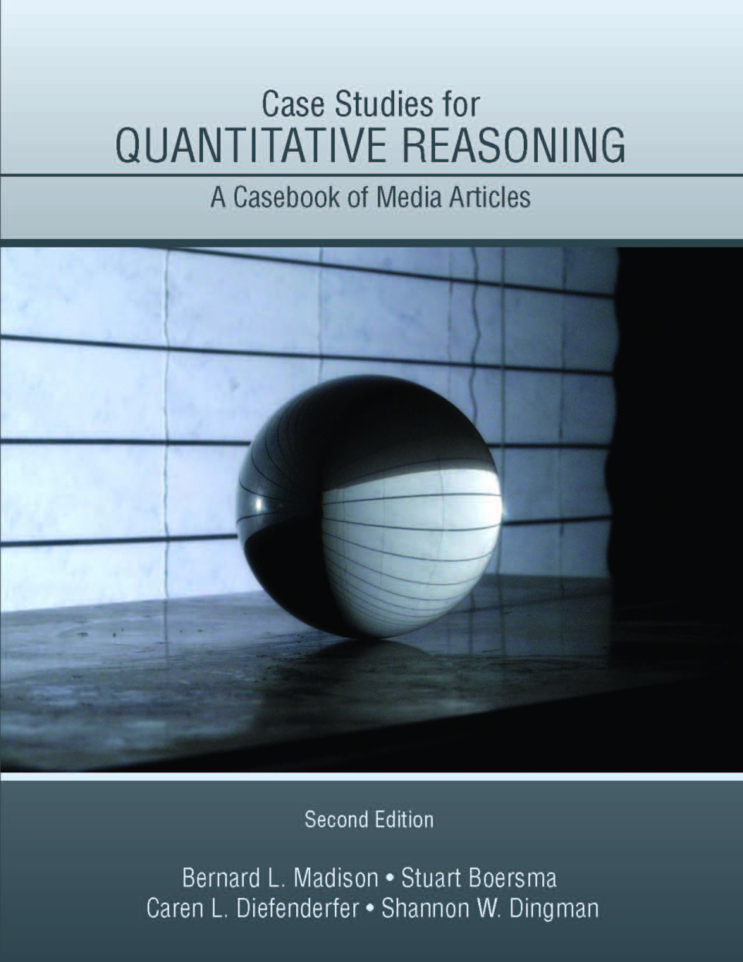
Resources
Teaching Quantitative Reasoning with the News,
PKAL/QUIRK Workshop 2010.
Textbook:
Pearson Custom Publishing
ISBN-13: 978-0-558-19880-0.
http://www.cwu.edu/~boersmas/QRCW
These slides:
http://www.cwu.edu/~boersmas
Longer “How To” article at SERC’s Pedagogy in Action:
http://serc.carleton.edu/sp/library/teaching_news/index.html
Stuart Boersma: boersmas@cwu.edu Caren Diefenderfer: cdiefenderfer@hollins.edu
Bernie Madison: bmadison@uark.edu Shannon Dingman: sdingman@uark.edu

Slide 15
Challenges
Teaching with the news provides elements of surprise and serendipity.
  taking time to assemble a fair amount of material before the first day of class allows for a more topical approach. Current articles may still be brought to class several times a week in an effort to keep the topics current.
Teaching with the news may make an instructor feel constrained by the topics covered and, possibly, the depth of coverage.
  Personal/departmental/college reflection on what QL is.
Teaching with the news requires an instructor adept at facilitating discussions.
Teaching with the news requires an instructor to assess written work.
  Explain classroom expectations to students (complete sentences, correct grammar and punctuation, clear and precise explanations, correct use of quantitative terms, etc)
  Create/share rubric

Slide 16
Tips for the first time:
Begin gradually
  Use a few relevant newspaper articles to supplement a familiar QR course;
  Adopt the habit of perusing a daily paper and identifying articles which exemplify the type of skills you are expecting of your students.
Be Prepared
  Have a list of topics/learning objectives which are important to you;
  Have 80-90% of the articles to be studied assembled ahead of time and organized into topics with specific learning objectives.
Clearly articulate your assessment strategies to your students.
Decide on your class standard for language regarding absolute v relative percent change. This is the only way one can "test" for this knowledge later on. For example, if the unemployment rate changes from 6% to 8% how will you expect your students to articulate this change?
Decide how you plan to encourage students to bring in their own articles and how you convey the characteristics of an interesting article.
  Required? Extra credit? Focus on theme/geographic area?

Slide 17
How to Use an Article
Introduction of concept: An article can be used to introduce a topic. When used in this fashion an instructor should prepare a set of framing questions used to get students to begin to think about the concept, its importance, and its applications.
Further exploration of concept: Often articles will be used to continue to explore and/or develop ideas and concepts.
Brief review of concept: Concepts covered in depth earlier in the course will naturally be revisited at later dates as dictated by the articles being read at that time.
Assessment of concept: Any concept, skill, or technique that has been emphasized in class can be assessed via another article. Unlike many other assessment strategies, using a variety of articles to introduce, explore, develop, and assess a skill naturally requires a high degree of transferability.

Slide 18
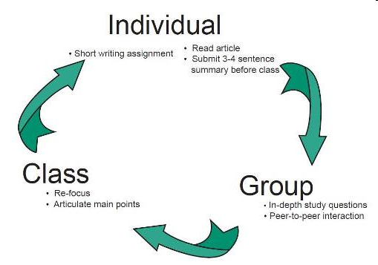
How to Use an Article
Class discussion
Group work
Individual assessment
Creative Combinations

Slide 19
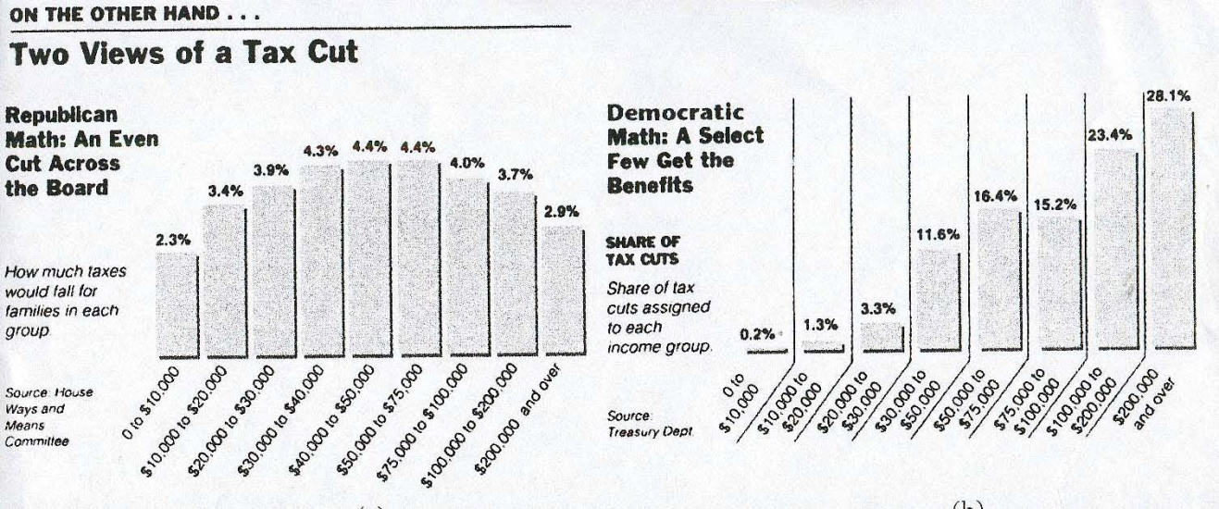
Example:
Percents: language and comparing quantities
Describe what each graph represents.
Is this tax cut uniform? Does it favor the wealthy?

