Slide 1
The Math You Need, When You Need It implementation at McHenry County College
Kate Kramer,
Instructor of Earth Science and Geology, McHenry County College

Slide 2
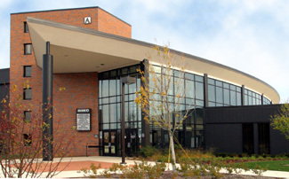
McHenry County College (MCC)
Small community college of approximately 7,200 students
Far northwest suburbs of Chicago, Illinois
Rural and urban communities
Physical Geology
  Lecture & Lab
  24 students

Slide 3
Perceived Problems in the Classroom
Community College - Open Enrollment
No prerequisite
Diverse math abilities

Slide 4
Assessment
Pretest
  Pass/Fail in grade book
  One opportunity to complete
Post Module Assessments
  Completed after working online modules but before topic is covered in laboratory
  Unlimited attempts to show mastery of subject
Post test
  Graded

Slide 5
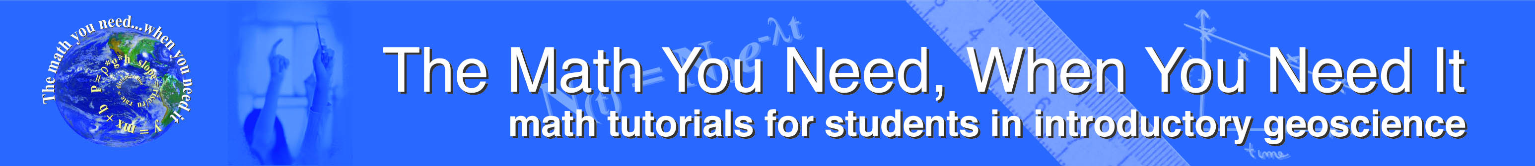
Difference Pre to Post Module

Slide 6
Essential for Success
Instructor Engagement
  Integration into lectures & labs
  Be enthusiastic & positive!
  Point out specific problems from TMYN and how they apply to lectures & labs

