Slide 1

The Math You Need,
When You Need It
Implementation at
Patrick Henry Community College
Martinsville, VA

Slide 2

A bit about Martinsville
Last year – 18.5% unemployment
16% of population holds a post-secondary degree
Notes:
So education has not been, and still isn’t highly valued.

Slide 3

My typical class
~18 students
Mostly
  male
  white
  traditional (aged 18-25)
  Science-phobic and Math-phobic!!
Notes:
~18 students
2/3 male
85% white
¾ traditional (18-25)/
Age range 18-58
Science-phobic and Math-phobic!!

Slide 4


Reasons to implement TMYN
Time in class
So stuck in rote they miss meaning- even MORE time

Slide 5
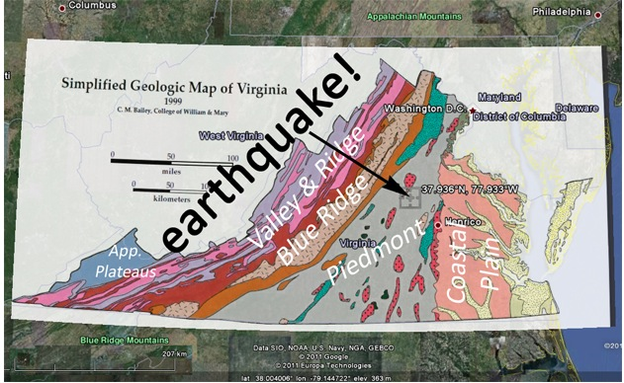
Pre-test/ Post-test
Pre-test administered on the first day of class
Also began first module (Graphing)
Post-test given in class after the last module
Notes:
May 31, 1897 was a 5.9; still largest ever as August 23, 2011 was a 5.8

Slide 6

Modules
Graphing*, density, rates*, slopes* and topographic maps
Assigned out of class; quiz due before class
Integration at beginning of lab
Module quizzes reassigned each time used
Notes:
Integration involved asking if there were any questions about the module and doing some similar problems in class
Modules quizzes being reassigned before each implementation meant I again could spend less time on math and more on the geology content
Graphing- rock compositions, streams and floods, flood frequency, earthquake frequency vs. magnitude, climate change
Density- minerals, rocks, plate tectonics, ocean circulation
Rates- plate tectonics, streams and groundwater, glacial retreat, climate change
Slopes- streams, mass movements

Slide 7
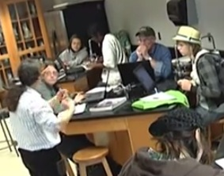
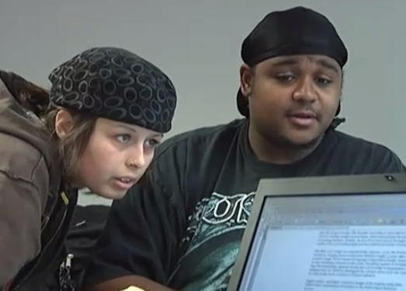
Pedagogy
More time for geology content!
Have time for cognitive rather than pure quantitative
Collaborations were good (both in an out of class)
I’ll look for more of this

Slide 8

Anecdotal Information
Mixed student views
Participation and questions up
Students seemed less anxious
Enabled more time for discussions
Despair.com
Notes:
Less anxious may have been end of semester fatigue as well

Slide 9

Future Fixes
Will integrate in lecture
Need to make connection more concrete
As it was average score improved 35%!
Notes:
Integrate in lecture by bringing module discussion into lecture and not wait until lab to go over questions about the modules.
also directly refer to the modules during lecture rather than assume or hope they see the tie-in

