Slide 1
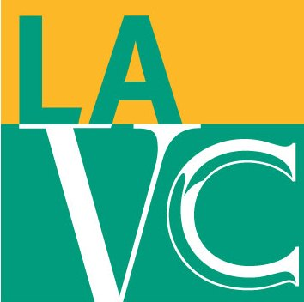

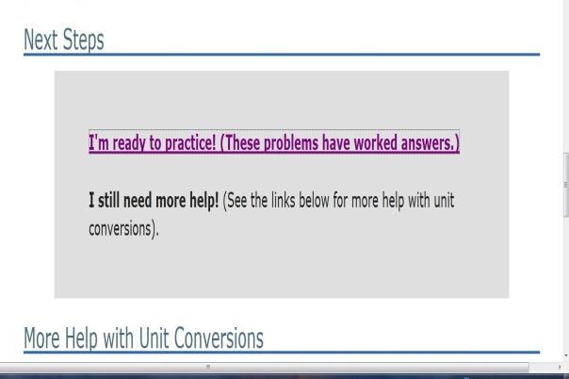
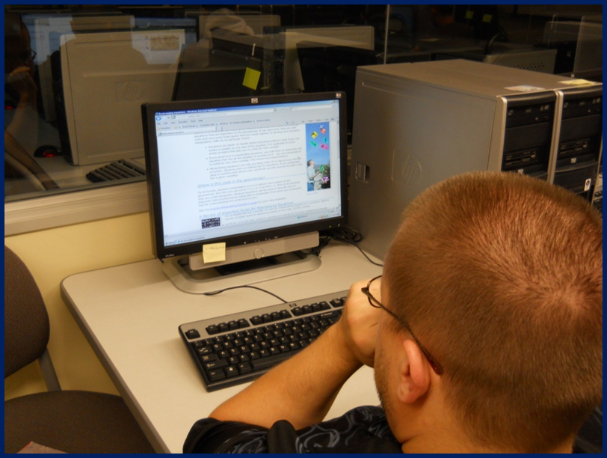
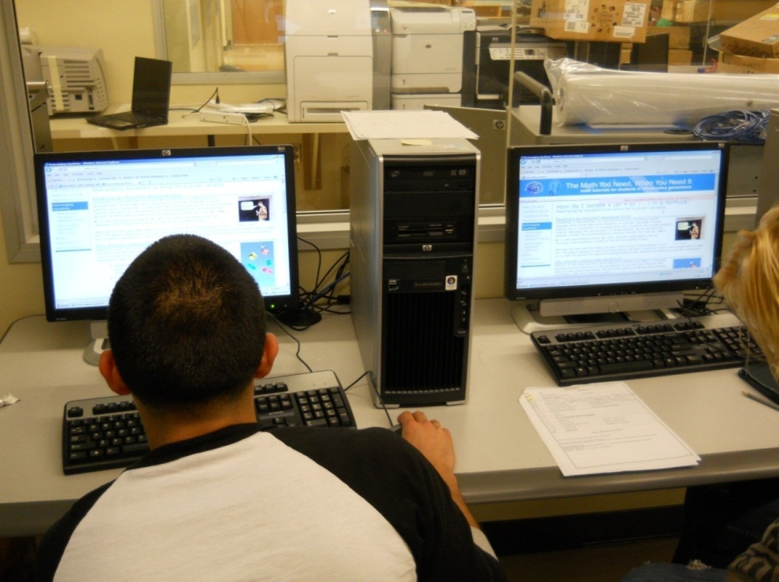
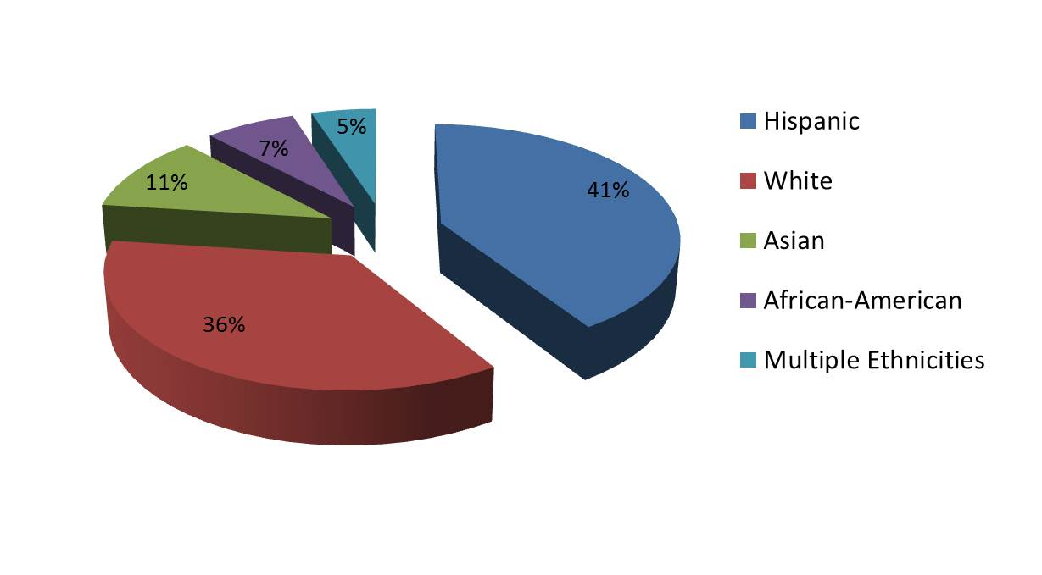
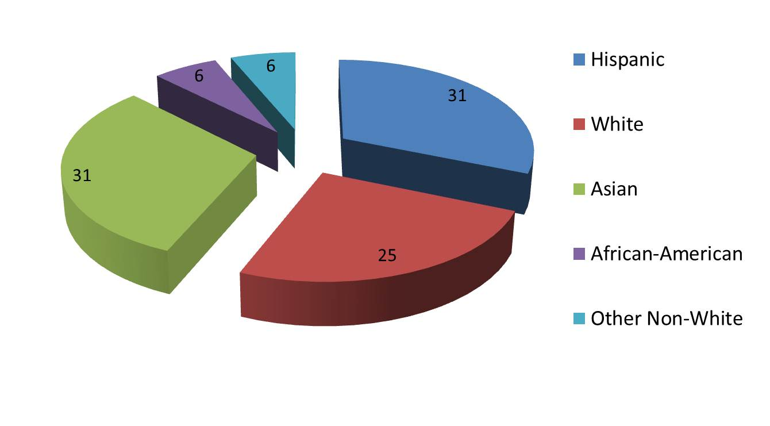
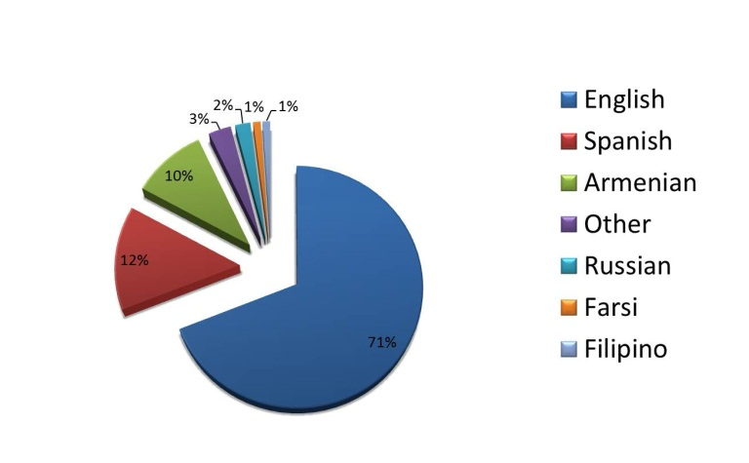
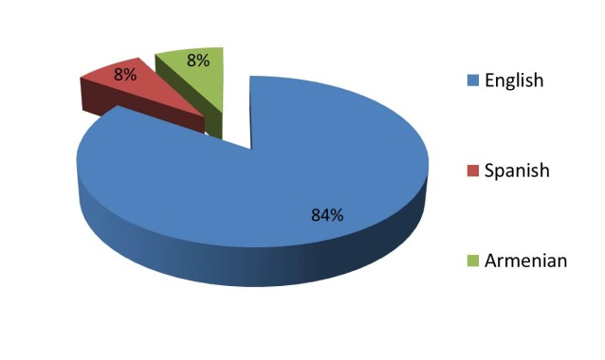
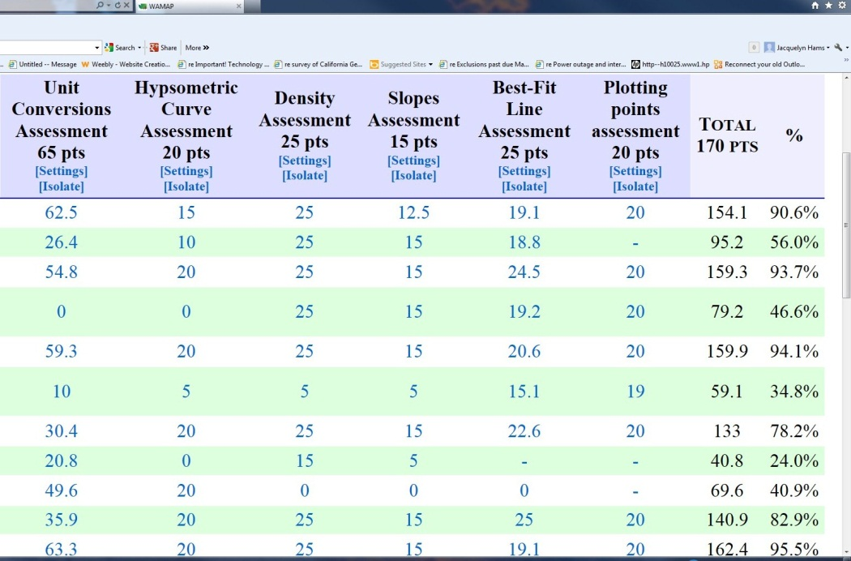
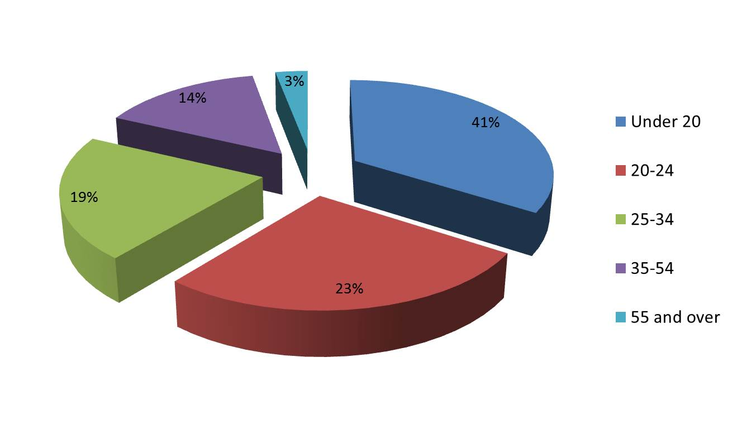
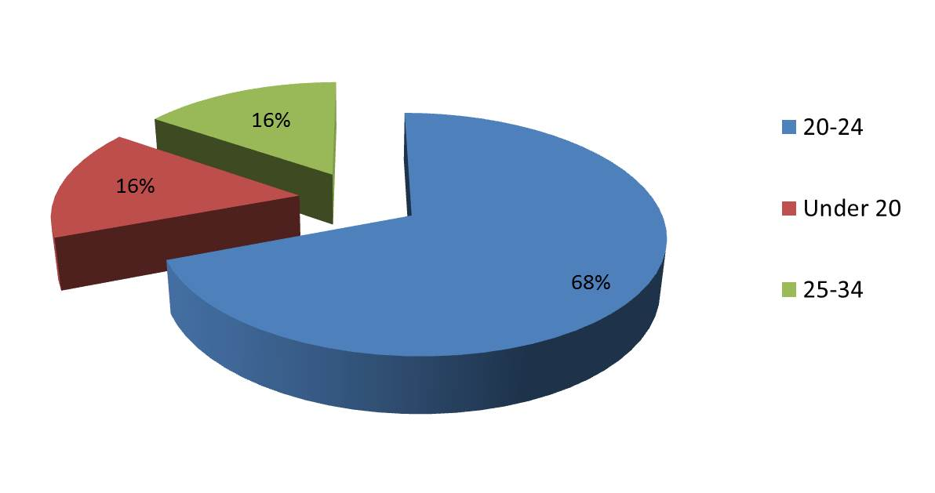
The Math You Need When You Need It
Incorporating quantitative skills to improve student success in introductory geoscience laboratory courses
Jacquelyn Hams, Department of Earth Science, Los Angeles Valley College, Valley Glen, CA 91401 hamsje@lavc.edu
Introduction
Classroom Implementation
Math Attitudinal Survey
Assessment Results
“The Math You Need When You Need It” (TMYN) tutorial program is used at Los Angeles Valley College to provide supplemental instruction and give students the quantitative knowledge they need just before they use it in geoscience courses. TMYN modules were incorporated into an introductory Oceanography lecture class as a pilot study during summer 2010 and are currently used in the introductory Oceanography and Geology laboratory courses. This poster summarizes the implementation process, as well as results from the module assessments and a student attitudinal survey towards math.
TMYN modules were incorporated into LAVC classes as a pilot project in the summer 2010. The following modules are typically used for the Geology and Oceanography laboratory classes during the semester:
  Unit Conversions
  Hypsometric Curves
  Density
  Slopes
  Best Fit Line
  Plotting Points
How do students feel about math? Many instructors have anecdotal evidence but data driven evidence of students’ attitudes, previous background and comfort level with math is collected as part of the implementation of TMYN program at LAVC. The graphs below display the results of representative questions from a Math Attitudinal Survey administered to students using TMYN instructional modules.
Conclusions
TMYN modules have been used in multiple earth science lab classes continuously since the summer 2010. The following conclusions are based upon results of the student surveys and are supported by the assessment data.
92% of the students completed all or some of TMYN modules and assessments.
31% of the students learned the most from the Unit Conversions modules.
33% of the students felt that the Unit Conversions modules were the most challenging.
54% of the students felt that Plotting Points was the easiest module.
Students complete practice problems and quizzes for each module before taking the final assessments.
Student Profile
Los Angeles Valley College (LAVC) is one of the nine two-year colleges that comprise the Los Angeles Community College District. LAVC is located in the eastern San Fernando Valley, just north of downtown Los Angeles. The college enrollment is approximately 18,500 students. Student profile statistics for the college and TMYN surveyed classes are presented below.
60% of the students reported that TMYN modules helped them understand quantitative material presented in the class.
LAVC Ethnicity
Math Attitudinal Survey Ethnicity
The graph on the left shows the assessment results of the six modules incorporated into the summer 2010 pilot study.
Students complete TMYN modules in the computer lab before completing the class laboratory exercise for that class session.
Figures 1a and 1b below are tables prepared from current Oceanography and Geology introductory laboratory syllabi and illustrate how topics from the laboratory courses correlate with the TMYN modules.
TMYN modules are currently incorporated into classes based on the type of laboratory exercises covered in class. The graphs below show the average assessment scores from each of the laboratory classes using TMYN modules. The last graph shows average assessment scores from different classes which used the same module.
LAVC Primary Language
Math Attitudinal Survey Language
Geology Laboratory topic | TMYN Module/s
Course Introduction | TMYN Orientation TMYN Pre-test
Topographic Maps | Slopes
Plate Tectonics | Unit Conversions Rearranging Equations
Earthquakes and Seismology | Plotting Points Best Fit Line
Minerals | Density
Oceanography Laboratory topic | TMYN Module/s
Course Introduction | TMYN Orientation TMYN Pre-test
Bathymetry | Hypsometric Curves Plotting Points Best Fit Line
Properties of Water | Density
Plate Tectonics | Unit Conversions Rearranging Equations
Figure 1a.
Figure 1b.
LAVC Age
Math Attitudinal Survey Age
Figure 1c. (left) is a screenshot of the gradebook feature in TMYN tutorial program. Instructors can select questions to be assessed, assign point values, and view the total points. Grade information can also be downloaded into excel format and exported into other grading programs if needed.
Figure 1c.

