Slide 1
Spit on Mars
In-Class Activity 1_Water World

Slide 2
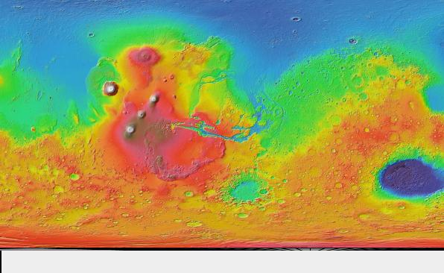
Notes:
Use in Exploration
MOLA Colorized Elevation Map
Retrieved from JMARS software

Slide 3
Where is the carbonate on Mars?
In-Class Activity 2_Water World

Slide 4
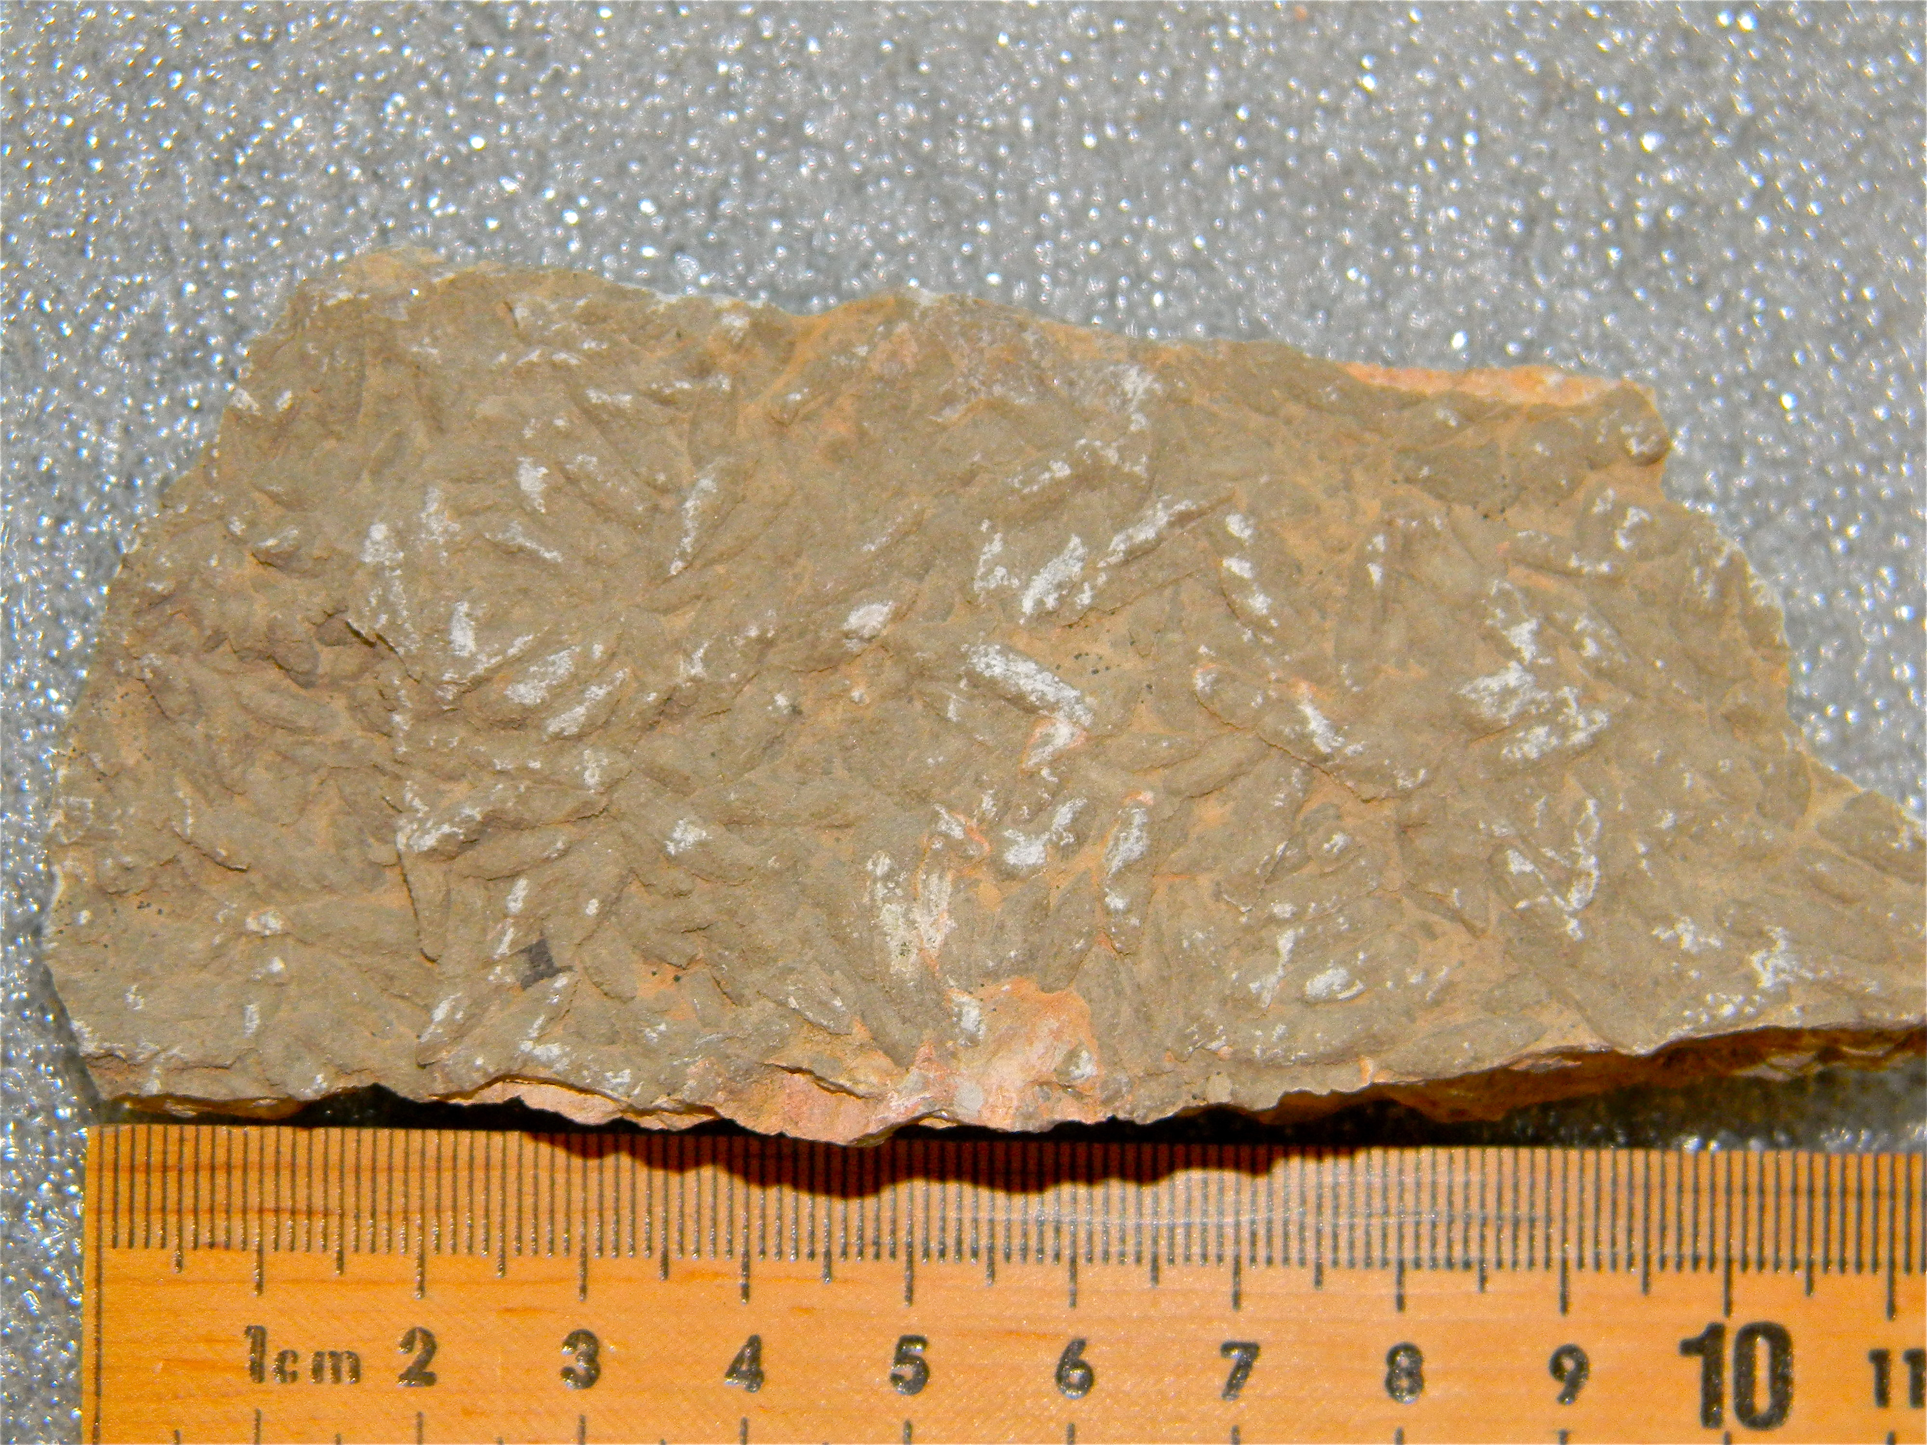
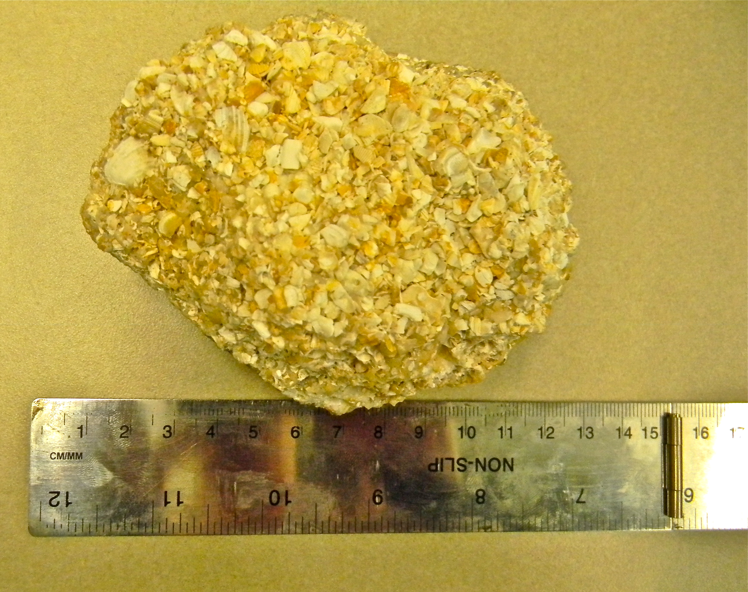
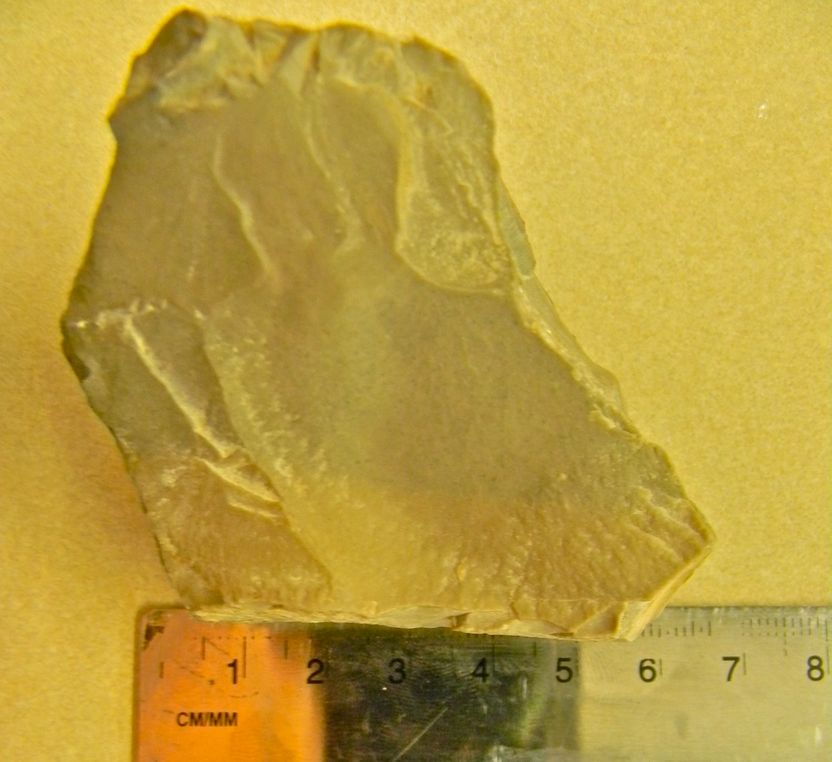
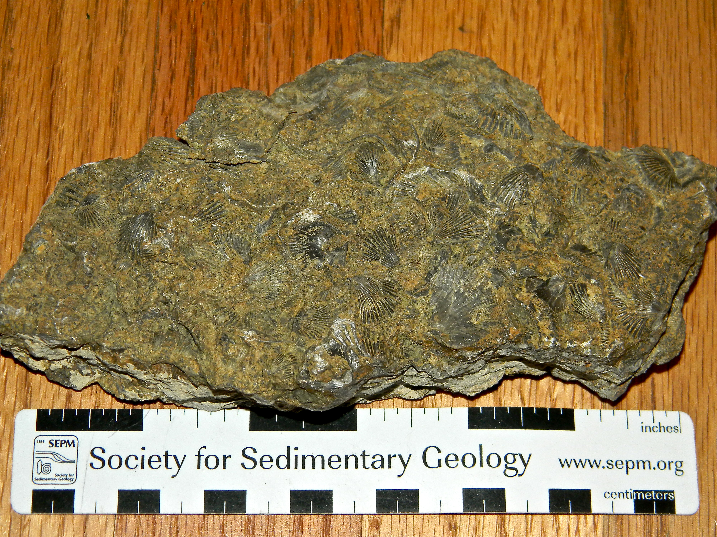
A.
B.
C.
D.
Notes:
Use in Engagement
A. Packstone (formanifera?)
B. Coquina
C. Mudstone
D. Brachiopod grainstone
Images can be displayed separately and enlarged.

Slide 5
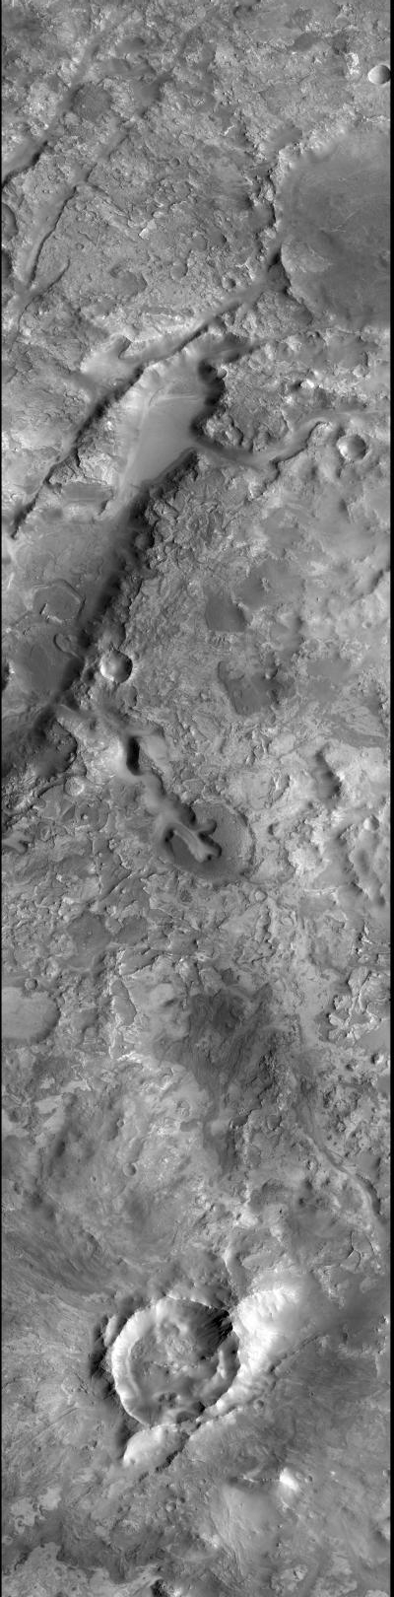
Notes:
Use in Evaluation
Nili Fossae Region Imaged by CTX
Image Credit: ASU/Malin Space Science Systems
Image Source: http://viewer.mars.asu.edu/planetview/inst/ctx/P03_002176_2024_XI_22N283W#start

