Slide 1
Sandbox dunes
In-Class Activity 1_Vast Deserts

Slide 2
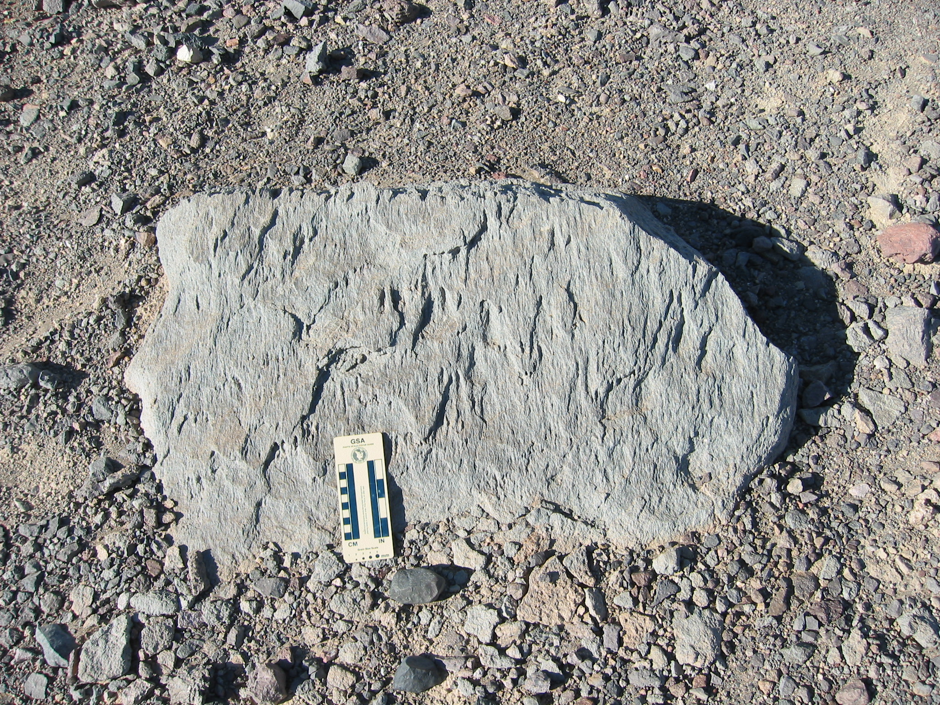
Notes:
Death Valley Ventifacts and desert pavement
Photo by Marjorie Chan

Slide 3
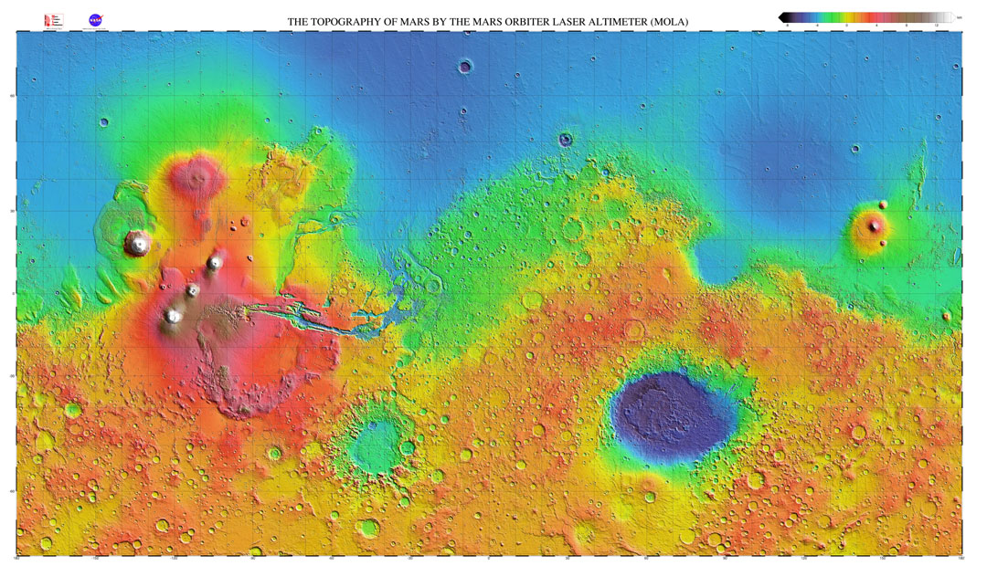
Western Nereidum Montes
Terra Sirenum
Notes:
MOLA Mars Global Map as of 2000
Image Source: http://mola.gsfc.nasa.gov/images/mercat_med.jpg

Slide 4
Martian ventifacts
In-Class Activity 2_Vast Deserts

Slide 5
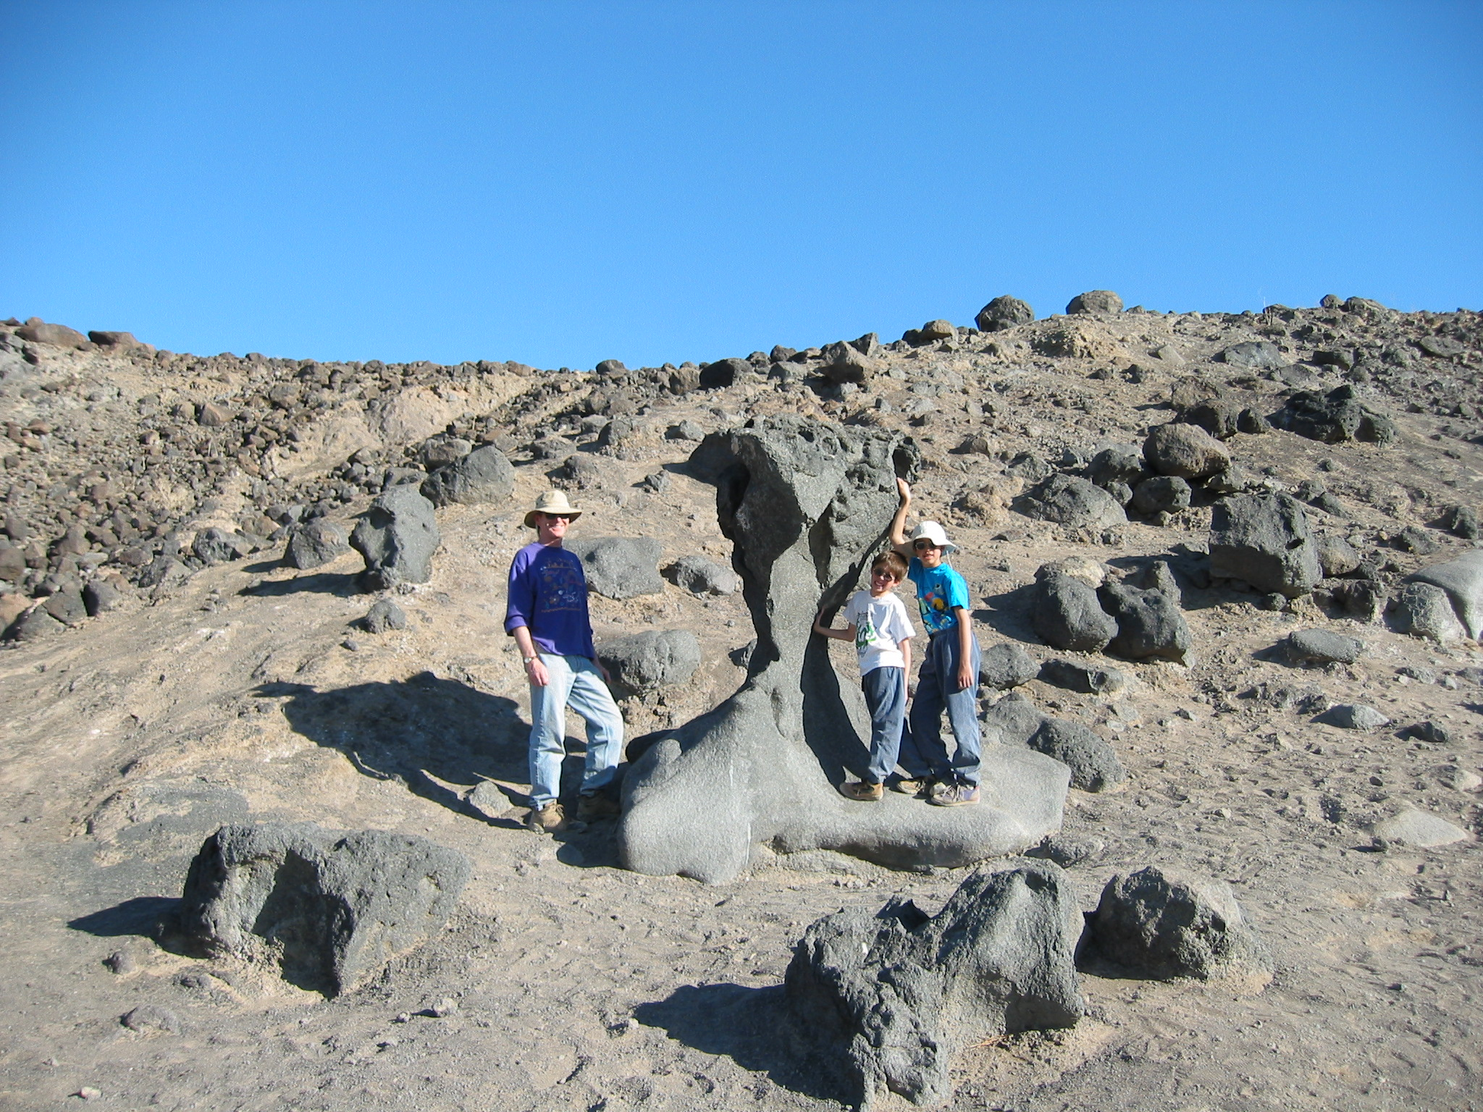
Notes:
Use in Engagement
Image Credit: Marjorie Chan

Slide 6
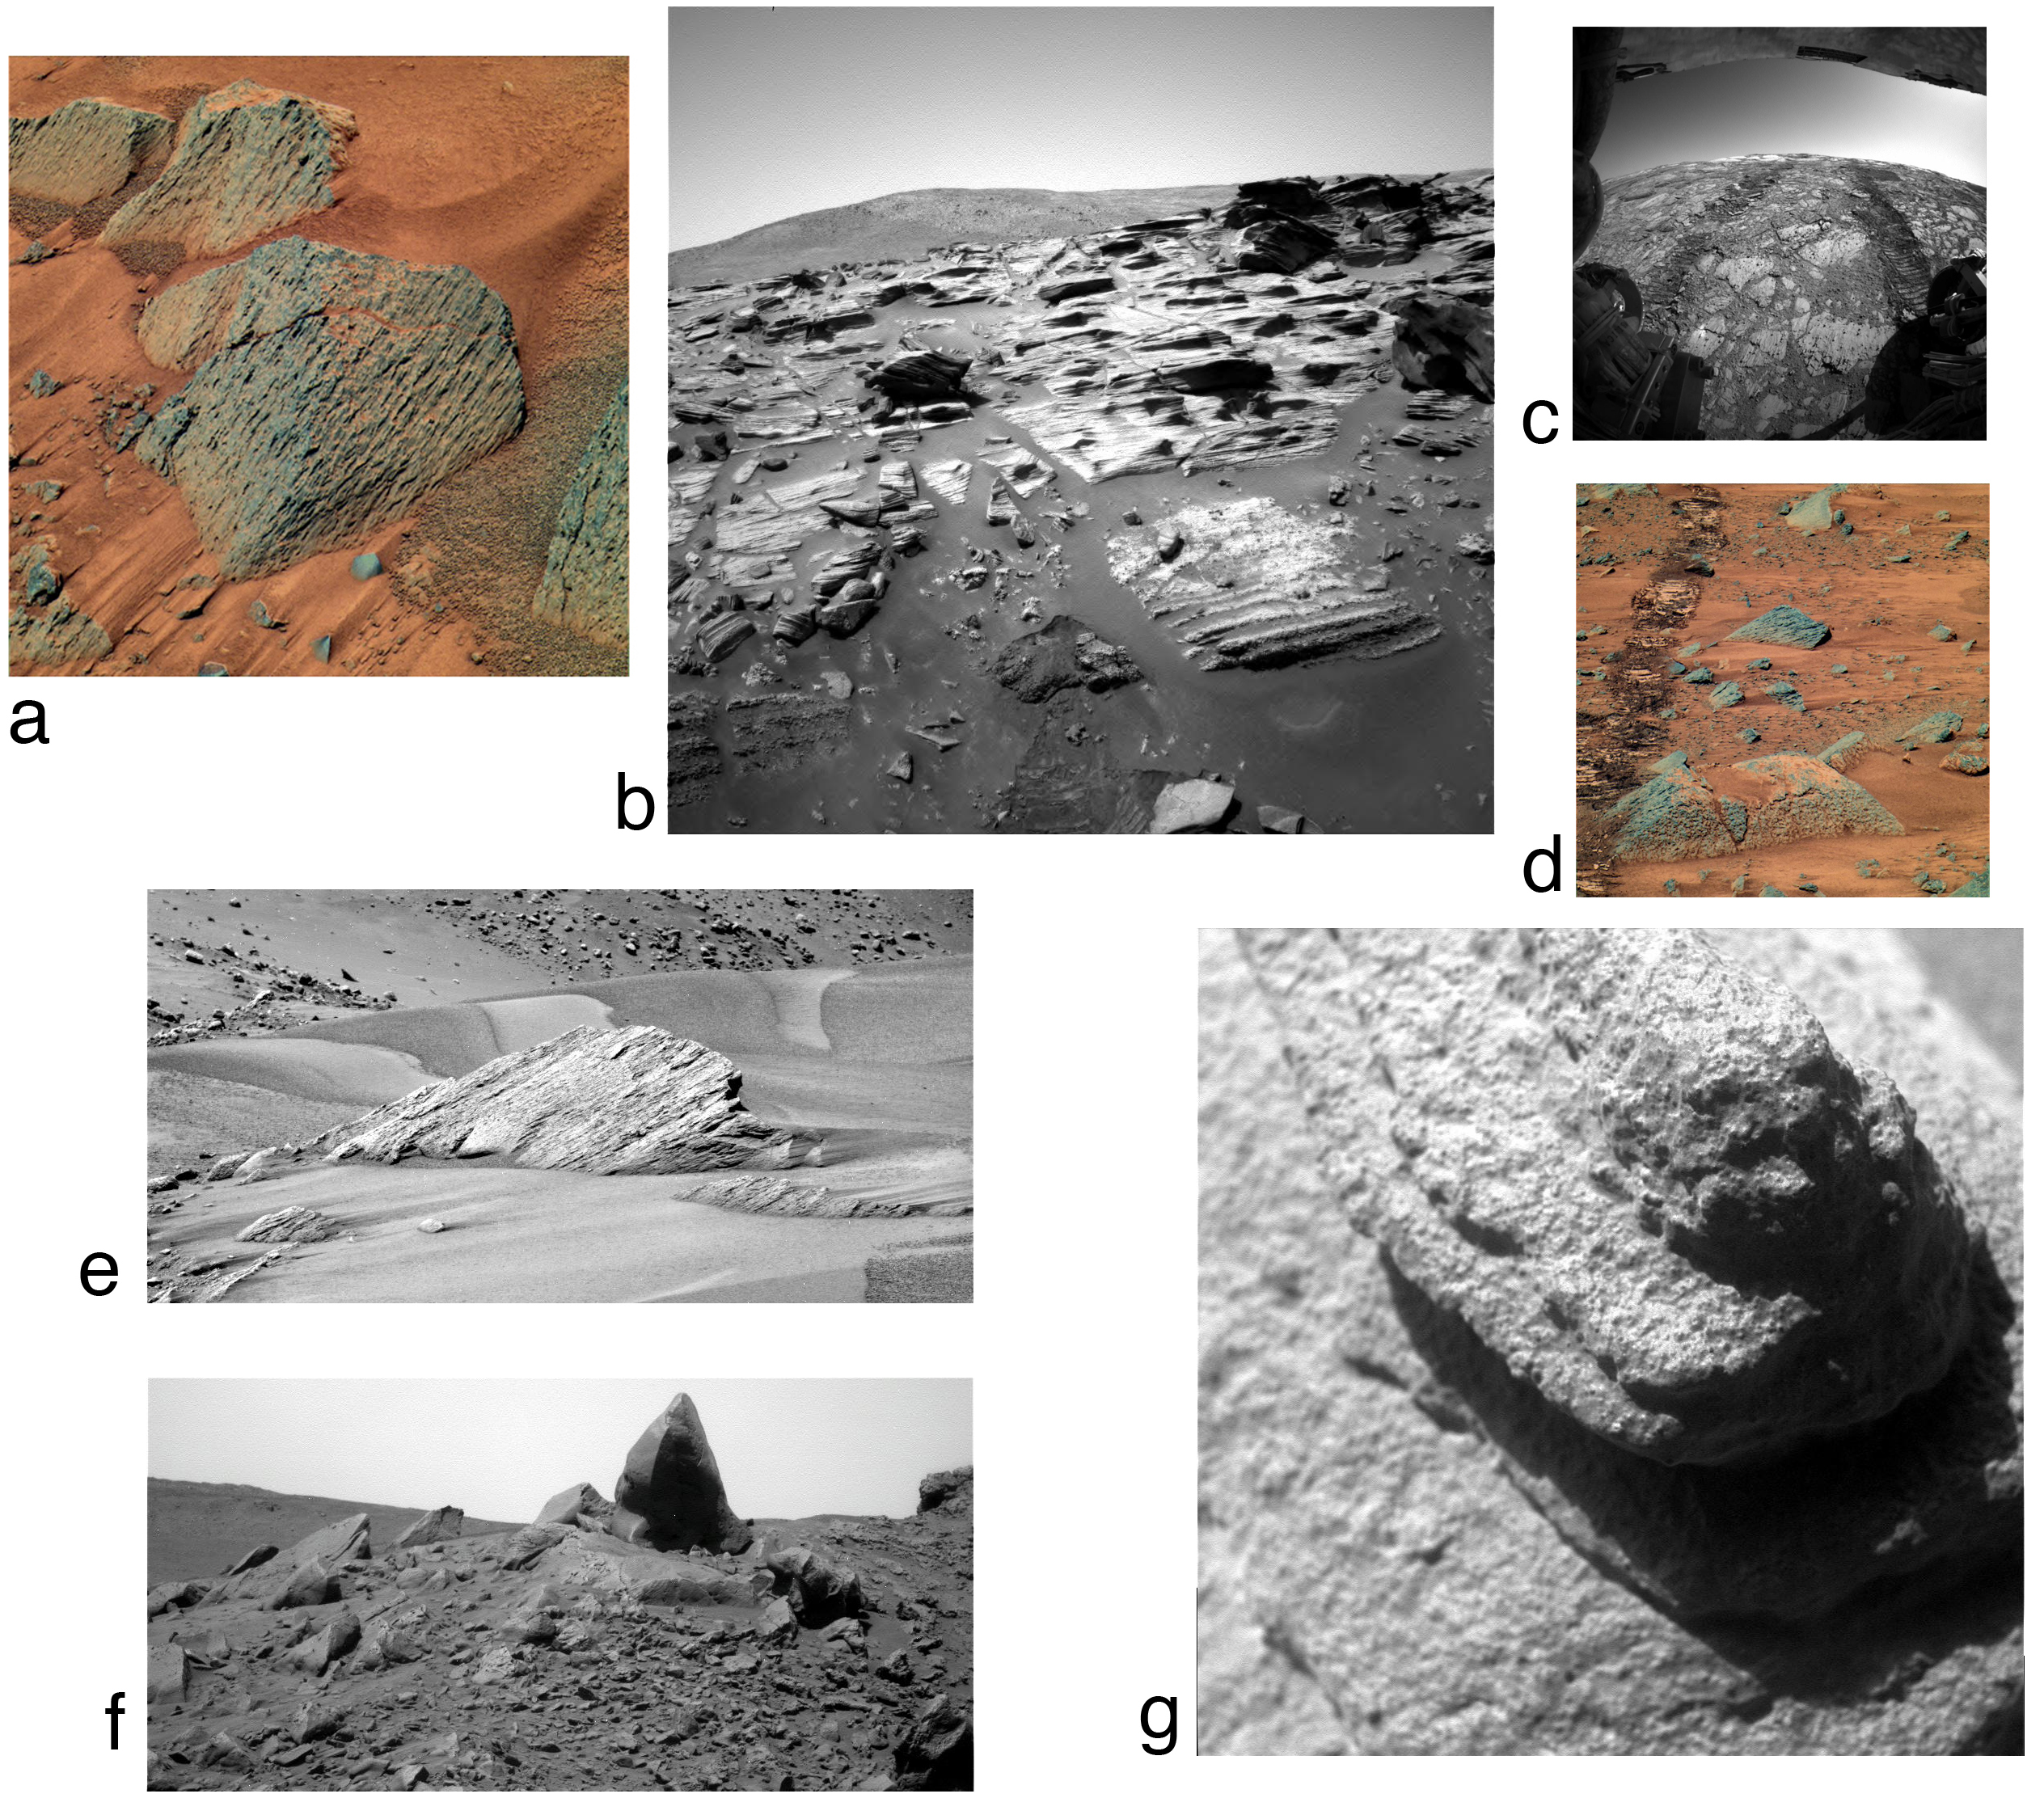
Notes:
Use in Elaboration
Mars Ventifacts Source: http://www.psi.edu/pgwg/images/jul09image.html
Caption: (a) Fluted rocks at the Spirit site (Pancam composite color, Sol 584). (b) Bedded rocks that have preferentially abraded along weak layers, Columbia Hills, Spirit site (Pancam, Sol 754). (c) "Tails" in the lee of resistant nodules within sulfate-rich soft rock at the Opportunity site (Hazcam, Sol 142). (d) Faceted and fluted rocks at the Spirit site (Pancam, Sol 585). (e) Faceted rocks near bedforms at the Spirit site (Pancam, Sol 620). (f) Faceted rocks at summit in Columbia Hills, Spirit site (Pancam, Sol 1344). g) Microscopic image of rock texture in vicinity of Image 1b (image width is 3 cm, Sol 753). [

Slide 7
Bounding through dunes
Homework 1_Vast Deserts

Slide 8
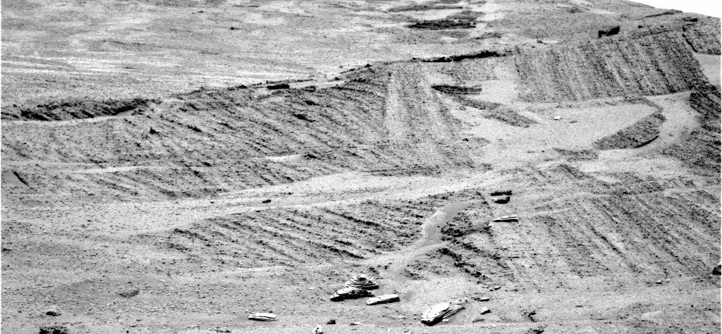
Notes:
Burns Formation
Left Panoramic Camera Non-linearized Sub-frame EDR acquired on Sol 288 of Opportunity's mission to Meridiani Planum at approximately 13:10:16 Mars local solar time, camera commanded to use Filter 7 (432 nm). NASA/JPL/Cornell

Slide 9
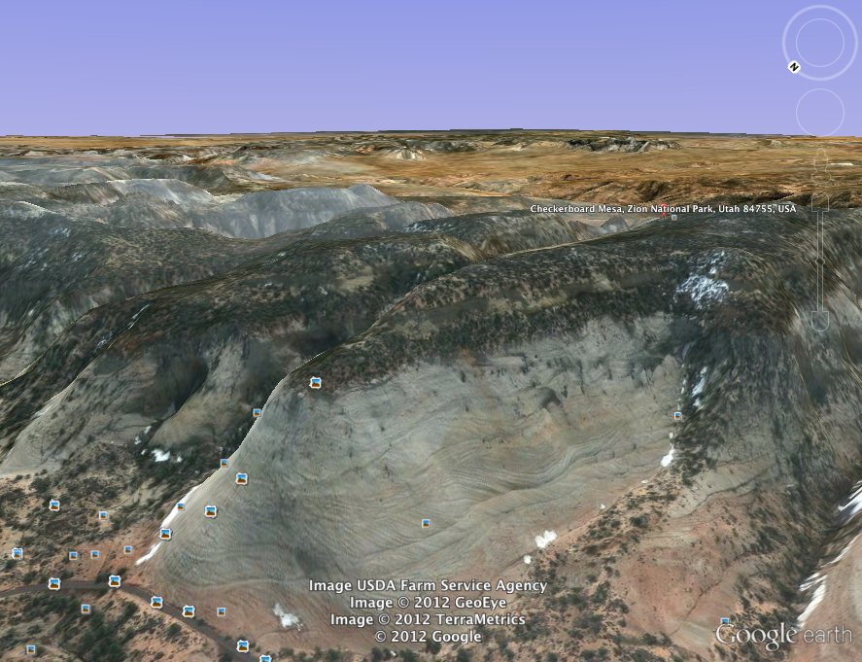
Notes:
Checkerboard Mesa Zion National Park, UT
37°13’30.75”N 112°52’54.13”N and orient the window looking Southwest

Slide 10
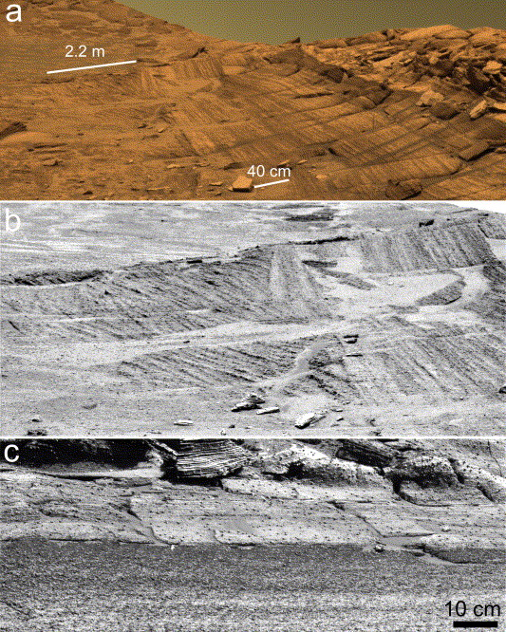
Notes:
Grotzinger, J.P. et al., 2005. Stratigraphy and sedimentology of a dry to wet eolian depositional system, Burns formation, Meridiani Planum, Mars. Earth & Planetary Science Letters, v. 240, p.11-72
Caption:
Contacts between stratigraphic units of the Burns formation as obtained by the Pancam at Burns cliff, Endurance crater. (a) Burns formation
at eastern end of Burns cliff. The three informal subdivisions (lower, middle, and upper units) of the formation are visible, as described in Fig. 4.
Because of its broad coverage, the scale varies significantly across area of image. This image is an approximate true-color composite mosaic
generated from images acquired on sol 278, sequence P2440, using Pancam’s 750, 530, and 430 nm filters. (b) Close-up of Wellington contact and
Burns lower unit strata. Note thick lamination of cross-bedding below contact, which contrasts with fine lamination above. Scale of cross-bedding
provided by bar in (a), and by visible concretions (small black dots) which are up to 3–5 mm in diameter. Grayscale bsuper-resolution imageQ using
Pancam’s 430 nm filter on sol 288. (c) Close-up of Burns middle unit/upper unit transition and Whatanga contact. Contact is characterized by an
upward gradation from light to dark tone in upper part of middle unit, followed by an abrupt shift to a much lighter tone which defines the contact.
Grayscale bsuper-resolution imageQ using Pancam’s 430 nm filter on sol 289.

