Slide 1
Carving Mars: Rivers
In-Class Activity 1_Surface sculpting waters of Mars

Slide 2
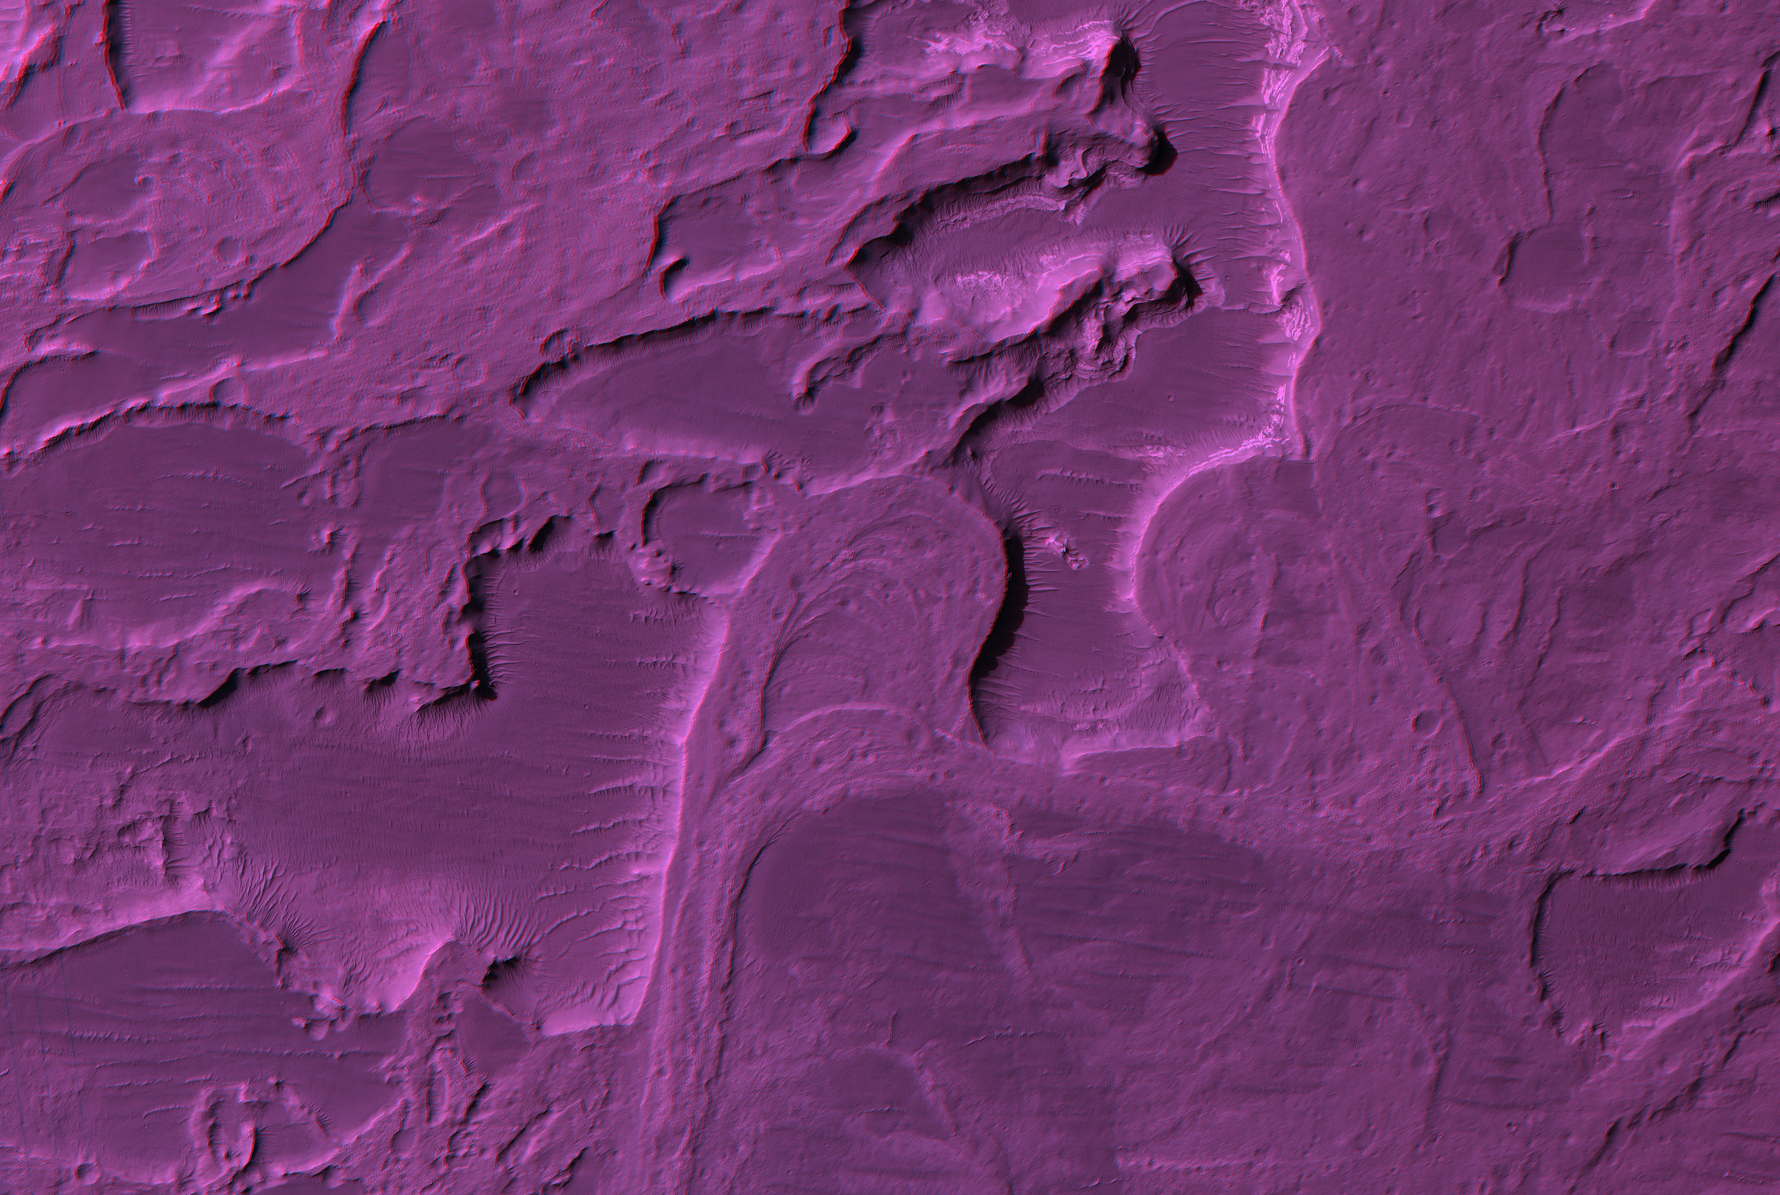
NASA/JPL/University of Arizona
Notes:
Eberswalde Delta Mars- HIRISE
Image Source: http://hirise.lpl.arizona.edu/images/2007/details/cut/Eberswalde-delta-3x.jpg
Image Context: http://hirise.lpl.arizona.edu/PSP_001534_1560

Slide 3
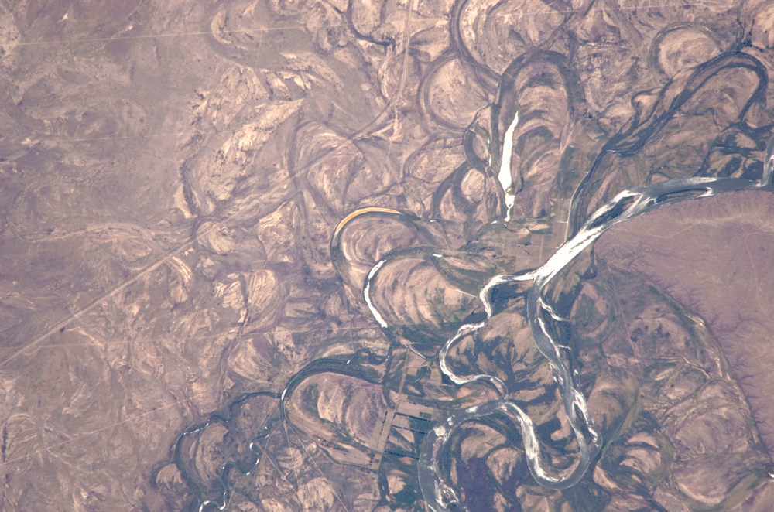
Notes:
Image from the ISS of:
Features: RIO NEGRO, COLONEL JOSEFA AREA, FLOOD PLAIN
Center Point Latitude: -39.8 Center Point Longitude: -65.4
Image Source: ftp://eol.jsc.nasa.gov/EFS_highres_ISS022_ISS022-E-19513.JPG

Slide 4
Eberswalde delta
In-Class Activity 2_Surface sculpting waters of Mars

Slide 5
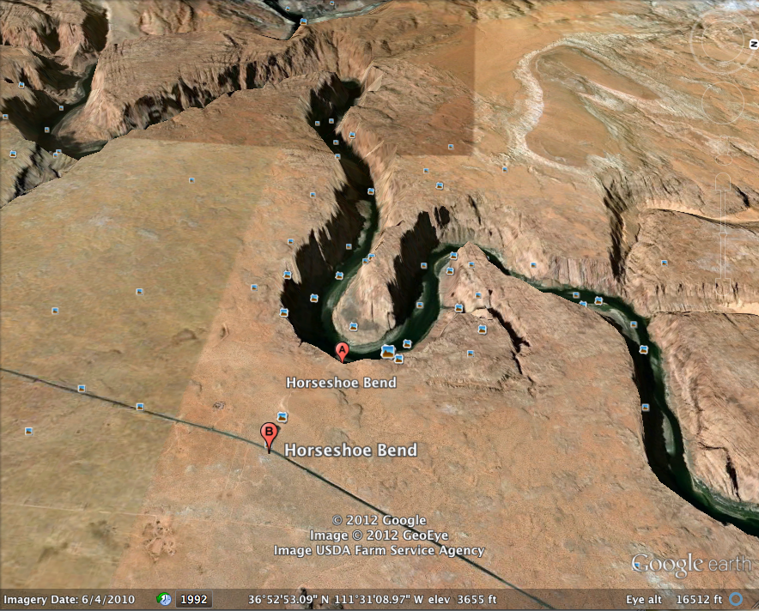
Notes:
Use in Engagement
Horseshoe Bend, Colorado River, USA
Google Earth
36°52’49.73’’ N
111°30’57.40’’ W

Slide 6
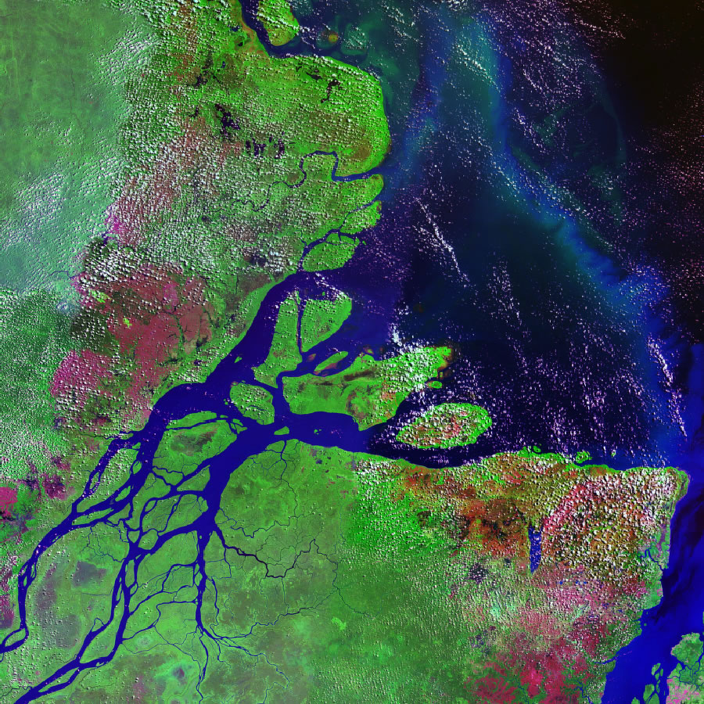
Notes:
Use in Engagement
Amazon Delta
Image Source: http://jeffsayre.com/wp-content/uploads/2010/02/amazon-delta-lg.jpg

Slide 7
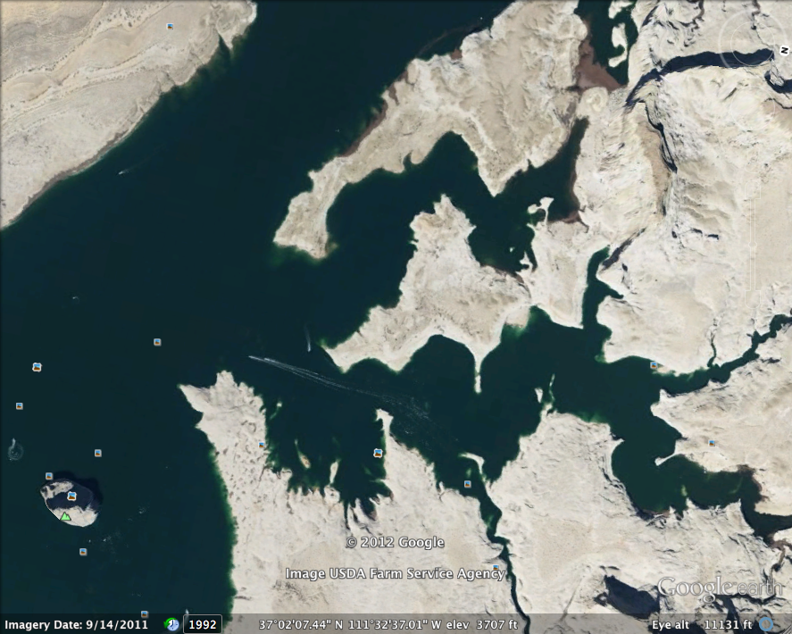
Notes:
Use in Engagement
Lake Powell
Google Earth
37°02’15.46’’ N
111°32’29.00’’ W

Slide 8
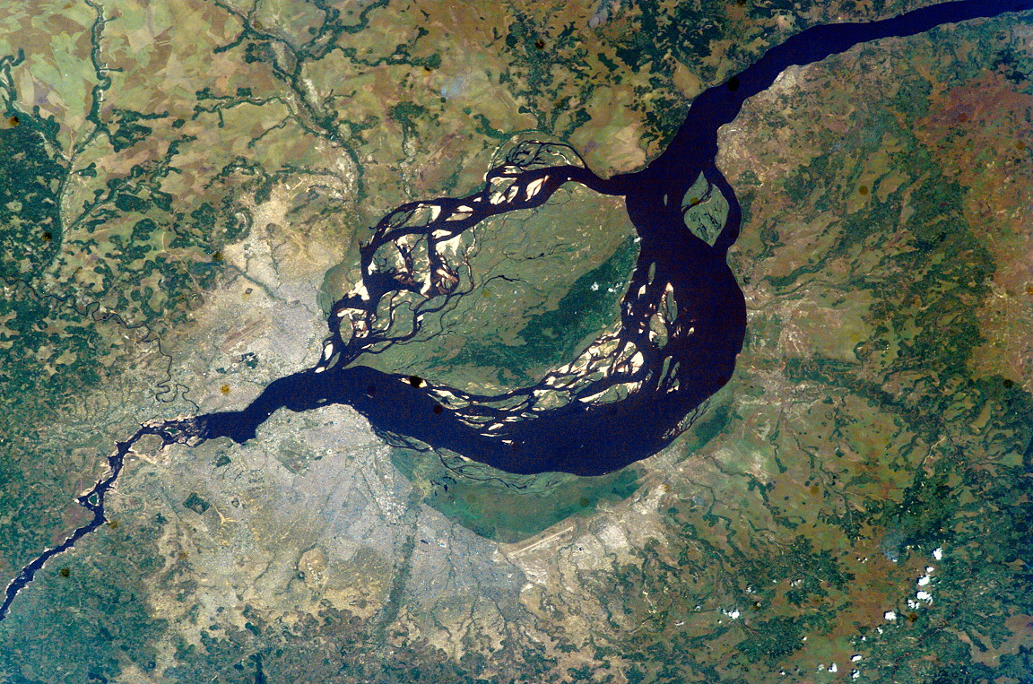
Notes:
Use in Engagement
Congo River
Image Source: http://www.placestudies.com/category/travel-fictions/heart-darkness

Slide 9
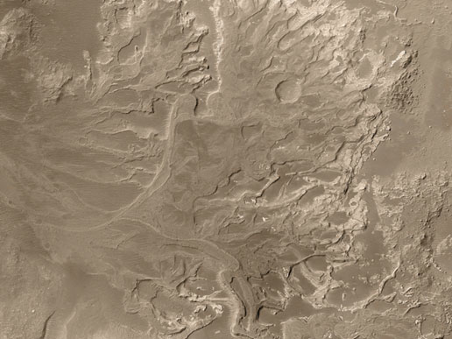
Photo Credit: NASA/JPL/Malin Space Science Systems
Notes:
Use in Exploration
Eberswalde Delta
Image Source: http://www.nasa.gov/multimedia/imagegallery/image_feature_98.html
Image Context: http://www.msss.com/mars_images/moc/2003/11/13/

Slide 10
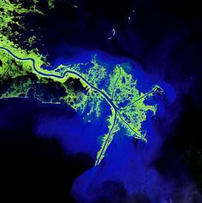
Mississippi River Delta/ USGS
Notes:
Bird’s foot Delta/River-dominated delta: Mississippi River Delta
Use in Exploration
Image source: http://www.nature.com/news/2009/091110/full/news.2009.1077.html

