Slide 1
Scale & Context
Remote Sensing_In-Class Activity Images

Slide 2
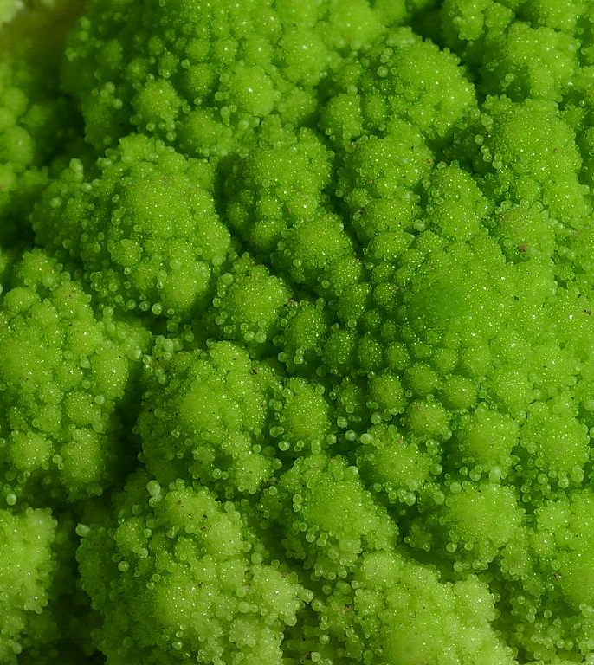
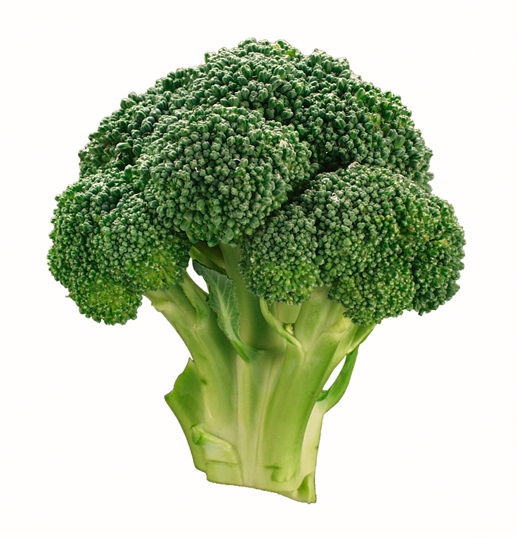
Seeing is believing?
Notes:
In Class Activity/Scale and Context (do not show large image of broccoli for exercise until students have finished Exploration)
What are your observations?
Can students identify what this is?
What can students learn from this exercise?
Know the scale
Know the context
Image credit: Petr Kratochvil (no copywrite/public domain)
Image credit: http://mobile-cuisine.com/

Slide 3
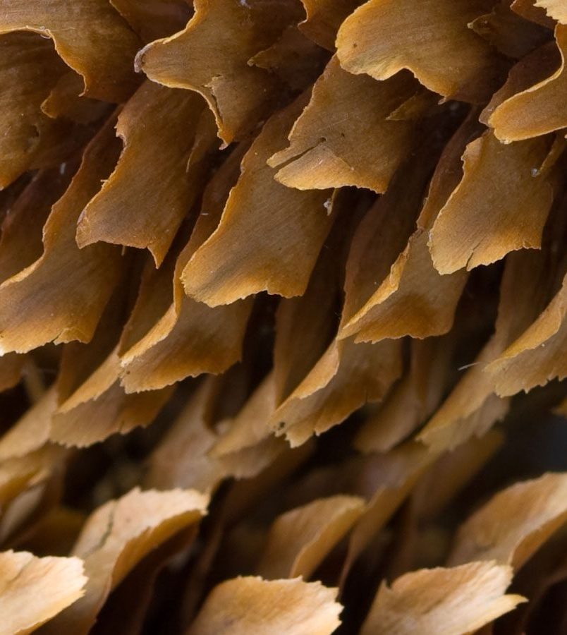
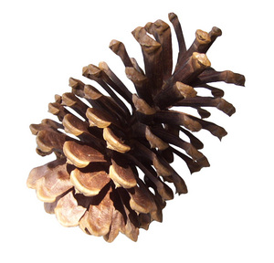
Take another look:
Notes:
In Class Activity/Scale and Context (do not show large image of pine conei for exercise until students have finished Exploration)
Can students identify the object in the image given the following information?
Have students recognize the importance of scale and context.
Image credit: Petr Kratochvil (no copywrite/public domain)
Image credit: http://www.jnack.com/

Slide 4
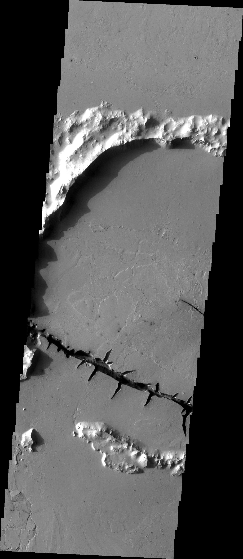
Notes:
In Class Activity/Scale and Context
THEMIS Image: In Class Activity/Scale and Context
THEMIS Image #V13300013, Image width: 25km; Lat 7.3/Long 161.3. Image credit: NASA/JPL/ASU; Image Source: http://themis.asu.edu/zoom-20050225a

Slide 5
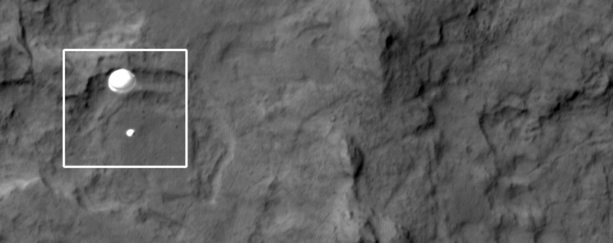
Notes:
HiRISE image (ESP_028256_9022) of Curiosity descending to the Martian surface acquired August 5, 2012. Scale = 33.6 cm/pixel;
Image Source: http://hirise.lpl.arizona.edu/releases/msl-descent.php

Slide 6
MARS image analysis
Remote Sensing_Homework/Lab

Slide 7
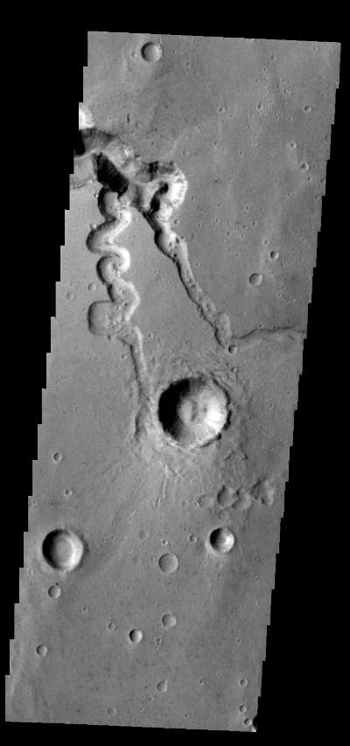
Image Credit: NASA/JPL/ASU
Notes:
Homework/Mars Image Analysis
Image source: http://themis.asu.edu/node/5765
Latitude: 2.71399
Longitude: 316.959
Orbit Number: 43593
Captured: 2011-10-12 18:23
Posted to Web: Tue, 2011-11-22
Instrument: VIS
Image Width: 512 pixels (19 km)
Image Height: 1824 pixels (67 km)
Vertical Resolution: 0.036851 km/pixel
Horizontal Resolution: 0.038997 km/pixel

Slide 8
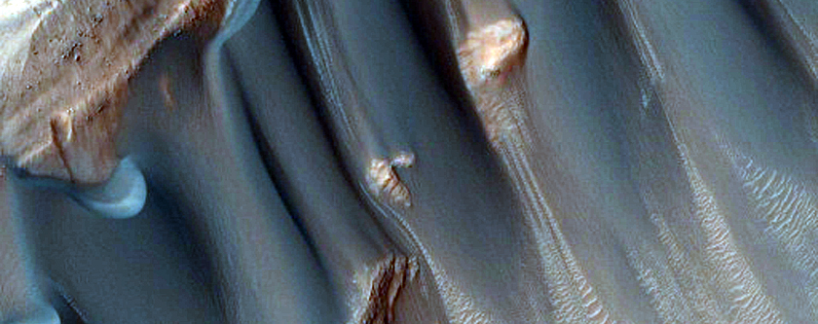
NASA/JPL/University of Arizona
Notes:
Homework/Mars Image Analysis
Dunes in the Western Nereidum Montes ESP_013046_1390
Image Source: ttp://hirise.lpl.arizona.edu/ESP_013046_1390

