Slide 1
Columnar jointing on Mars
In-Class Activity 2_Oympus Mons & Igneous Rocks

Slide 2
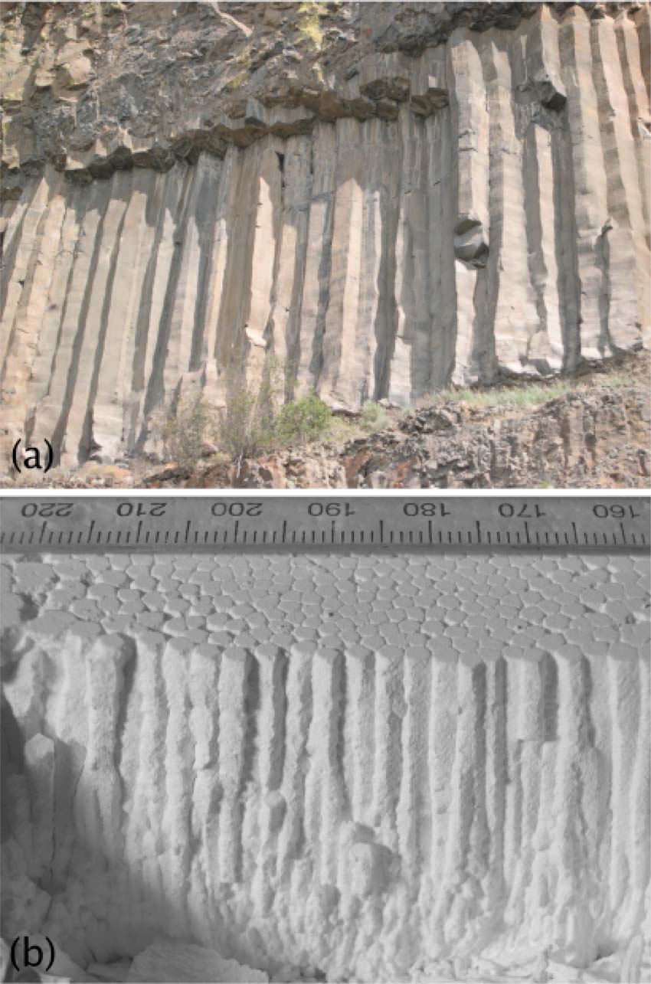
(Gohering et al., 2006)
Notes:
FIG. 1. (a)Columnar jointing in a basalt of the
Columbia Plateau near Banks Lake 95 cm average diameter, and
(b) in desiccated corn starch.
Gohering L., Morris, S.W., and Lin, Z., 2006. Experimental investigation of the scaling of columnar joints. PHYSICAL REVIEW E 74, 036115, p. 1-12.

Slide 3
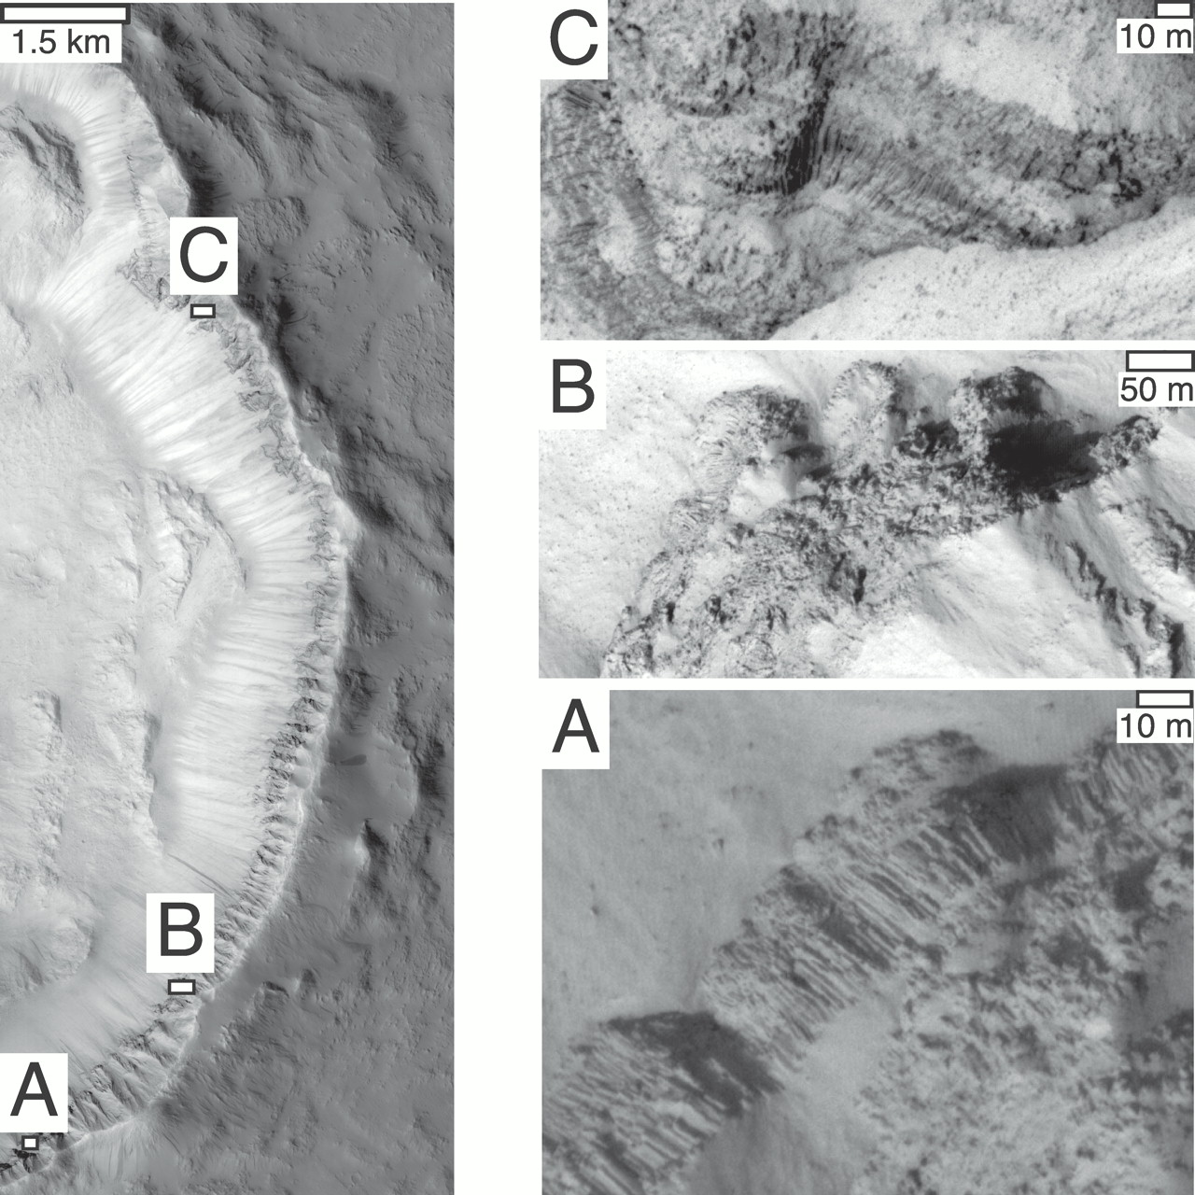

Left: HiRISE (High Resolution Imaging Science Experiment) image PSP_005917_2020 (cropped).
Milazzo M et al. Geology 2009;37:171-174
©2009 by Geological Society of America
Notes:
Left: HiRISE (High Resolution Imaging Science Experiment) image PSP_005917_2020 (cropped). Columnar jointing is seen in rocky outcrops that were exposed and tilted during formation of the crater. North is up and to right. A: The most well-exposed columns are seen in this outcrop. Columns are ~25–30 m long and 2 m wide. B: At the base of the outcrop we see fanning and radiating columns <1 m wide (see Fig. 3B for close-up). C: Thin, fanning columns, probably entablature, are also visible in this outcrop. Scale bars are only valid in horizontal direction due to foreshortening of cliffs.

Slide 4
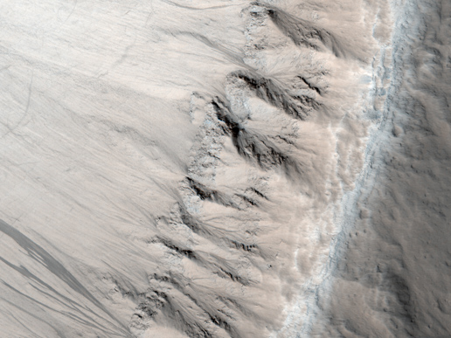
Image Credit: NASA/JPL-Caltech/University of Arizona
Notes:
First Observation of Columnar Jointing on Mars
Image source: http://www.nasa.gov/mission_pages/MRO/multimedia/mro20090225.html
This image from the High Resolution Imaging Science Experiment (HiRISE) on NASA's Mars Reconnaissance Orbiter shows an exposure of layered rock that exhibits a type of fracturing -- called columnar jointing -- that results when cooling lava contracts. The observation is cited in a report, "Discovery of Columnar Jointing on Mars," http://geology.gsapubs.org/cgi/content/full/37/2/171 in the February 2009 issue of the journal Geology. The authors propose that flooding by water was likely what caused a quick cooling of lava to result in this jointing.
The image, taken Oct. 31, 2007, shows a portion of an unnamed crater 16 kilometers (10 miles) in diameter and centered at 21.52 degrees north latitude, 184.35 degrees north longitude. Shown here is a section about one kilometer (0.6 mile) wide from the image catalogued by the HiRISE team as PSP_005917_2020 [link to http://hirise.lpl.arizona.edu/PSP_005917_2020]. The column-forming fractures resemble textures common on Earth in locations such as the Colombia River Basalt Group and in the Colorado Plateau.

Slide 5
Lava flows
In-Class Activity 1_Olympus Mons & Igneous Rocks

Slide 6
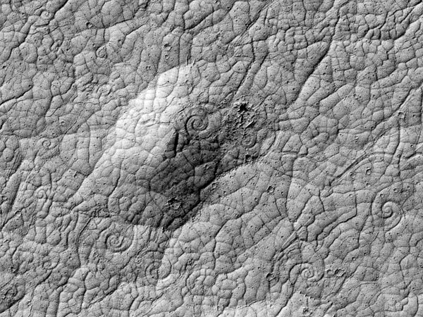
Credit: NASA/JPL/University of Arizona
Notes:
Use in Exploration
Athabasca Spiral lava flows: Discovery news article: http://www.space.com/15446-mars-lava-volcanoes.html
Image source: http://www.space.com/15446-mars-lava-volcanoes.html
Spirals are 16-98 ft wide

Slide 7
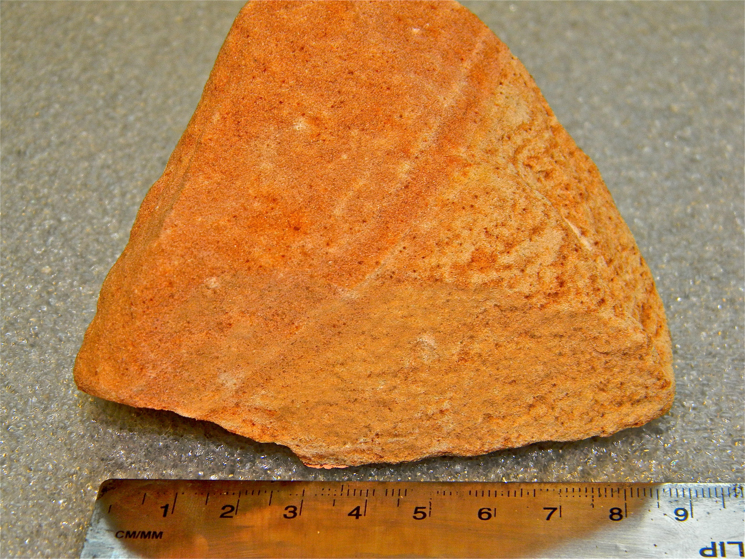
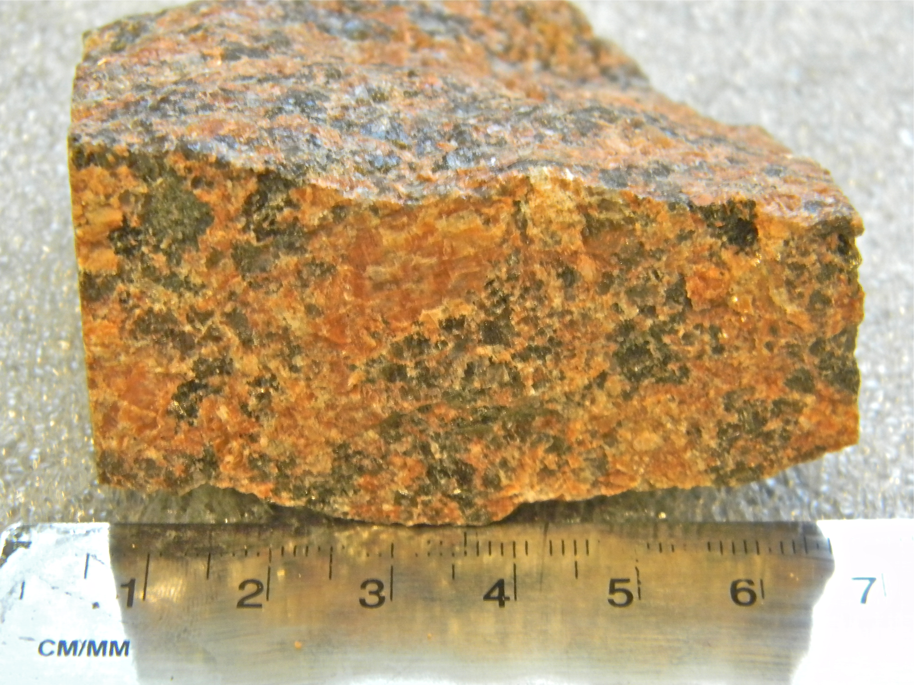
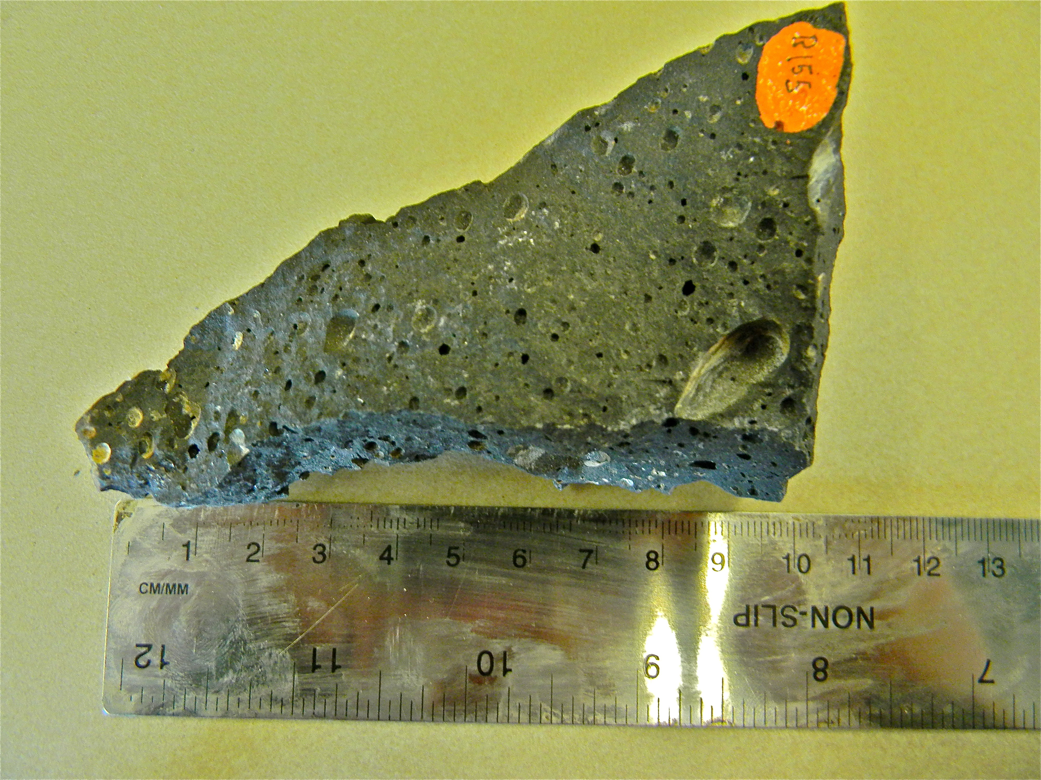
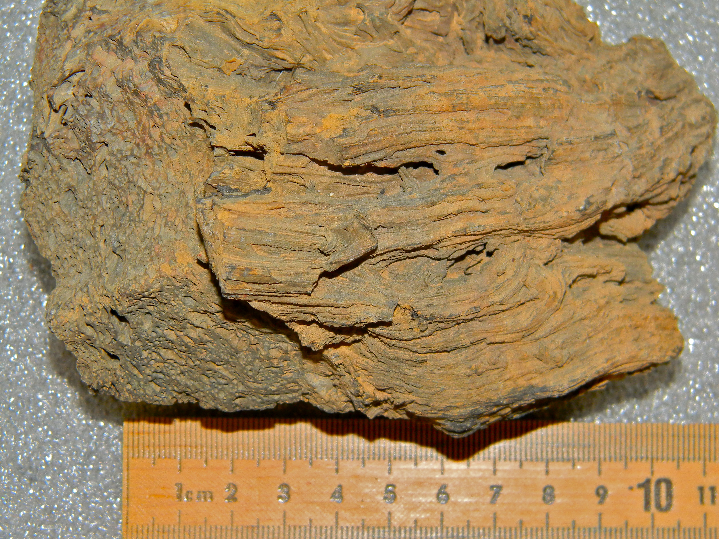
A.
B.
C.
D.
Credit: Mars for Earthlings, University of Utah, Levi Huish
Notes:
Use in Elaboration
Sandstone
Potassium Feldspar Granite
Basalt
Oxidized Basalt
All images may be use separately as desired and can be enlarged with good resolution.

