Slide 1
Living Extremely
In Class Activity 1- Extremophiles

Slide 2
Extremophile classification
Acidophile
Alkaliphile
Anaerobe
Endolith
Halophile
Piezophile
Psychrophile
Thermophile
Xerophile
Requires salt
Needs high pressure
40°C or higher
Lives inside rocks
No need for O₂
Low pH
High pH
Low H₂O activity
15°C or lower
Notes:
Use in Explanation
1) Here we have a classification system for extremophiles (via http://serc.carleton.edu/microbelife/extreme/extremophiles.html).
2) Ask students or teams to connect the name to its preferred environment
3) Monitor student’s classification

Slide 3
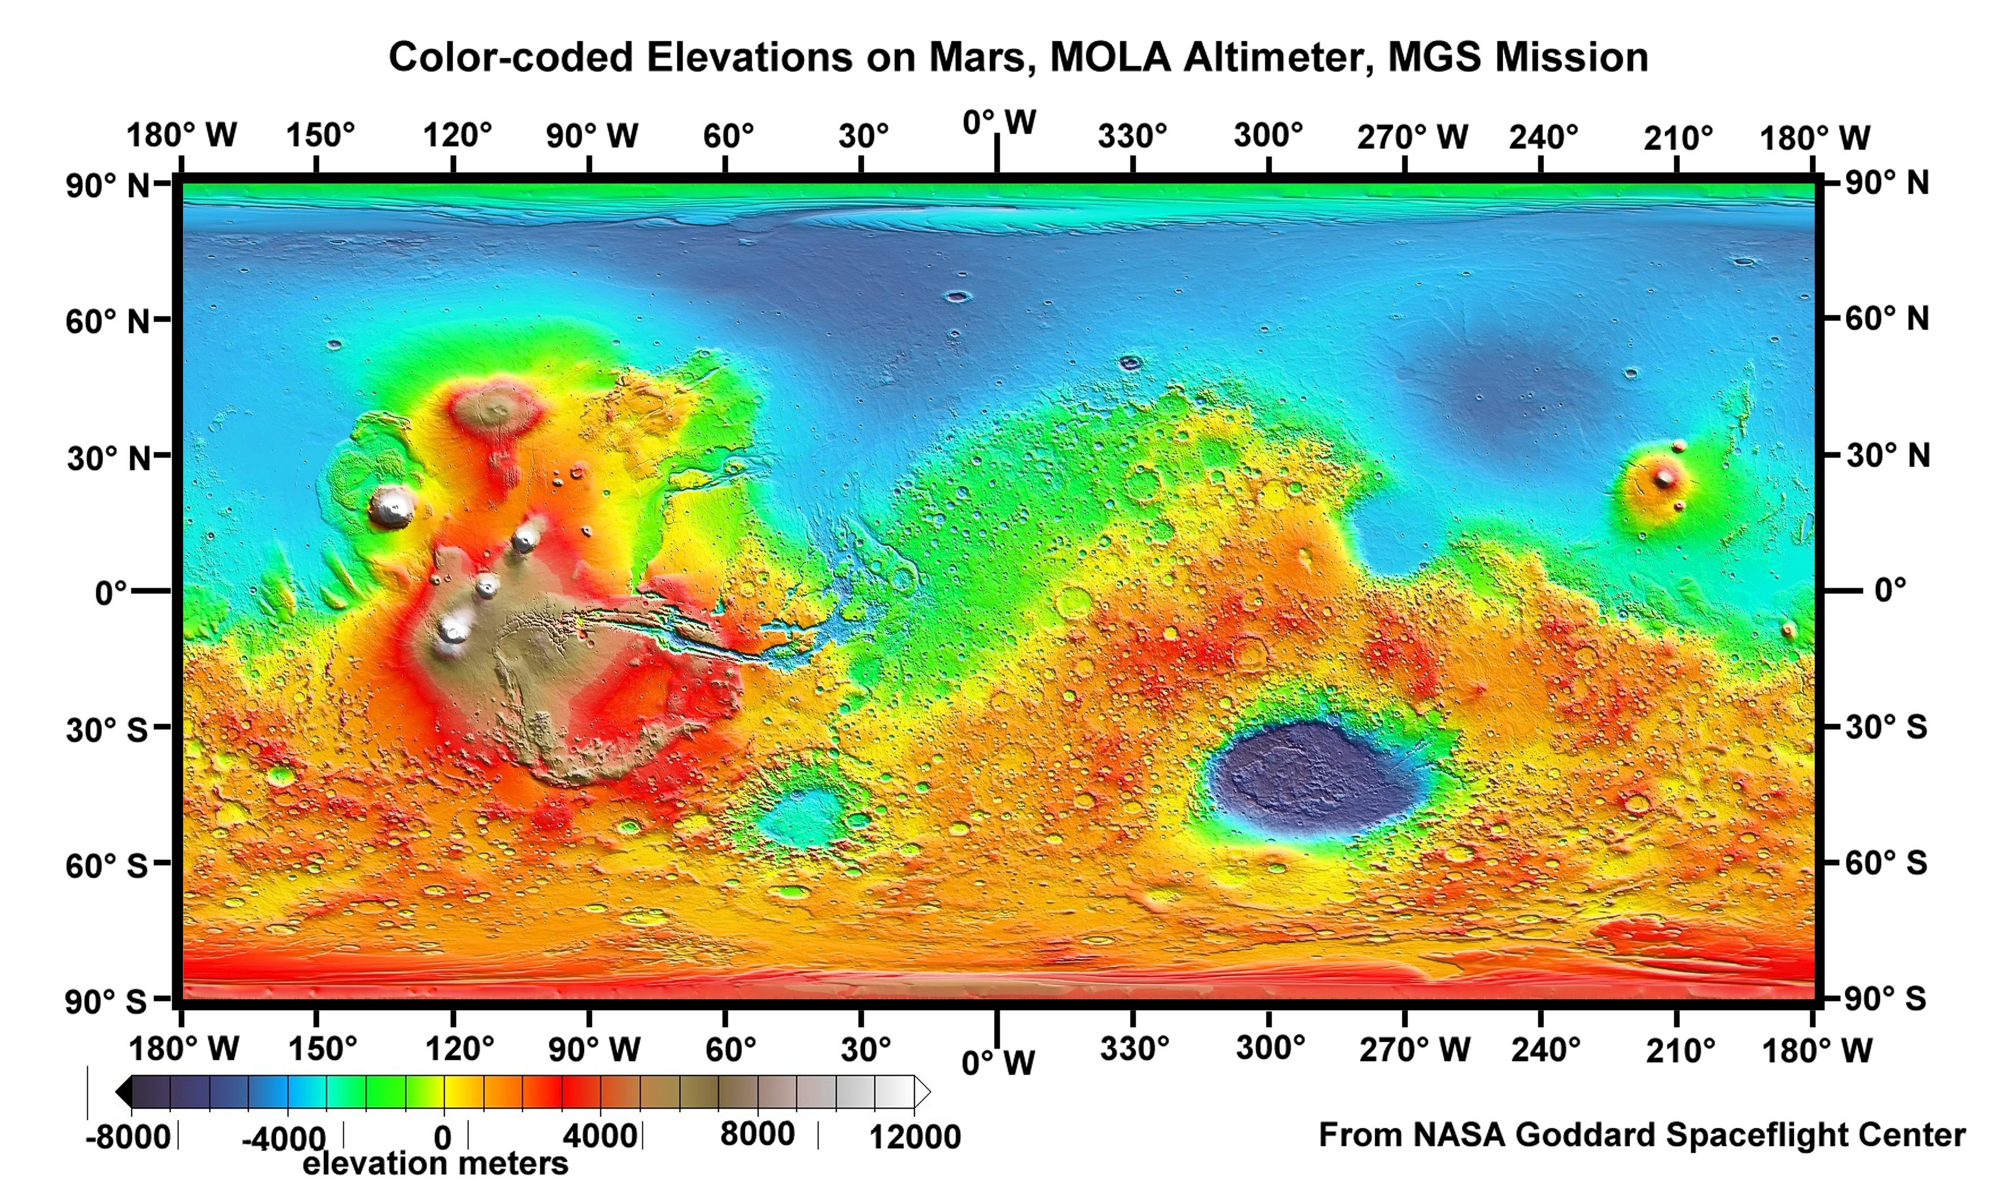
Notes:
Use in Elaboration
Where could the Tardigrade potentially live on Mars?

Slide 4
Mars life: through the lens of Curiosity
In Class Activity 3- Extremophiles

Slide 5
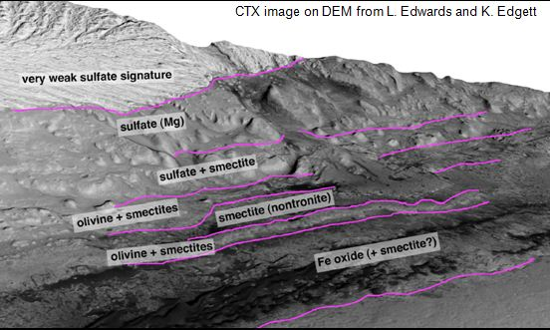
Notes:
Use in Evaluation
Image Source: http://www.universetoday.com/wp-content/uploads/2011/06/Gale-crater-stratigraphy.jpg

