Slide 1
Genesis, Context and Structure of Week-long Pre-orientation Program
Jim Swartz, Dack Professor of Chemistry
For my Committed Colleagues

Slide 2
Grinnell College
General
  Private, selective, residential
  185 faculty
  Grinnell, Iowa (pop. 9,000+)
Student Body
  1,600 students
  from 50 States
  traditional and full-time
  25% Domestic Students of Color
  12% International

Slide 3
Grinnell College
Curriculum
  No Distribution or Core Requirements
    1st semester seminar required
  Full-time load for students is 4 courses per semester
Science
  35% of students major in science
  Nearly all students take science and 75% take calculus
  70% of science graduates earn graduate degrees
60% of students spend a semester on off campus study

Slide 4
In the late 1980’s we began to worry in an organized way about the lack of women and students of color among our science graduates.
There is some evidence that some students are more sensitive to problems with the curriculum and pedagogy and that changes will benefit all students.

Slide 5
Where We Started
Perceived underperformance in women and domestic students of color in sciences
“Minority Student Retention Committee”
Some assertions that we were admitting the wrong students

Slide 6
Data Analysis
What correlated with poor grades in introductory math and science at Grinnell:
Weak correlation with standardized exam scores or high school grades
Correlation with:
  First generation college student
  Graduation from high school with < 50% graduates going on to college
  Being a domestic student of color

Slide 7
Barriers to the Successful
Study of Science
Acclimation to student life and lack of supportive community =>Pre-orientation, community building
Different learning styles => Pedagogical Reform
Role models and contexts for the study of science => Exposure to Research

Slide 8
Pre-orientation Week
Students are invited to campus a week prior to New Student Days to participate in a special
pre-orientation program
Alleviate anxieties of first year which may hinder academic performance and provide uncomfortable campus climate
Provide a small cohort in which relationships and a support network may be built
Introduce and acquaint students with faculty
Help students become comfortable with campus and acquaint students with services available

Slide 9
Who is Invited?
Students who paid deposits to attend Grinnell, expressed an interest in science and are:
  Domestic students of color
  First generation college students
  Women interested in physics, math, and computer science

Slide 10
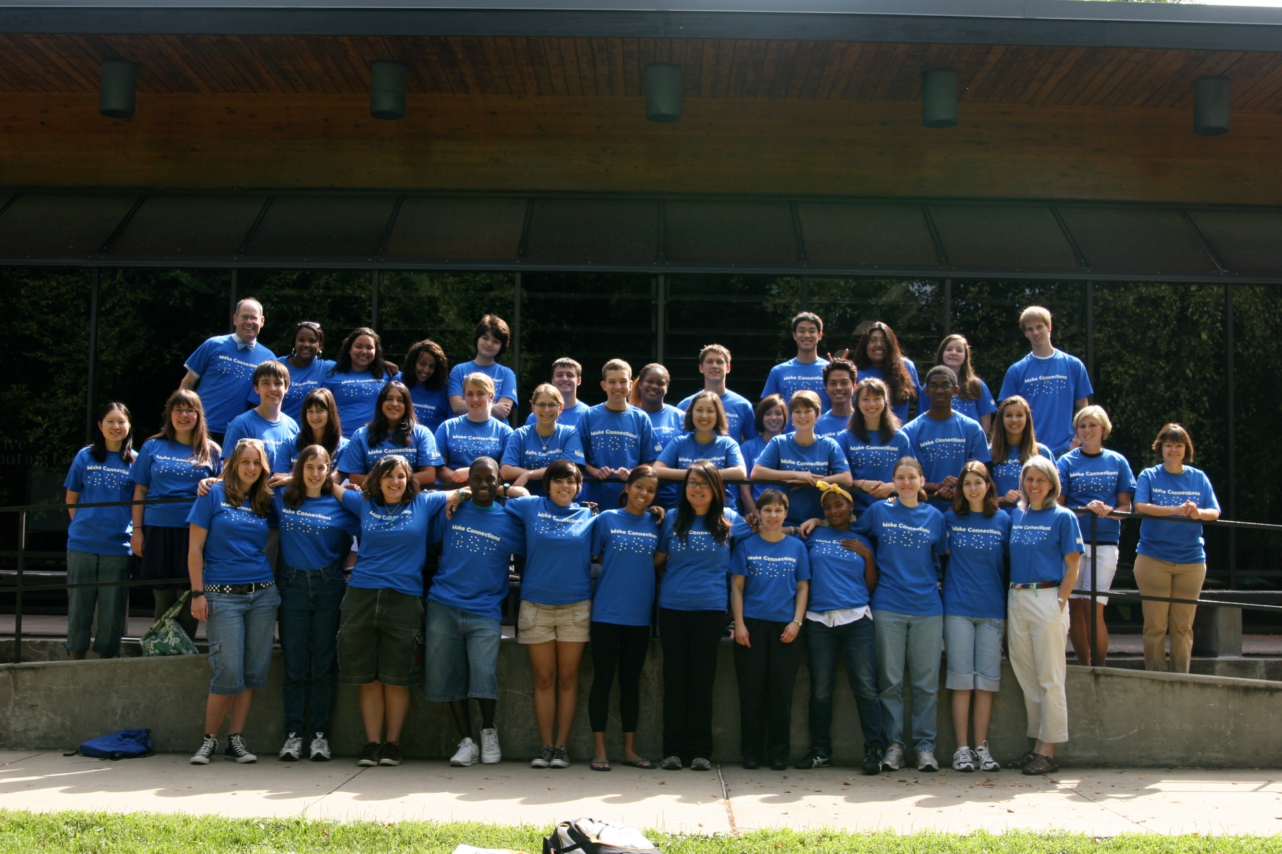

Slide 11
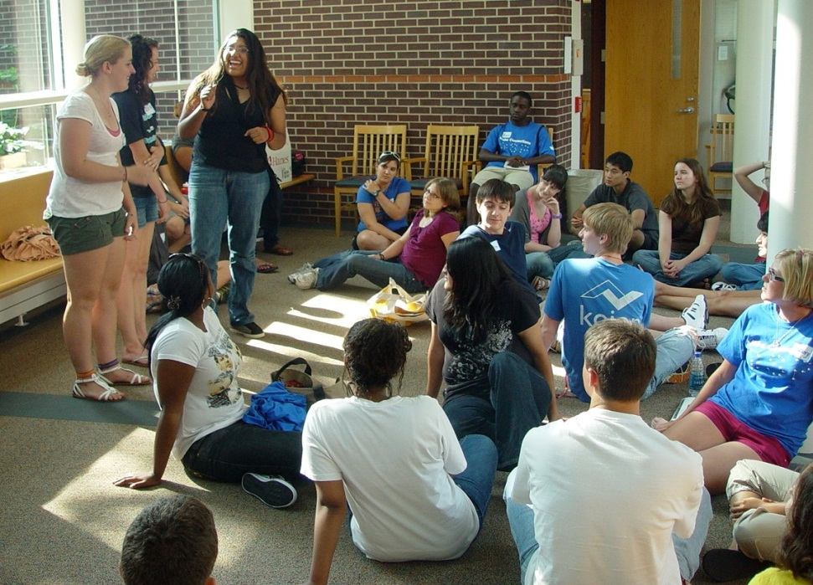
Schedule Elements
Numerous interactions with faculty, staff, experienced students, informal activities
Group Activities
  Puzzles and Problems
  Scavenger Hunt
Lab Project
Working the System
  Class registration
  Navigating and surviving classes
  Peer Support

Slide 12
Puzzles and Problems
Students work in groups on a series of challenging puzzles and problems over the course of the week.
They typically need to seek advice in their approach.

Slide 13
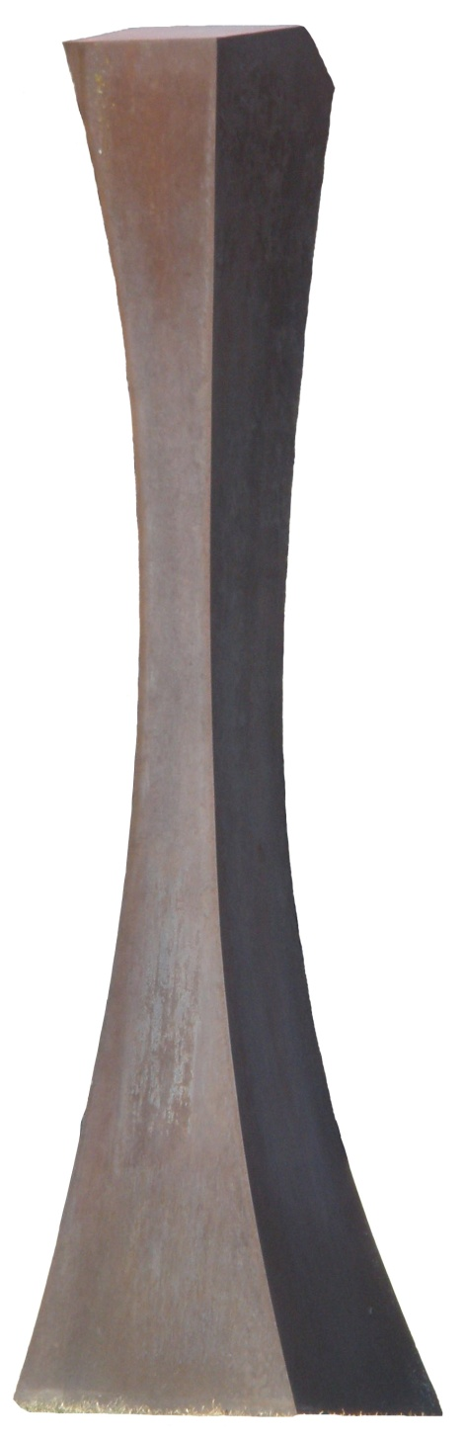
Did you know…?
One of the tasks GSP students have during pre-orientation is to find the volume of the Zirkle.
The Zirkle is an untitled sculpture on central campus by the late Louis Zirkle, longtime professor of art at the College.
It is also featured in the GSP logo, seen at the bottom left of the slideshow, and on the GSP t-shirt, seen in the next slide.

Slide 14
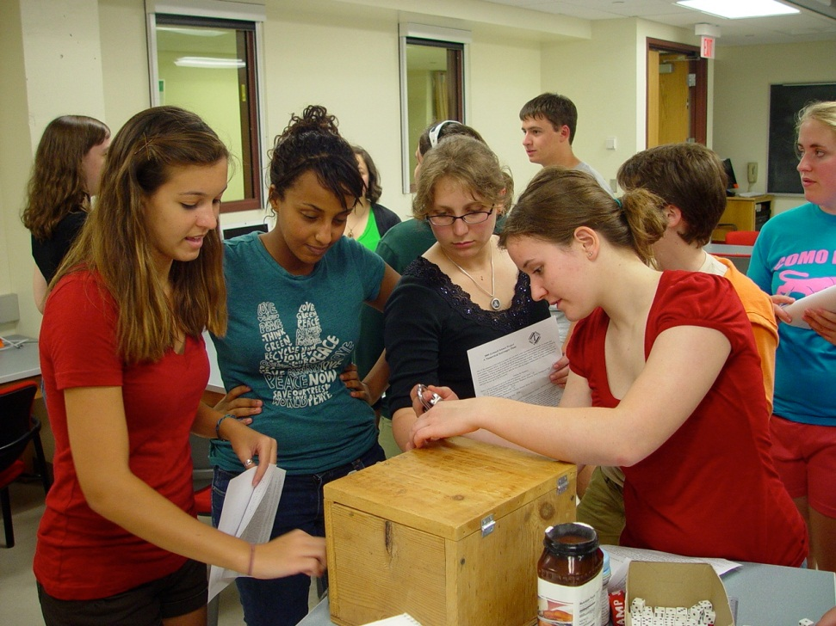
Scavenger Hunt
Students, in groups, need to find and visit various offices, individuals, and locations to retrieve a number
They then manipulate the numbers using Excel
Ultimately they get a series of numbers that are the combination to a series of locks on a box containing a prize

Slide 15
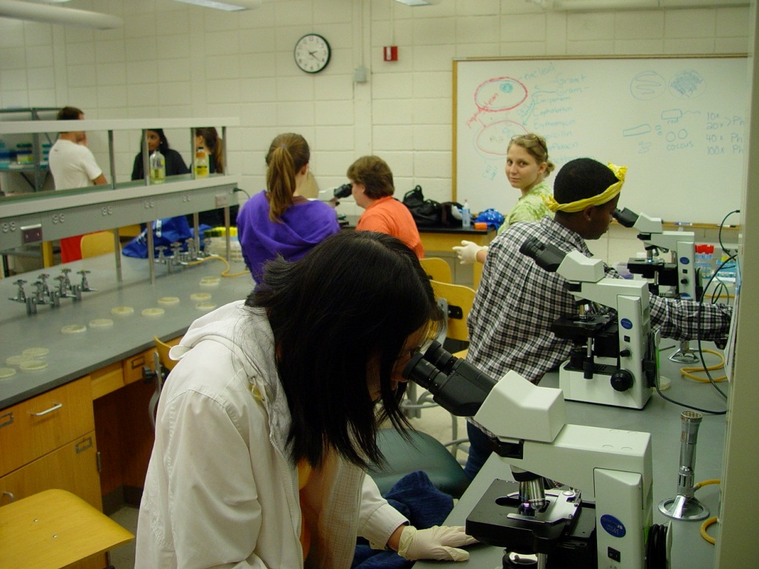
Lab Project
Students work in a group of about 6 on a research-like project
Build a relationship with one another and with a faculty member
Gain experience with using literature, investigation, analysis, presentation
Gain self confidence

Slide 16
Working the System
Sessions with dramatized ‘bad’ lecture and student panel on strategies for dealing with it.
Description and hints on course choice and registration
Wellness orientation and time, including counseling services
Meet and establish comfort with faculty
Seeking and taking advantage of peer support

Slide 17
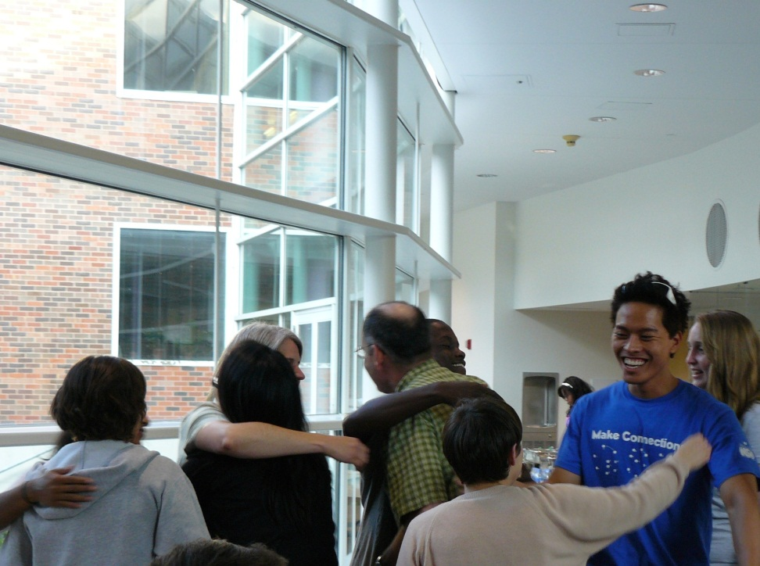
Implicit
Feel comfortable on the campus and with campus functions and support structures
Establish relationships with faculty and critical staff
Establish relationships with peers and experienced students

Slide 18
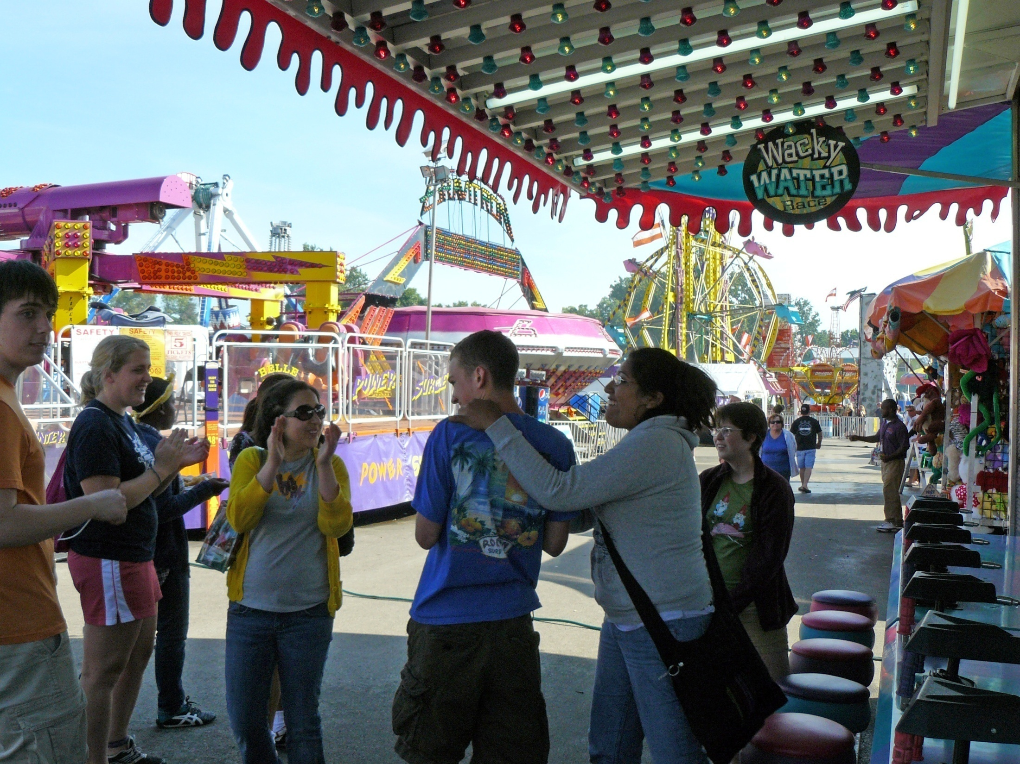

Slide 19
Evidence of Success—Quantitative
Tripling the number of African American and Hispanic American Students graduating with science majors
Halving the grade ‘gap’ in introductory math and science courses

Slide 20
Evidence of Success—Qualitative
•Improved climate for minorities
•Decrease (elimination?) of organized protests by students of color
•Dramatically better portrayal of science to prospective students by current students
•Eagerness of GSP students to become student assistants for pre-orientation

Slide 21
“I do not remember the games and workshops we did, but I remember meeting the faculty, their advice, and, most effectively, the feeling that they expected that I could and would learn. I felt included in the informal science club.”
- GSP alum

