Slide 1
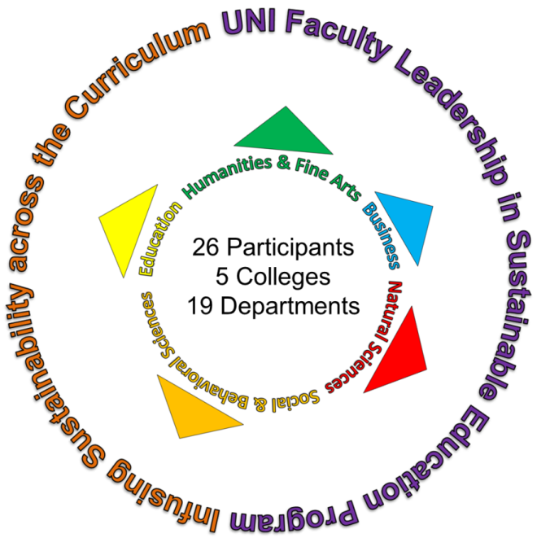
UNI Faculty Leadership Program in Sustainability Education:
Infusing Sustainability across the University Curriculum
William M. Stigliani, Catherine Zeman, and Gowri Betrabet Gulwadi
University of Northern Iowa
Cedar Falls, Iowa
Presented at Carleton College
Workshop on Systems, Society, Sustainability and the Geosciences
July 25-26, 2012

Slide 2
The UNI Faculty Leadership Program in Sustainability Education:
Need for Support from Senior Administrators
The success of the UNI leadership program would not have been possible without the enthusiasm and support of the Provost and the Deans.
This “leadership from above” provides higher visibility, recognition, and acknowledgement of the importance of sustainability education within the campus community.
It also helps to stimulate interest in sustainability among faculty and students, recruit more faculty to take on leadership roles in the program, incentivize their efforts, and facilitate harmony and communication between the faculty leadership and the administration.

Slide 3
The Ponderosa/Piedmont Model
The UNI program adopted the Ponderosa/Piedmont model:
  Combines the University of Northern Arizona’s Ponderosa Project [developed under the leadership of Geoffrey Chase]; and the Emory University’s Piedmont Project [developed under the leadership of Peggy Barlett].
  To promote wider use of the combined model at other colleges and universities across the U.S., AASHE sponsors immersive two-day workshops for selected applicants.
  Invited faculty members learn how to apply the Ponderosa/Piedmont model at their respective home institutions.
  In June, 2010 I attended the AASHE-sponsored “Sustainability across the Curriculum Leadership Workshop” in San Diego, which was facilitated by Chase and Barlett.

Slide 4
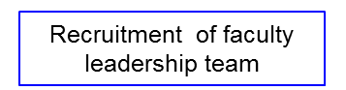
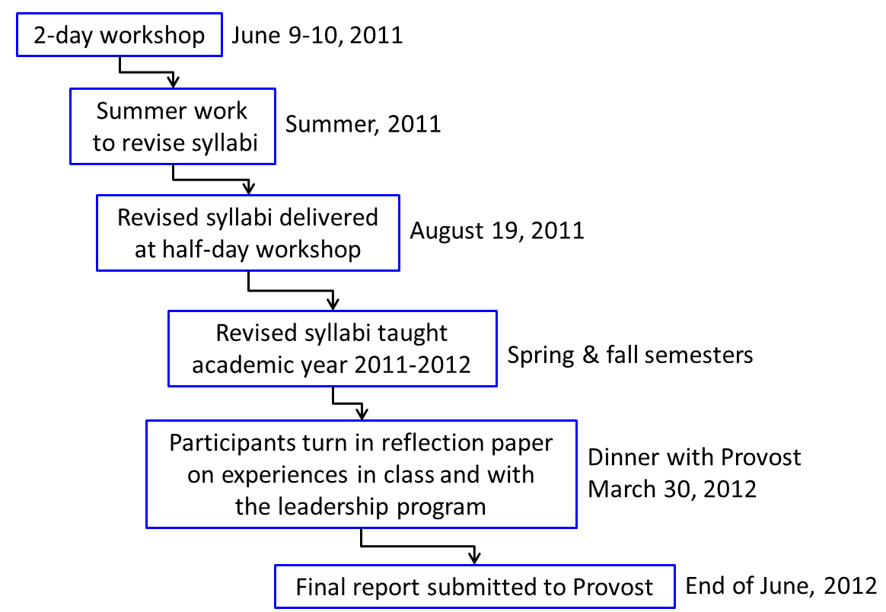
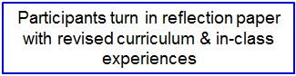
Eight Steps Adopted from the Ponderosa/Piedmont Model
Timeline

Slide 5
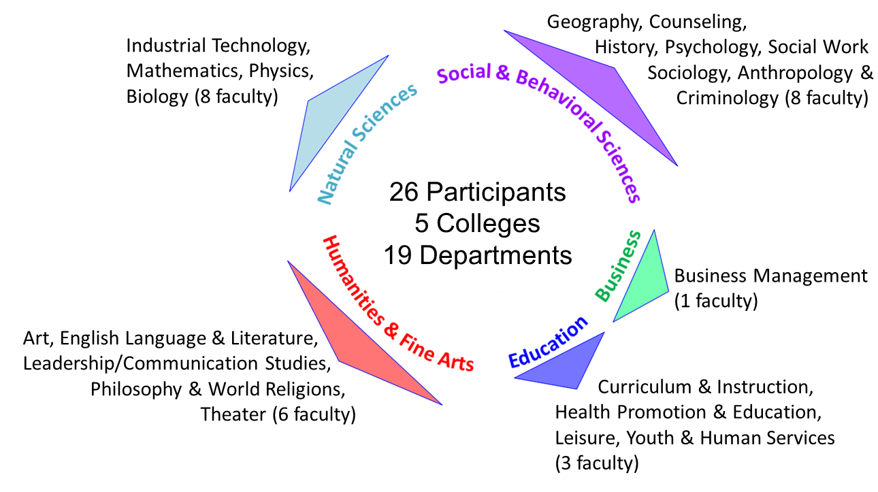
Participants in the UNI Faculty Leadership Program
in Sustainability Education

Slide 6
Eight Steps Adopted from the Ponderosa/Piedmont Model
Timeline

Slide 7
Goals of Workshop
The goals of the workshop were three-fold:
    Strengthening intellectual engagement and sophistication;
    Fostering multidisciplinary dialog;
    Developing pedagogy for teaching sustainability.
The workshop participants heard keynote presentations on topics that specifically addressed these goals.
Each presentation was followed by breakout sessions in which participants joined their assigned discussion groups.
Each group member shared reflections on the relevance and connections of the topic presented to their coursework and discipline.

Slide 8
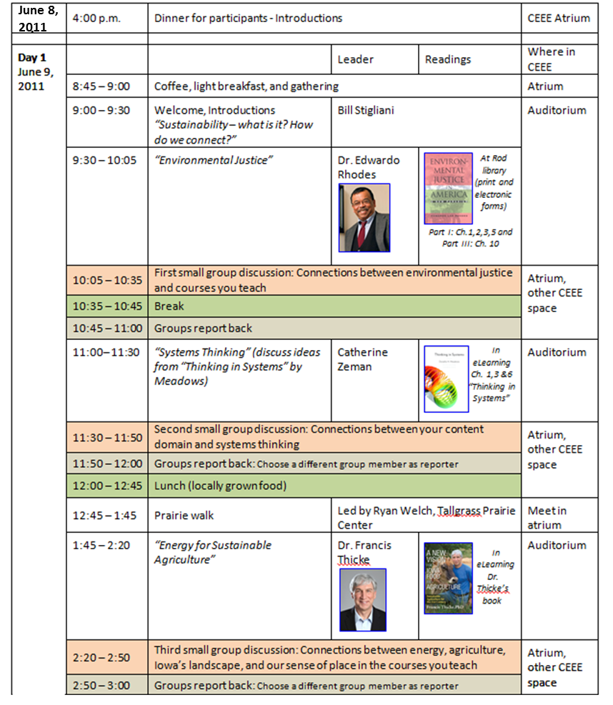
Workshop Agenda

Slide 9
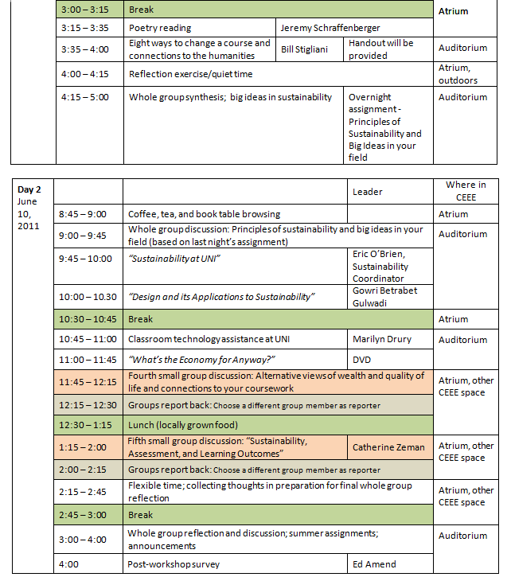
Workshop Agenda
(cont.)

Slide 10
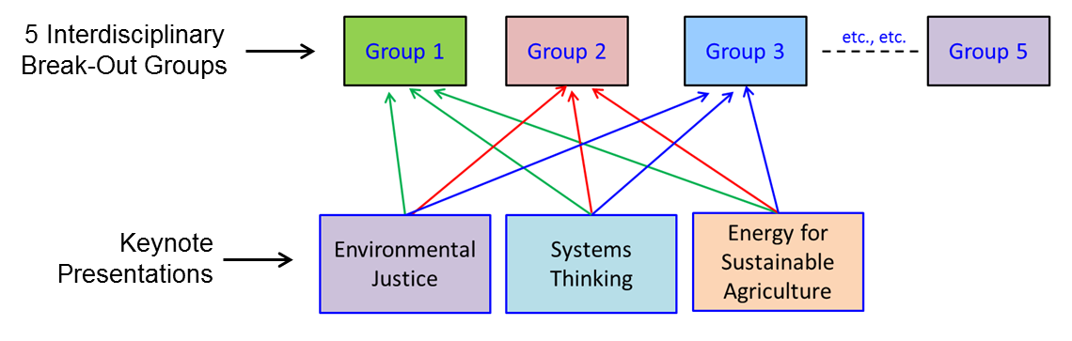
Workshop Break-Out Groups: Multidisciplinary Dialog
Features
Ample time for interdisciplinary sharing of ideas was a key focus.
Each of the five discussion groups represented by a multidisciplinary mix of faculty from the social and natural sciences, fine arts, and education.
Group members were asked to reflect on each keynote topic, and discuss how it was related to the disciplines they teach.
The five discussion groups met in five break-out sessions during the two-day workshop.

Slide 11
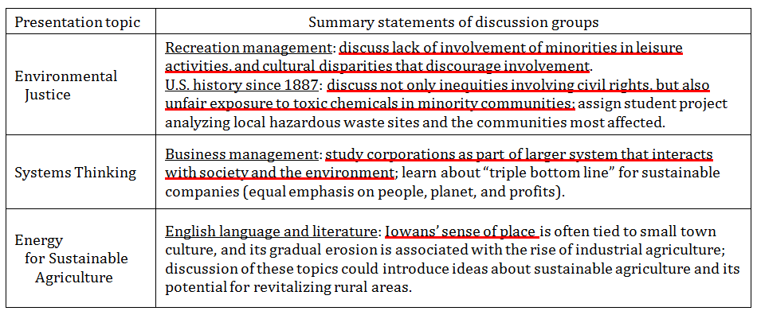
Sample of How Participants Related Courses they Teach
to Keynote Addresses

Slide 12
Workshop Evaluation
Goal 1: Intellectual Engagement and Sophistication:
The post-workshop survey indicated majority of participants had previously included aspects of sustainability in their classes, but had not experienced teaching from multidisciplinary perspectives and systems thinking until this leadership workshop.
They gained new insights from keynote presentations, teaching methods, and sustainable design. They indicated plans to teach sustainability in more specific and comprehensive ways.
Almost all participants hoped to continue improving their skills for teaching sustainability in their courses.

Slide 13
Workshop Evaluation
Goal 2: Multidisciplinary Dialog.
Participants especially enjoyed what they called the “interactivity” of the workshop with “lots of brainstorming during the group breakout sessions.”
Most participants viewed multidisciplinary connection with colleagues as the “single most important thing” they gained from the workshop.
One said, “I made more meaningful connections with faculty from outside my department in two days than I had previously in four years at UNI.”

Slide 14
Workshop Evaluation
Goal 3: Developing Pedagogy for Teaching Sustainability.
Two teaching methods particularly emphasized at the workshop were “systems thinking” and relating to “sense of place.”
Systems theory and thinking were developed to study complex systems, which can be directly applied to interactions between the biosphere and human society.
Systems thinking can be a powerful unifying principle for diverse scholars to examine sustainability through their unique lenses within the common framework of systems analysis.
As the UNI faculty apply systems thinking in teaching their revised courses, its efficacy as a pedagogical foundation can be evaluated as the methodology is practiced and tested in the classroom.

Slide 15
Workshop Evaluation
Goal 3: Developing Pedagogy for Teaching Sustainability. (cont.)
The pedagogy of place was an important consideration, especially in the keynote discussion about Sustainable Agriculture.
Agriculture is an issue directly relevant to the state of Iowa and much debated among its citizens. Farms make up about 92% of Iowa's land, and about one-third of the best farmland in the United States is located in Iowa. Most of the state's residents are in some way dependent upon Iowa's fertile soils and crops.
Thus, any topic associated with agriculture is not an abstraction to Iowa’s citizens, because it is connected to the place where they live.
  “Sense of place” is important because sustainability cannot be taught in a detached, generic way.
  It requires an understanding of ourselves and our behaviors through affiliation with the space we inhabit. The “pedagogy of place” has been effectively applied to teach sustainability (Barlett, 2005).

Slide 16
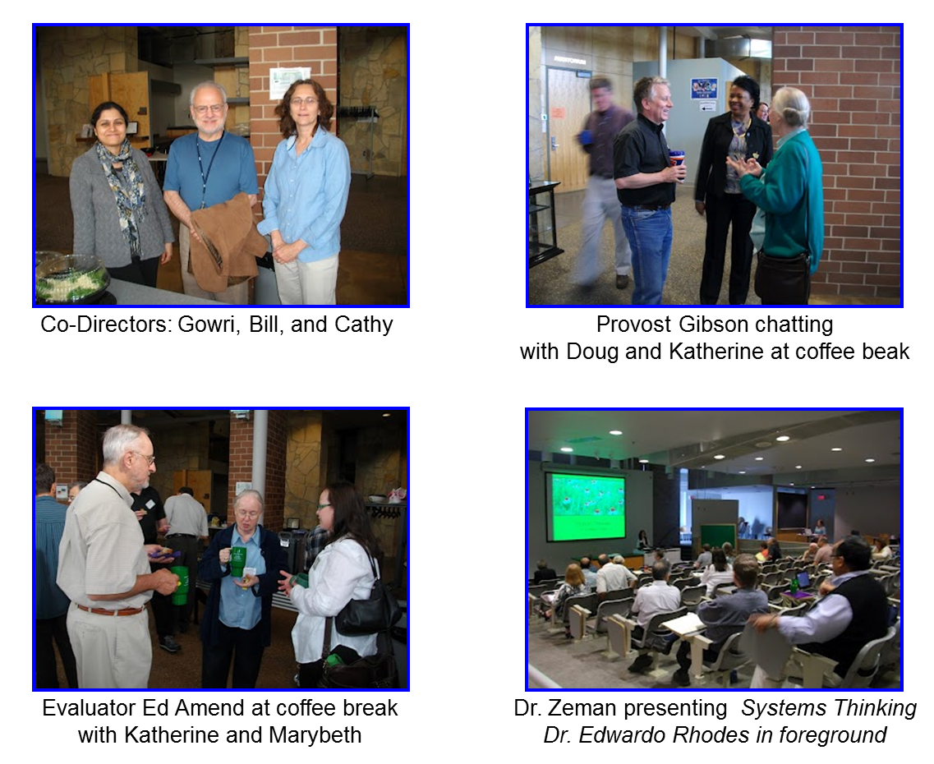
Photo Album of Workshop

Slide 17
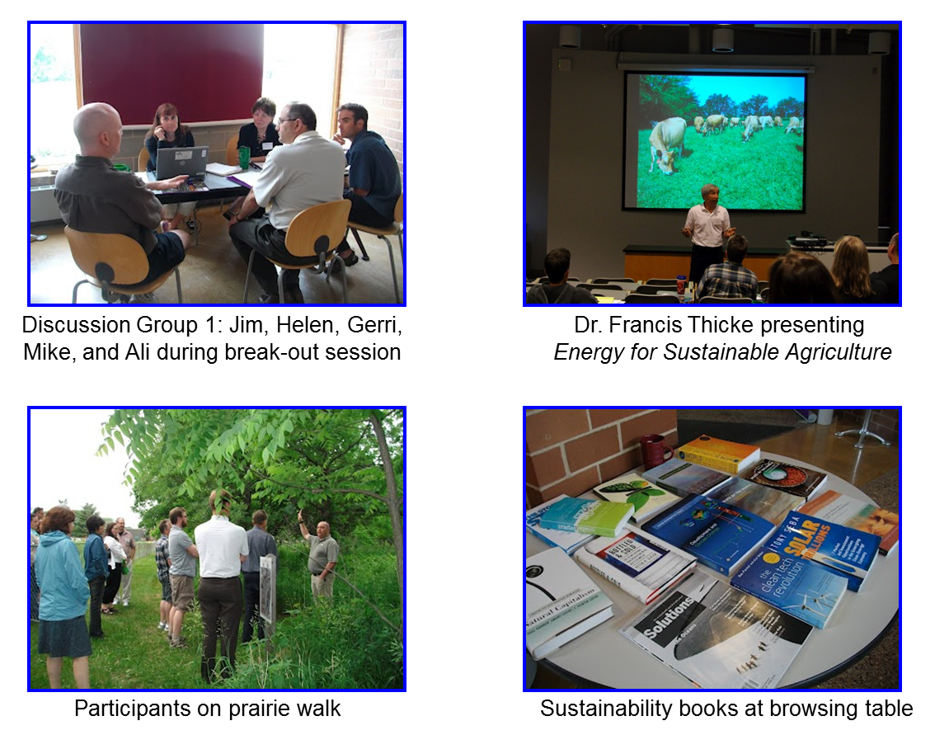
Photo Album of Workshop

Slide 18
Eight Steps Adopted from the Ponderosa/Piedmont Model
Timeline

Slide 19
Eight Steps Adopted from the Ponderosa/Piedmont Model
Timeline

Slide 20
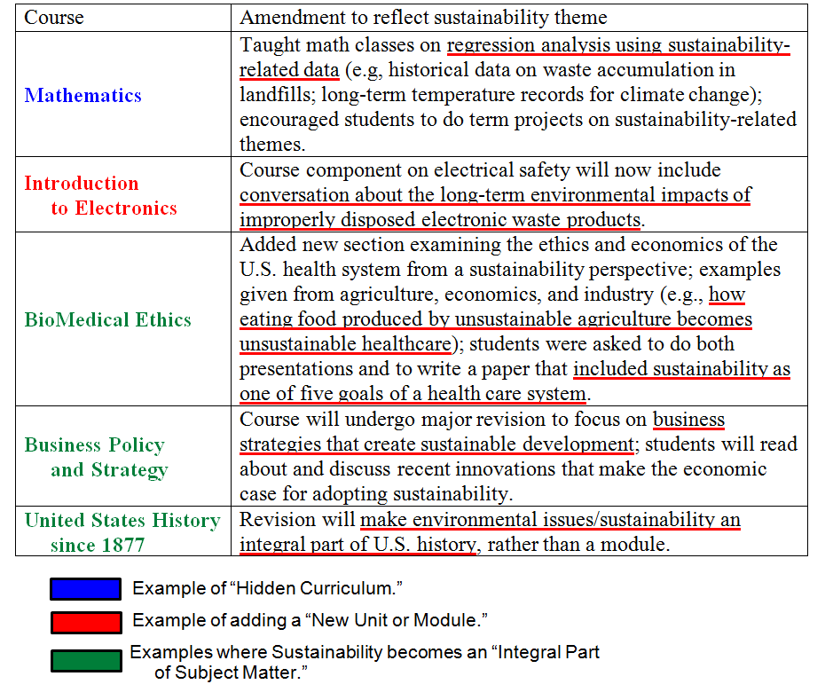
Sample of the Ways Courses Changed after Infusing Sustainability

Slide 21
Questions for Self-Reflection on Experiences in the Classroom
and with the Leadership Program
Question 1: Level of success
Please indicate the level of success you had in delivering your new curricular methods to your class, where 1 is “low level of success” and 5 is “high level of success.”
Question 2: Student receptiveness
Please indicate your students’ receptiveness to the new curricular methods/materials you introduced, where 1 is “not very receptive” and 5 is “highly receptive.”
Question 3: Personal/professional change
Please indicate how your experience in teaching your revised course has changed you personally/professionally, where 1 is “no change” and 5 is “significantly changed.”
Question 4: Interdisciplinarity of curriculum
Please indicate the impact you think this experience will have long-term on the interdisciplinarity of your curriculum , where 1 is “no impact” and 5 is “significant impact.”
Question 5: Inclusion of systems thinking
Please indicate the degree to which “Systems Thinking” approaches provided a better contextual analysis for teaching sustainability issues, where 1 is “low degree” and 5 is “high degree

Slide 22
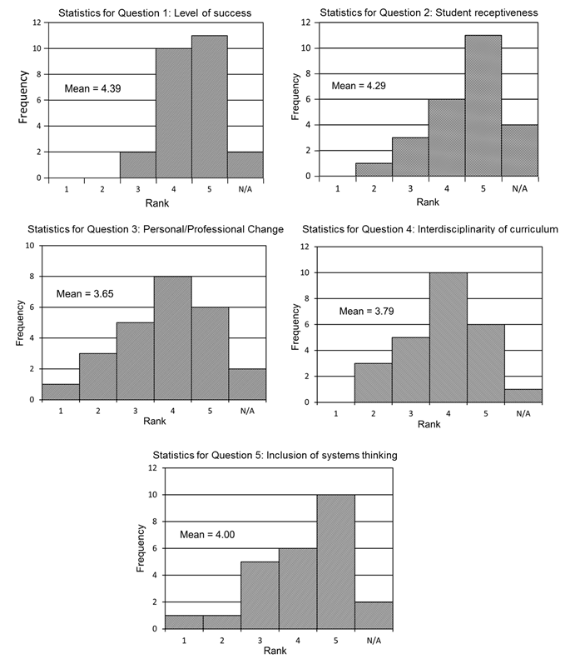
Results on Statistical Analysis of Five Questions

Slide 23
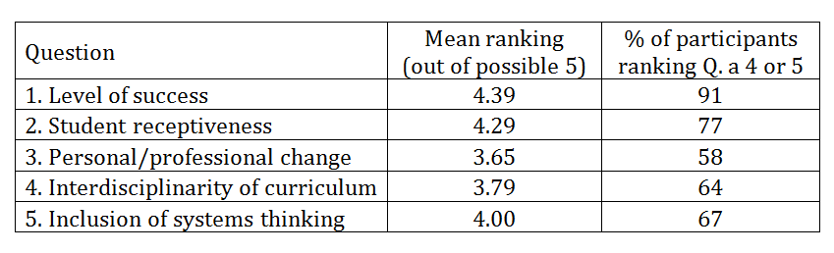
Mean Values of Questions, and Percentage of Participants
Ranking Questions either a 4 or 5

Slide 24
The End

