Slide 1
Environmental History as an Interdisciplinary Gateway
Derek Larson
The College of St. Benedict/St. John’s University
Department of Environmental Studies

Slide 2
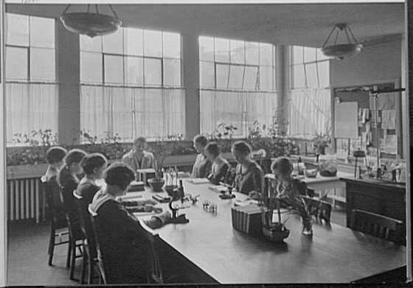
History requires consideration of…
Change over time
Historical context
Historical causation
Historical contingency
“Nature class,” Spence School New York City, 1930
Photo: Library of Congress

Slide 3
Environmental history is…
The study of change over time, uniting natural and human history
The history of natural systems
The history of the human/nature relationship
The cultural history of “nature” as a construct
A broadly interdisciplinary field

Slide 4
Sustainability…
Appears in economics literature in 1950s (as “sustainable growth”)
Takes on contemporary meaning of “the property of being environmentally sustainable” 1980
U.N. Brundtland definition of sustainable development as “development that meets the needs of the present without compromising the ability of future generations to meet their own needs” 1987
“Triple bottom line” of social, economic and environmental sustainability 1995

Slide 5
Questions we might ask…
What made a past practice sustainable (or not)?
How did a practice change over time to make it more or less sustainable?
What can we learn from past practices to improve sustainability today?

Slide 6
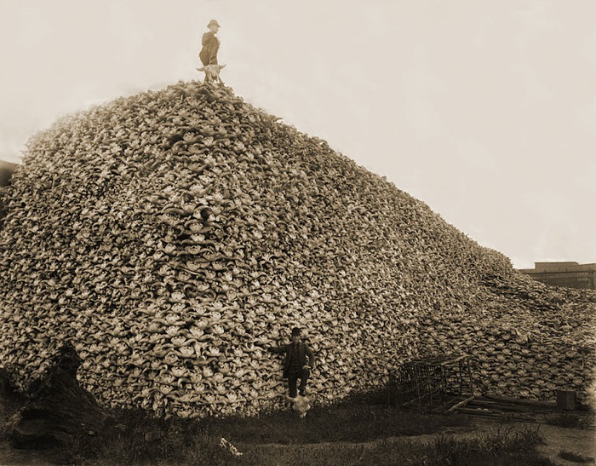
Example: Great Plains Bison
Everyone “knows” what happened to the bison in the late 19th century
Stable systems (human/nature) were intentionally disrupted to great effect by wasteful Euro-Americans who exterminated the bison
Bison skulls to be processed, c. 1870.
Detroit Public Library photo

Slide 7
But environmental history finds…
Ecology, anthropology, archaeology, climatology, and history overturn conventional wisdom
Bison on southern plains were in decline by 1825
Horses, overhunting, predator removal, political change, and robe trade made the system ecologically unsustainable
See Dan Flores “Bison Ecology and Bison Diplomacy: The Southern Plains from 1800 to 1850” The Journal of American History, Vol. 78, No. 2 (Sep., 1991)

Slide 8
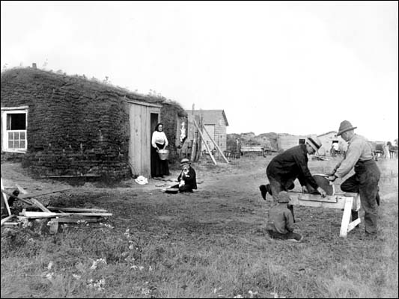
Example: Home Building Techniques
19th c. homes were largely made of local materials, designed to site, and unconnected to broader infrastructure
Jerdin family farm near Osnabrock, N.D., 1897. Photo: Library of Congress

Slide 9
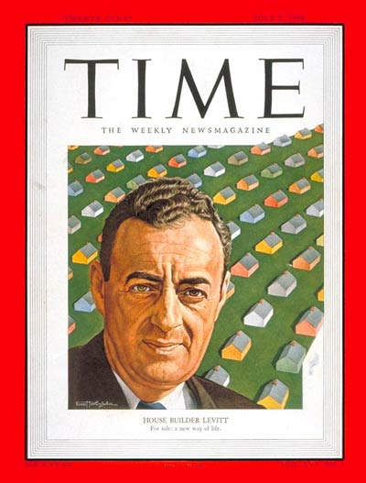
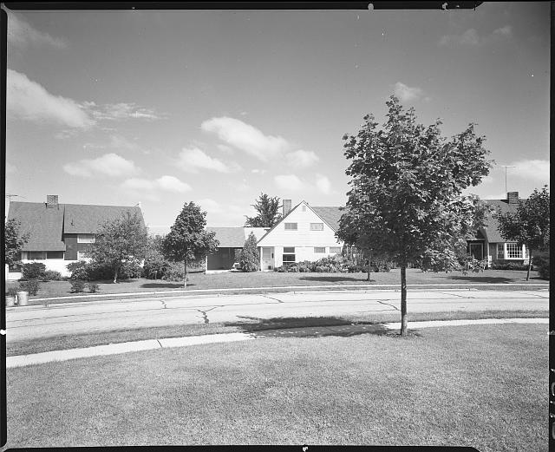
Levittown was unsustainable…
Affordable, assembly-line style housing relied on greenfields, septic tanks, asbestos, heavy equipment, and regional/national suppliers to increase annual output from 12 to 500+ homes in the 1950s.
Time Magazine, July 3, 1950

Slide 10
Student research project found…
Construction systems have evolved over time with new materials, new technologies, new desires, and new markets changing practices
Homes evolved to be larger, more energy intensive, and used fewer local materials through the 20th century
Recent efforts to improve sustainability have mixed success (new technologies, techniques, styles)
Lessons from 19th c. homebuilders could improve modern performance (passive solar, site orientation, convective cooling, local/natural materials)
See Jared Smith “Rethinking the Wall: A Comparison Study and Decision-Making Tool for Residential Wall Construction” CSB/SJU Environmental Studies Department, May 2012

Slide 11
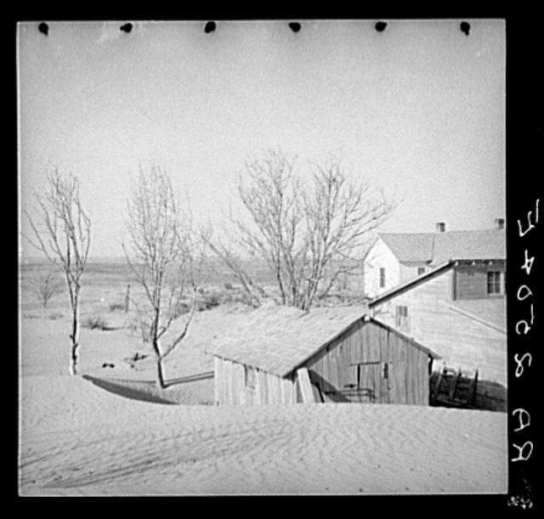
Example: Past Lessons on Climate
Research question: Can future farmers learn from past to adapt to climate change projections?
Methods: analysis of weather and agricultural data seeking correlations between wet/dry periods and changing practices
Minnesota case study developed to test hypothesis
Soil drifts to home near Liberal, Kansas, March 1936. Photo: Library of Congress

Slide 12
Interdisciplinary methods at work…
Student developed a model for past climate based on weighted water years using NOAA data for Minnesota
Agricultural census data was used to determine acres of corn, soy, and wheat planted and overall yield
Where correlations appeared, qualitative research was used to confirm linkage
Primary sources (interviews, ag publications, etc.) were used to track changing practice
Local farmers were interviewed to determine feasibility of past adaptations
See Krista Schrammel “The Future Farmer’s Almanac: Climate Change and the Future of Farming in Minnesota” CSB/SJU Environmental Studies Department, May 2012

Slide 13
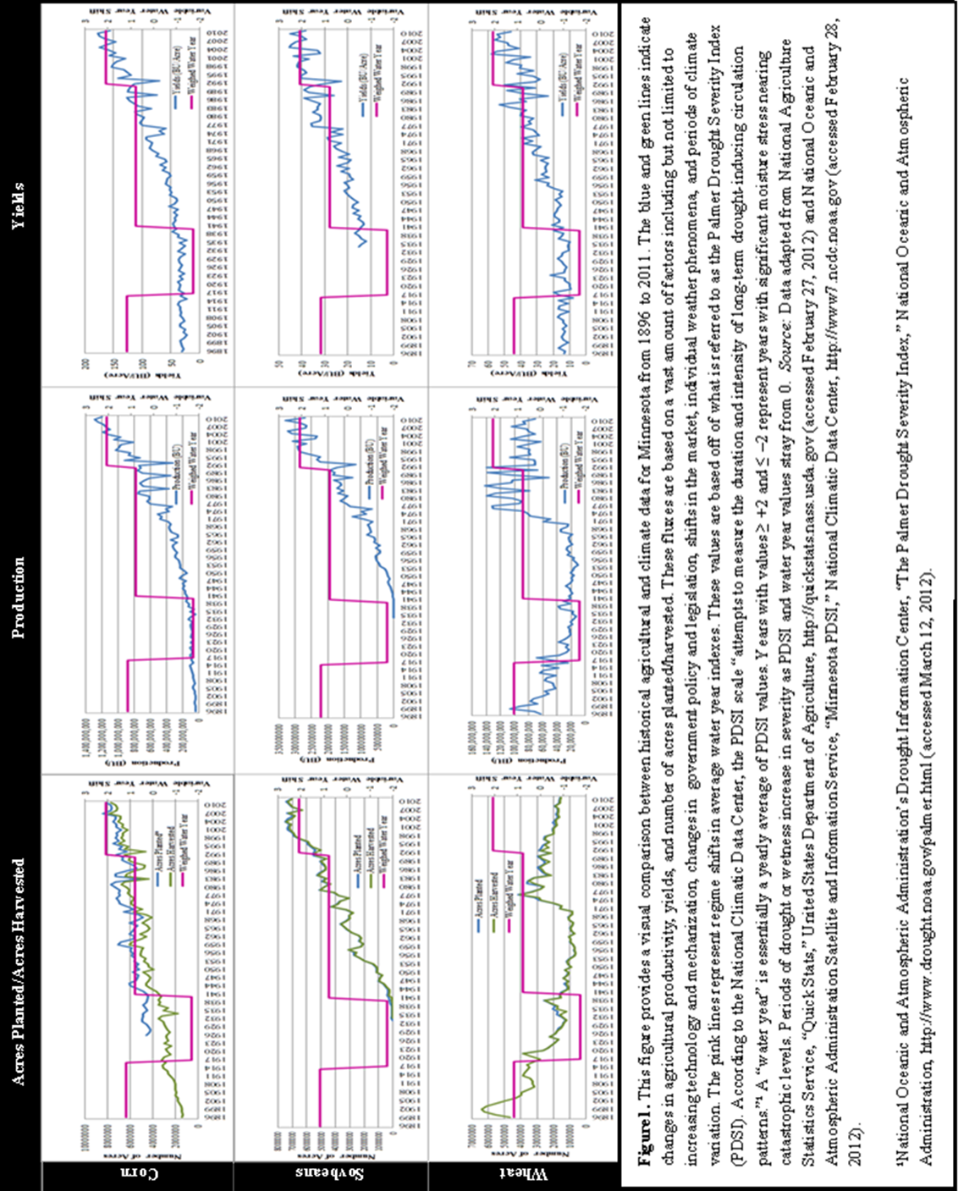

Slide 14
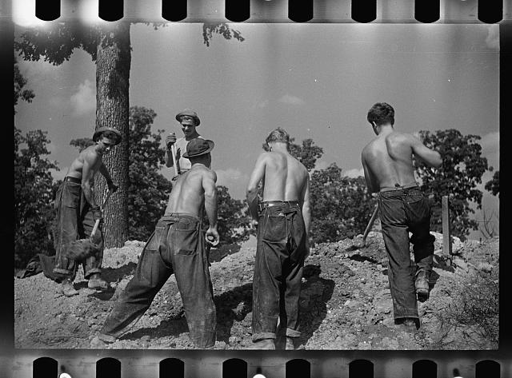
In the classroom…
Past practices can be explored using a sustainability lens
Lessons from unsustainable activities can be carried forward
Historical questions about ecology, natural resources, and human economic/social/political systems can be linked
Cultural questions (“what is sustainability and why do we value it now?”) offer perspectives on past and present
Students like doing historical research!
CCC boys at work, Maryland, 1935
Photo: Library of Congress

