Slide 1
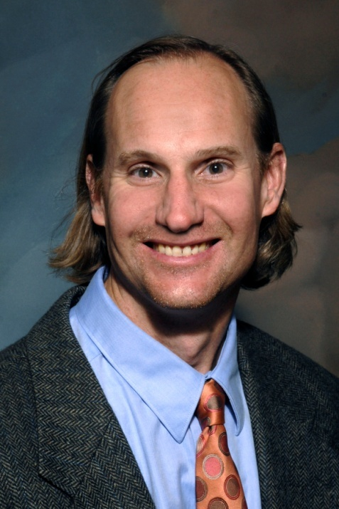
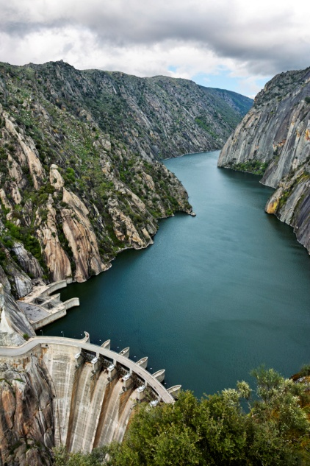
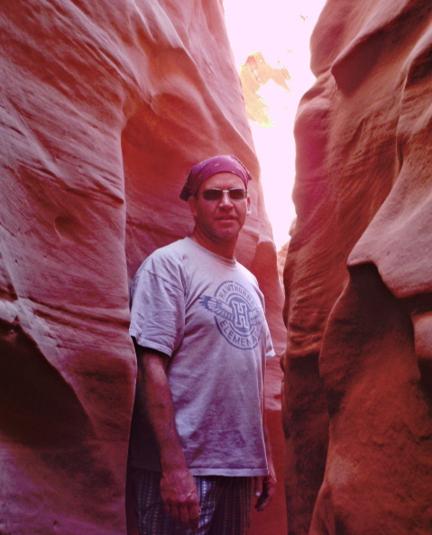
Avoiding Another Tower of Babel:
Lessons Learned from Team Teaching
Across the Disciplinary Divide
Design requires *&X>!D)+]
Values and &*&X>!D)+]
Ed Barbanell and Steve Burian
Dept. of Philosophy, Dept. of Civil & Environmental Engineering
University of Utah

Slide 2

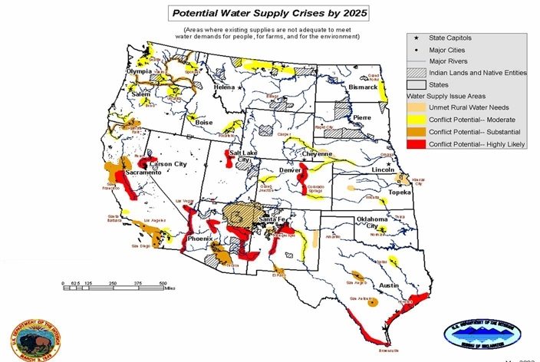
Hydrotopia: Sustainable Water Mgmt
“Anyone who solves the problem of water deserves not one Nobel Prize but two – one for science and the other for peace”
- John F. Kennedy
“Whiskey is for drinking, water’s for fighting about”
- Mark Twain
(U.S. DOI 2003)
Course brings together students from engineering, humanities, sciences, planning, and other disciplines to learn necessary cross-disciplinary knowledge, skills, critical thinking, and creativity to develop sustainable water management solutions in the western U.S.

Slide 3
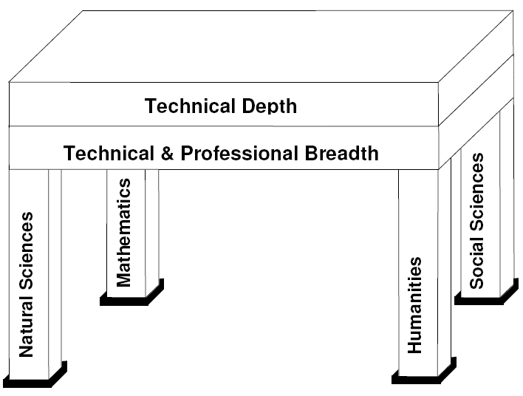

Motivation for Course
How to Implement?
Gen. ed. requirements
Modules (e.g., guest speakers)
Broadly read CE profs
Multidisciplinary courses
(Evans and Lynch 2008)
Integrate throughout curriculum…

Slide 4
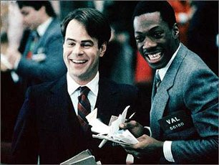
Hydrotopia Goals
Cultivate in engineering professionals responsible for planning, designing, and managing water resources systems a broader sensibility about the cultural climate in which they will operate.
Develop in humanists, social scientists and others who will be responsible for shaping and articulating that cultural climate a more grounded understanding of water solutions and technologies available to them.
by having students trade places we will stimulate innovative multi-disciplinary solutions to address water management issues in the west

Slide 5
Course Learning Objectives
Explain water projects to non-technical people
Describe multi-disciplinary elements of water projects
Analyze broader impacts of water projects
Judge implications of technical and non-technical water project decisions in a societal context
Communicate with others to develop and recommend multi-objective solutions to water resources challenges

Slide 6
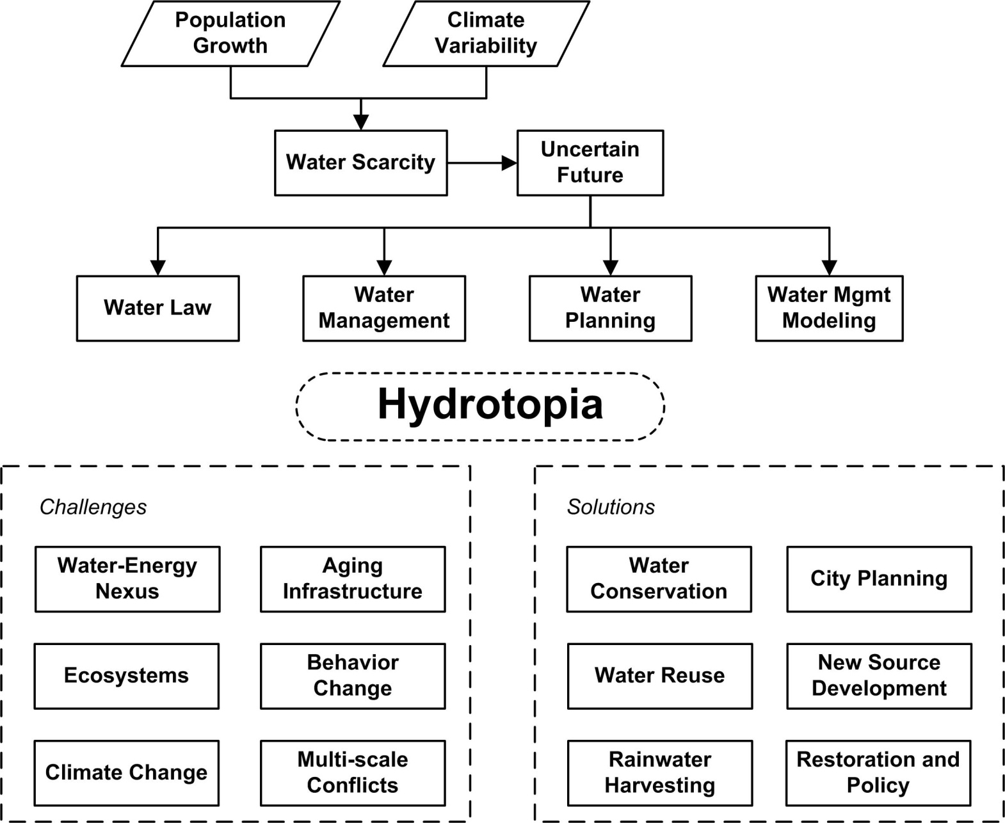
Course Organization

Slide 7
Pedagogical Approach
Preparation: reading, movies, videos, articles
Classroom: faculty presentations, guest presentations, discussions, moderated debates, student presentations
Assignments: case study analyses, defining “Hydrotopia”, position papers (pipeline, dam removal, water grab, toilet-to-tap), technical projects
Stimulate critical thinking
Force students to analyze water projects from outside their disciplinary perspectives (e.g., engineers argue against water development and humanists for water development)

Slide 8
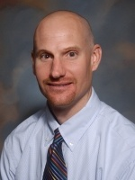
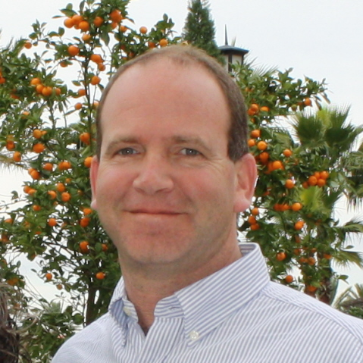
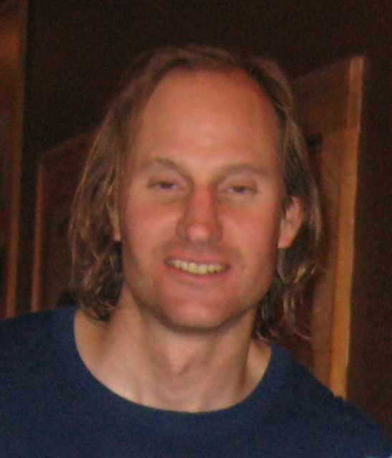
Team Teaching
Water Engineering/ Law Expertise
Common Goal
Philosopher

Slide 9
Team Teaching Approach
Relationship: establish a good personal and professional relationship
Preparation: both involved in planning and conducting all phases of course
Classroom: both present for all activities – not a parade of stars
Grading/Assessment: both grade, calibration needed
Student interaction: continuous interaction for all phases

Slide 10
Calibration
Consistency and structure: we need to be very structured and organized in our approach to teaching – there already are many moving parts with two instructors
Expectations: students must hear identical expectations from both instructors and of all students
Fair: must not take sides with “home” discipline

Slide 11
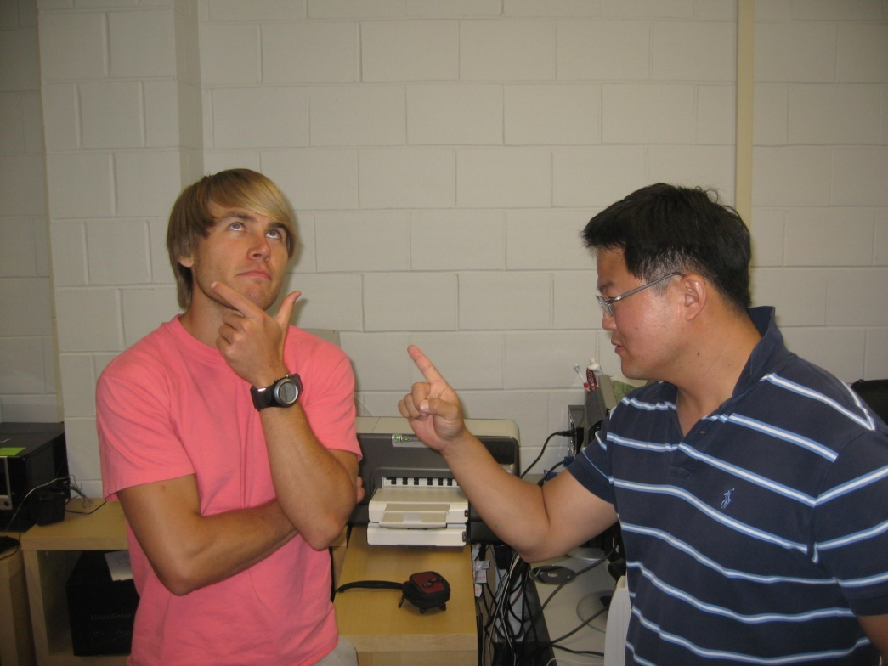
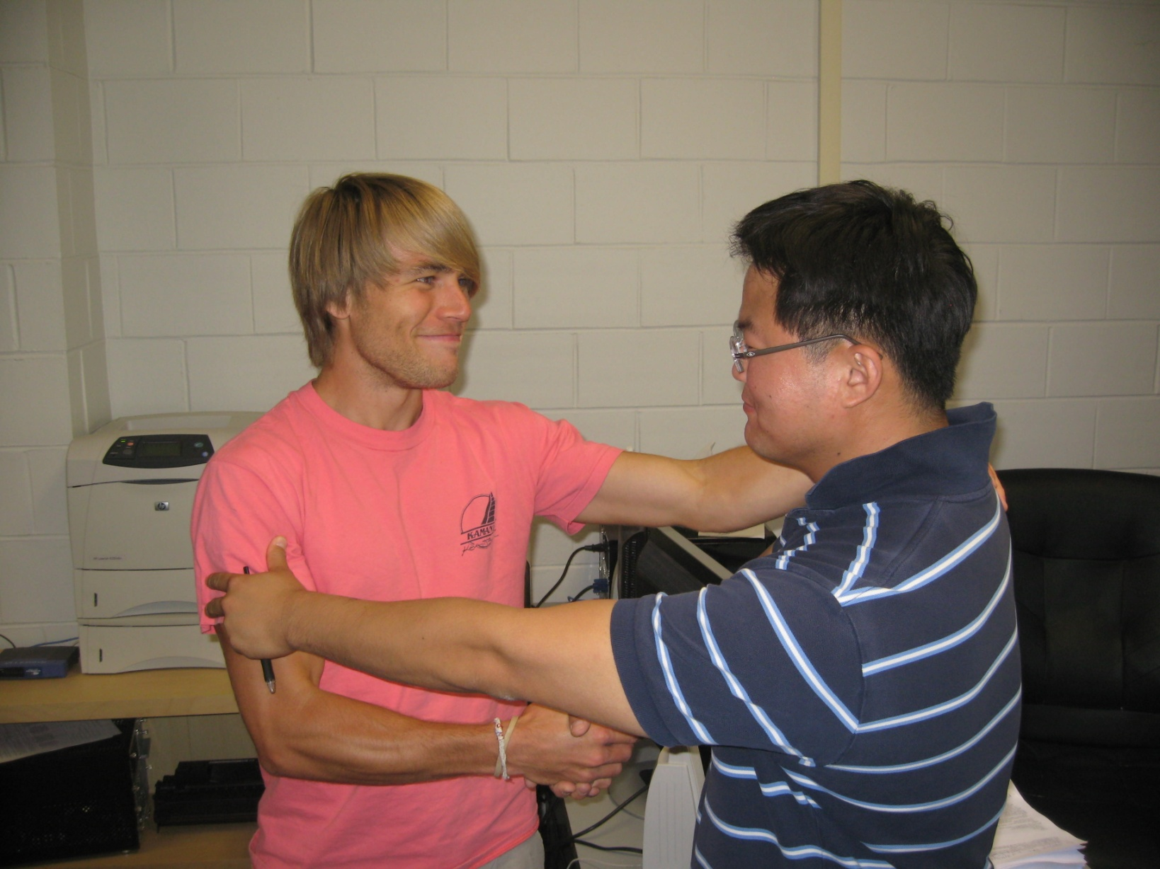
Effective Communication
In first offering in 2009 we discovered communication challenges among disciplines
Designed course elements to enhance communication: Lesson Learning Objectives, Outside Events (conference, seminars, etc.), Case Studies, Multi-discipline Structure for In-Class Exercises and team Project, and Instructor Interaction & Role Playing

Slide 12
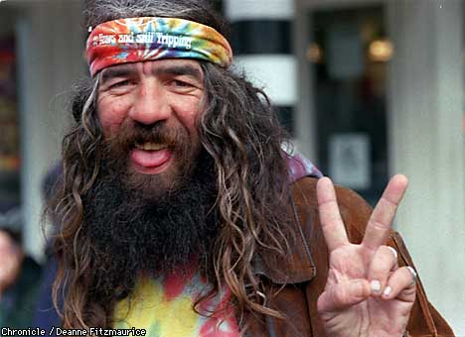
Role Play Interactions
Team teaching essential to role play effective multi-disciplinary interaction
We tell students they will work in teams during their careers, yet we never provide models
As instructors we need to show appreciation, understanding, and ability to take perspective of others – opposite is typically what happens in classroom

Slide 13
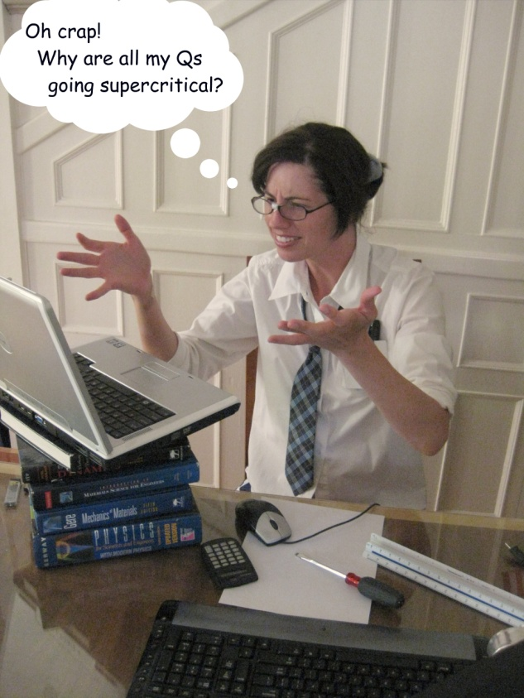
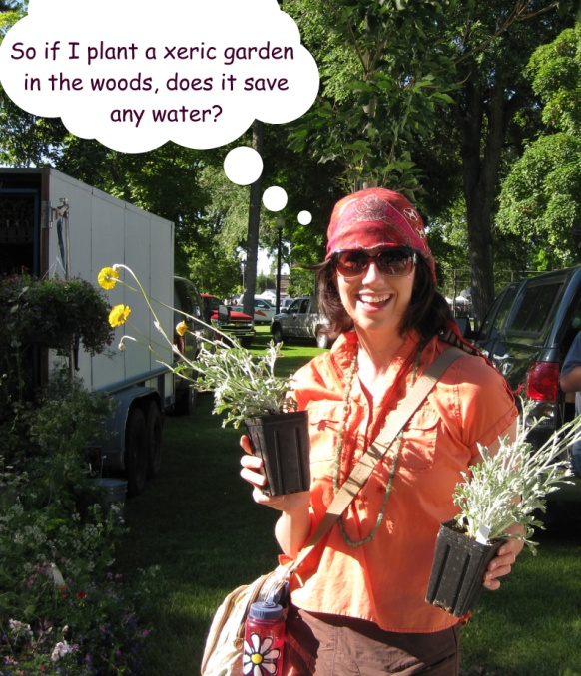
Observed Outcomes
Engineers: able to explain broader worldview and importance of humanities and social sciences related to water projects
Humanities & Soc. Sci.: able to explain practicalities & engineering constraints associated with water projects
All Students: increased awareness of roles of other disciplines; able to place projects within societal context; achieved course learning objectives (team teaching worked!)

Slide 14
Institutional Constraints
Challenge: team teaching does not fit in typical teaching model – how can we both be teaching the same students and both get credit for it?!
Opportunity: interdisciplinary teaching grant
Opportunity: build into educational research opportunity & publish
Opportunity: brand as a unique, essential experience for the students
Our Solution: counts as teaching credit for both of us equally; because we made case to our chairs and they have an open mind to doing things differently and have the interest of students in mind

Slide 15
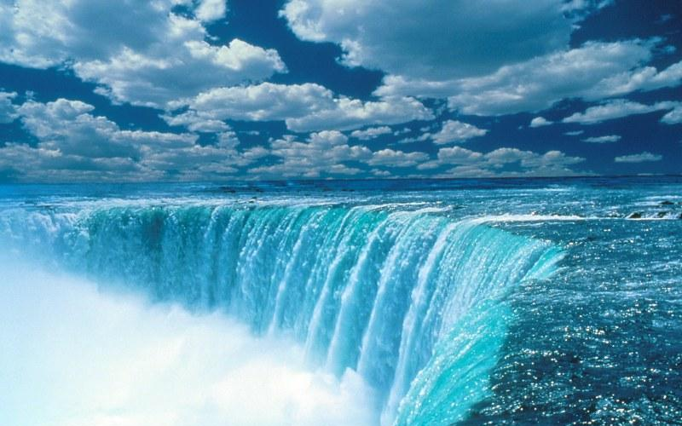
Questions?

