Slide 1
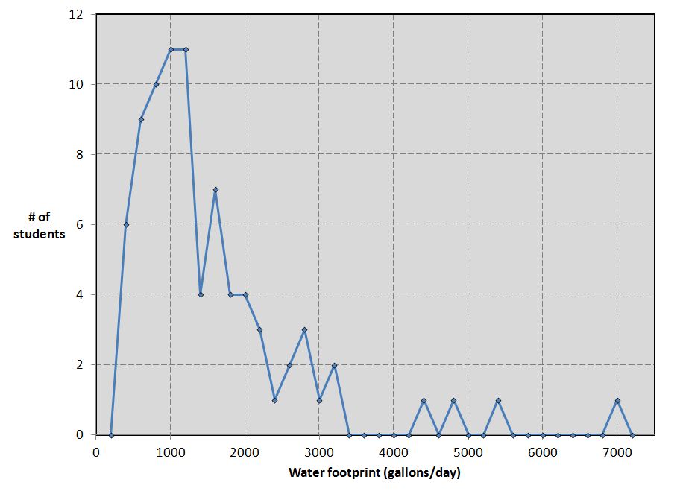
ESS 102, Spring 2012: 82 students

Slide 2
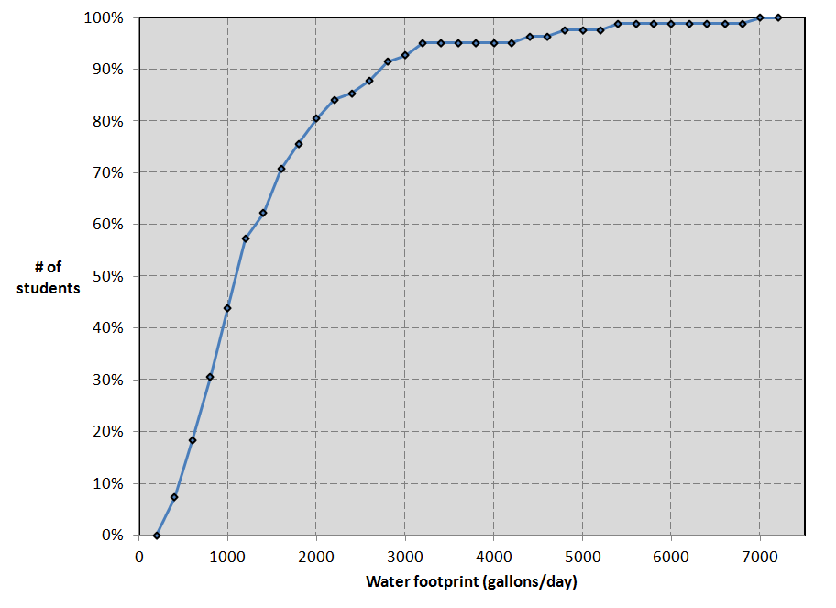
ESS 102, Spring 2012: 82 students

Slide 3
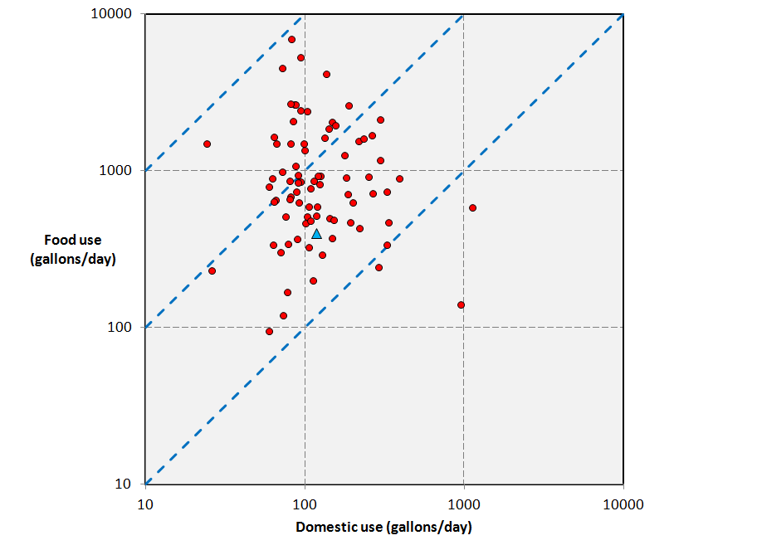
ESS 102, Spring 2012: 82 students (blue triangle = Tim)
100:1
10:1
1:1

Slide 4
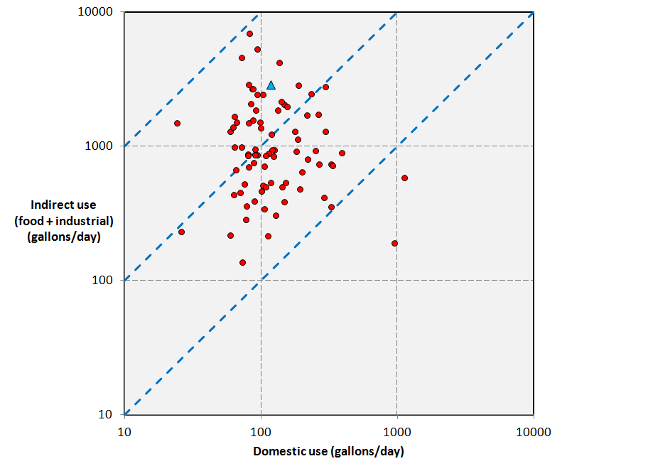
ESS 102, Spring 2012: 82 students (blue triangle = Tim)
100:1
10:1
1:1

Slide 5
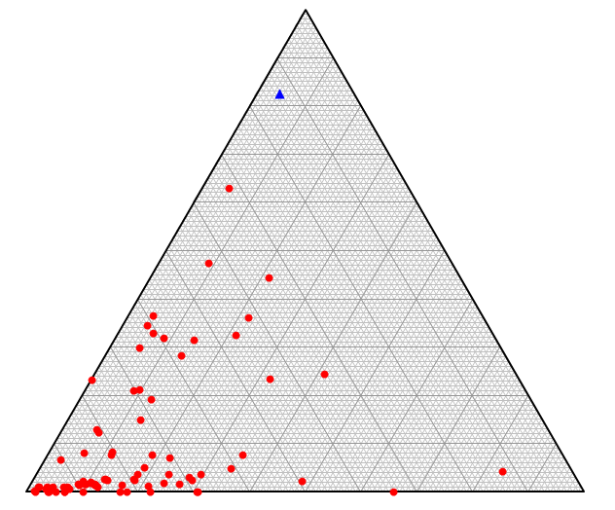
ESS 102, Spring 2012: 82 students (blue triangle = Tim)
Industrial
Water footprint components
Food
Domestic

Slide 6
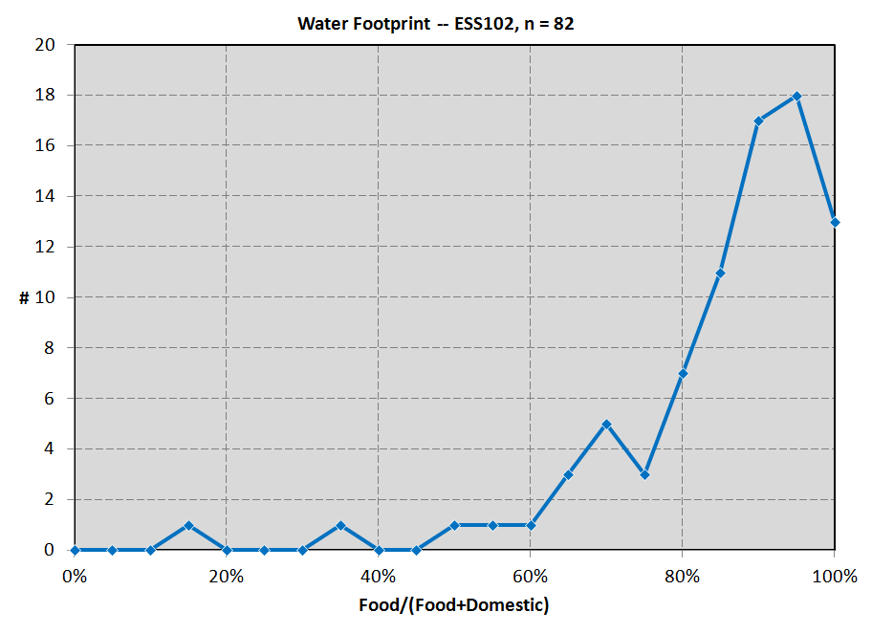

Slide 7
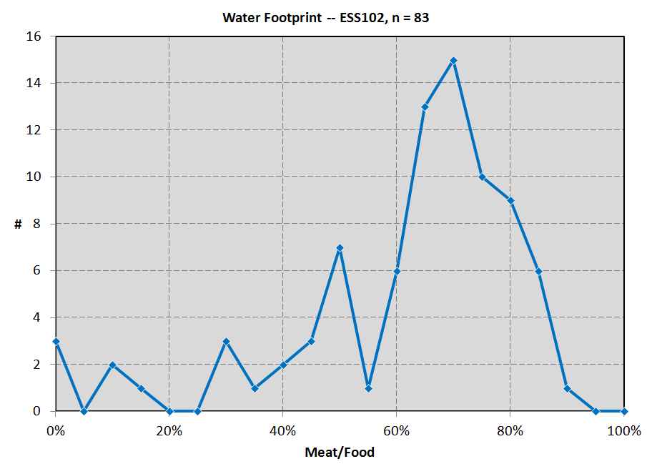

Slide 8
How do the basic inputs of the water footprint calculator (www.waterfootprint.org) translate into water usage? Roughly,
1 pound of vegetables/week= 960 gallons/year
1 “ “ fruit/week = 1,300 “ “
1 “ “ cereal/week= 3,700 “ “
1 “ “ dairy/week = 4,300 “ “
1 “ “ meat/week = 33,200 “ “
1 load of laundry/week = 1,850 “ “
1 10-minute shower/day = 11,500 “ “
Each $1000 gross income = 6,500 “ “

Slide 9
How do the basic inputs of the water footprint calculator (www.waterfootprint.org) translate into water usage? Roughly,
4 ounces of vegetables/day= 1,680 gallons/year
4 “ “ fruit/day = 2,280 “ “
4 “ “ cereal/day = 6,480 “ “
4 “ “ dairy/day = 7,520 “ “
4 “ “ meat/day = 58,100 “ “
1 load of laundry/week = 1,850 “ “
1 10-minute shower/day = 11,500 “ “
Each $1000 gross income = 6,500 “ “

Slide 10
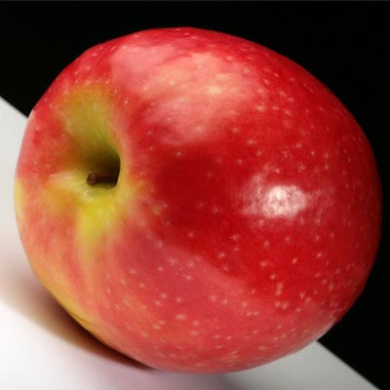
Apple
Water footprint: 18 gallons for one apple (18 gal. = 1” x 29 ft²)
We assume here a ¼ pound apple. One glass of apple juice costs about 50 gallons of water.
Adapted from www.waterfootprint.org

Slide 11
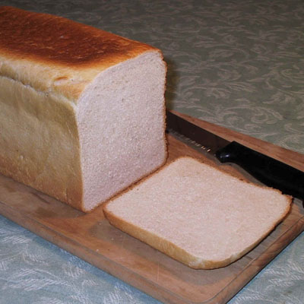
Bread
Water footprint: 11 gallons of water for one slice of wheat bread.
Producing wheat costs 155 gallons of water per pound (global average).
One slice of bread has a weight of about 1 ounce, which implies a water footprint of 11 gallons.
If the bread is consumed together with 1 slice of cheese (⅓ ounce), then it all together costs 24 gallons of water (24 gal. = 1” x 38 ft²).
Adapted from www.waterfootprint.org

Slide 12
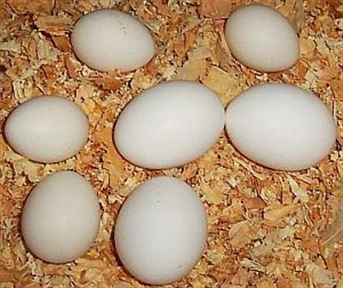
Eggs
Water footprint: 53 gallons of water for one egg (53 gal. = 1” x 85 ft²).
We assume here that one egg has a weight of 2 ounces. As a global average, eggs require 872,000 gallons of water per ton. Most of the water is required for feeding the chickens.
Adapted from www.waterfootprint.org

Slide 13
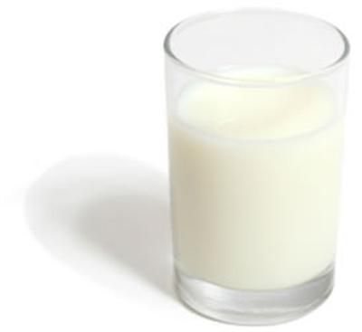
Milk
Water footprint: 1000 gallons of water for 1 gallon of milk (1000 gals. = 1” x 1600 ft²)
Drinking a glass of milk (¼ quart) costs 53 gallons of water.
Drinking the same volume of orange juice or apple juice would cost 45 and 50 gallons of water respectively.
Drinking a plain glass of water requires only little more than the water itself.
Adapted from www.waterfootprint.org

Slide 14
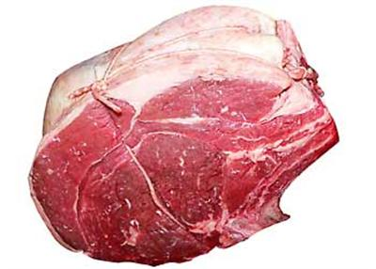
Beef
Water footprint: 1855 gallons of water per pound of beef (1855 gals. = 1” x 3000 ft²).
In an industrial beef production system, it takes an average three years before the animal is slaughtered to produce about 440 pounds of boneless beef (1” x 30 acres).
The animal consumes nearly 2866 pounds of grains (wheat, oats, barley, corn, dry peas, soybean meal and other small grains), 15900 pounds of roughages (pasture, dry hay, silage and other roughages), 6340 gallons of water for drinking and 1850 gallons of water for servicing.
This means that to produce one pound of boneless beef, we use about 6.5 pounds of grain, 36 pounds of roughages, and 20 gallons of water (only for drinking and servicing). Producing the volume of feed requires about 1835 gallons of water on average.
Adapted from www.waterfootprint.org

Slide 15
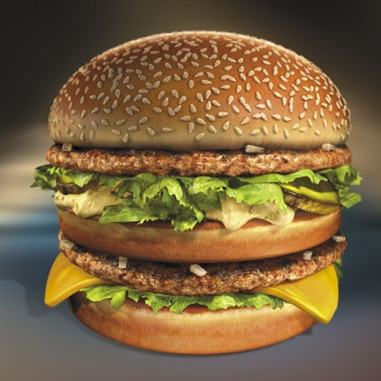
Hamburger
Water footprint: 634 gallons of water for one hamburger!
(634 gals. = 1” x 1000 ft²).
Most of the water is needed for producing the beef contained in the hamburger. In our hamburger we assumed there is about ⅓ pound of beef.
Adapted from www.waterfootprint.org

Slide 16
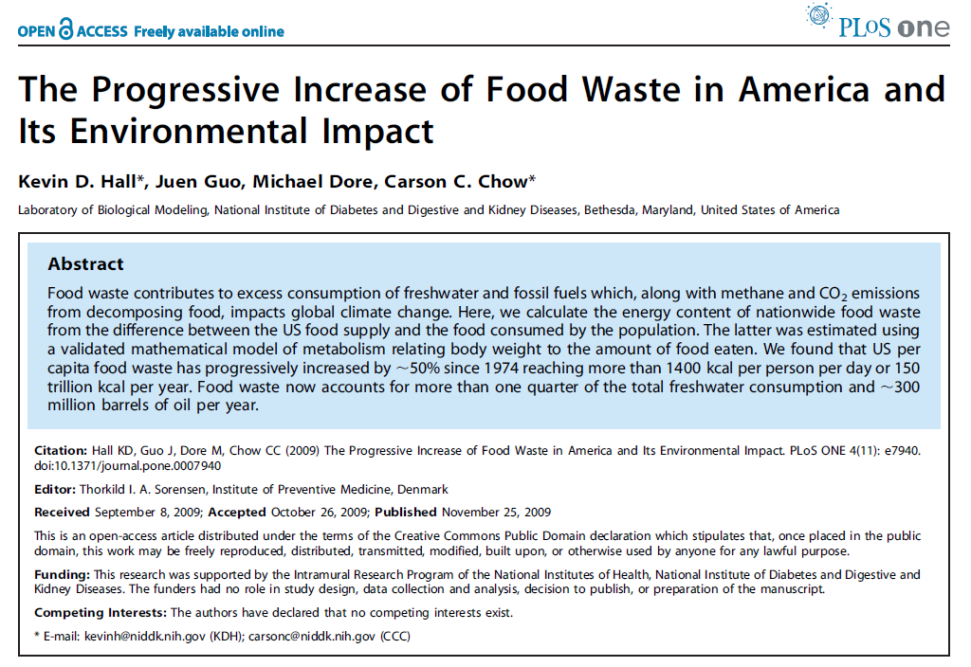

Slide 17
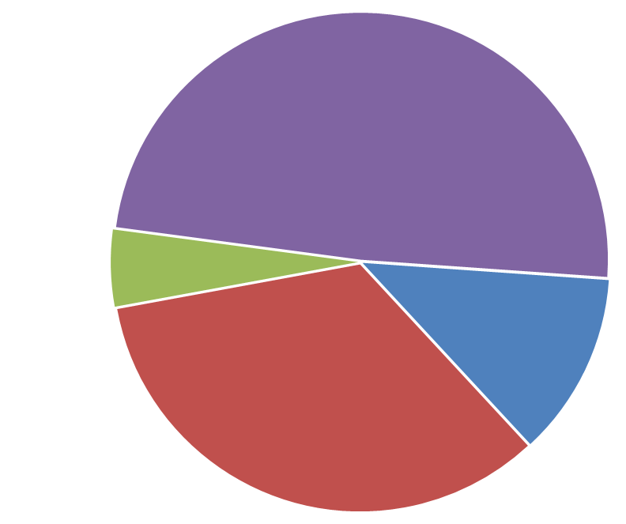
U.S. fresh water consumption (2005)
349 billion gallons/day
Domestic = 98 gal/d
  Total = 1180 gal/d
Thermoelectric power generation
(fossil + nuclear)
Industry & mining
Public water supply incl. domestic use
Agriculture (crop irrigation, livestock, aquaculture)
http://water.usgs.gov/watuse/

Slide 18
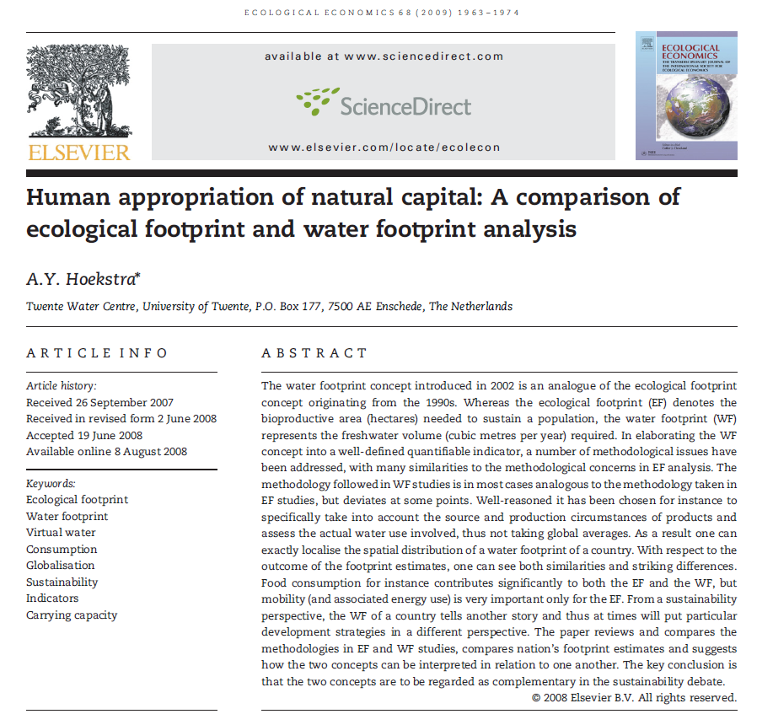

Slide 19
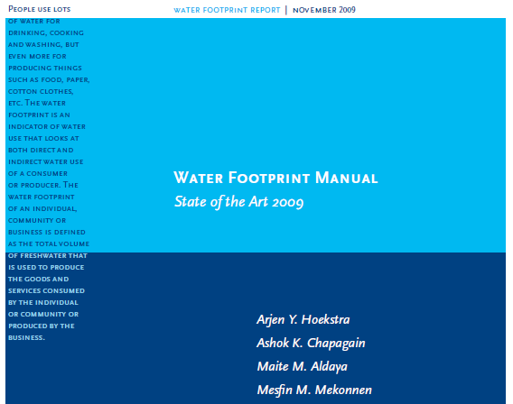

Slide 20
As with many challenges, finding the best solutions requires first asking the right questions. Typically, when planners and engineers see a water shortage on the horizon, they ask themselves what options exist to expand the supply. The typical answer: Get more water from a distant river, deeper wells, or a desalination plant.
But as the limitations of these “supply-side” options have become more apparent, a vanguard of citizens, communities, farmers, and corporations has started asking a different question: What do we really need the water for, and can we meet that need with less? The upshot of this shift in thinking is a new movement in water management that is much more about ideas, ingenuity, and ecological intelligence than it is about pumps, pipelines, dams, and canals.
This smarter path takes many forms, but it embodies two strategic attributes. First, solutions tend to work with nature, rather than against it. In this way, they make effective use of so-called ecosystem services—the benefits provided by healthy watersheds, rivers, wetlands, and other ecological systems. And second, through better technologies and more informed choices, these solutions seek to raise water productivity—the benefit derived from each liter of water extracted from a river, lake, or aquifer.
Sandra Postel, Water: Adapting to a new normal. The Post Carbon Reader: Managing the 21st Century's Sustainability Crises (Kindle Locations 1708-1718). Watershed Media in collaboration with Post Carbon Institute. Kindle Edition.

Slide 21
Atmosphere
Evaporation
Evaporation
Precipitation
Outside the watershed
Outside the watershed
In the watershed
Transpiration (via plants)
In the watershed
Land surface (watershed)
Stream
Runoff
Gaged
streamflow
Infiltration
Soil water
Ground water flow
Watershed
Infiltration
Natural hydrologic cycle for a gaged watershed
Ground water

Slide 22
Atmosphere
Evaporation
Evaporation
Precipitation
Human use
Waste water
Water supply
Transpiration
Land surface (watershed)
Stream
Runoff
Gaged
streamflow
Infiltration
Water supply
Soil water
Ground water flow
Infiltration
Natural and human-built hydrologic cycle ignoring inter-basin transfers
Ground water

Slide 23
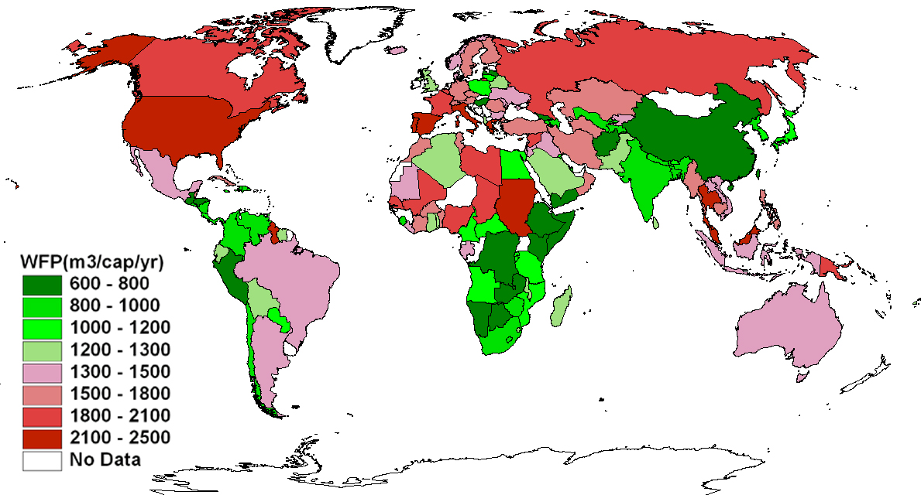
Water footprints of nations
Lowest: ∼ 430 gallons/(person day)
Highest: ∼ 1800 gallons/(person day)
From www.waterfootprint.org

Slide 24
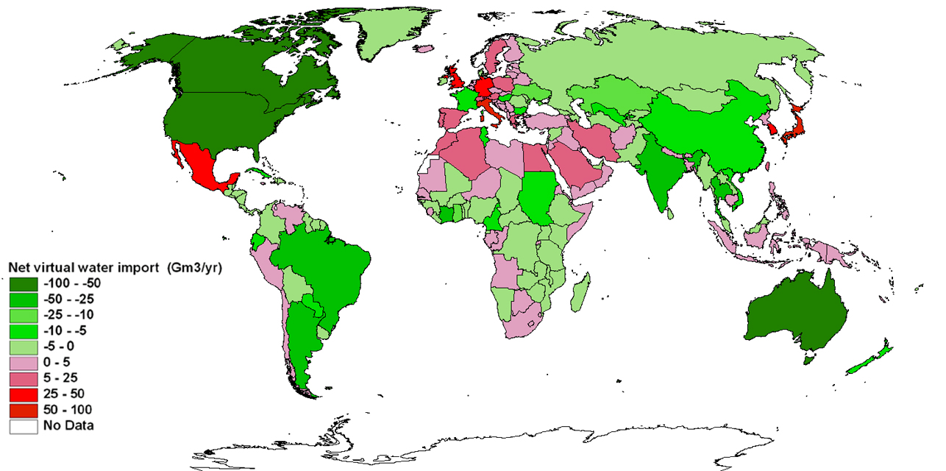
Net virtual water trade via products: exporters and importers
From www.waterfootprint.org

Slide 25
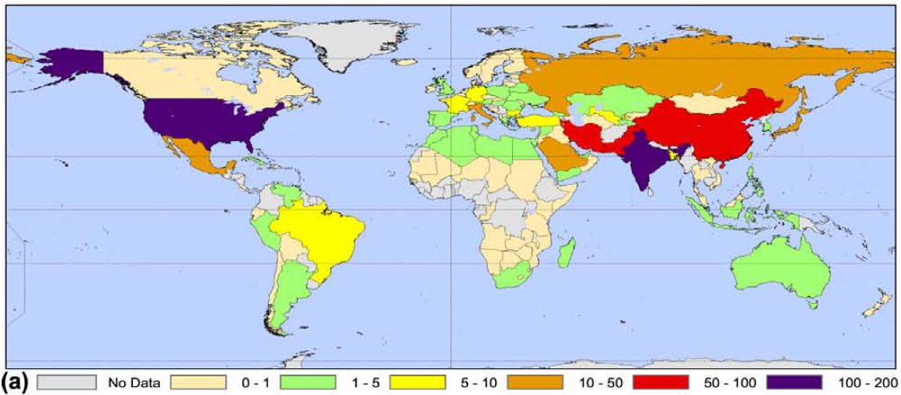
Groundwater abstraction = nonsustainable use
Groundwater abstraction (cubic kilometers/year)
[1 cubic kilometer = 264 billion gallons]
Wada et al., 2012, Nonsustainable groundwater sustaining irrigation: a global assessment: Water Resources Research, v. 48.

Slide 26
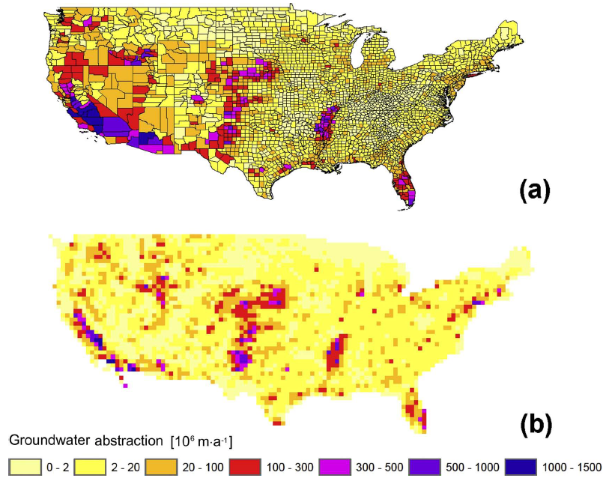
Groundwater abstraction = nonsustainable use
Groundwater abstraction (million cubic meters/ year)
Wada et al., 2012, Nonsustainable groundwater sustaining irrigation: a global assessment: Water Resources Research, v. 48.

