Slide 1
Using systems thinking to understand complex issues
Meghann Jarchow
Iowa State University

Slide 2
Objectives
Introduce and experience systems thinking
Appreciate complexity and interrelationships in sustainability-related issues

Slide 3
Systems thinking
Process of understanding
  Complementary to reductionism
Characterized by
  Parts and processes part of a larger system
  Interdependence among parts and processes
  Non-linear and complex systems

Slide 4
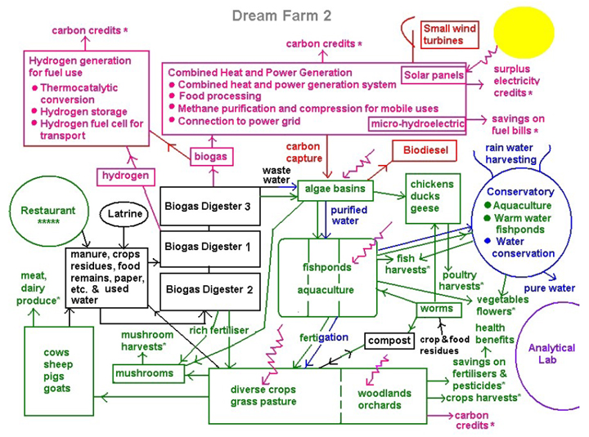
Concept map
Image from http://kauaian.net/blog/?p=1354

Slide 5
How does ethanol production relate to sustainability?

Slide 6
How does the production of ethanol (from corn grain) affect agriculture, the environment, energy production, and government policies?

Slide 7
Assignment
Pick a complex issue and make a concept map about that issue

Slide 8
Additional resources
Concept mapping
  Visual Understanding Environment (VUE)
    http://vue.tufts.edu/
  Bubbl
    https://bubbl.us/
  Cmap Tools
    http://cmap.ihmc.us/
  List of many concept mapping software
    http://en.wikipedia.org/wiki/List_of_concept-_and_mind-mapping_software#Free_software
Systems thinking readings
  Thinking in Systems: A Primer by Donella H. Meadows

