Slide 1
University of Illinois
School of Earth, Society and Environment
Notes:
(Who here is in a School, rather than a department? Can have an advantage, esp. for sustainability. I’ll talk about a couple of examples)

Slide 2
Geographic Information Systems
Introduction to GIS
Advanced GIS databases, interfaces, automated
Programming for GIS apps, mobile, cloud
Notes:
GIS has become a foundational tool in much of sustainability and earth science.
We can offer it because of our School structure, like many geology units, we’ve joined a School - the other department-level units are geography and atmospheric science. Geography already had a focus in GIS, and we’ve been able to bring this technical skill into our earth science programs because of their faculty.

Slide 3
Geographic Information Systems
Introduction to GIS
Environmental GIS applications
Remote Sensing aerial and satellite obs.
Advanced GIS databases, interfaces, automated
Programming for GIS apps, mobile, cloud
Notes:
Brought in an environmental and earth science part of the chain, for users rather than makers
One intro:
Introduction to GIS (software basics, math concepts)
Two middle:
Environmental GIS (applications)
Remote Sensing (incorporating satellite and aerial observations)
Two upper:
Advanced GIS (database management, interface between software and automated data systems)
Programming for GIS (creation of new GIS apps, mobile GIS, cloud GIS)

Slide 4
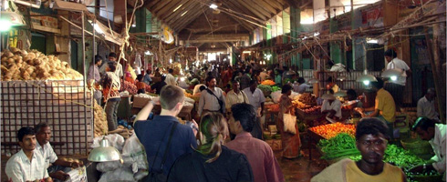
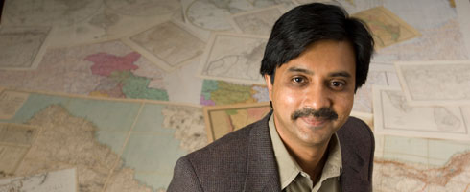
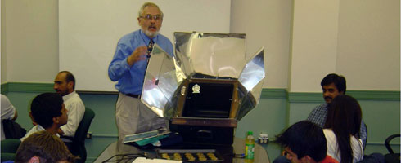
The Market as part of a Sustainable Society
3 courses:
Sustainable Business
Sustainable Organizations
Sustainable Entrepreneurship
Notes:
Sustainable Business - about markets and marketing
Sustainable Organizations - institutional processes; organizational change, supply chain sustainability
Sustainable Entrepreneurship - launching green initiatives and products, transformative approaches
We have 3 courses, taught by two professors from the Business College. They’re committed folk, but I’m still very careful to treat them well (small class sizes) as I couldn’t afford to pay them market rates! The three courses are all online:

Slide 5

Online Courses
Notes:
I’ve mentioned online courses; we offer enough major coursework that you can complete all of the requirements (outside lab based science courses) entirely online. These courses are popular with our own students as well - Kevin and Kim here are taking ESE 320 Water Planet and are regular on-campus students in our major.

Slide 6
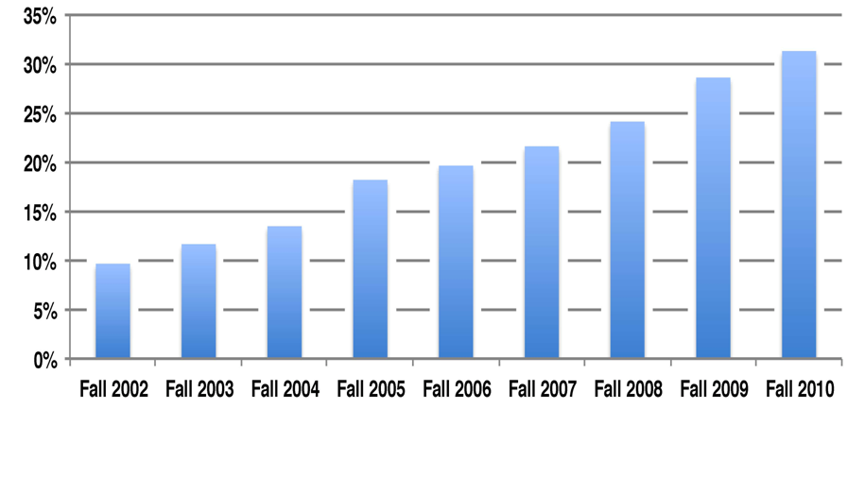
Percentage of US students in online courses
Allen and Seaman (2011)
Notes:
"Thirty-one percent of all higher education students now take at least one course online."

Slide 7
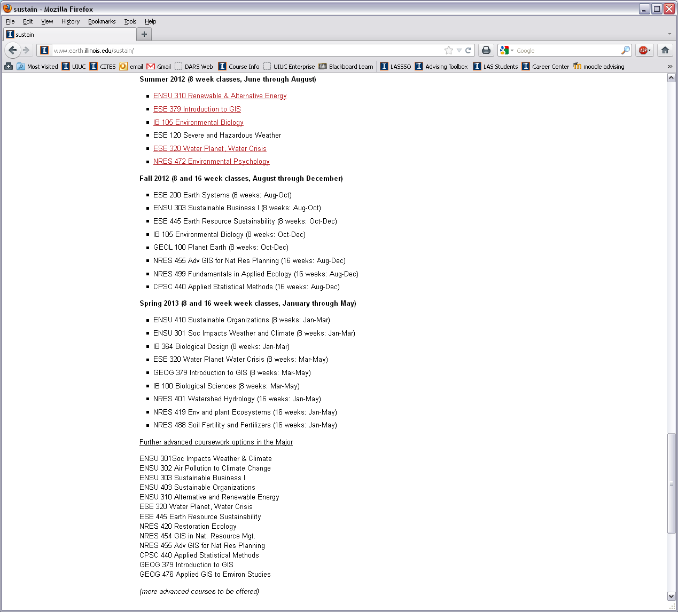
Notes:
This Fall we will launch our Environmental Sustainability bachelor degree completion program for people with some college or an associates degree, entirely online. It’s exactly the same degree - same piece of paper, same requirements, same graduation ceremony, same everything - as that given out to traditional students. Here’s a screenshot of next year’s classes:

Slide 8
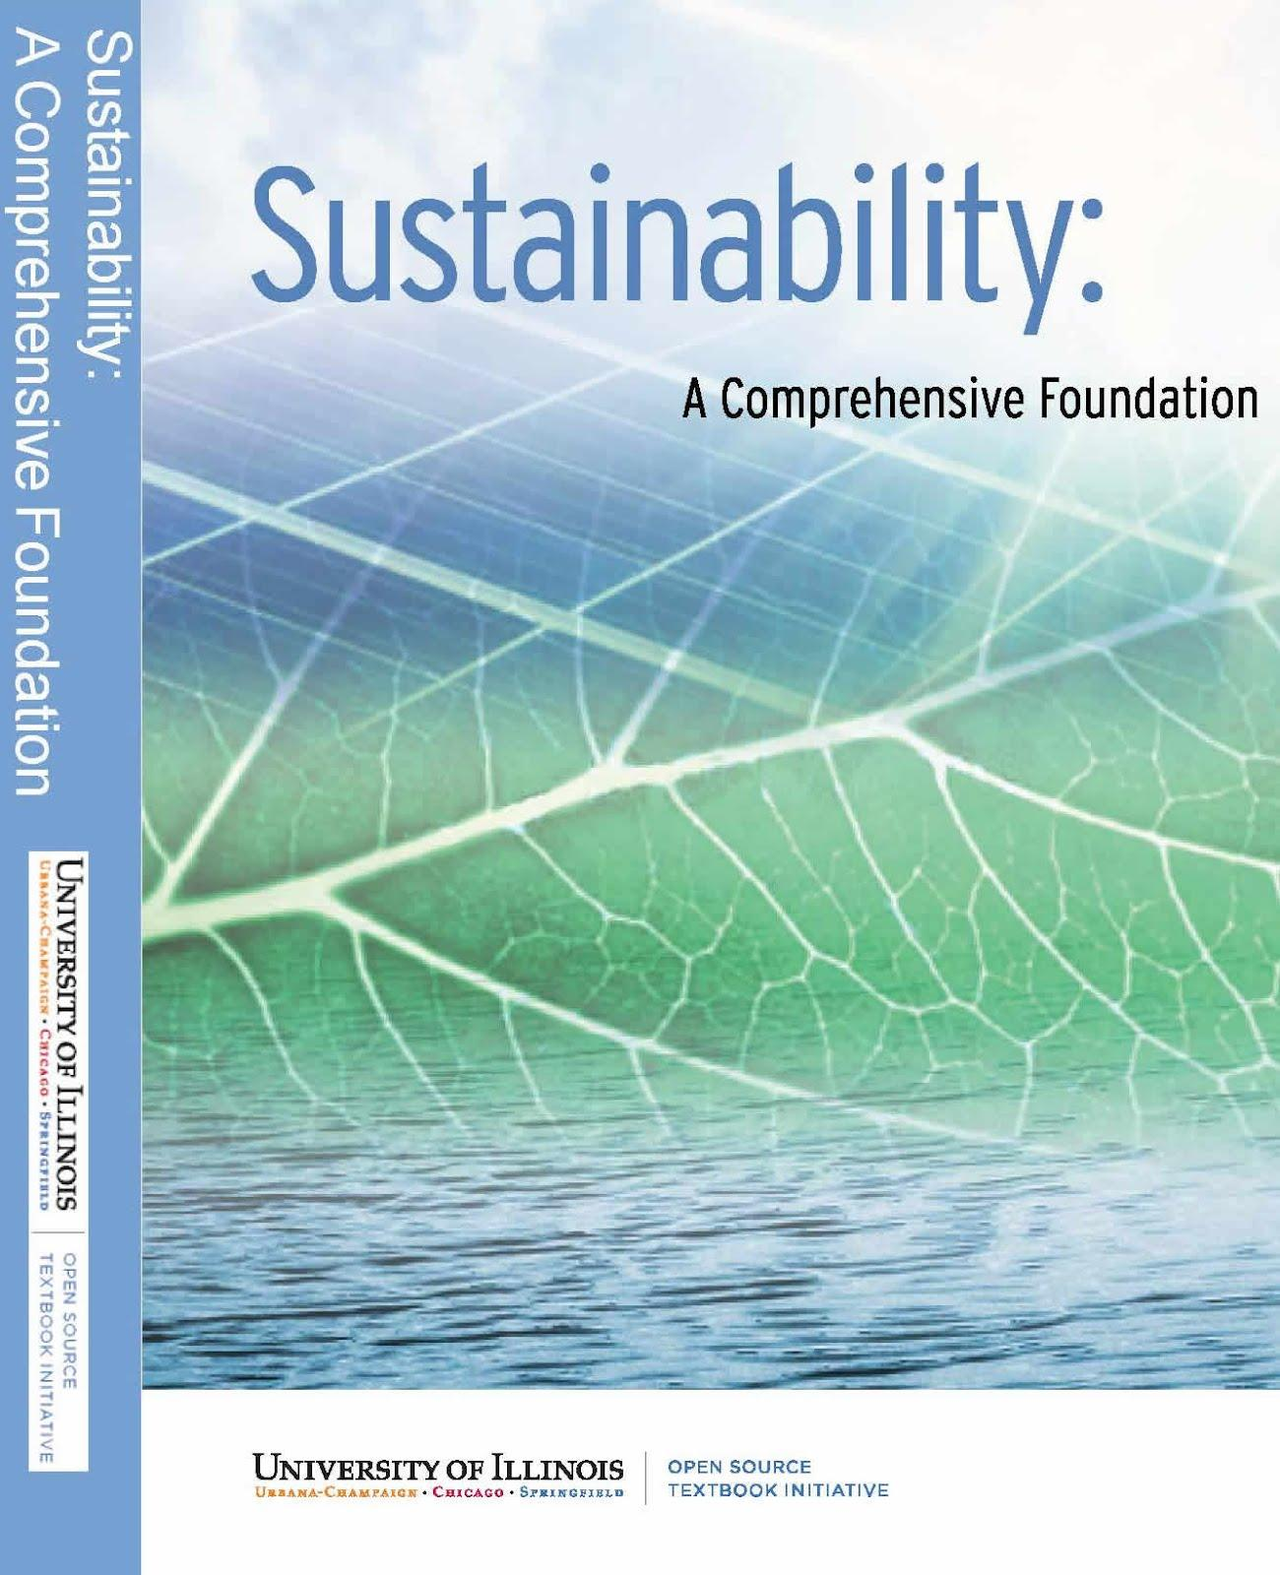
Free Online Text
1. Humanity and the Environment
2. Environmental Policy in the US
3. Climate and Global Change
4. Biosphere
5. Physical Resources
6. Environmental Economics
7. Modern Environmental Management
8. Sustainable Energy Systems
9. Metrics, and Tools for Sustainability
10. Ethics, Culture, and History
11. Sustainable Infrastructure

Slide 9
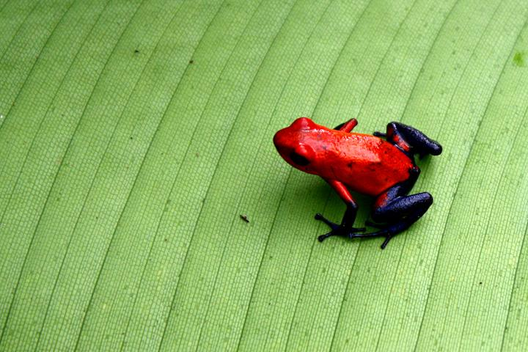
Free Online Sustainability Course
Starts August 27th
http://www.earth.illinois.edu/class.html
Notes:
here’s a free Massive Open Online Course that anyone can take - if you're interested in how an online sustainability course might work - even you can take it! “Lurkers” welcome.
8 weeks long, talk to me for details

Slide 10

Notes:
Last Thought:
Since we're at Stanford, this is a motivating development that should keep us thinking - the future of education is not like the past.

