Slide 1
Department of Environmental Studies
Emory University ~ Atlanta, GA
Establishing Links with Professional Schools: Business, Law and Public Health
Anne Larson Hall ~ Senior Lecturer and
Director of Undergraduate Studies
B.S./B.A. in Environmental Studies
B.S./B.A. in Environmental Studies with a Concentration in Business
B.S./M.P.H. in Environmental Studies/Public Health

Slide 3
Strong partnerships with the Goizueta Business School and Rollins School of Public Health

Slide 4

Rollins School of Public Health
Approved AC 2006-07
Dual Degree
Currently 12 ENVS students
Students are enrolled for four years in Emory College completing a B. S. in Environmental Studies. During their Junior and Senior years, students complete graduate level public health courses.
Students are expected to have a strong foundation in chemistry and biology prior to full matriculation in the Rollins School of Public Health.
During the fifth year, students complete the M.P.H. curriculum in Environmental Health
at the
Rollins School of Public Health
5-year B.S/M.P.H. Degree

Slide 6
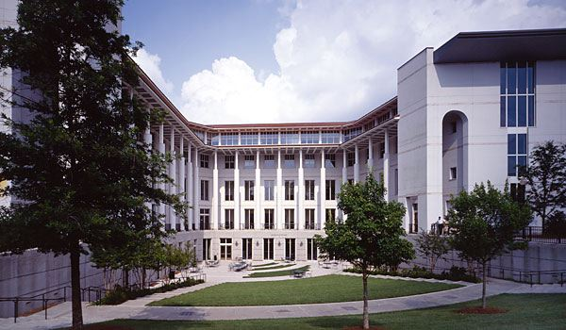
The Major in Environmental Studies with a Concentration in Business
The Concentration in Environment and Sustainability Management
A collaboration between the Department of Environmental Studies in Emory College and the Goizueta Business School BBA Program.
Environmental Studies students who complete the concentration will acquire grounding in business principles and practices, including management, marketing, finance and strategy.

Slide 8
Links with
Emory Law School
Environmental Studies Courses that offer an interdisciplinary foundation in the environment with links to Law
ENVS 420: Law and Biodiversity
ENVS 348: Sustainable Water Resources
ENVS 324: Ecological Economics
ENVS 320: Environmental Assessment and Management
ENVS 339: Politics And The Environment
The Law School allows students to create ad hoc joint degree programs with Emory’s graduate degree programs, for example the JD/MPH
As the ENVS department develops a new graduate program, we anticipate developing formalized links with the Law School

Slide 10
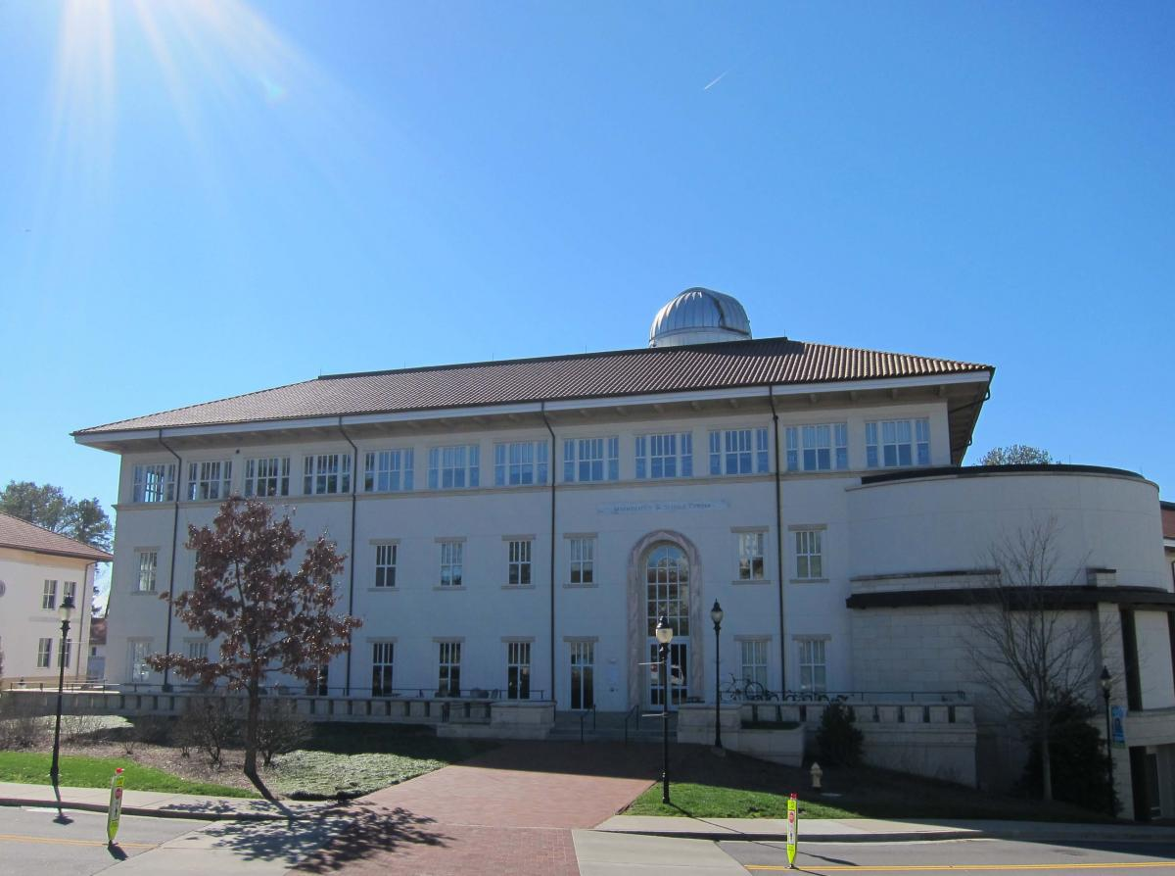
Benefits for our Environmental Studies Majors
Our students are able to pursue a path of study that fits their interests and goals; our Department’s links with the professional schools help students define a career path
A strong background in natural science, policy and professional training helps our students to succeed in today’s job market and in further academic training
Our students understand that complex environmental problems require
interdisciplinary solutions

