Slide 1
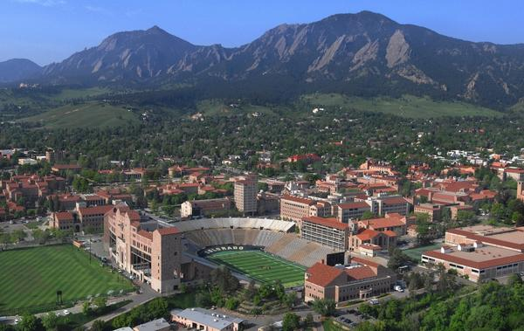
University of Colorado
Environmental Studies Program

Slide 2
Program structure and people
Grew out of a conservation biology certificate program
ENVS now is essentially a department: 6 full tenure track faculty FTE – multiple split positions (dual unit affiliations). Faculty from other units volunteer time in ENVS (some actively, some less so).
Mix of science, social science & some humanities

Slide 3
Undergraduate program structure
Focus of ENVS is on science, policy, and values components of environmental issues. Highly interdisciplinary unit.
Courses begged, borrowed, or stolen from other units…
Challenge #1: We don’t control the content of our curriculum

Slide 4
ENVS Curriculum Structure
Yes I know it’s really ugly…
Capstone:
1 semester high level integrative course
Specializations (12-15 hrs):
Climate and energy
Natural Resources and the Environment
Sustainable Development
Upper Division:
‘Cornerstone’ – Mid level integration of science policy & values
Upper division
Skills:
Statistics (1 semester)
Calculus or Social Science Research
Methods (1 semester)
Intermediate courses:
Intermediate Natural Science (1 semester)
Intermediate Social Science (1 semester)
Intermediate Values – Econ or Phil (1 semester)
Intermediate Policy (1 semester)
Introductory courses:
Introduction to Environmental Science (ENVS)
Chem or Physics (1 semester) + Geology, Geography, or Atm. Science (1 year) + Biology ( 1 year)

Slide 5
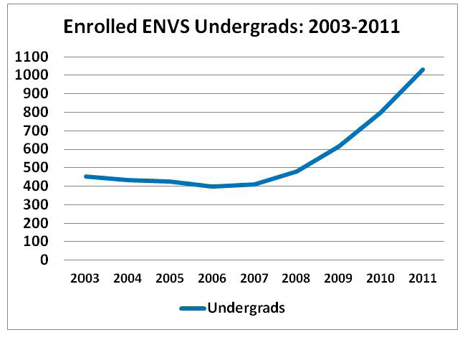
Challenge #2: Program Growth

Slide 6
Opportunities
Challenge #1: We don’t control the content of our curriculum
Opportunity: As we grow, we can build courses using modern science ed principles & can be flexible in responding to new areas of need.
Challenge #2: The growth of the undergraduate population
Opportunity: We have the chance to reach over 1000 students in a curriculum rich in interdisciplinary topics and sustainability.

Slide 7
Opportunities
CU is exceptionally strong in environmental science but those efforts are diffuse and fractured across campus.
Resource constraints and slow growth could provide incentive to remove redundancies and build stronger links across programs.

