Slide 1
Determining Program Success in the
School of Earth Sciences & Environmental Sustainability, Northern Arizona University assessment as a continuous process
Rod Parnell
Academic Affairs and
School of Earth Sciences &
Environmental Sustainability
Notes:
Although curriculum revision is a natural and continuous process, a combination of factors at Northern Arizona University have allowed us to accelerate that process in up-date a curriculum little changed from the 1990s.

Slide 2
What does NAU SESES mean by assessment ?
Our degree programs: assess what we do/teach compared to what we say want to do
compare activities in each course to our program goals, competencies, and learning outcomes
Our students: assess what students have learned and developed including dispositional (internalized) outcomes
did they learn what we wanted them to learn,
did they develop the skills we wanted them to
look at performance, not student achievement (measure student progress not student aptitude/ability)
Notes:
Although curriculum revision is a natural and continuous process, a combination of factors at Northern Arizona University have allowed us to accelerate that process in up-date a curriculum little changed from the 1990s.

Slide 3
well established undergraduate environmental sciences (BS) environmental studies (includes sustainability focus) (BA/ BS) geology (BS) also earth science (BS) and sustainability minor assessment and course redesign for core courses in ENV and GLG also have: well established graduate environmental sciences and policy (MS) geology (MS) newer or revised sustainability programs: climate sciences and solutions (PSM) earth sciences and environmental sustainability (PhD)
SESES degree programs

Slide 4
Sustainability for every major,
the Global Learning Initiative
diversity, environmental sustainability, and global engagement are mission-central and interrelated university values
University-wide students learning outcomes result from them
using natural resources in sustainable, ethical & responsible ways including, for example:
a. how culture determines use of environmental resources.
b. the connection between environmental awareness and global citizenship.
c. the scientific basis, concepts and vocabulary of environmental sustainability.
d. how human interactions with the environment relate to the root causes of many global problems.

Slide 5
university-wide drivers cause us to redesign and reassess our degree programs
Global Learning Initiative
build competencies throughout degree program (not gen ed)
three interrelated themes
interdependence of human experience on a global scale
significance, options for & ethics of sustainability
nature & consequences of diversity in the society & environment
curriculum redesign process
ID learning outcomes map curriculum
revise teaching/assessment revise curriculum

Slide 6
Some ENV programs sustainability learning outcomes (pre-GLI effort in italics)
Understand key environmental sustainability principles from natural and social sciences perspectives.
Refine and make explicit existing GLI related core course learning objectives (e.g. how do diverse perspectives and global engagement impact our understanding of sustainability and environmental studies/sciences/geology)
Define Environmental Sustainability from Environmental Sciences Perspective
Develop and Promote Diversity opportunities
promote diversity courses and study especially related to environmental justice
Increase Opportunities for Co-Curricular Global learning
extracurricular involvement

Slide 7
Course level: systems thinking and analysis describe environmental issues with systems tools scientific method & traditional ecological knowledge in environmental management climate-appropriate agriculture and water resource use
Program level: interdisciplinary analysis work with others in application of multiple disciplines to analyze complex biophysical/culture issues informational literacy media searches, source discrimination, literature analysis
Example ENV undergraduate program learning outcomes

Slide 8
Map current knowledge and abilities throughout the curriculum
understandings and knowledge outcomes
  system structure, function, resilience and stability/sustainability across all scales from the local to the global, including biotic, abiotic, and cultural components
  science/policy interface
  principles and applications of biogeochemical cycling
  We will add principles and applications of environmental justice
ability outcomes
  systems modeling using quantitative reasoning including basic statistical analysis, error analysis
  understand & explain the science behind the science of environmental change
  apply an understanding of principles of resource management and environmental policy at all scales
  apply an understanding of ecosystem services

Slide 9
Assessment tools used by SESES
tools applied at multiple times through the program to determine increasing levels of competencies
Direct tools (faculty measures like projects and exams)
Indirect tools (student measures like essays and surveys)
Initial (intro course) and final (capstone course) exams and small group projects, surveys and essays
Junior level writing course assignments
Capstone (internship or research) portfolio, presentations, and group projects assessed by group of faculty
Exit interview and final survey (e.g. CEDD NCSE)
Notes:
As a result of these drivers, we are pursuing curriculum revision goals

Slide 10
Revise teaching and assessment by adding a curriculum goal (our current stage in SESES)
incorporate concepts & practice of sustainability and social & environmental justice in undergraduate curriculum
Go back to individual courses
develop new learning outcomes and ways to assess them
Remap these learning outcomes throughout the program
Rinse and repeat
Notes:
As a result of these drivers, we are pursuing curriculum revision goals

Slide 11
Rubric from University Assessment Committee
1) PROCESS: conversations and action plan completed a) faculty reviewed plan and identified revisions, students and/or other stakeholders included b) previous feedback informs priorities for this cycle (e.g. program review, assessment or accreditation reports) c) learning outcomes and methods/indicators are prioritized and feasible/valid
2) DATA: Collection and Analyses of Evidence a) student Learning Outcomes have been assessed and interpreted b) findings interpreted with respect to goals and students to be below, at, or above expected levels of proficiency.
3) IMPLEMENTATION findings recommend specific curricular changes
How is an assessment plan assessed ?

Slide 12
NAU On-going Degree-Program Assessment Process
DEPARTMENT
Degree-Program Annual
Assessment Report
OAA
Seal Awards
Certificates,
E-Emblem
OAA
Database,
Web Site
UAC
Subcommittees,
Monthly Review,
Rubric Feedback
OAA
Review,
Letter with
UAC Rubric
UAC
Summer Review,
Seal of Assessment
Nominations
OAA = Office of Academic Assessment
UAC = University Assessment Committee
Notes:
Joe – slides 5 - 9

Slide 13
Carrots and sticks, concepts vs practice
Roughly half NAU academic programs participate annually
very small carrots (seal of participation)
small sticks
reports necessary for external reviews and accreditation
any curricular changes must have basis in assessment
perception that review cycle is too frequent
(annual reports desired)
not a high priority in light of increased teaching loads and decreased tenure density
Notes:
Although curriculum revision is a natural and continuous process, a combination of factors at Northern Arizona University have allowed us to accelerate that process in up-date a curriculum little changed from the 1990s.

Slide 14
How NAU tries to increase faculty buy-in
assessment start-up mini-grants
OAA and UAC feedback and consulting
Outside experts
Internal conferences/workshops
Tied to 7-year Program Review process.
Curriculum change forms require assessment justifications.
Institutional recognition for using assessment to improve learning (seals of OAA approval)

Slide 15
Resources useful to me: http://www.bridgew.edu/AssessmentGuidebook/ https://www4.nau.edu/assessment/

Slide 17
NAU’s history of assessment
1997: NCA Self Study requires improved assessment
1999: Degree-Program Assessment
  First program assessment plans
  University Assessment Committee
2002: Office of Academic Assessment created
2005:OAA Director, budget expanded
  Startup Mini-grant Project
    Consulting, Guest Presenters, Books, Workshops to stimulate program assessment.
2006-07: Assessment Committee focuses on annual assessment reports.
  Rubrics with feedback to all departments.
  Recognition System Installed
2007: NCA Site Visit: Highest Ratings

Slide 18
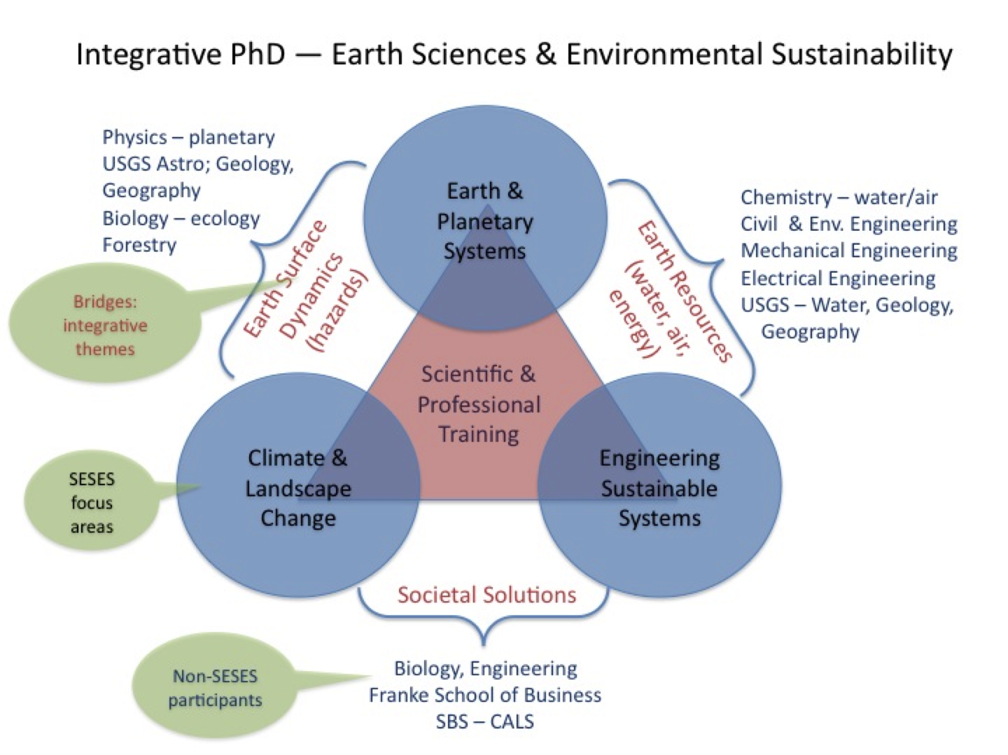
New

Slide 19
Develop additional GLI learning goals for ENV programs
Enhancing awareness of relationships between human and non-human components of the environment at local to global scales
Generating environmentally aware citizen who are inspired, committed, active, participatory, persuasive and influential.

Slide 20
Multiple levels of competencies and assessments
Introductory, “novice” level | Advanced, senior level capstone
Interdisciplinary analysis Work in small group to understand and communicate a local resource issue | Interdisciplinary analysis apply expertise in small group to use multiple perspectives to analyze a resource issue
Systems analysis Understand concepts of system components/structures and functions/interactions | Systems analysis Working with others, develop a quantitative (e.g. STELLAII) analysis of a linked natural/social system

Slide 21
“competencies” and “learning outcomes” in sustainability
competency: a functionally linked complex of knowledge,
skills, and attitudes that enable successful task performance
and problem solving (Weik et al 2011)
complexes of knowledge, skills, and attitudes that
enable successful task performance and problem solving
with respect to real-world sustainability problems, challenges,
and opportunities
competencies usually discussed as laundry list rather than coherent programmatic framework
learning outcomes: the specific knowledge, skills and attitudes taught to/acquired by students to help them achieve the broader competencies

Slide 22
a framework for competencies in sustainability
analyze and solve sustainability problems,
& explore less desirable future conditions that would
occur without action
anticipate and prepare for future sustainability challenges,
create and enact opportunities for sustainability
how to get from current to more sustainable conditions.
sustainability problems have specific characteristics so analyzing & solving sustainability problems requires
specialized, interlinked competencies (Wiek et al. 2011)
systems-thinking competence, anticipatory competence,
normative competence, strategic competence,
interpersonal competence.

Slide 23
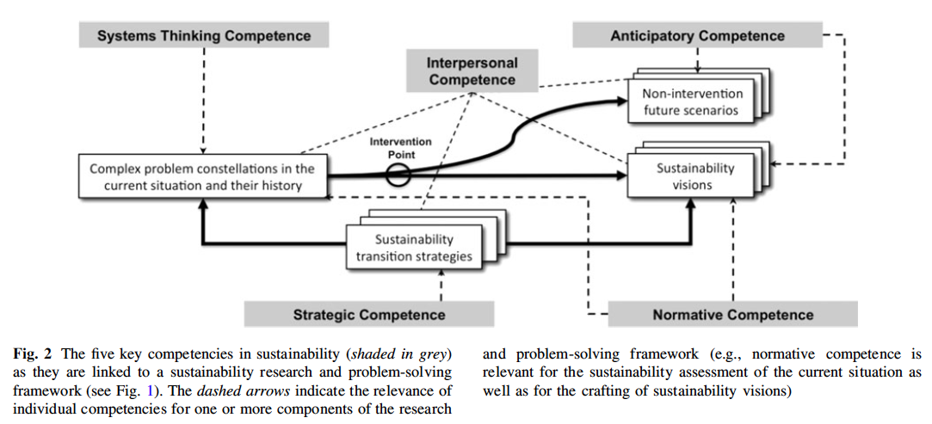
Weik et al 2011
Systems-thinking: analyze coupled human-environment systems across domains (society, environment, economy) and scales, considering systemic features (e.g. feedback loops)
Anticipatory: collectively analyze, evaluate, and conceptualize the future of sustainability issues and solutions
Normative: collectively map, specify, apply, reconcile, and negotiate sustainability values, principles, goals by collectively assessing the sustainability of current and/or future states of systems and then creating sustainability visions for these systems.
Strategic: collectively design & implement governance strategies toward sustainability.
Interpersonal: motivate, enable, and facilitate collaborative and participatory
sustainability research and problem solving.

Slide 24
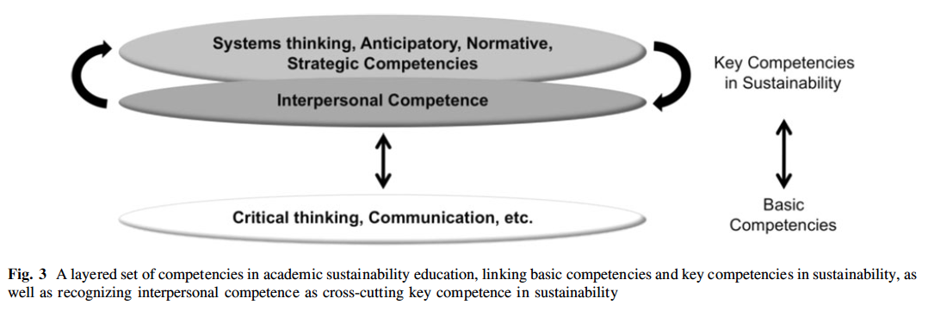
Sustainability competencies build upon basic (liberal studies) ones

Slide 25
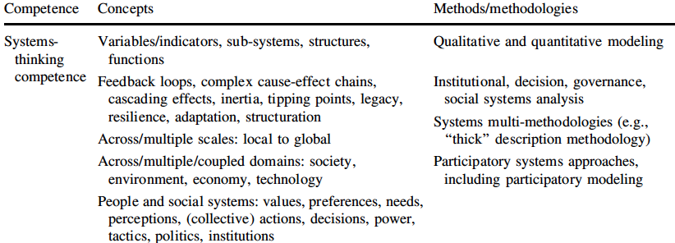
Moving from program competencies to learning outcomes

Slide 26
ENV: expose students to broad, multiple perspectives in core curriculum
senior capstone project & presentation course
internship or undergraduate research
studies
environ politics
environ economics (rec)
environ ethics
intensive writing
environ humanities
environ communications
plus focus area courses
Sciences
conservation ecology
energy resources and policy
atmosphere/hydrosphere
chemistry
calculus, statistics
GIS
plus emphasis area courses
ecology
environmental sustainability foundations of envi sciences

