Slide 1

Assessment in an Undergraduate Environmental Studies Program: Focus on 21st Century Skills
Dave Gosselin and Sara Cooper
Environmental Studies Program
University of Nebraska-Lincoln
Ron Bonnstetter and Bill Bonnstetter
Target Training International, Ltd.
Scottsdale, AZ

Slide 2
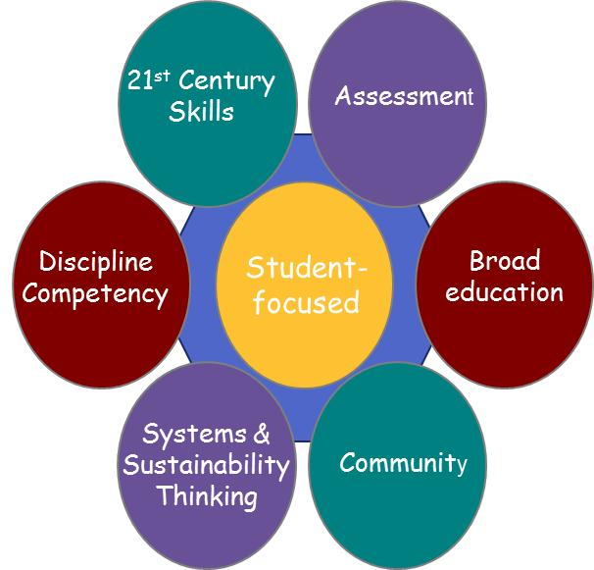
UNL – Environmental Studies Program
Key Program Attributes
Program Redesign
Initiated Fall 2008
Program Fully
Implemented
Fall 2010
ENVR Common Core
Pre 5 SCH to Post 13 SCH
Earth Systems Courses
12 Emphasis Areas
Physical and Math Req.

Slide 3
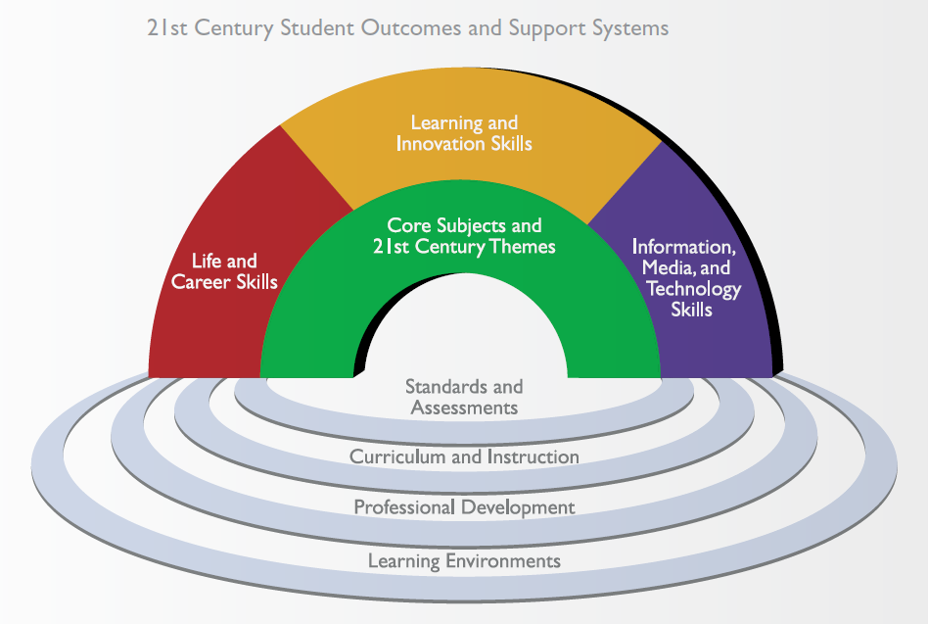
UNL – Environmental Studies Program
Key Program Attributes
“21st-century skills”
“21-century learning”
“21st-century education”
Partnership of 21st Century Skills (P21) include, among others, the US Department of Education, the International Society for Technology in Education (ISTE), Microsoft, Apple, DELL and Cisco.

Slide 4
UNL – Environmental Studies Program
Key Program Attributes
Learning and Innovation Skills
• Creativity and Innovation
• Critical Thinking and Problem Solving
• Communication and Collaboration
“21st-century skills”
“21-century learning”
“21st-century education”
Life and Career Skills
• Flexibility and Adaptability
• Initiative and Self-Direction
• Social and Cross-Cultural Skills
• Productivity and Accountability
• Leadership and Responsibility

Slide 5
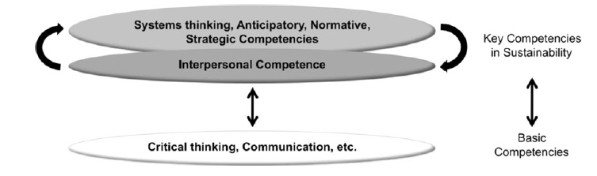
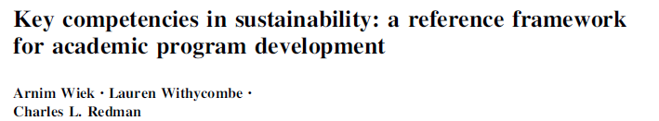
5 Key Competencies in Sustainability
21st Century
Skills
Interpersonal competence = ability to motivate, enable, and facilitate collaborative and participatory sustainability research and problem solving. T
Requires advanced skills in
● communicating
● deliberation and negotiation
● leadership
● pluralistic and transcultural thinking
● empathy
Sustain Sci. 2011
DOI 10.1007/s11625-011-0132-6

Slide 6
Current Assessment Questions
To what extent have our students improved their 21st century skills?
What motivates our students to become passionate 21st century learners?

Slide 7
Personal Attributes
Data Collection
Target Training International's TriMetrix™ Assessment
How
(Give and Receive Information)
Behavior
DISC
Why
(Time &Energy)
Attitudes
Motivators
Personal
DNA
What
Personal Skills (25)
DNA INDEX

Slide 8
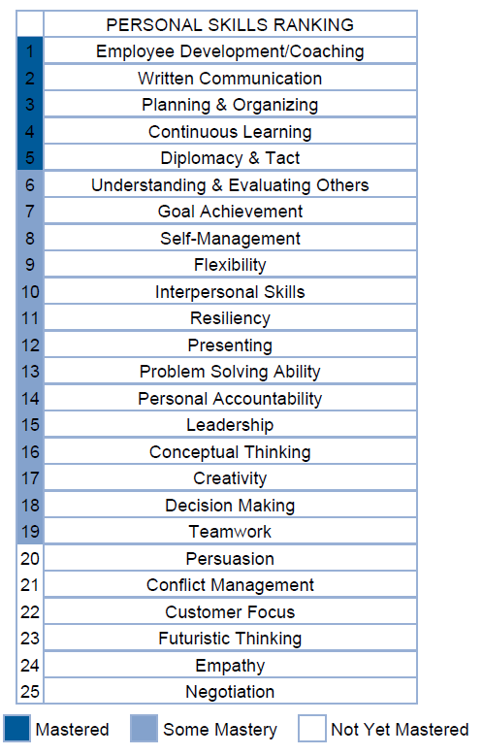
Question 1. Measuring 21st Century Skills
(What?)
Dave
Experienced Based
Context

Slide 9
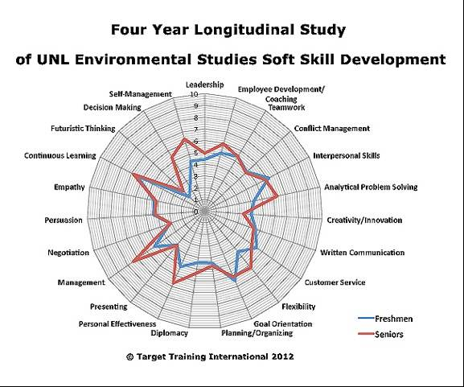
Self-Management
N = 30
Decision-Making
Continuous
Learning
Analytical Problem Solving
Management
Flexibilty
Personal Effectiveness
Pre-Program
Post-Program

Slide 10
Question 1. Measuring 21st Century Skills
CONTINUOUS LEARNING: Taking initiative in learning and implementing new concepts, technologies and/or methods.
Program Increased
  SELF-MANAGEMENT (TIME AND PRIORITIES): Demonstrating self control and an ability to manage time and priorities.
  ANALYTICAL PROBLEM SOLVING: Anticipating, analyzing, diagnosing, and resolving problems.
  FLEXIBILITY: Agility in adapting to change.
  PERSONAL EFFECTIVENESS: Demonstrating initiative, self-confidence, resiliency and a willingness to take responsibility for personal actions.
  MANAGEMENT: Achieving extraordinary results through effective management of resources, systems and processes.
  DECISION MAKING: Utilizing effective processes to make decisions.

Slide 11
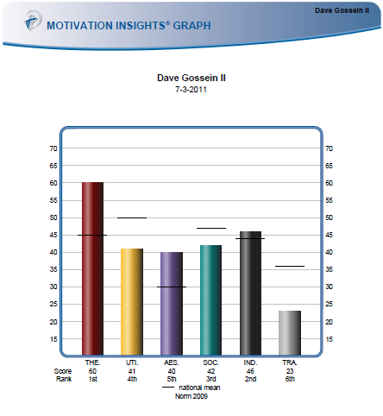
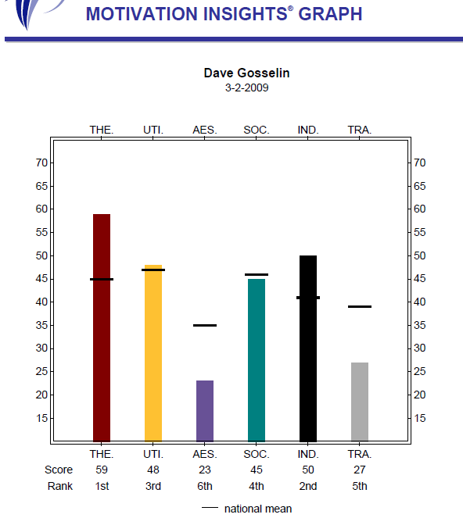
Question 2. Measuring Motivators (Why?)
Knowledge of an individual's attitudes help to tell us WHY they do things. Energy and time.
Attitudes – initiate behavior and are sometimes called the hidden motivators because they are not always readily observed.
PIAV report measures the relative prominence of six basic interests or attitudes (a way of valuing life):
Theoretical Utilitarian Aesthetic Social Individualistic Traditional.
Dave’s Motivators

Slide 12
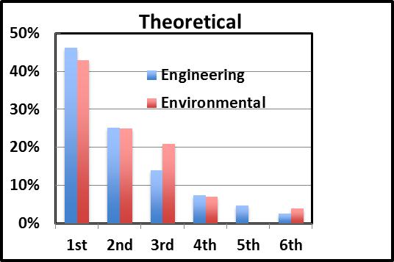
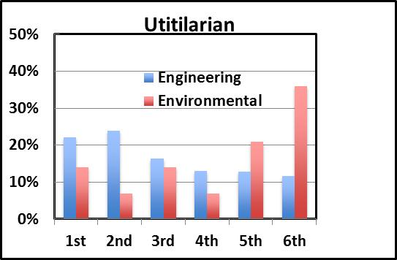
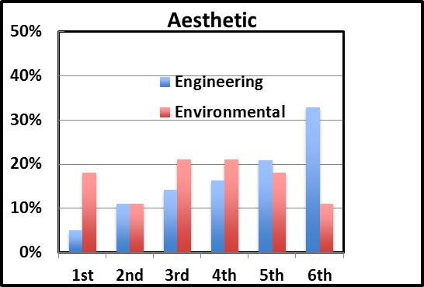
Question 2. Measuring Motivators
Engineering Students (n = 1717) and Environmental Students (n =30)
Top 2: 71 vs 68
Top 2: 46 vs 21
All
Pre-Program
Students
Top 2: 16 vs 29

Slide 13
Current Assessment Questions
+ Answers (?)
To what extent have our students improved their 21st century skills?
  Improved SELF-MANAGEMENT; ANALYTICAL PROBLEM SOLVING; FLEXIBILITY; PERSONAL EFFECTIVENESS; MANAGEMENT; and DECISION MAKING
What motivates our students to become passionate 21st century learners?
  Students are not the same (Major Dependent)
  Faculty and students may not different by same motivators

Slide 14


Questions

Slide 15
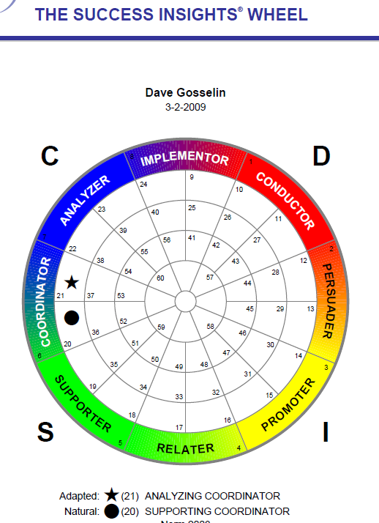
Question 3. Measuring Behavior (How?)
DISC
Analyzes behavioral style
Person's manner of doing things

Slide 16
Question 3. Measuring Behavior (How?)
What DISC Measures - High and Lows
Emotions
Anger
Optimism
Nonemotion
Fear
D
I
S
C
Will more assertively accept problems
Will actively seek people to interact with or influence
Will actively resist change
Will follow rules set by others
High
How a person solves problems
or accepts challenges
How a person influences people
or interacts with others
How a person sets the pace
or reacts to change
How a person responds to rules
procedures or constraints
Will accept challenges in a conservative manner & avoids conflict
Will use more skeptical logical approach to influencing
Will actively attempt to set their own rules
Will actively seek change & fast paced
Low
Dominance
Influencer
Steadiness
Compliance

Slide 17
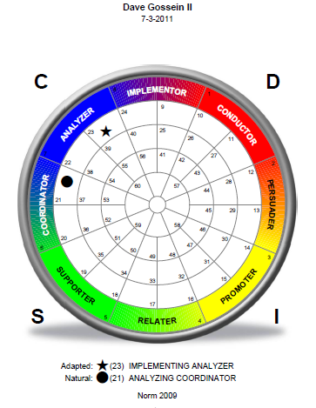
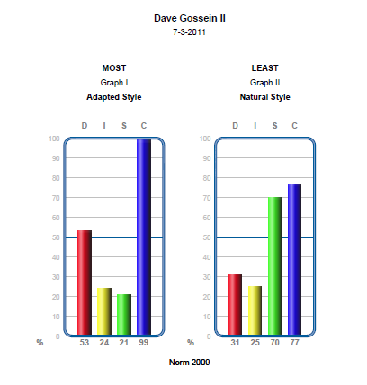
Question 3. Measuring Behavior (How?)
Dave’s DISC

Slide 18
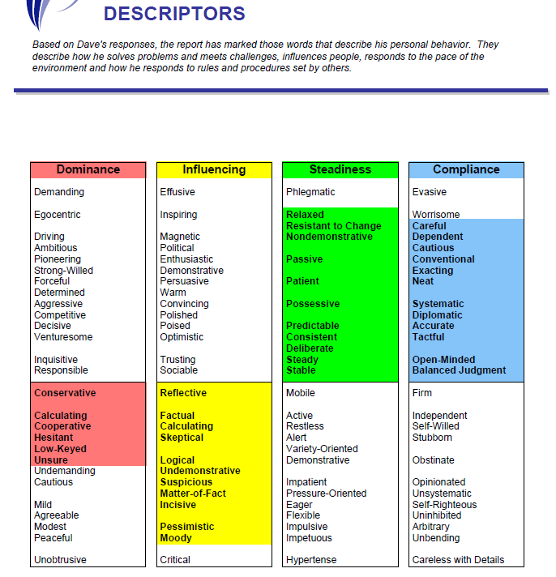
Question 3. Measuring Behavior (How?)
Dave’s
DISC
Descriptors

Slide 19
Question 3. Measuring Behavior (How?)
Post-Program
Pre-Program
C
D
S
I

